Slide 1
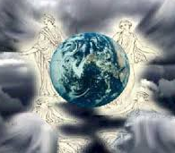
Revelation 7
144,000
Incalculable Throng
Great Tribulation
Who/What Are 144K?
Revelation 7

Slide 2
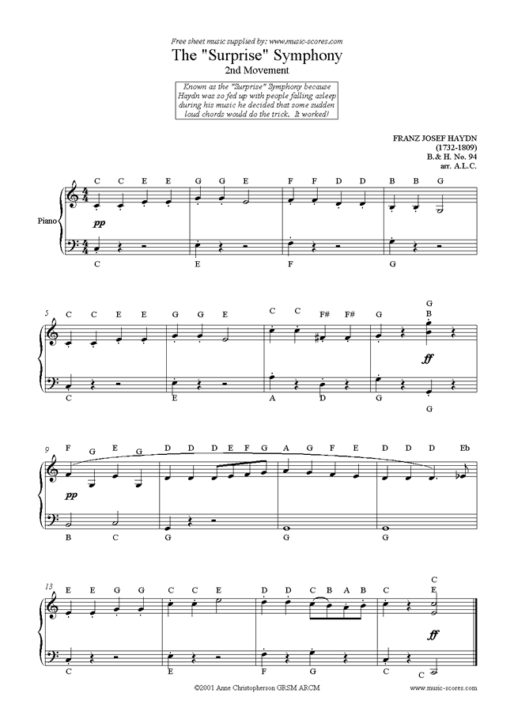

Slide 3
Angels and the Winds
Zechariah 6:5 – 4 teams of horses/chariots in 4 directions
Isaiah 19:1—Yahweh rides on a swift cloud / Egyptian hearts melt
Isaiah 66:15-16 Yahweh’s chariot is a whirlwind / brings flames of fire
Jeremiah 4:11-12 – a scorching wind to judge God’s people
Jeremiah 49:36 –scatter Elam to the four winds

Slide 4
Revelation 7:2
Now the glory of the God of Israel went from above the cherubim, where it had been, and moved to the threshold of the temple. Then the Lord called to the man clothed in linen who had the writing kit at his side and said to him, “Go throughout the city of Jerusalem and put a mark on the foreheads of those who grieve and lament over the detestable things that are done in it.” Ezekiel 9:3-4 (NIV)
“And I saw the glory of the God of Israel coming from the east. His voice was like the roar of rushing waters and the land was radiant with his glory.” Ezekiel 43:2(NIV)

Slide 5
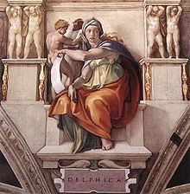
Sibylline Oracles
215 And there shall be upon them fearful wrath When from the east a people of twelve tribes Shall come in search of kindred Hebrew people Whom Assyrian shoot destroyed; and over these Shall nations perish. But they afterwards 220 Shall over men exceeding mighty rule, Elect and faithful Hebrews, and enslave Them as before, since their power ne'er shall fail. He that is highest of all, the all-surveying, Dwelling in heaven, will scatter sleep on men, For a dark mist shall hide the boundless world, East, west, and south, and north. And then shall flow 245 A mighty stream of burning fire from heaven And every place consume, earth, ocean vast, And gleaming sea, and lakes and rivers, springs, And cruel Hades and the heavenly sky. And heavenly lights shall break up into one 250 And into outward form all-desolate. For stars from heaven shall fall into all seas. And all the souls of men shall gnash their teeth Burned both by sulphur stream and force of fire In ravenous soil, and ashes hide all things.
Alleged prophecy in Greek hexameter, crafted by Jewish/Christian writers after 2nd century (or up to 7th)

Slide 6
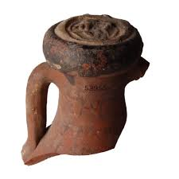
Protecting Planet/Life

Slide 7
Special Numbers
3
The number of eternity (past, Present Future) and God who caused to be, is, and is to come (as well as Trinity)
The number of the created order (four rivers, four living creatures, four winds, four directions)
4
3
+
4
=
7
3
4
=
12
*
12
12
(12²)
=
144
*

Slide 8
Holy Mathematics
2
The number of humanity because God made humankind as male and female
The number of adequacy because 5 represents five digits on a hand, so it is what can be held in one hand
5
2
5
=
10
the number of plenty / sufficiency
*
10
10
10
(10³)
=
1,000
*
*

Slide 9
And the Point?
144
The number for humanity in right relationship to God (12 to the human power)
1,000
The number for divine sufficiency (in this case, grace
Humanity’s proper response times God’s provision of divine grace
144
(12²)
1,000
(10³)
=
144,000
*

Slide 10
144,000 Explained
Tribe of Dan
“The Anti-Christ” is not biblical – I John 2:18 – “you have heard antichrist [no “the” in Greek] is coming, even now many antichrists have come / I John 2:22 – “anyone who denies Jesus is the Christ is the antichrist” / I John 4:3 – not confessing Jesus as the Son of God is “spirit of the antichrist…who is NOW in the world” / I John 4:7 – any who deny is a deceiver and an antichrist!
Judges 18:30 – “There the Danites set up for themselves idols…” / I Kings 12:29-30 – a calf set up in Dan “and this thing became a sin and the people went as far as Dan to worship”

Slide 11
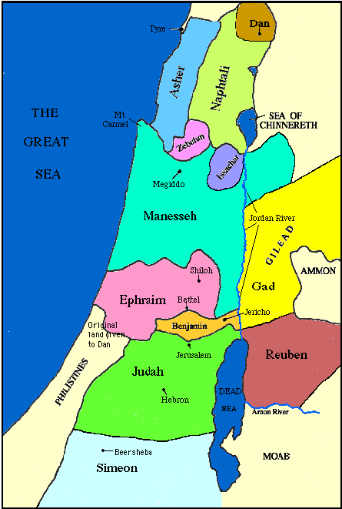
Genesis 49 Ezekiel 48
Geneaologies
Reuben
Simeon
Levi
Judah
Zebulun
Issachar
Dan
Gad
Asher
Naphtali
Joseph
Benjamin
Dan
Asher
Naphtali
Manasseh
Ephraim
Reuben
Judah
Benjamin
Simeon
Issachar
Zebulun
Gad

Slide 12
Genesis 49 Ezekiel 48 Revelation 7
Geneaologies
Reuben
Simeon
Levi
Judah
Zebulun
Issachar
Dan
Gad
Asher
Naphtali
Joseph
Benjamin
Dan
Asher
Naphtali
Manasseh
Ephraim
Reuben
Judah
Benjamin
Simeon
Issachar
Zebulun
Gad
Judah
Reuben
Gad
Asher
Naphtali
Manasseh
Simeon
Levi
Issachar
Zebulun
Joseph
Benjamin

Slide 13
Revelation 7:9

Slide 14
Revelation 7:10-12

Slide 15
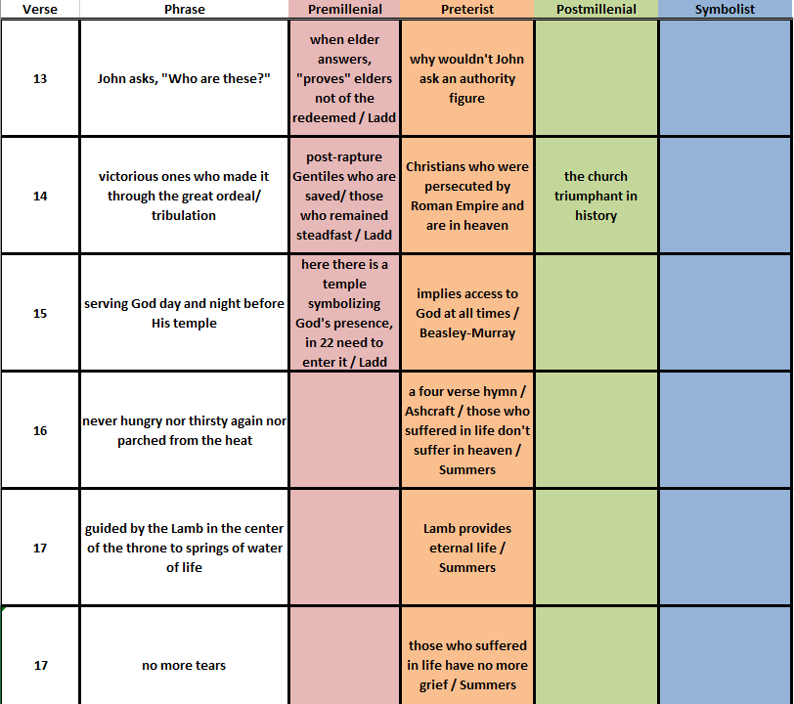
Rewards of the Faithful

Slide 16
EXPLAIN
10
min

Slide 17
EXTEND / ELABORATE
10
min
Have students take what they have learned and see it in authentic contexts.
Show, or have students view, “10 AWESOME MAGNET TRICKS!” www.youtube.com/watch?v=h5oXWtSMHzw
EVALUATE
10
min
“Magnetic Fields”
www.ck12.org/section/Magnetic-Fields/

