Slide 1
Beating the Devil
Revelation 20

Slide 2
Binding Satan

Slide 3
The Definitive Idea of the Futurist Position
Hal Lindsey
“The Bible teaches that lasting peace will come to the world only after Christ returns and sits upon the throne of David in Jerusalem and establishes his historic kingdom on earth (Revelation 20:4-6).”
“Some say that Christ returns spiritually when people accept Him and that is all that is meant by the various predictions of His return. Others teach that Jesus may return some day but that it is irrelevant to study or talk about it. The latter are worse than the former, for one out of every twenty-five verses in the New Testament is related to the second coming of Christ.”

Slide 4
The Rosy Vision of the Continuous-Historical Position
B. H. Carroll
“…imagine, if you can, what will be the increased population of the world in a thousand years under such conditions – no wars to kill off the people and eat up their substance; no pestilences like cholera, smallpox, the bubonic plague, no grinding poverty, and the churches all shining, and the preachers all shining, not a false note in their preaching; the whole earth subdued, the obstacles of nature overcome, every part of the earth brought under the dominion of man until one may live as comfortably at the North Pole as in the temperate zone or the tropics, …”

Slide 5
The Concern of the Preterist Position
Ray Summers
“…the overthrow of Satan, and not the reign of a thousand years, is the main theme of the first ten verses of this chapter.” Summers, Ray. Worthy Is the Lamb (p. 202).
“The chain is not literal; one would hardly use a literal chain on a spiritual being. The thousand-year-period is no more literal than the chain. Numbers in Revelation are symbolical. “Ten” is a complete number, and “one thousand” is a high multiple of ten. The number is to be understood as an idea of completeness.” Summers, Ray. Worthy Is the Lamb (p. 204).

Slide 6
Binding/Loosing Satan

Slide 7
Thrones and Judges

Slide 8
Considering the Thrones
Daniel 7
Revelation 20
As I looked, the thrones were placed (v. 9)
The court sat in judgment (v. 10)
Judgment given to the saints of the Most High …and the time came when the saints received the kingdom (v. 22)
And I saw thrones (v. 4)
Those seated on thrones given judgment (v. 4)
They lived and reigned (or judged) a thousand years (v. 4)

Slide 9
Spiritual or Literal?

Slide 10
Spiritual and Literal?
John 5:21-29 (New Century Version)
“²¹ Just as the Father raises the dead and gives them life, so also the Son gives life to those he wants to. ²² In fact, the Father judges no one, but he has given the Son power to do all the judging ²³ so that all people will honor the Son as much as they honor the Father. Anyone who does not honor the Son does not honor the Father who sent him.
²⁴ “I tell you the truth, whoever hears what I say and believes in the One who sent me has eternal life. That person will not be judged guilty but has already left death and entered life. ²⁵ I tell you the truth, the time is coming and is already here when the dead will hear the voice of the Son of God, and those who hear will have life. ²⁶ Life comes from the Father himself, and he has allowed the Son to have life in himself as well. ²⁷ And the Father has given the Son the approval to judge, because he is the Son of Man. ²⁸ Don’t be surprised at this: A time is coming when all who are dead and in their graves will hear his voice. ²⁹ Then they will come out of their graves. Those who did good will rise and have life forever, but those who did evil will rise to be judged guilty.

Slide 11
Gog and Magog

Slide 13
Devil Gets His Due

Slide 14
Defeated Foe

Slide 15
Quis ut Deus

Slide 16
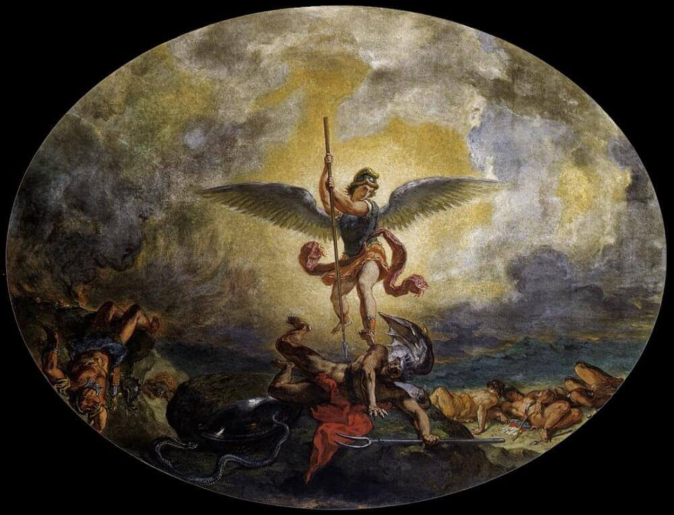
Contrasts

Slide 17
Last Judgment

Slide 18
Last Judgment

