Slide 1
Christmas Worship
圣诞崇拜
Sunday, December 24, 2023
2023 年 12 月 24 日星期日

Slide 2
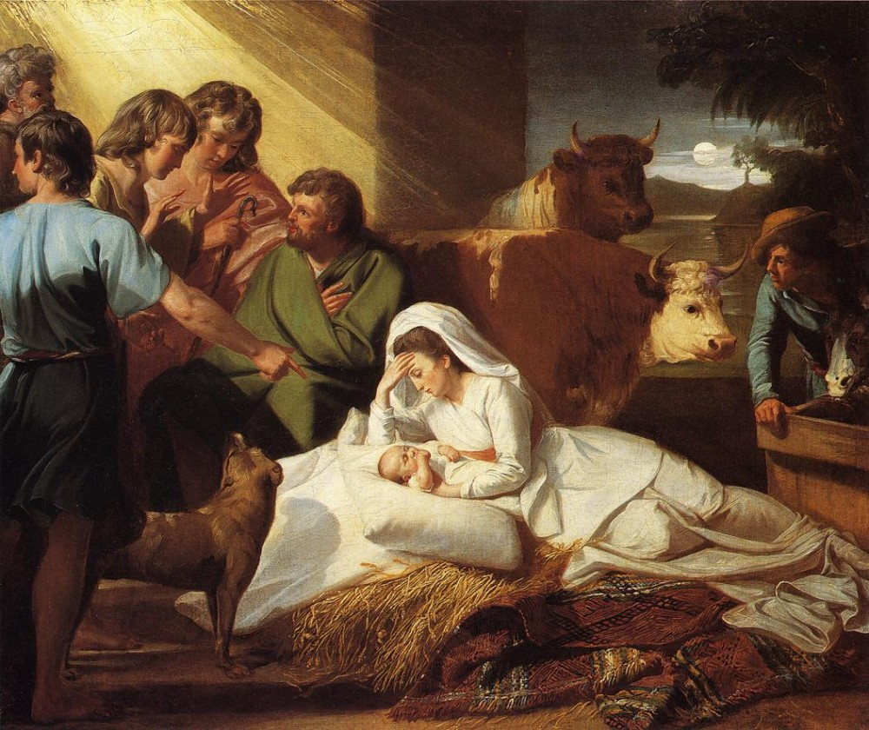
Welcome – Dr. Philip Wong/Ginny Ching Yin Lo
歡迎

Slide 3
Call to Worship: John 1:9-14 [CEB]
宣召经文: 道成肉身 1:9-14 [新譯本]
⁹ The true light that shines on all people
was coming into the world.
⁹ 那光來到世界，是普照世人的真光。
¹⁰ The light was in the world,
and the world came into being through the light,
but the world didn’t recognize the light.
¹⁰ 他在世界，世界也是藉著他造的，世界卻不認識他。

Slide 4
Call to Worship: John 1:11-12 [CEB]
宣召经文: 道成肉身 1:11-12 [新譯本]
¹¹ The light came to his own people,
and his own people didn’t welcome him.
¹¹ 他到自己的地方來，自己的人卻不接受他。
¹² But those who did welcome him,
those who believed in his name,
he authorized to become God’s children,
¹² 凡接受他的，就是信他名的人，他就賜給他們權利，
成為 神的兒女。

Slide 5
Call to Worship: John 1:13 [CEB]
宣召经文: 道成肉身 1:13 [新譯本]
¹³ born not from blood
nor from human desire or passion,
but born from God.
¹³ 他們不是從血統生的，不是從肉身的意思生的，也不是從人意生的，而是從 神生的。

Slide 6
Call to Worship: John 1:14 [CEB]
宣召经文: 道成肉身 1:14 [新譯本]
¹⁴ The Word became flesh
and made his home among us.
We have seen his glory,
glory like that of a father’s only son,
full of grace and truth.
¹⁴ 道成了肉身，住在我們中間，滿有恩典和真理。我們見過他的榮光，正是從父而來的獨生子的榮光

Slide 7
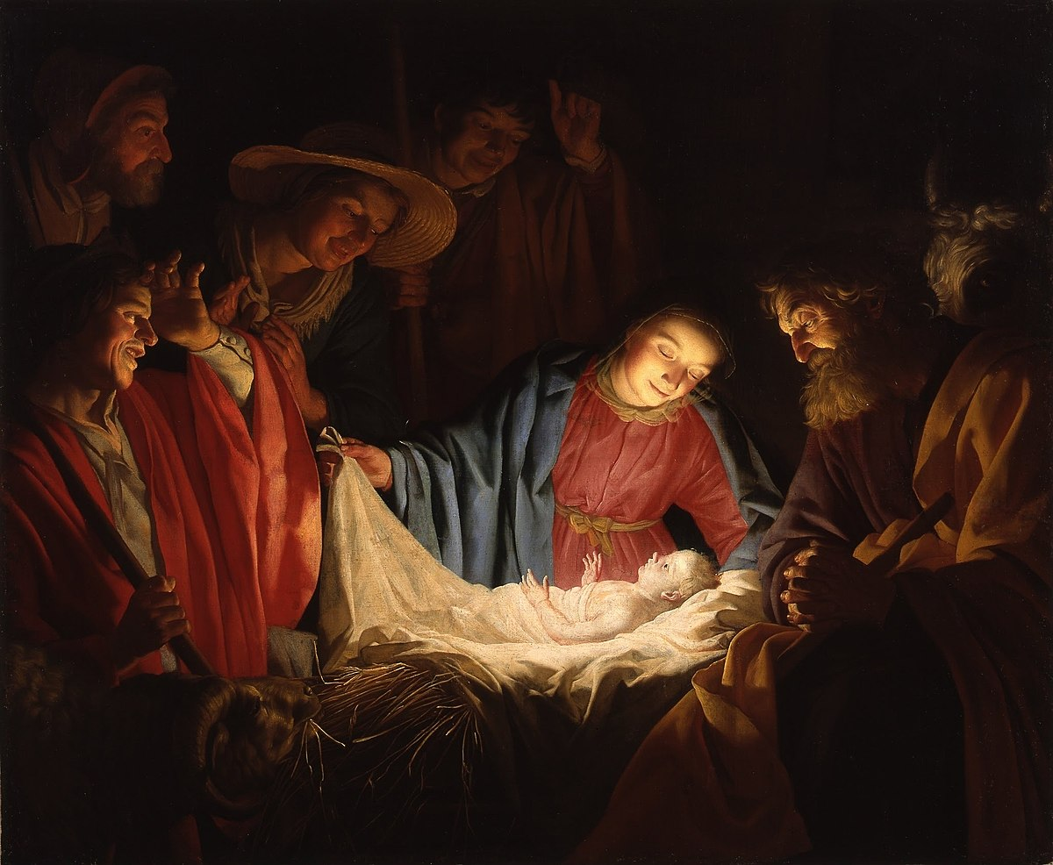
祷告
Opening Prayer -- Dr. Philip Wong/Ginny Ching Yin Lo

Slide 8
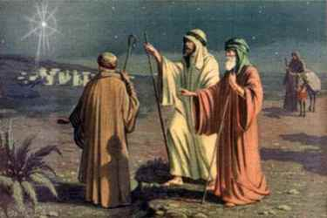
Choral Call to Worship: English Ministry
合唱的宣召经文: 英語事工
Go, tell it on the mountain
去山上說吧
Over the hills and everywhere!
越過山丘和各處
Go, tell it on the mountain
去山上說吧
That Jesus Christ is born!
耶穌基督誕生了！

Slide 9
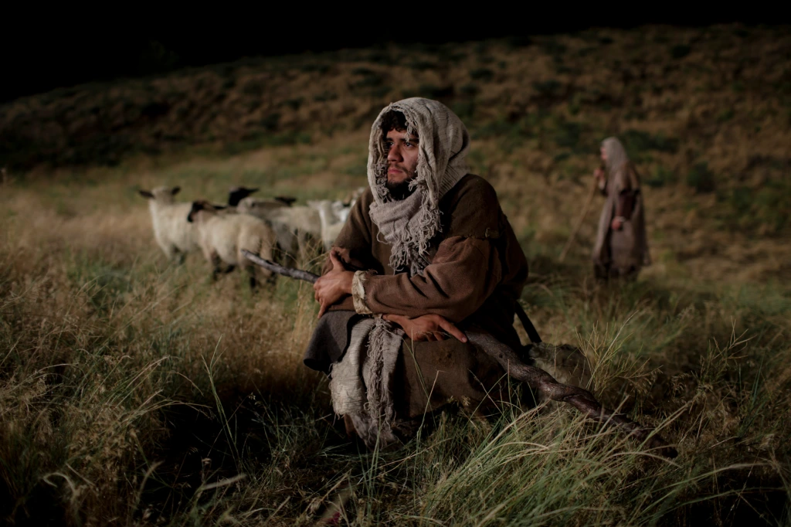
Choral Call to Worship: English Ministry
合唱的宣召经文: 英語事工
While shepherds kept their watching
當牧羊人觀看時
O’er silent flocks by night,
在夜間寂靜的羊群之上
Behold throughout the heavens
看！ 在天上
There shone a holy light.
聖光閃耀

Slide 10
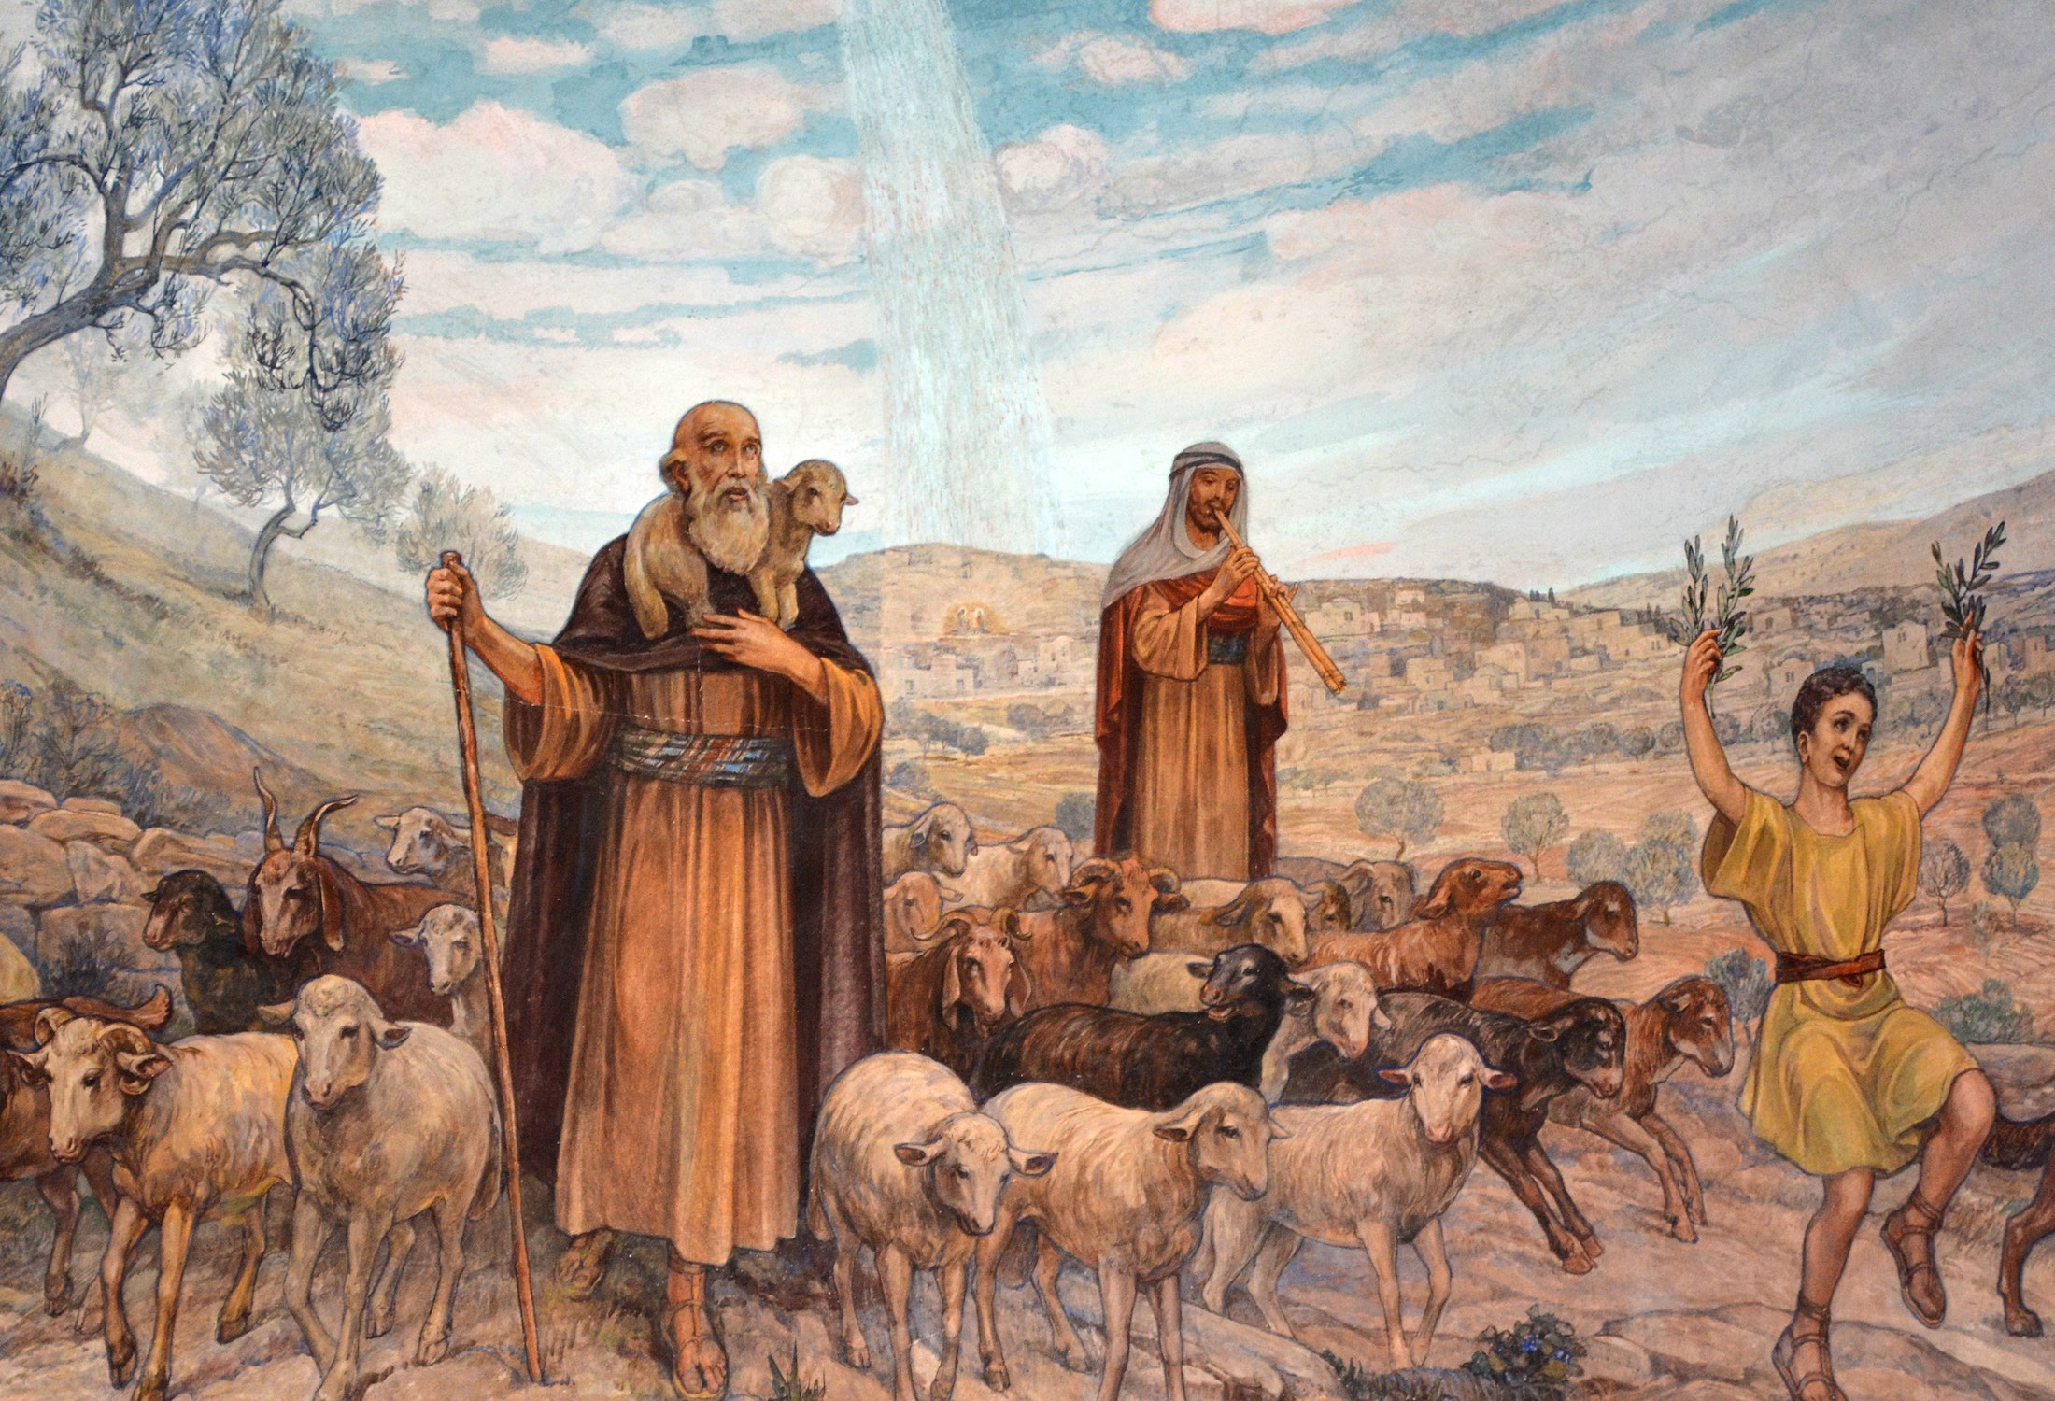
Choral Call to Worship: English Ministry
合唱的宣召经文: 英語事工
Go, tell it on the mountain
去山上說吧
Over the hills and everywhere!
越過山丘和各處
Go, tell it on the mountain
去山上說吧
That Jesus Christ is born!
耶穌基督誕生了！

Slide 11
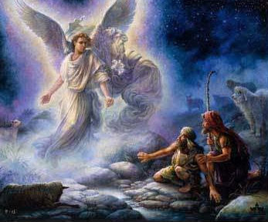
Choral Call to Worship: English Ministry
合唱的宣召经文: 英語事工
The shepherds feared and trembled
牧羊人感到恐懼和顫抖
When lo! Above the earth
當在地球上方時
Rang out the angel chorus
演奏了天使的合唱
That hailed our Savior’s birth.
歌頌耶穌誕生的歌聲

Slide 12

Choral Call to Worship: English Ministry
合唱的宣召经文: 英語事工
Go, tell it on the mountain
去山上說吧
Over the hills and everywhere!
越過山丘和各處
Go, tell it on the mountain
去山上說吧
That Jesus Christ is born!
耶穌基督誕生了！

Slide 13
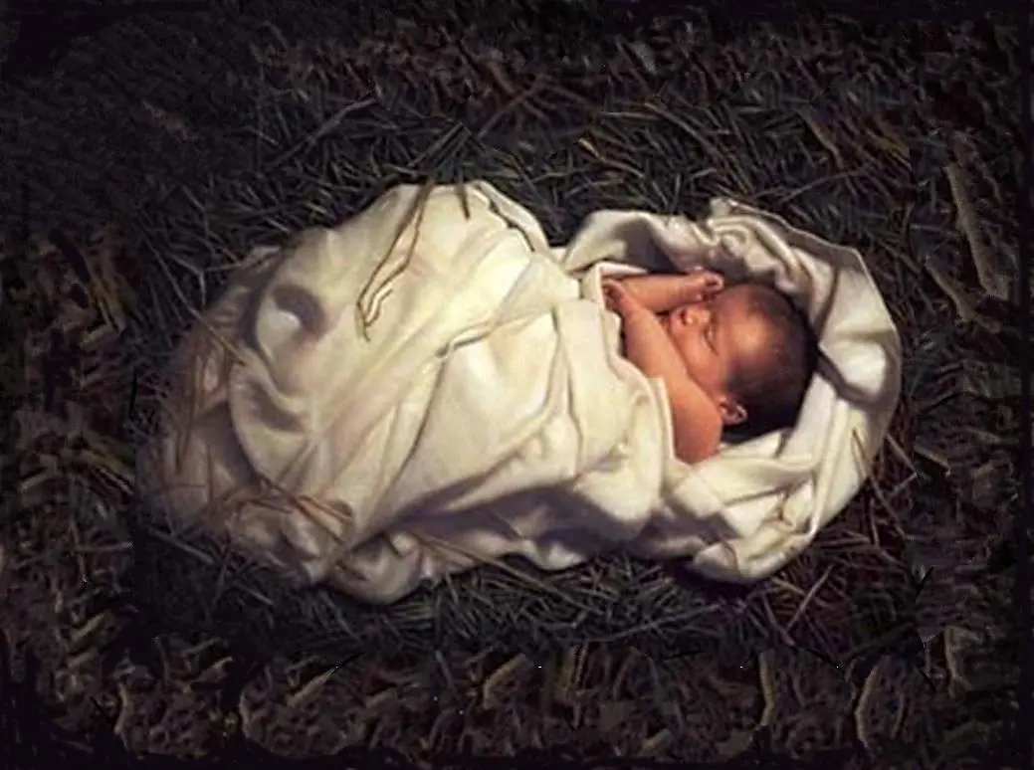
Choral Call to Worship: English Ministry
合唱的宣召经文: 英語事工
Down in a lowly manger
在卑微的馬槽裡
The humble Christ was born,
謙卑的基督誕生了
And God sent us salvation
神提供了拯救
That blessed Christmas morn.
那個幸福的聖誕節早晨

Slide 14
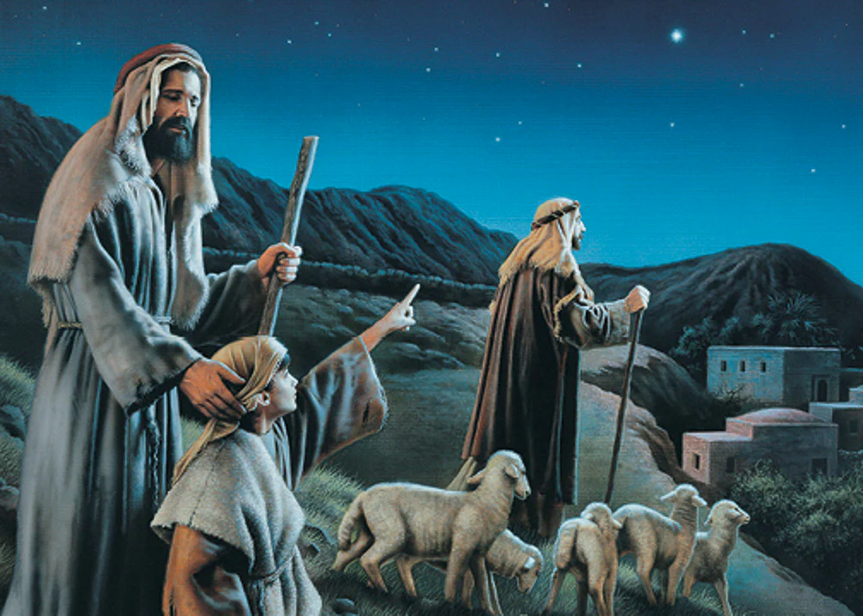
Choral Call to Worship: English Ministry
合唱的宣召经文: 英語事工
Go, tell it on the mountain
去山上說吧
Over the hills and everywhere!
越過山丘和各處
Go, tell it on the mountain
去山上說吧
That Jesus Christ is born!
耶穌基督誕生了！

Slide 15

請和我們一起唱歌

Slide 16
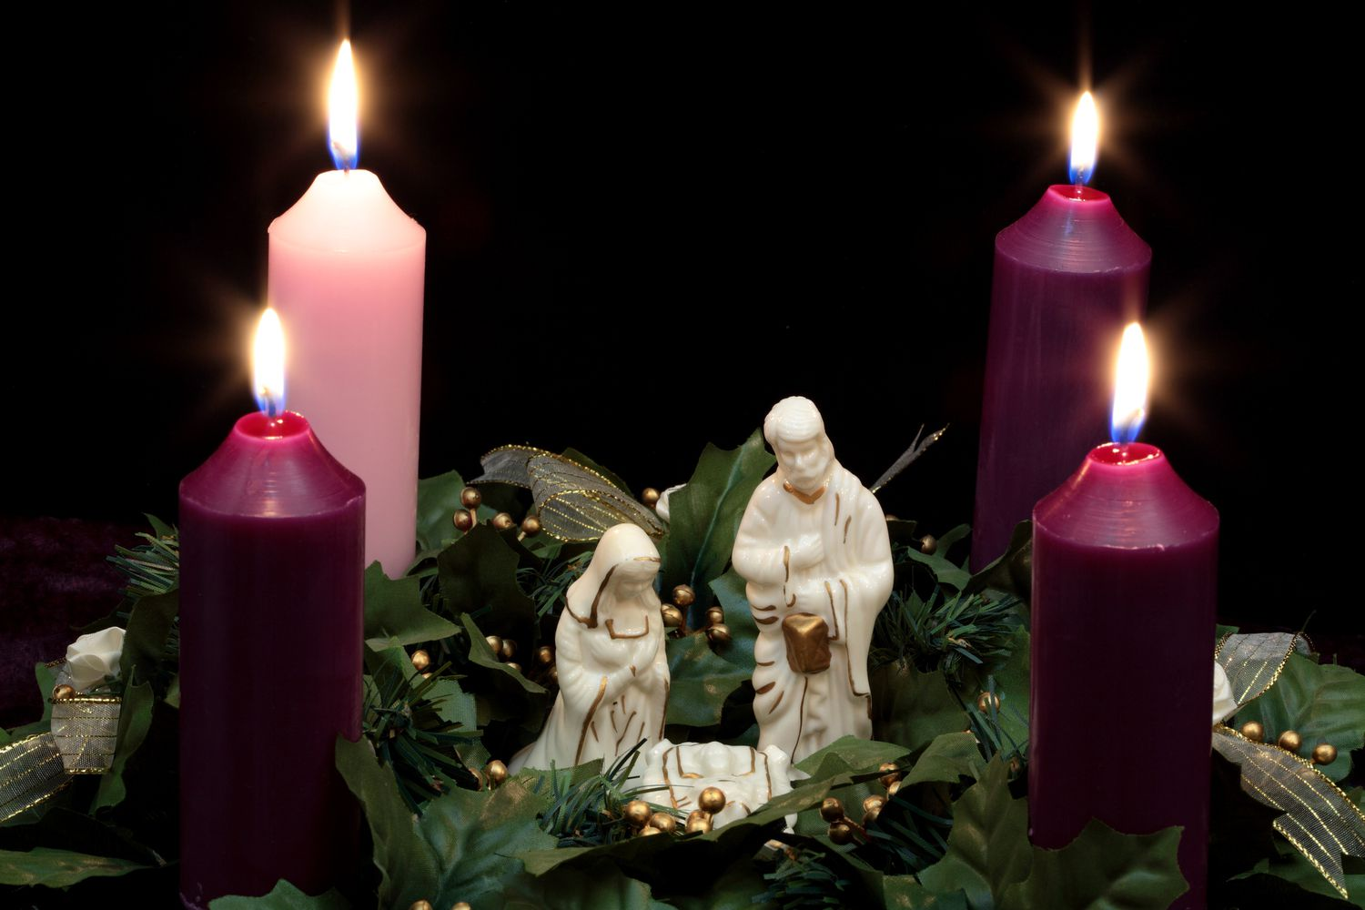
Lighting the Advent Candles
點燃降臨節蠟燭

Slide 17
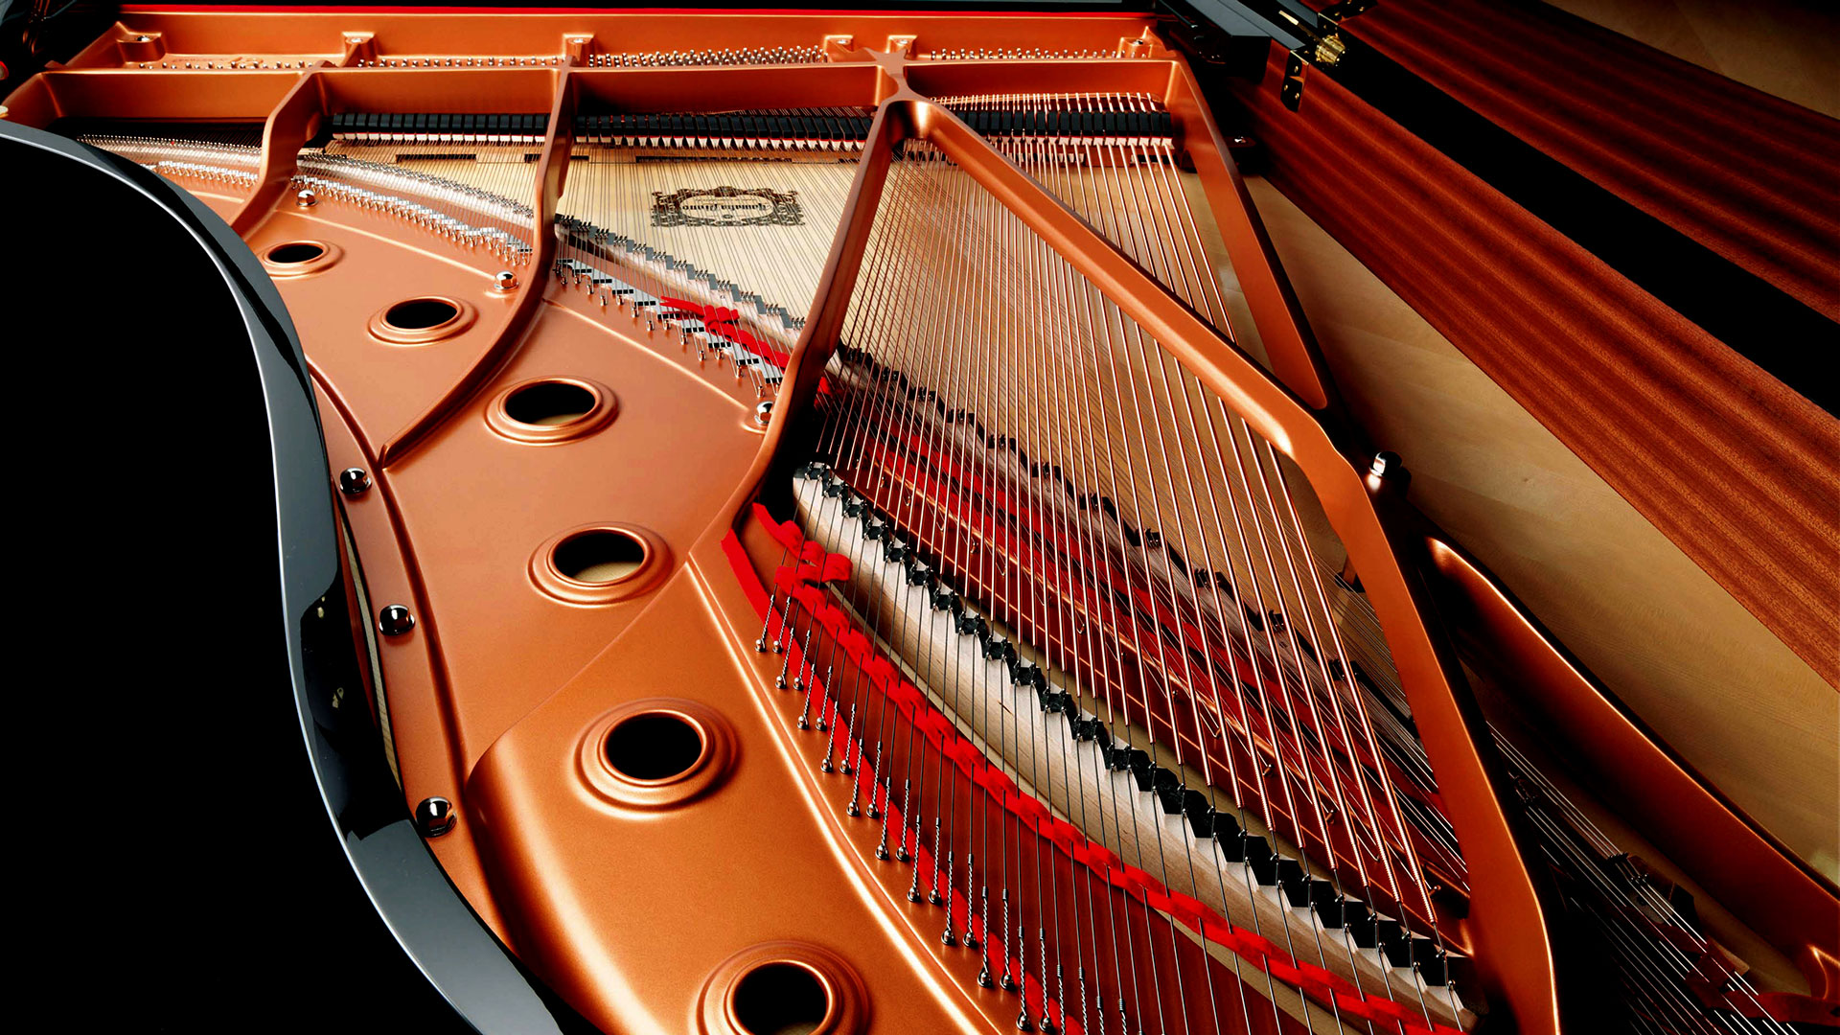
“O Holy Night”: Sophia Jiang, Soloist
聖夜啊

Slide 18
Scripture Reading: Matthew 1:18-21 [CEB]
閱讀經: 马太福音 1:18-21 [新譯本]
¹⁸ This is how the birth of Jesus Christ took place. When Mary his mother was engaged to Joseph, before they were married, she became pregnant by the Holy Spirit.
¹⁸ 耶穌基督的降生是這樣的：耶穌的母親馬利亞許配了約瑟，他們還沒有成親，馬利亞就從聖靈懷了孕。
¹⁹ Joseph her husband was a righteous man. Because he didn’t want to humiliate her, he decided to call off their engagement quietly.
¹⁹ 她丈夫約瑟是個義人，不願張揚使她受辱，就打算暗中與她解除婚約。

Slide 19
Scripture Reading: Matthew 1:18-21 [CEB]
閱讀經: 马太福音 1:20-21 [新譯本]
²⁰ As he was thinking about this, an angel from the Lord appeared to him in a dream and said, “Joseph son of David, don’t be afraid to take Mary as your wife, because the child she carries was conceived by the Holy Spirit.
²⁰ 他一直想著這些事，主的使者就在夢中向他顯現，說：“大衛的子孫約瑟，只管放膽把你的妻子馬利亞迎娶過來，
因為她懷的孕是從聖靈來的。
²¹ She will give birth to a son, and you will call him Jesus, because he will save his people from their sins.”
²¹ 她必生一個兒子，你要給他起名叫耶穌，
因為他要把自己的子民從罪惡中拯救出來。”

Slide 20
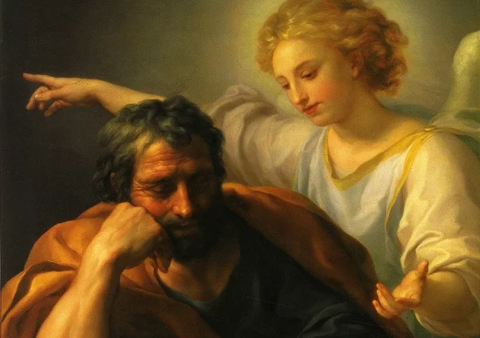
Pastor Johnny as “Joseph”
牧師 Johnny 飾演 約瑟夫

Slide 21
Hymn: #88 “O Come All Ye Faithful”
聖歌: #88 “”
¹O come, all ye faithful,
Joyful and triumphant,
O come ye, O come ye,
to Bethlehem;
Come and behold Him
Born the King of angels.

Slide 22
Hymn: #88 “O Come All Ye Faithful”
聖歌: #88 “”
Chorus:
O come let us adore Him,
O come let us adore Him,
O comes let us adore Him,
Christ the Lord.

Slide 23
Hymn: #88 “O Come All Ye Faithful”
聖歌: #88 “”
²Sing choirs of angels,
Sing in exultations,
O sing, all ye citizens of
heaven above;
Glory to God in the highest!
O come let us adore Him,
O come let us adore Him,
O comes let us adore Him,
Christ the Lord.

Slide 24
Hymn: #88 “O Come All Ye Faithful”
聖歌: #88 “”
3Yea, Lord, we greet Thee,
Born this happy morning;
O Jesus to Thee be all
glory given.
Word of the Father,
Now in flesh appearing.

Slide 25
Hymn: #88 “O Come All Ye Faithful”
聖歌: #88 “”
Chorus:
O come let us adore Him,
O come let us adore Him,
O comes let us adore Him,
Christ the Lord.

Slide 26
Scripture Reading: Luke 1:26-33 [CEB]
閱讀經: 道成肉身 1:26-33 [新譯本]
²⁶ When Elizabeth was six months pregnant, God sent the angel Gabriel to Nazareth, a city in Galilee,
²⁶ 到了第六個月，天使加百列奉 神差遣，往加利利的拿撒勒城去，
²⁷ to a virgin who was engaged to a man named Joseph, a descendant of David’s house. The virgin’s name was Mary.
²⁷ 到了一個童貞女那裡，她已經和大衛家一個名叫約瑟的人訂了婚，童貞女的名字是馬利亞。

Slide 27
Scripture Reading: Luke 1:28-30 [CEB]
閱讀經: 道成肉身 1:28-30 [新譯本]
²⁸ When the angel came to her, he said, “Rejoice, favored one! The Lord is with you!”
²⁸ 天使進去，對她說：“恭喜！蒙大恩的女子，主與你同在！
²⁹ She was confused by these words and wondered what kind of greeting this might be.
²⁹ 她卻因這話驚慌起來，反覆思想這樣祝賀是甚麼意思。
³⁰ The angel said, “Don’t be afraid, Mary. God is honoring you.
³⁰ 天使說：“馬利亞，不要怕！因你已從 神那裡蒙了恩。

Slide 28
Scripture Reading: Luke 1:31-33 [CEB]
閱讀經: 道成肉身 1:31-33 [新譯本]
³¹ Look! You will conceive and give birth to a son, and you will name him Jesus.
³¹ 你將懷孕生子，要給他起名叫耶穌。
³² He will be great and he will be called the Son of the Most High. The Lord God will give him the throne of David his father.
³² 他將要被尊為大，稱為至高者的兒子，主 神要把他祖大衛的王位賜給他，
³³ He will rule over Jacob’s house forever, and there will be no end to his kingdom.”
³³ 他要作王統治雅各家，直到永遠，他的國沒有窮盡。”

Slide 29
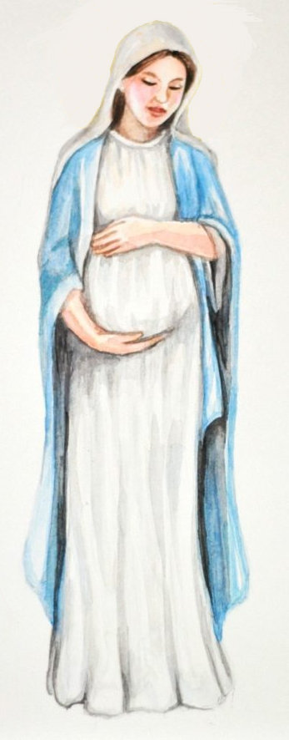
Breath of Heaven – English Ministry
天堂的氣息 --英語事工
I have traveled
many moonless nights,
我走過許多個沒有月亮的夜晚
cold and weary,
with a babe inside
又冷又疲倦
裡面有一個嬰兒

Slide 30
Breath of Heaven – English Ministry
天堂的氣息 --英語事工
And I wonder what I’ve done,
我想知道我做了什麼
Holy Father, You have come,
and chosen me now,
to carry Your son,
聖父您來了, 現在你挑選了我
生下你的兒子

Slide 31
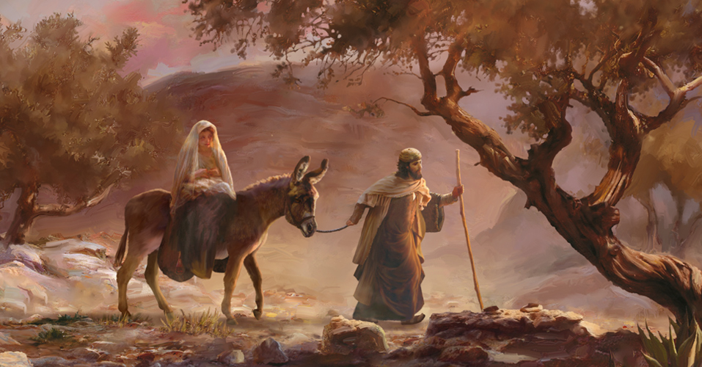
Breath of Heaven – English Ministry
天堂的氣息 --英語事工
I am waiting in a silent prayer,
我在默默的祈禱中等待
I am frightened,
by the load I bear.
我對我所承擔的重擔感到害怕

Slide 32
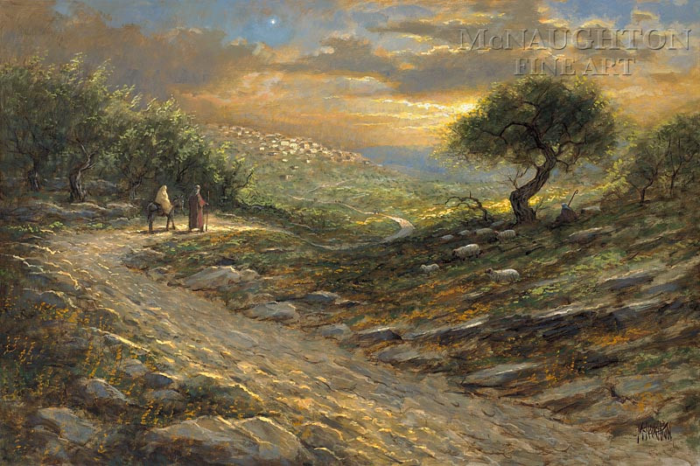
Breath of Heaven – English Ministry
天堂的氣息 --英語事工
In a world as cold as stone,
我在默默的祈禱中等待
Must I walk this path alone?
我對我所承擔的重擔感到害怕
Be with me now,
Be with me now.
現在和我在一起
現在和我在一起

Slide 33
Breath of Heaven – English Ministry
天堂的氣息 --英語事工
Breath of Heaven, hold me together, be forever near me,
Breath of Heaven.
天堂的氣息, 把我抱在一起, 永遠留在我身邊,天堂的氣息,
Breath of Heaven, lighten my darkness, pour over me Your
holiness, for You are holy, Breath of Heaven.
天堂的氣息, 點亮我的黑暗, 將祢的聖潔傾倒在我身上,
因為你是聖潔的,天堂的氣息

Slide 34
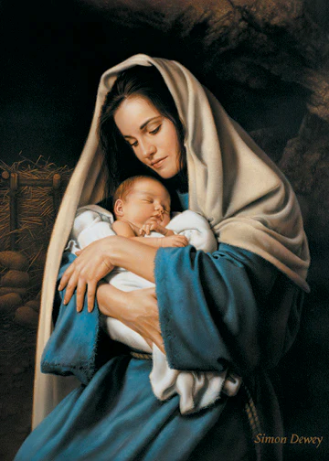
Breath of Heaven – English Ministry
天堂的氣息 --英語事工
Do You wonder as You watch my face,
當你看著我的臉時你是否想知道
If a wiser one should have had my place?
如果有更聰明的人應該佔據我的位置

Slide 35
Breath of Heaven – English Ministry
天堂的氣息 --英語事工
But I offer all I am for the mercy of Your plan.
但我提供我的一切
為了你的計劃的憐憫
Help me be strong, help me, help me.
幫助我堅強, 幫我, 幫我

Slide 36
Breath of Heaven – English Ministry
天堂的氣息 --英語事工
Breath of Heaven, hold me together, be forever near me,
Breath of Heaven.
天堂的氣息, 把我抱在一起, 永遠留在我身邊,天堂的氣息,
Breath of Heaven, lighten my darkness, pour over me Your
holiness, for You are holy.
天堂的氣息, 點亮我的黑暗, 將祢的聖潔傾倒在我身上,
因為你是聖潔的,

Slide 37
Breath of Heaven – English Ministry
天堂的氣息 --英語事工
Breath of Heaven, hold me together, be forever near me,
Breath of Heaven.
天堂的氣息, 把我抱在一起, 永遠留在我身邊,天堂的氣息,
Breath of Heaven, lighten my darkness, pour over me Your
holiness, for You are holy.
天堂的氣息, 點亮我的黑暗, 將祢的聖潔傾倒在我身上,
因為你是聖潔的,

Slide 38
Breath of Heaven – English Ministry
天堂的氣息 --英語事工
Breath of Heaven,
天堂的氣息,
Breath of Heaven,
天堂的氣息,
Breath of Heaven,
天堂的氣息,
Breath of Heaven,
天堂的氣息,

Slide 39
Scripture Reading: Luke 2:4-7 [CEB]
閱讀經: 道成肉身 2:4-7 [新譯本]
⁴ Since Joseph belonged to David’s house and family line, he went up from the city of Nazareth in Galilee to David’s city, called Bethlehem, in Judea.
⁴ 約瑟本是大衛家族的人，也從加利利的拿撒勒上猶太去，到了大衛的城伯利恆，
⁵ He went to be enrolled together with Mary, who was promised to him in marriage and who was pregnant.
⁵ 與所聘之妻馬利亞一同登記戶口。那時馬利亞的身孕已經重了。

Slide 40
Scripture Reading: Luke 2:6-7 [CEB]
閱讀經: 道成肉身 2:6-7 [新譯本]
⁶ While they were there, the time came for Mary to have her baby.
⁶ 他們在那裡的時候，馬利亞的產期到了，
⁷ She gave birth to her firstborn child, a son, wrapped him snugly, and laid him in a manger, because there was no place for them in the guestroom.
⁷ 生了頭胎兒子，用布包著，放在馬槽裡，因為客店裡沒有地方。

Slide 41
Choir Anthem: “The First Noel”
合唱團國歌: 第一個諾埃爾
The first noel the angel
did say,
Was to certain poor
shepherds in fields
as they lay.

Slide 42
Choir Anthem: “The First Noel”
合唱團國歌: 第一個諾埃爾
In fields where they
lay keeping their sheep,
On a cold winter’s night
that was so deep.
Noel, Noel, Noel, Noel!
Born is the King of Israel!
Noel, Noel, Noel, Noel,
Noel!

Slide 43
Choir Anthem: “The First Noel”
合唱團國歌: 第一個諾埃爾
For all to see there was
a star shining in the
east beyond them far,
And to the earth it gave
great light,
And it continued both
day and night.
讓所有人看到 有一顆星星
閃耀在東方 遠遠超越他們
它為地球帶來了偉大的光明
它白天和黑夜都閃耀

Slide 44
Choir Anthem: “The First Noel”
合唱團國歌: 第一個諾埃爾
In fields where they
lay keeping their sheep,
On a cold winter’s night
that was so deep.
Noel, Noel, Noel, Noel!
Born is the King of Israel!
Noel, Noel, Noel, Noel,
Noel!

Slide 45
Season’s Greetings?
季節的問候?
Luke 2:8-14
道成肉身 2:8-14

Slide 46
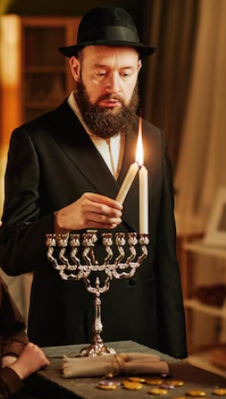
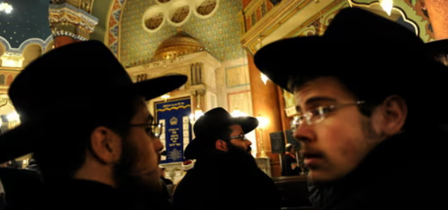
Who Are They?
他們是誰？

Slide 47
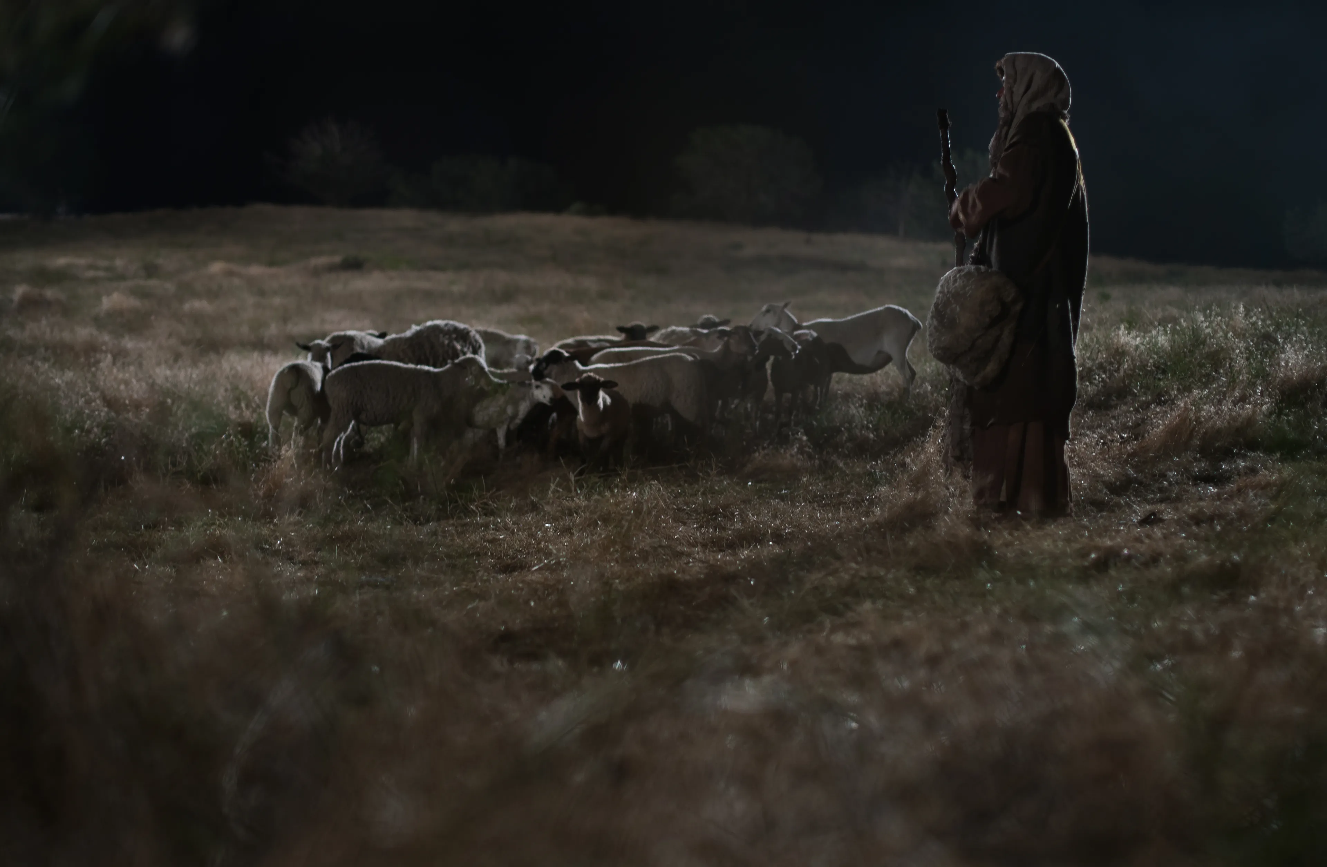
⁸ Nearby shepherds were living in the fields, guarding their sheep at night. [CEB]
⁸ 在伯利恆的郊外，有一些牧人在夜間看守羊群。

Slide 48
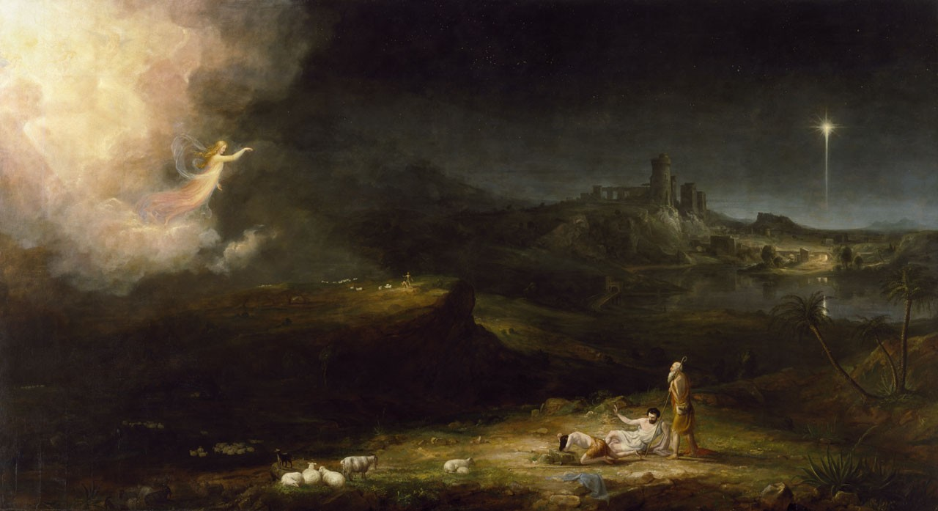
⁹ The Lord’s angel stood before them, the Lord’s glory shone around them, and they were terrified. [CEB]
⁹ 主的一位使者站在他們旁邊，主的榮光四面照著他們，他們就非常害怕。

Slide 49

What Do You See?
你看到了什麼？

Slide 50
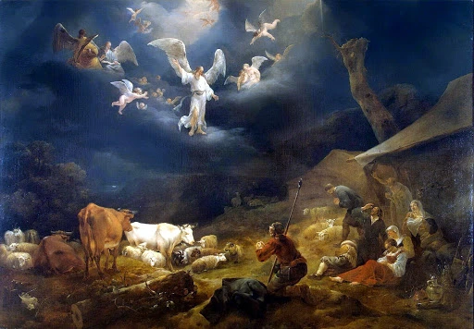
¹⁰ The angel said, “Don’t be afraid! Look! I bring good news to you—wonderful, joyous news for all people. [CEB]
¹⁰ 天使說：“不要怕！看哪！我報給你們大喜的信息，是關於萬民的：

Slide 51
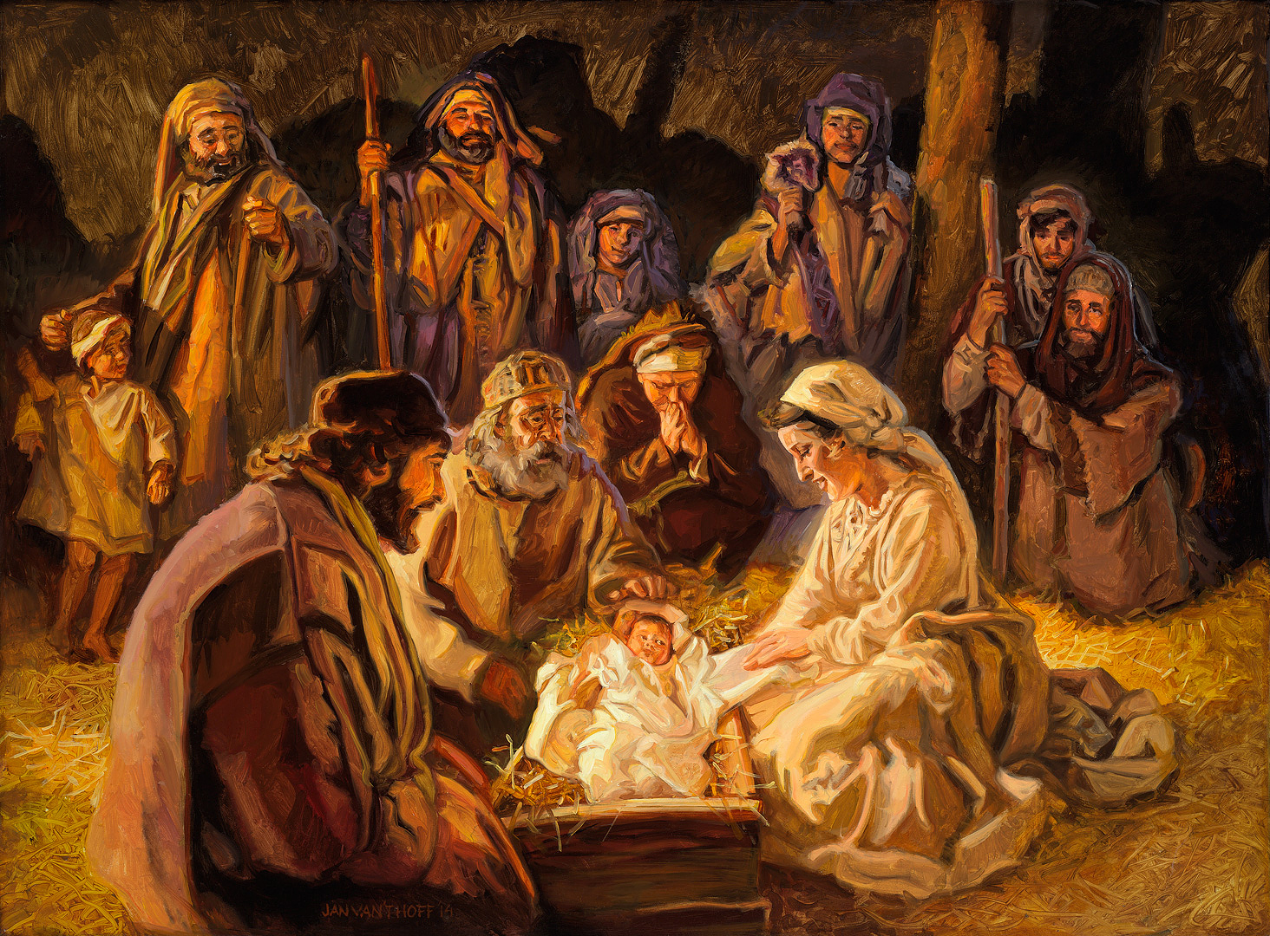
¹¹ Your savior is born today in David’s city. He is Christ the Lord. [CEB]
¹¹ 今天在大衛的城裡，為你們生了救主，就是主基督。

Slide 52
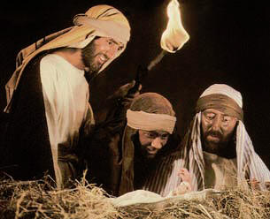
¹² This is a sign for you: you will find a newborn baby wrapped snugly and lying in a manger.” [CEB]
¹² 你們要找到一個嬰孩，包著布，臥在馬槽裡，那就是記號了。

Slide 53
Hymn: #95 “Angels from the Realms of Glory”
聖歌: #95 “”
1 Angels from the realms of glory,
wing your flight o'er all the earth;
ye who sang creation's story
now proclaim Messiah's birth:
Come and worship, come and worship,
worship Christ, the newborn king.

Slide 54
Hymn: #95 “Angels from the Realms of Glory”
聖歌: #95 “”
2 Shepherds, in the field abiding,
watching o'er your flocks by night,
God with us is now residing;
yonder shines the infant light:
Come and worship, come and worship,
worship Christ, the newborn king.

Slide 55
Hymn: #95 “Angels from the Realms of Glory”
聖歌: #95 “”
3 Sages, leave your contemplations,
brighter visions beam afar;
seek the great Desire of nations;
ye have seen his natal star:
Come and worship, come and worship,
worship Christ, the newborn king.

Slide 56

Snuffing Out Flame of Advent Candles

Slide 57
“What Child Is This?” – English Ministry
這是一個什麼樣的孩子？--英語事工
What child is this, who, laid to rest
On Mary's lap, is sleeping?
Whom angels greet with voices sweet
While shepherds watch are keeping?
This, this is Christ the King
Whom shepherds guard and angels sing
Haste, haste to bring him praise
The Babe, the Son of Mary!

Slide 58
“What Child Is This?” – English Ministry
這是一個什麼樣的孩子？--英語事工
2 Why lies He in such mean estate,
Where ox and ass are feeding?
Good Christian, fear: for sinners here
The silent Word is pleading.
This, this is Christ the King
Whom shepherds guard and angels sing
Haste, haste to bring him praise
The Babe, the Son of Mary!

Slide 59
請和我們一起唱歌
3 So bring Him incense, gold, and myrrh,
Come, peasant, king to own Him.
The King of kings salvation brings;
Let loving hearts enthrone Him
This, this is Christ the King
Whom shepherds guard and angels sing
Haste, haste to bring him praise
The Babe, the Son of Mary!

