Slide 1
Holy City and Finale
Revelation 22 and Wrap-Up Considerations

Slide 2
Futurist Chart

Slide 3
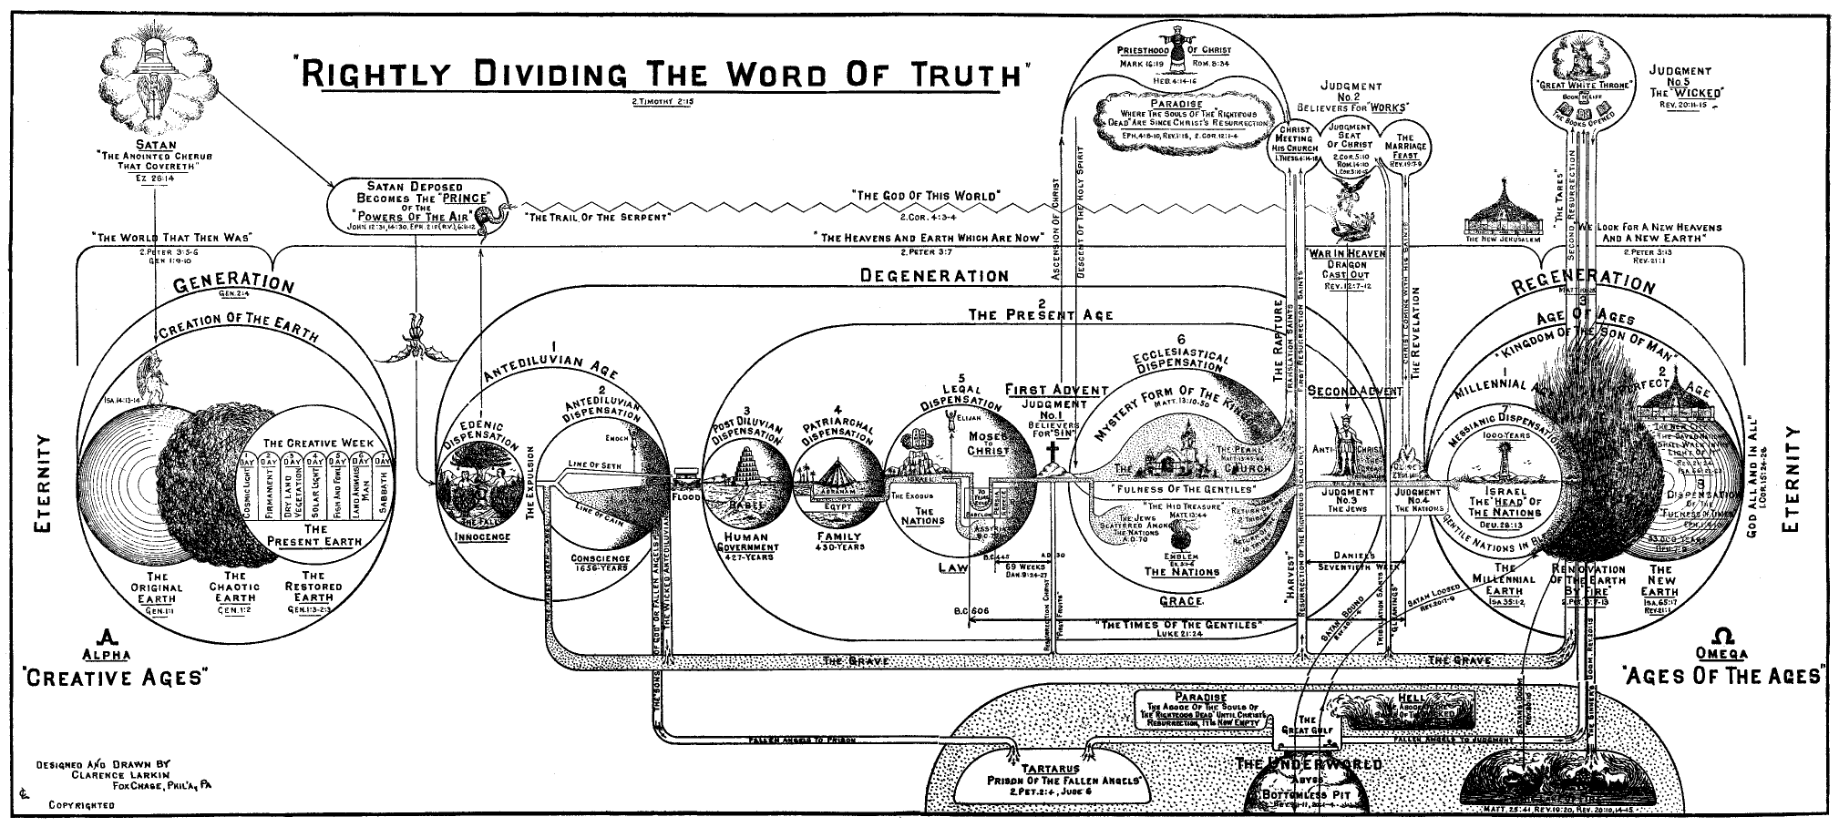
C. I. Scofield

Slide 4
Dispensations / Scofield, Pentecost
Edenic Innocence – Genesis 2-3 “Adam was the theocratic administrator whose responsibility was to subject all creation to himself, so that through him creation might be subject to the authority of God.”
Human Conscience – Genesis 4-9:5 “…as men subjected themselves to the rule of conscience, they were in subjection to the authority of God.”
Human Government – Genesis 9:6-11 “It was the responsibility of human government to curb lawlessness and to bring man in subjection to the authority of God. Again man failed miserably.
Patriarchal Theocracy – Genesis 12-50 “…instituted a covenant…”

Slide 5
Dispensation / Scofield
5. Legal Governance – Exodus – Malachi A. includes Davidic covenant B. includes Deuteronomic covenant (roots back to Moses, but probably not developed until time of Josiah and completed thereafter) C. includes Jeremianic [New] covenant (foreshadowing first coming of Christ and Holy Spirit promise)
6. Ecclesiastical Governance – from coming of Christ to “THE Rapture” and Second Coming
7. Tribulation (Seals, Trumpets, and Bowls) – brought to an end by Battle of Armageddon

Slide 6
Final Dispensations -- Scofield
8. Millennial Governance (Jews on Earth)
9. Judgment and Destruction (the “little season” of Revelation 20:7-15)
10 New Heaven and New Earth

Slide 8
“The river flows through the middle of the street of the city. This is not to be taken in a literal sense to mean…like the canals which flow down the center of the streets in Amsterdam. It merely expresses the centrality of eternal life in the new Jerusalem.” G. E. Ladd, p. 287

Slide 10
Defixiones = Roman Curse Tablets

Slide 11
λατρεύσουσιω

Slide 12
No Night, God’s Light (v. 5)
“The light of the New Jerusalem is not due as in Philo to a multitude of unextinguishable and unadulterated lights, but to the light of God’s own presence always and everywhere present.” R. H. Charles, p. 210

Slide 13
The Light of the World Even More!

Slide 14
The End is the Beginning

Slide 15
The Theme of Revelation -- Scofield
Jesus Christ and TIME – “which is, and which was, and which is to come” (1:4)
Jesus’ relationship to His own (1:9-3:22) to the tribulation (4:1-19:21), to the kingdom (20:1-22:21)
Jesus in His offices – High Priest (8:3-6), Bridegroom (19:7-9), King-Judge (20:1-15)

Slide 16
Worthy is the Lamb
“The same assurance is given to Christians in every age. Find the greatest enemy of Christ (whether corrupt religion, godless government, social anarchy, or any other), put it in the place of emperor worship, and see its eventual failure as the living Christ, the redeeming Lamb, marches to victory over chaotic world conditions–Worthy Is the Lamb.” --Summers, Ray. Worthy Is the Lamb (p. 208).

