Slide 1
Leadership Webinar: Spiritual Gifts
Grace Chinese Christian Church

Slide 2
Paul Speaks of Differing Types of Gifts
Motivational Gifts
Functional Gifts
Prophecy
Service
Teaching
Exhortation
Giving
Organization
Mercy
Word of wisdom
Word of knowledge
Faith
Healing
Miracle-working
Prophetic speech
Discernment of spirits
Speaking in tongues
Interpretation of tongues

Slide 3
How Might Spiritual Gifts Be Used?
Let’s imagine different gifts on a hospital visit!
PROPHECY – What is God trying to say to you through this illness? Is there unconfessed sin to deal with?
SERVICE – Here’s a gift; I brought your mail; I fed your dog; I watered your plants, and washed dishes.
TEACHING – I did some research on your illness and I believe I can explain what is happening and, maybe what you can do to deal with it.
EXHORTATION – Let’s think of how we can use what you’re learning through this to help others in the future?
GIVING – Do you have insurance to cover this kind of illness? Needs?
ORGANIZATION – Don’t worry, I’ve got four others covering what it usually only takes you to do.
MERCY – I can’t begin to tell you how I felt when I learned you were sick.

Slide 4
Motivational Gift of Prophecy
Needs to express thoughts and ideas verbally, especially with regard to right and wrong
Tends to make quick judgments and to speak up quickly
Has an amazing ability to sense when someone is not what they appear to be (and reacts harshly)
Peter spoke more often than other disciples in the Gospels and was spokesman for the early church (Acts 2:4; 3:12).
Peter spoke FIRST more than any other disciple (Matthew 14:28; 15:25; 16:26; 17:4, 19:27; 26:33; John 6:68; 13:6).
Peter's condemnation of the deception of Ananias and Sapphira resulted in their death (Acts 5:3-10).

Slide 5
Prophecy (continued)
4. Desires to reject those who offend so that justice will be done and others will be warned
5. Is generally open about personal faults and failures, being honest with oneself as well as with others
6. Tends to be impulsive in actions and to be wholeheartedly involved in whatever one chooses to do
Peter was reluctant to forgive his offender and asked how much he had to forgive (Matthew 18:2).
Peter fell at Jesus' knees and said, "Depart from me, for I am a sinful man, O Lord." (Luke 5:8).
Peter was eager to walk on water (Matthew 14:28). After forbidding Jesus to wash his feet, he wanted Him to wash everything else (John 13:6-15).

Slide 6
Prophecy (completed)
7. Tends to be painfully frank correcting others
8. Desires to give open evidences of loyalty and total commitment
9. Willing to suffer for doing what is right
10. Is very persuasive in defining what is wrong (doesn't mince words)
Peter rebuked Jesus Himself for action Peter didn’t think was right to take (Mark 8:31-33).
Peter assured Jesus he would never deny Him (Matthew 26:33)
Peter rejoiced in suffering shame for Jesus when he was beaten (Acts 5:29-42).
God brought conviction to thousands as Peter preached (Acts 2:14-47).

Slide 7
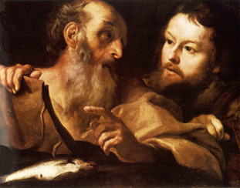
Abusing Prophecy
Trying to correct those for whom you are not responsible
Jumping to conclusions about words, deeds, and motives
Obsessing over “evidence” to support your initial condemnation
Being more concerned about exposing an offender than restoring one

Slide 8
Abusing Prophecy
“Cutting off” one who has failed
Dwelling on the negative rather than the positive
Lacking discipline with regard to speaking out at inappropriate times
Demanding an immediate response to a rebuke
Condemning themselves
Being suspicious of others

Slide 9
Motivational Gift of Service
Able to see practical needs and desires to meet them
Enjoys serving when it frees others to do other important ministries (not just to keep busy)
Tends to disregard personal health and comfort in serving others
Paul confirmed Timothy's capacity for meeting needs (Philippians 2:20).
Timothy served Paul so Paul could carry on the ministry (Philippians 2:22, I Corinthians 16:10, Acts 18:5).
Timothy served in spite of his physical ailments and weaknesses (I Timothy 5:23).

Slide 10
Service (continued)
4. Has difficulty saying "No," resulting in a tendency to feel overbooked or get sidetracked
5. Especially enjoys providing for physical needs and comforts, as well as having an ability to remember likes and dislikes
6. Needs appreciation to confirm that services are both appreciated and valued satisfactory
Timothy was warned twice by Paul not to allow himself to get sidetracked (I Timothy 4:9, 21).
Timothy was instructed to bring Paul his cloak, books, and parchment (II Timothy 4:13).
Paul gave Timothy more instruction and praise than any other helper (I Timothy 4:6, 16, II Timothy 1:2-9, 3:10, 14).

Slide 11
Service (completed)
7. Has a strong desire to be with others because it provides more serving opportunities
8. Enjoys short-range projects, but has a tendency to become frustrated with long-range responsibilities
9. Has a tendency to feel inadequate and less qualified for spiritual leadership due to his/her "down-to-earth" ministry
Timothy seems always to work with others (Acts 16:2, 17:14-15, 19:22, 20:4, I Thessalonians 1:1+).
On two occasions, Paul had to urge Timothy to stick with the task (I Timothy 4:16, II Timothy 2:3).
Paul had to reassure Timothy that he was qualified by ordination and training (I Timothy 4:14, II Timothy 3:10-14, II Timothy 1:5).

Slide 12
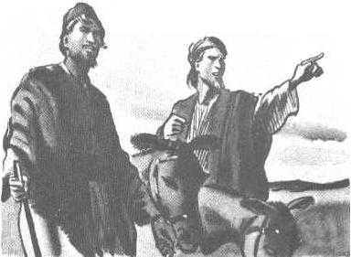
Abusing Service
Neglecting home responsibilities to help others
Accepting too many jobs at once
Wearing oneself down physically
Being too persistent in giving unrequested help to others
Going around proper authorities to get the job done

Slide 13
Abusing Service
Excluding others from the chance to help on some jobs
Providing premature help before God has finished disciplining someone
Becoming hurt by the ingratitude of those who have been helped
Getting “sidetracked” before all the tasks are done

Slide 14
Motivational Gift of Teaching
Needs to validate truth and certify statements made by others
Tends to validate new truth by testing against established systems of truth
Gives teaching credentials before teaching and wants them from others before listening
Luke's intent in writing was to help all be CERTAIN about truth (Luke 1:4).
Luke correlates Christ's words to Old Testament prophecies and his own writing to other accounts (Luke 1:1-3).
Luke emphasizes his qualifications at the start of his gospel (Luke 1:2-3).

Slide 15
Teaching (continued)
4. Desires to present truth in a systematic sequence
5. Loves researching and giving as many facts on a subject as possible
6. Emphasizes the importance of accuracy in reporting/sharing
Luke tried to present the gospel in a chronological approach (Luke 1:1-3).
Luke's gospel is the longest and includes material left out of the others. He emphasizes the completeness of his work (Acts 1:1).
Luke gives precise descriptions of events, conversations, and physical conditions [as with a "great fever" in Luke 4:38].

Slide 16
Teaching (completed)
7. Is often alert to factual details not noticed or mentioned by others
8. Tends to remain silent until information has been hear, observed, and discussed
9. Needs to exercise diligence and endurance in research and preparation
Luke's gospel has more names, offices, cities, dates, etc. than any of the other gospels.
As opposed to other gospel writers, Luke doesn't interject his personal comments.
Luke demonstrated his faithful determination by remaining with Paul in prison until the end (II Timothy 4:10-11).

Slide 17
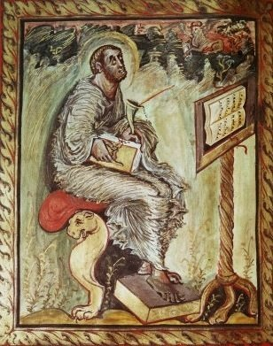
Abusing Teaching
Becoming too proud of their knowledge
Discounting the practical wisdom of those with a lack of formal education
Developing a culture of skepticism because of his/her critical methodology
Focusing on minor technical flaws and undermining otherwise sound teaching
Retreating into an ivory tower of books

Slide 18
Abusing Teaching
Depending on rational methodology over the Holy Spirit
Giving too much information without enough practical application
Boring listeners with too much detail

Slide 19
Motivational Gift of Exhortation
Motivated to urge people to their full spiritual maturity in Christ
Able to discern where a person is in spiritual growth and to speak to that level
Desires to give precise, practical steps of action in urging people to grow spiritually
Paul wanted everyone to attain maturity in Christ (Romans 12:1-2; I Corinthians 1:4-8; Colossians 1:28-29, etc.).
Paul saw the Corinthians as spiritual infants (I Corinthians 3:1) and Philippians as growing (Philippians 3:13-14).
Paul gives legal, marital, and business advice (I Corinthians 6:1-10, I Corinthians 7:1-16), (Colossians 3:22-4:1).

Slide 20
Exhortation (continued)
4. Desires to explain truth with logical reasoning to make it more likely to be accepted
5. Has capacity to visualize spiritual achievement for people and use this to motivate them for action
6. Desires face-to-face discussion to ensure a positive hearing and response
Paul uses the rhetorical question (Romans 6:1, 7:24, 8:33-35, Galatians 3:9) and syllogisms (I Corinthians 15:12-19) to convey truth.
Paul used his life as an example for fellow workers (Philippians 3:17, II Timothy 4:7-8, I Corinthians 11:1).
Paul liked to see and confer with other believers (I Thessalonians 2:17, 3:10, II Timothy 1:4, etc.).

Slide 21
Exhortation (completed)
7. Can identify with people of different types and backgrounds in order to gain a wider hearing
8. Motivated to bring harmony between diverse groups of believers
9. Recognizes in personal problems the heavenly sandpaper that enables further spiritual growth
Paul adapted for his audience (I Corinthians 9:19-23, Acts 17:16ff, Galatians 2:1-2, etc.).
Paul emphasized reconciliation between opposing groups (I Corinthians 3:3-4, Philippians 2:2, II Corinthians 9:12-14).
Paul recognized that his infirmities and weakness released power in his life (II Corinthians 1:5, 4:17, 12:9).

Slide 22
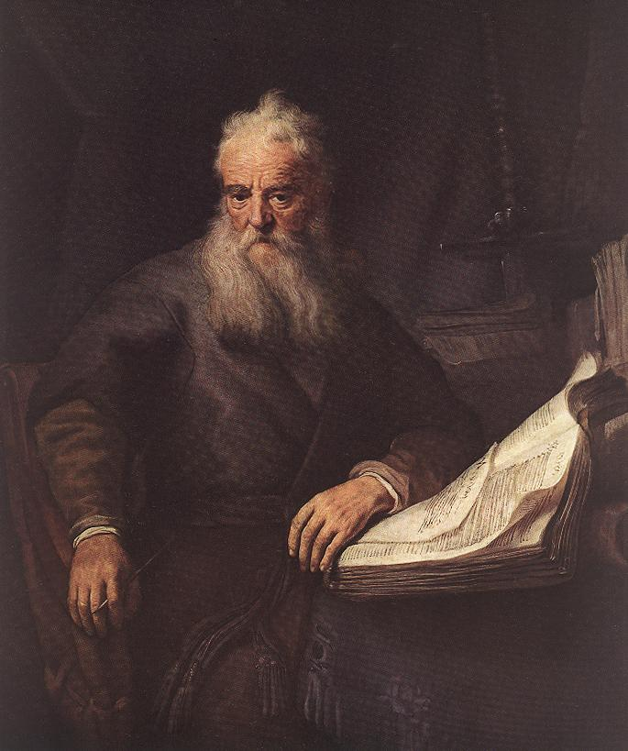
Abusing Exhortation
Prematurely raising others’ expectations
Stealing “family time” to counsel others
Treating people as “projects” not persons
Sharing private stories as illustrations without permission
Starting new projects before properly dealing with existing projects

Slide 23
Abusing Exhortation
Causing others to depend more on them than Holy Spirit
Trusting visible results rather than a change of heart
Neglecting proper emphasis on Bible doctrines
Prematurely offering counsel

Slide 24
Motivational Gift of Giving
Discerns wise investments to have more money to give
Desires to give quietly without public notice
Motivated to give to the Lord, not influenced by human giving campaigns
Matthew's gospel says more about money than any other (Matthew 6:20-21, 24, 31-33, 10:8-10, 14:13-21, 15:32-39, 16:26, etc.).
Matthew is the only gospel writer who emphasizes the need to give secretly (Matthew 6:2-4).
Matthew notes that when we give to the needs of other believers, we give to Christ (Matthew 25:35-46).

Slide 25
Giving (continued)
4. Desires to give gifts of high quality and value
5. Has capability for testing faithfulness and wisdom by how funds are handled
6. Tends to practice personal frugality and be content with basics
Matthew records in greater detail the costly gifts given to Jesus (Matthew 2:11, 26:6-13, 27:57-60).
Matthew reveals the foolishness and rebellion of those who misuse their resources (Matthew 21:33-34, 25:14-30).
Matthew had wealth and wealthy friends, but he chose to leave all to follow Jesus (Luke 5:27-32).

Slide 26
Giving (completed)
7. Is alert to what other people do with their money and resources
8. Has capacity for seeing financial needs overlooked by others
9. Desires to use giving as a way of motivating others to give
Matthew is the only Gospel writer who explains how the religious leaders spent the 30 pieces of silver (Matthew 27:3-8; 28:11-15).
Matthew records Jesus' condemnation of the Pharisees for not supporting their aged parents (Matthew 15:3-7) and details the fairness of paying ALL the laborers (Matthew 20:1-16)
Matthew was a tax collector. His job was to motivate people to give (Luke 5:29).

Slide 27
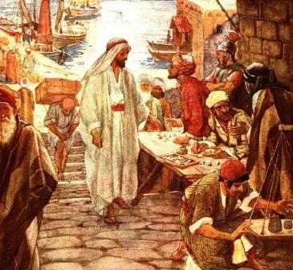
Abusing Giving
Giving too sparingly to their own family
Causing family to resent gifts to others
Listening to non-scriptural counsel on money-management
Putting pressure on those who don’t have as much to give
Being judgmental rather than helpful to those who don’t use funds well

Slide 28
Abusing Giving
Controlling people or ministries through their gifts
Corrupting people by being too generous
Investing in “projects” which do not provide sufficient benefits in ministering to people

Slide 29
Motivational Gift of Administration
Able to visualize the final result of a major project
Capable of breaking down major goals into smaller, achievable tasks
Assesses the resources needed to reach a goal
Nehemiah visualized the goal of rebuilding the wall of Jerusalem as a first step to recovery (Nehemiah 1:2-3, 2:5).
Nehemiah accomplished the huge rebuilding task by having smaller groups work on smaller sections (Nehemiah 3:1-31).
Nehemiah created a logical requisition of resources from the king (Nehemiah 2:6-8, 10:32-39, 12:44, and 13:3).

Slide 30
Administration (continued)
4. Tends to remove himself/herself from distracting details in order to focus on the ultimate goal
5. Has willingness to endure negative reaction from others in order to reach the goal
6. Needs loyalty and confidence from those directed and served or loses confidence
Nehemiah didn't get involved in the actual building project, but he removed the obstacles that would hinder the workers (Nehemiah 5:1-13).
Nehemiah had internal and external opposition (Nehemiah 4:18, 6:5-14, 13:4-9).
Nehemiah required oaths of cooperation from the people (Nehemiah 5:1-13).

Slide 31
Administration (completed)
7. Knows what should and shouldn't be delegated to others
8. Able to inspire and encourage workers by cheerfulness
9. Has joy and fulfillment in seeing everything come together
Nehemiah delegated the work on the walls, but personally dealt with the opposition (Nehemiah 4:13).
Nehemiah had a cheerful spirit and was skillful in challenging and encouraging his workers (Nehemiah 4:14).
Nehemiah expressed his joy in the completed task by appointing singers and scheduling a revival (Nehemiah 7:1-2, 8:1-18, 12:27-43).

Slide 32
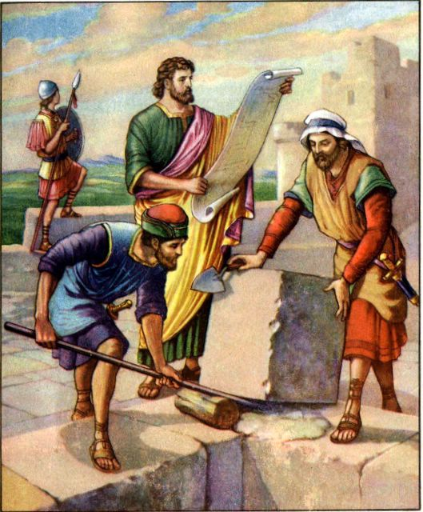
Abusing Administration
Viewing people as resources not persons
Using people to meet personal ambitions
Showing favoritism to one’s own “loyalists”
Taking charge of projects that haven’t really been directed by God

Slide 33
Abusing Administration
Delegating too much work to others
Overlooking serious character flaws to retain valuable workers
Being unresponsive to suggestions from others
Failing to give proper explanations and praise to co-workers

Slide 34
Motivational Gift of Mercy
Able to see genuine love and vulnerability in relationships
Needs deep friendships with mutual commitment
Tends to react harshly when intimate friends are rejected
John uses the word love more than it is used in any other book of the Bible.
John had a very close relationship with Jesus and Peter, referring to himself as the disciple Jesus loved (John 13:23, 19:26, 20:2, 21:7, etc.).
John and James wanted Jesus to call fire from heaven to consume the Samaritans who rejected Jesus (Luke 9:54).

Slide 35
Mercy (continued)
4. Has greater concern over mental joy or distress than the physical counterpart
5. Tends to attract people who are having emotional stress and want to confide
6. Needs to measure acceptance by physical, emotional closeness
John wrote to give readers: joy, fellowship, hope, confidence, and cast out fear (I John 1:3-4, 3:2, 17, 4:18).
Even many of the disciples confided in John (John 13:23-26).
John sought out the closest physical place to Christ (John 3:23).

Slide 36
Mercy (completed)
7. Desires to remove the causes of hurts even when it might reduce the chance to grow from them
8. Tends to avoid tough decisions unless eliminating greater hurts
9. Works well as a team with those with the spiritual gift of prophecy
John wanted to stop believers from hating and hurting each other (I John 3:11-15).
John was initially a "follower," but after a crisis, he became very bold and decisive (Acts 4:13, 19-20).
John spent more time with Peter than any other disciple (Luke 22:8, Acts 3:1-11, 4:13-19, 8:14).

Slide 37
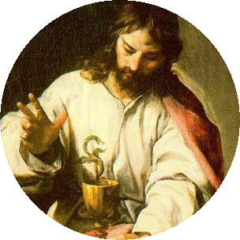
Abusing Mercy
Failing to be firm and decisive when necessary
Taking up the offenses of other people
Making decisions based on emotion rather than based on a rational interpretation of Scripture
Allowing improper affection to be formed with those of opposite sex

Slide 38
Abusing Mercy
Cutting off others because of perceived insensitivity to others
Reacting negatively when God uses suffering as heavenly sandpaper
Being too sympathetic to those outside of God’s will
Establishing possessive friendships with others

