Slide 1
Perspectives on ecclesiastes?
A brief look back

Slide 2

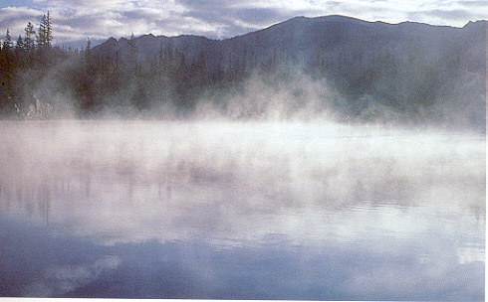
Something, Something, All is Something

Slide 3
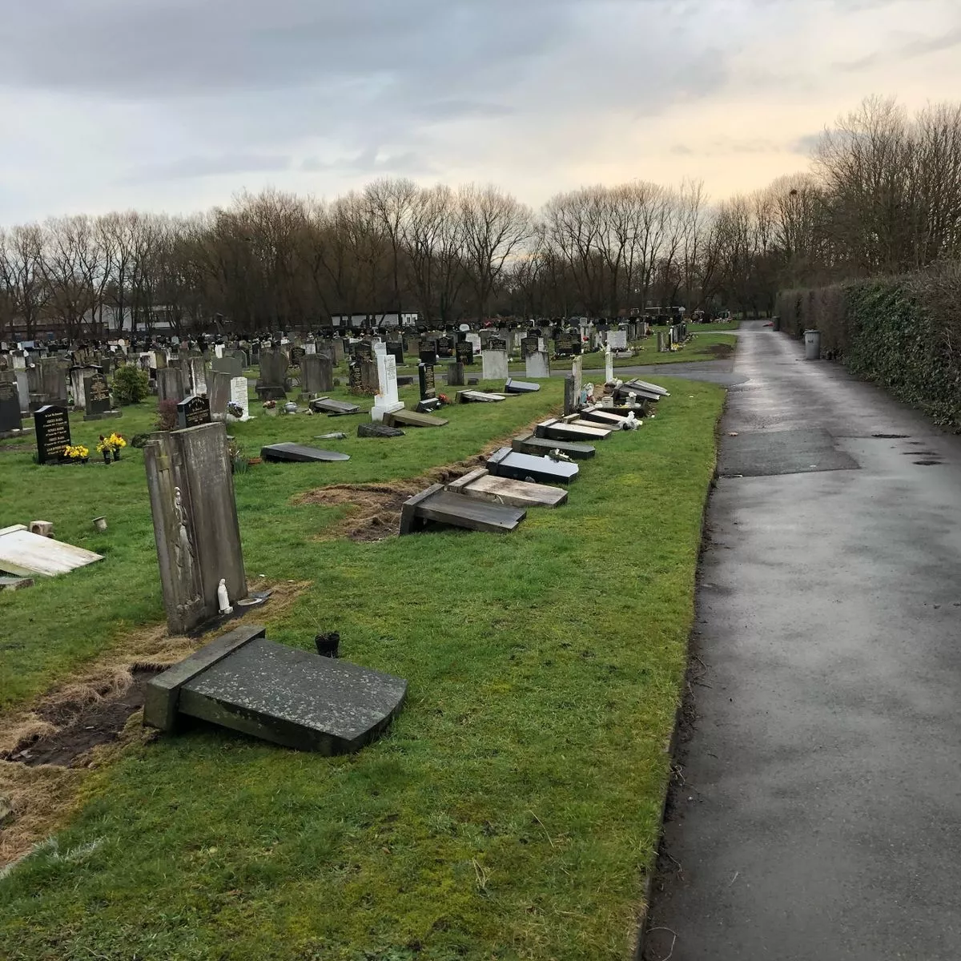
James 4:14 – What is your life? It is a vapor that appears for a short while and vanishes
James uses the word άτμις or “AT-mees”
The same word is used in many Greek translations of Ecclesiastes where we see breath, vapor, vanity, etc.
Both the OT wise person and the NT leader remind us that life is short
We can’t be certain of our future, humanly speaking (see James 4:16)

Slide 4
Chiastic Structure for 1st Poem (1:4-11)
A. Life (including human) short compared to earth’s lifespan (v. 4)
B. Everything in nature goes round-and-round (vv. 5-6)
C. Nothing in Nature gets filled or finished (vv. 7-8)
B’. Everything in history goes round-and-round, too (vv. 9-10)
A’. Everyone is forgotten in the end; history is a black hole (v. 11)
[adapted from Wright, Christopher J. H., Hearing the Message of Ecclesiastes: Questioning Faith in a Baffling World (Grand Rapids, MI: Zondervan, 2023), pp. 7-8]

Slide 5
Positive Lessons from 3:1-8
Things are constantly changing so we shouldn’t get bored or stuck in our ways
Time is always FOR something; it is never neutral. [Wright, Christopher J. H., Hearing the Message of Ecclesiastes: Questioning Faith in a Baffling World (Grand Rapids, MI: Zondervan, 2023), p. 31.]
“The various actions named are carried out apparently at man’s
volition—all but the first. The times of his birth and death
are not his to decide, and this gives the clue to Qoheleth’s
meaning. Just as surely as birth and death, so all other events
and human actions take place when and as God deems them
fitting.” [Scott, R. B. Y., The Way of Wisdom in the Old Testament
(New York: Macmillan and Company, 1971), p. 180.]

Slide 6
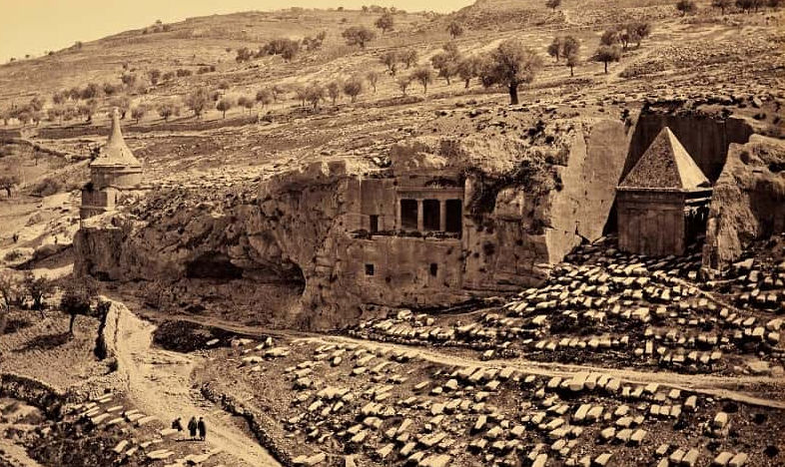
The inescapable reality of death is for Qoheleth the point of departure for life (v. 2b). Death orients the self toward authentic, rather than false, living. [Brown, Ecclesiastes, p. 73.]
“² You learn more at a funeral than at a feast—After all, that’s where we’ll end up. We might discover something from it.”
[Peterson, The Message, 7:2]
7:2 – Why is house of mourning better than the house of mirth? Because in the house of mourning,
“…the living will learn the meaning of life.” [Peterson, Broadman, p. 119]

Slide 7
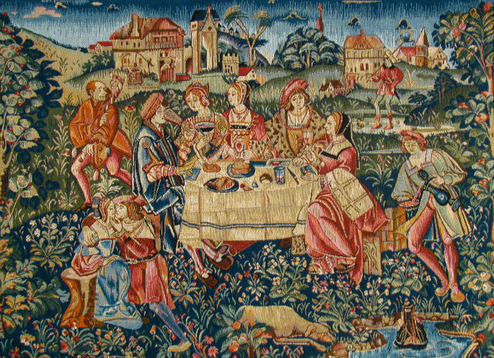
Ecclesiastes 3: 11 seen as a Tapestry
We observe the wonder and beauty of God’s accomplishment from within time [“tapestry”]
We sense, with human intuition, the transcendent reality God has placed in our mental/spiritual DNA.
Our knowledge is finite and bounded.
We see the pattern, but we can’t
see beyond our scene.
[adapted from Wright, Christopher
J. H. Hearing the Message of
Ecclesiastes: Questioning Faith in a
Baffling World, p. 34.]

Slide 8
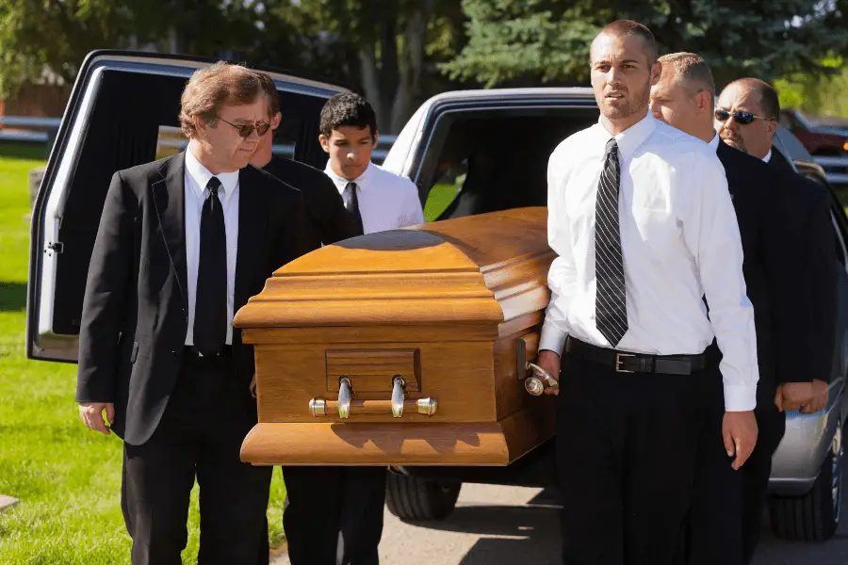
Summary of the Section on Wealth’s Dangers
“Since our lives are spent between two moments of nakedness, it is best to travel light.”
[John Stott, quoted in Wright, Christopher J. H., Hearing the Message of Ecclesiastes, p. 70.]

Slide 9
The Antidote? (18-20)
“To accept life as God has given it, and to respond positively to that gift of life is his form of faith.” [Scott, R. B. Y., The Way of Wisdom in the Old Testament (New York: Macmillan and Company, 1971), p. 187.]
“Not only is there nothing left for man but present enjoyment, but even for this he is dependent upon God.” [quoted in Longman, Tremper III, The New International Commentary on the Old Testament: The Book of Ecclesiastes (Grand Rapids, MI: William B. Eerdmans, 1998), p. 168.]

Slide 10

The only earthly good men and women can look forward to is to eat and drink well and have a good time—compensation for the struggle for survival these few years God gives us on earth. [Peterson, The Message, 8:15]
Not overindulgence, but
Similar to “buen provecho” in Spanish
“provecho” comes from aprovechar that means to use something wisely or take advantage of what has been provided to you.

Slide 11
HERE ARE FIVE “CARPE DIEM” PASSAGES:
2:24-26 (eat, drink, gain satisfaction from work, and please God),
3:13-14 (eat, drink, gain satisfaction from work, prioritize what God wants to last, and reverence [“fear”] God),
5:18-20 (eat, drink, gain satisfaction from work, treat blessings as a gift, allow God to provide joy),
8:15 (enjoy with eat, drink, pleasure to balance toil, and savor God’s gift of life),
9:7 (Go, eat your food in pleasure, and drink your wine with a good heart [“Enjoy, but don’t overdo it!”] because God is already pleased with your accomplishments. [PJT]).

Slide 12
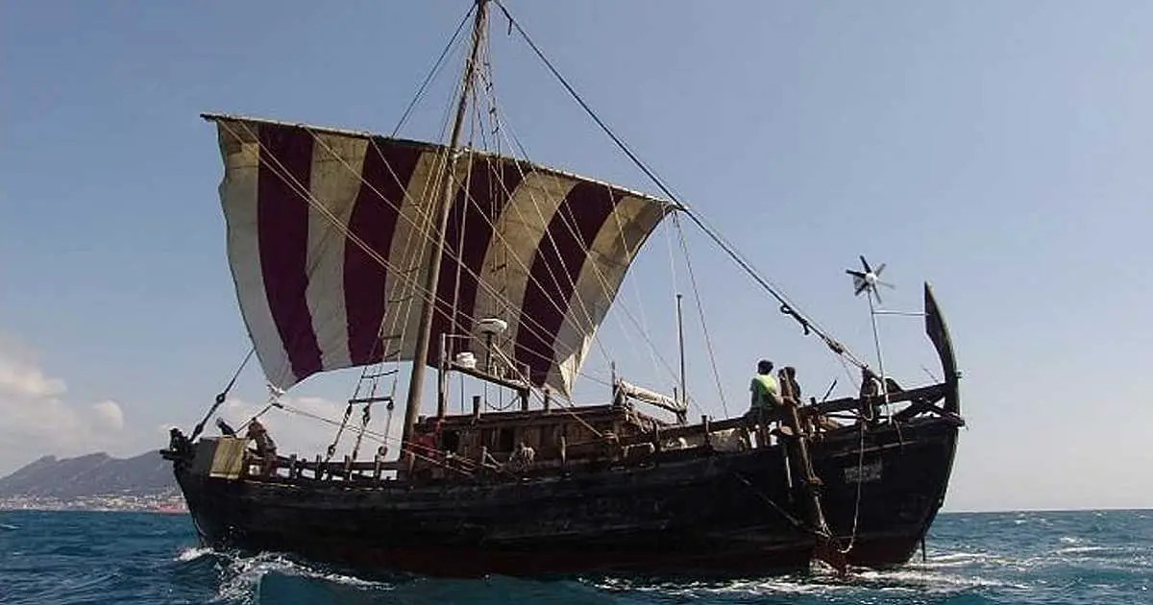
1) Send out your bread upon the surface [lit. “face”] of the waters BECAUSE in many days, you may find it. [PJT]
2) Give a portion to seven, and even to eight, BECAUSE you don’t know what catastrophe [or “evil”] may come upon the land. [PJT]

Slide 13
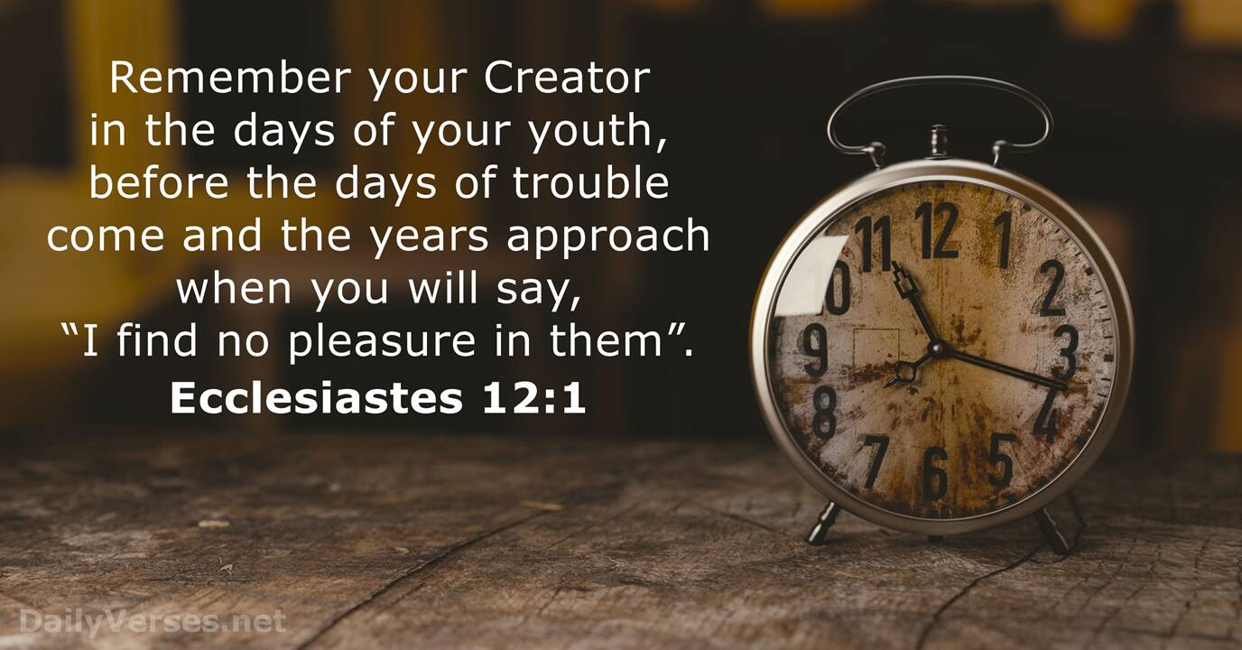
ברא = “bah-RAH” = Special Creation

Slide 14
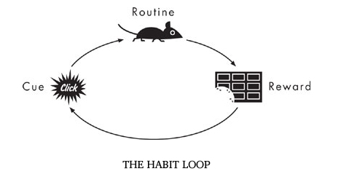
Humans are habit-making creatures: build your good habits early

Slide 15
Targum of Ecclesiastes 12:2-3
Sun = brightness of face
Moon = picture of cheeks
Stars = pupils of the eye
All affected by the aging process
Clouds = eyelids while rain = tears
Keepers of the house = hands or arms (slaves?)
Valiant men = the back or knees (free men?)
Grinders = teeth (women?)
Windows = eyes (older women?)

Slide 16
Allegories of Ecclesiastes 12:4-5
Double doors = closed to trade [or ears?]
Sound of the mill = business shut down [diminished hearing?]
Sound of a bird = solitary bird filling the silence where…
(light sleeping or rising timbre of voice)
Daughters of song bowed = no more festive energy (hearing)
Afraid of height = balance issues
Terror of road = hesitance to go anywhere
Almond blossom = white hair
Locust tree = impotence or insect dying after giving birth
Caper fruit = aphrodisiac doesn’t work

Slide 17
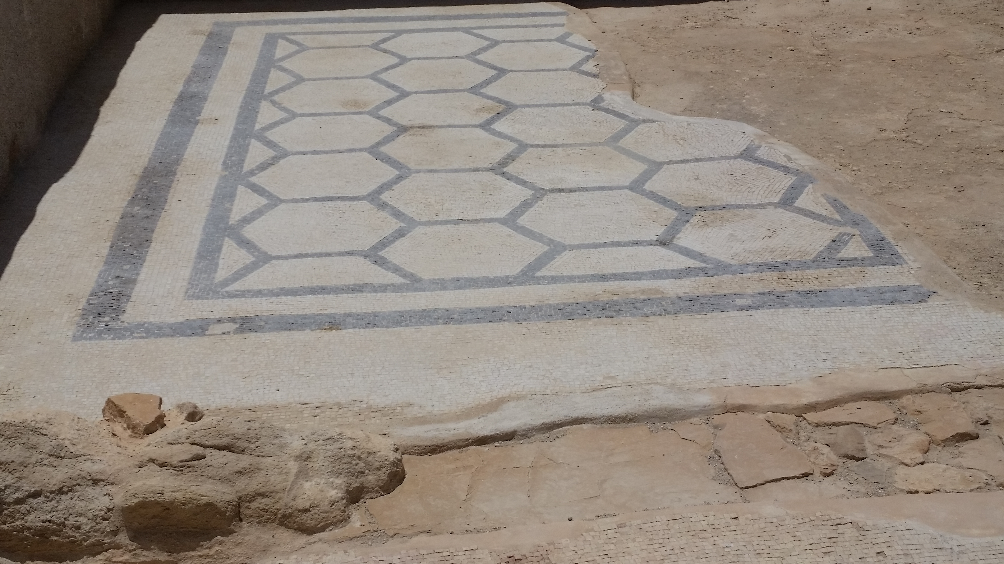
The Eschatological Allegory
Brown, William P. Ecclesiastes: Interpretation: A Bible Commentary for Teaching and Preaching (pp. 108-109)
I. Demise of the Cosmos verse 2
a. Cosmic darkness
b. Clouds
II. Demise of the Domicile verse 3
a. Incapacitated male “guardians”
b. Diminished female “grinders”
c. Dimmed female “onlookers”
III. Demise of Commerce verse 4a
a. End of commercial traffic
b. Decline of the mill sound

Slide 18
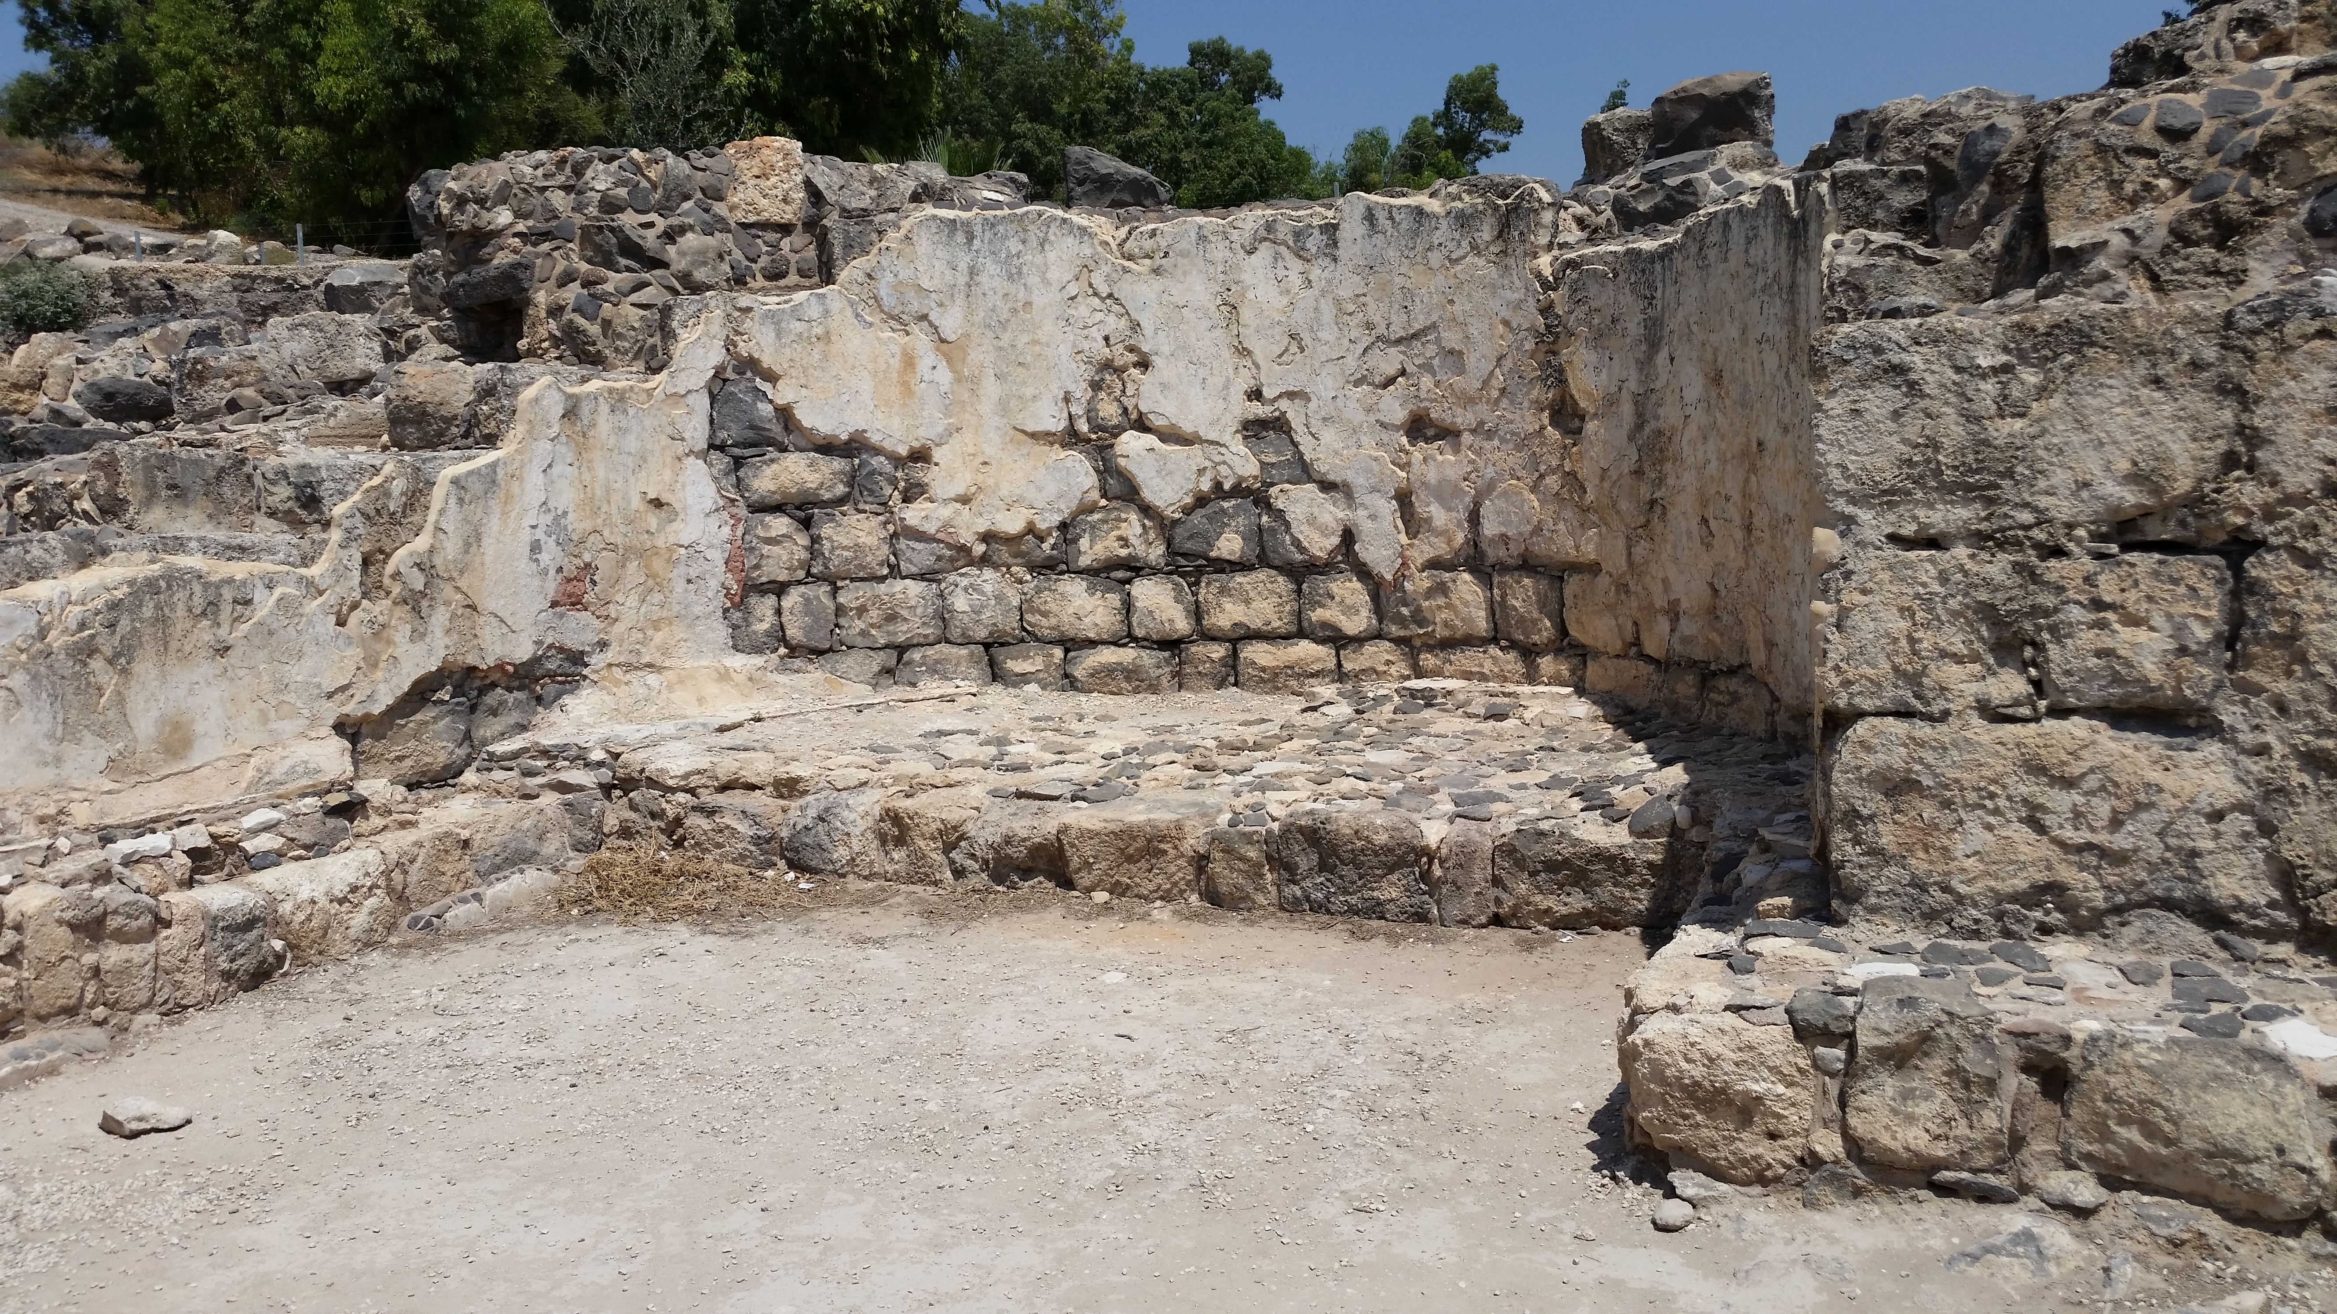
The Eschatological Allegory (Drills down)
Brown, William P. Ecclesiastes: Interpretation: A Bible Commentary for Teaching and Preaching (pp. 108-109)
IV. Rise/Demise of the Natural Realm verses 4b-5a
a. Rise of bird songs
b. Terror everywhere
c. Decay and impotence
V. Demise of the Individual verses 5b-7
a. Entrance into the eternal home
b. Broken symbols of life
c. Return to life’s genesis

