Slide 1
On To Jerusalem
Preparing to Teach Acts 21 and 22

Slide 2
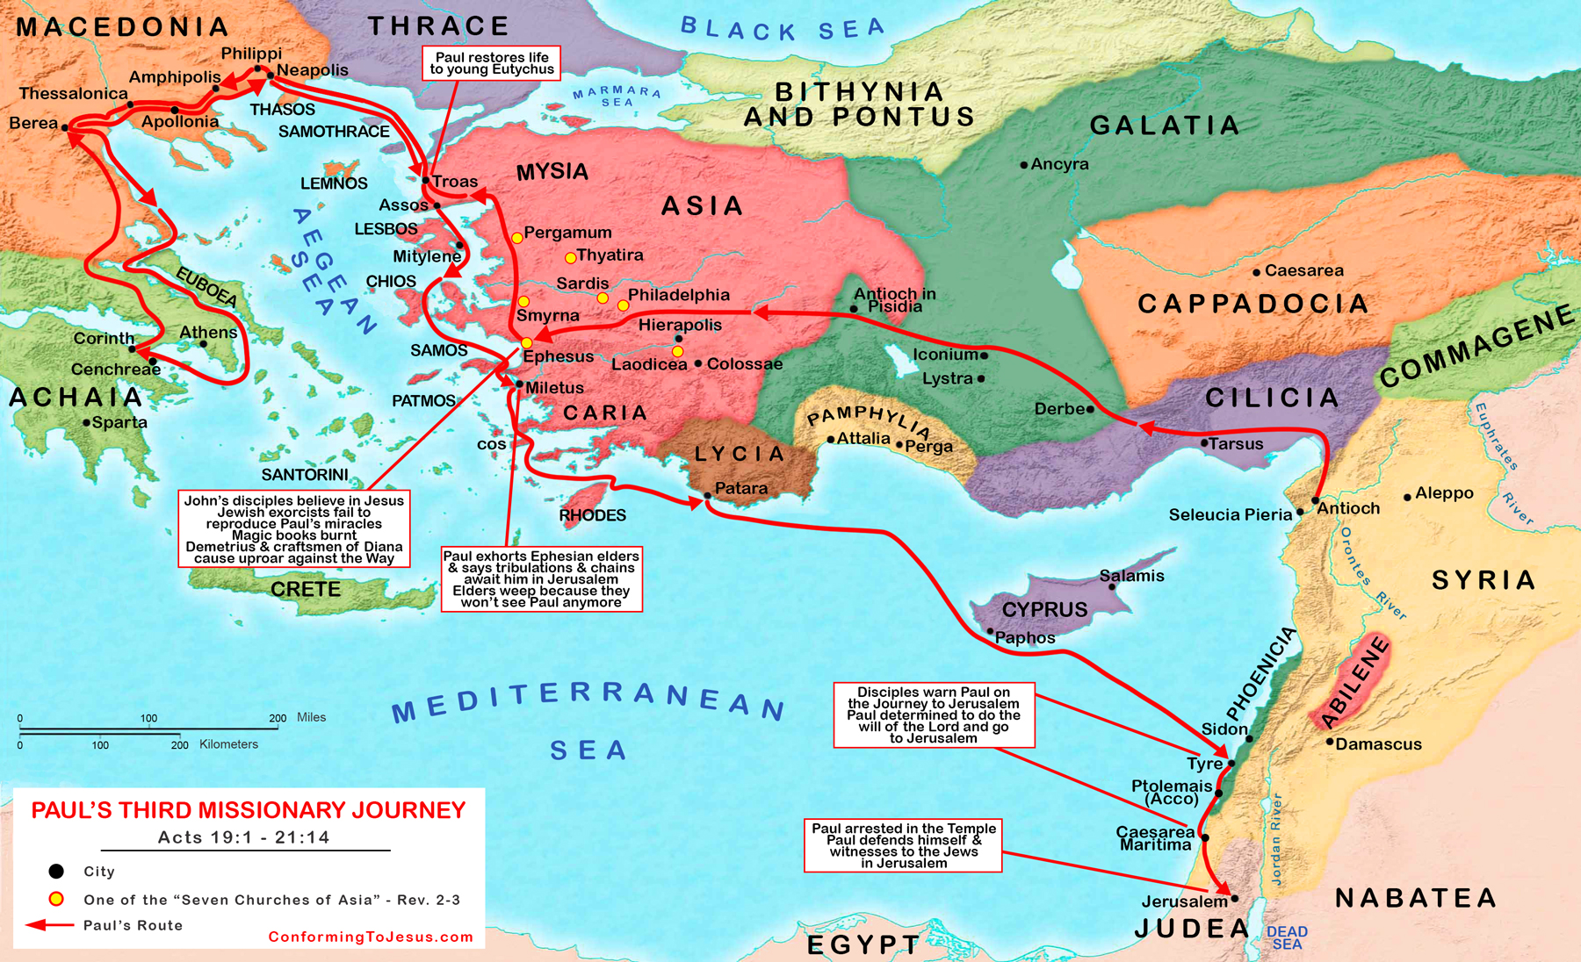
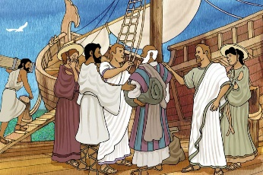
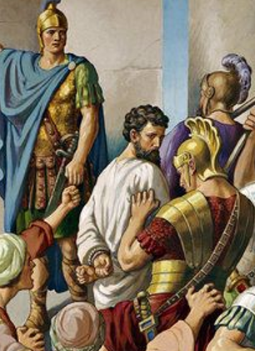
1) After it happened that we had pulled ourselves away from them, we raised our sails, sailing a straight course, we came to Kos/Cos. Then, the next day to Rhodes, and then to Patara. [PJT]

Slide 3
Kos/Cos

Slide 4
1) After it happened that we had pulled ourselves away from them, we raised our sails, sailing a straight course, we came to Kos/Cos. Then, the next day to Rhodes, and then to Patara. [PJT]

Slide 5
Rhodes and Patara

Slide 6
2) So, finding a ship crossing over to Phoenicia, we embarked, raising our sails. 3) Coming in sight of Cyprus, we passed by to the port side [lit. “left-hand side,” so south], we sailed to Syria, coming down to Tyre, for there, the ship was [as usual] unloading the cargo. 4) So, having searched out the disciples, we remained for seven days, some continuing to speak to Paul by means of the Spirit not to go up to Jerusalem. [PJT]

Slide 7
Tyre [Major Port of Antiquity]

Slide 8
5) So, when the days of outfitting [the ship] were over [lit. happened], we continued [lit. “went”] our voyage and everyone, along with women and children, accompanied us outside of the city, and kneeling (lit. “sitting down the knees”] on the beach, we prayed. 6) We said good-bye to each other and went up into the boat, but they returned to their [respective] places [idiom for “home”]. 7) So, we completed [or “continued”] our voyage from Tyre, we landed at Ptolemais [Acre, Acco] and greeted the brothers, and remained one day with them. [PJT]

Slide 9
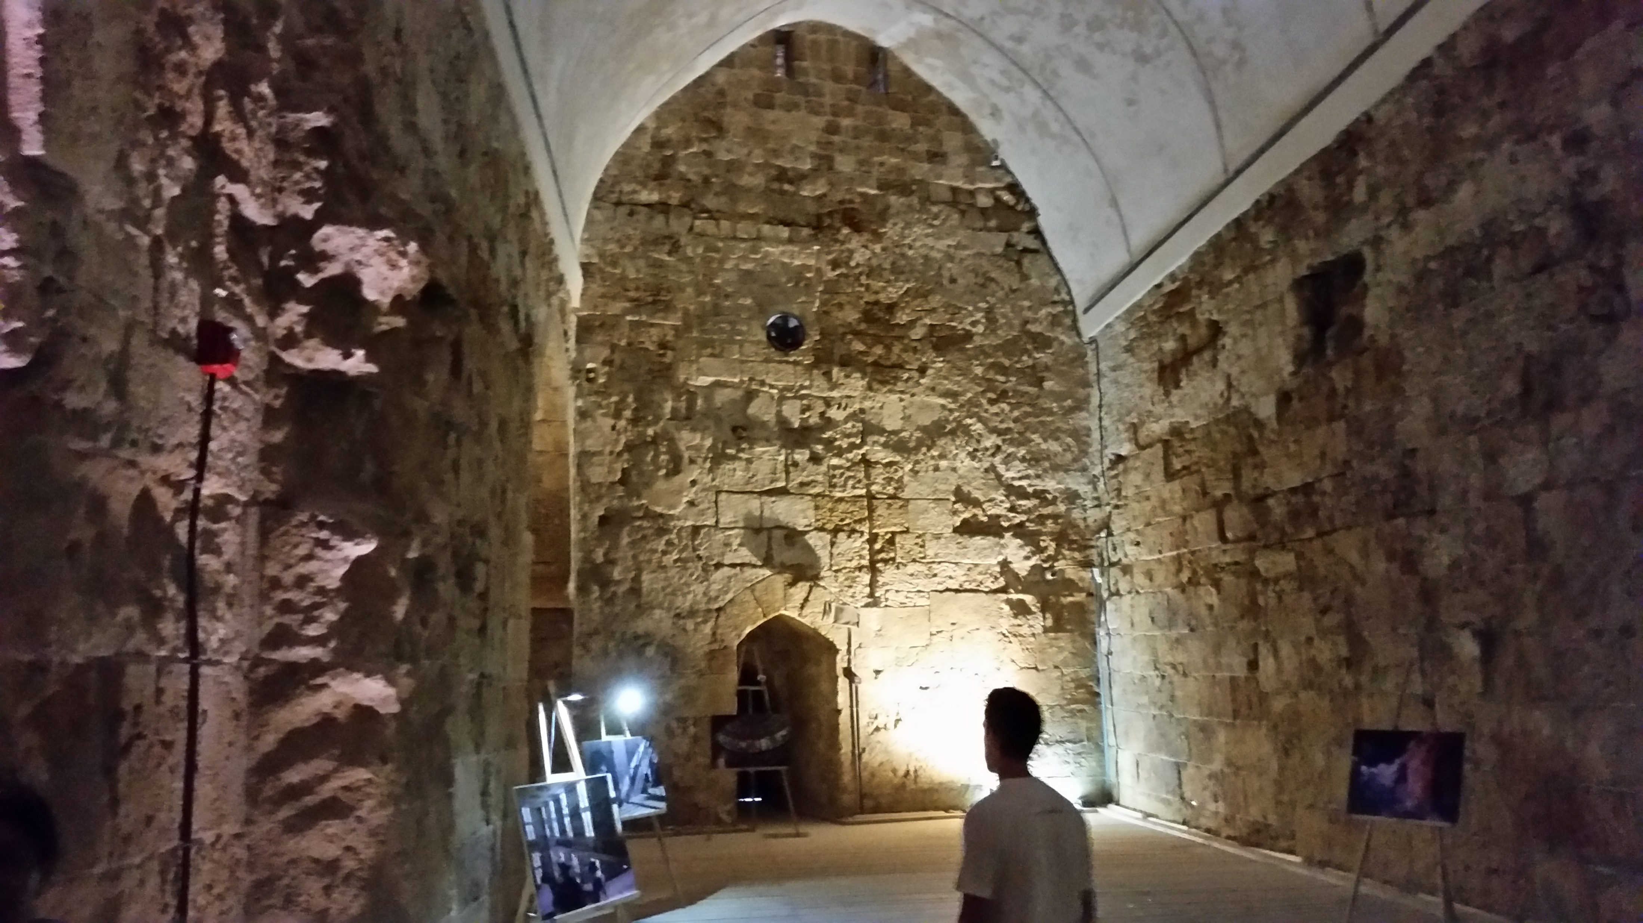
Ptolemais / Acre / Acco

Slide 10
8) But the coming day we left, coming into Caesarea, then we entered into the house of Philip the Evangelist, one of the seven, remaining with him. 9) Now, he had four daughters, virgins who were prophesying. [PJT]

Slide 11
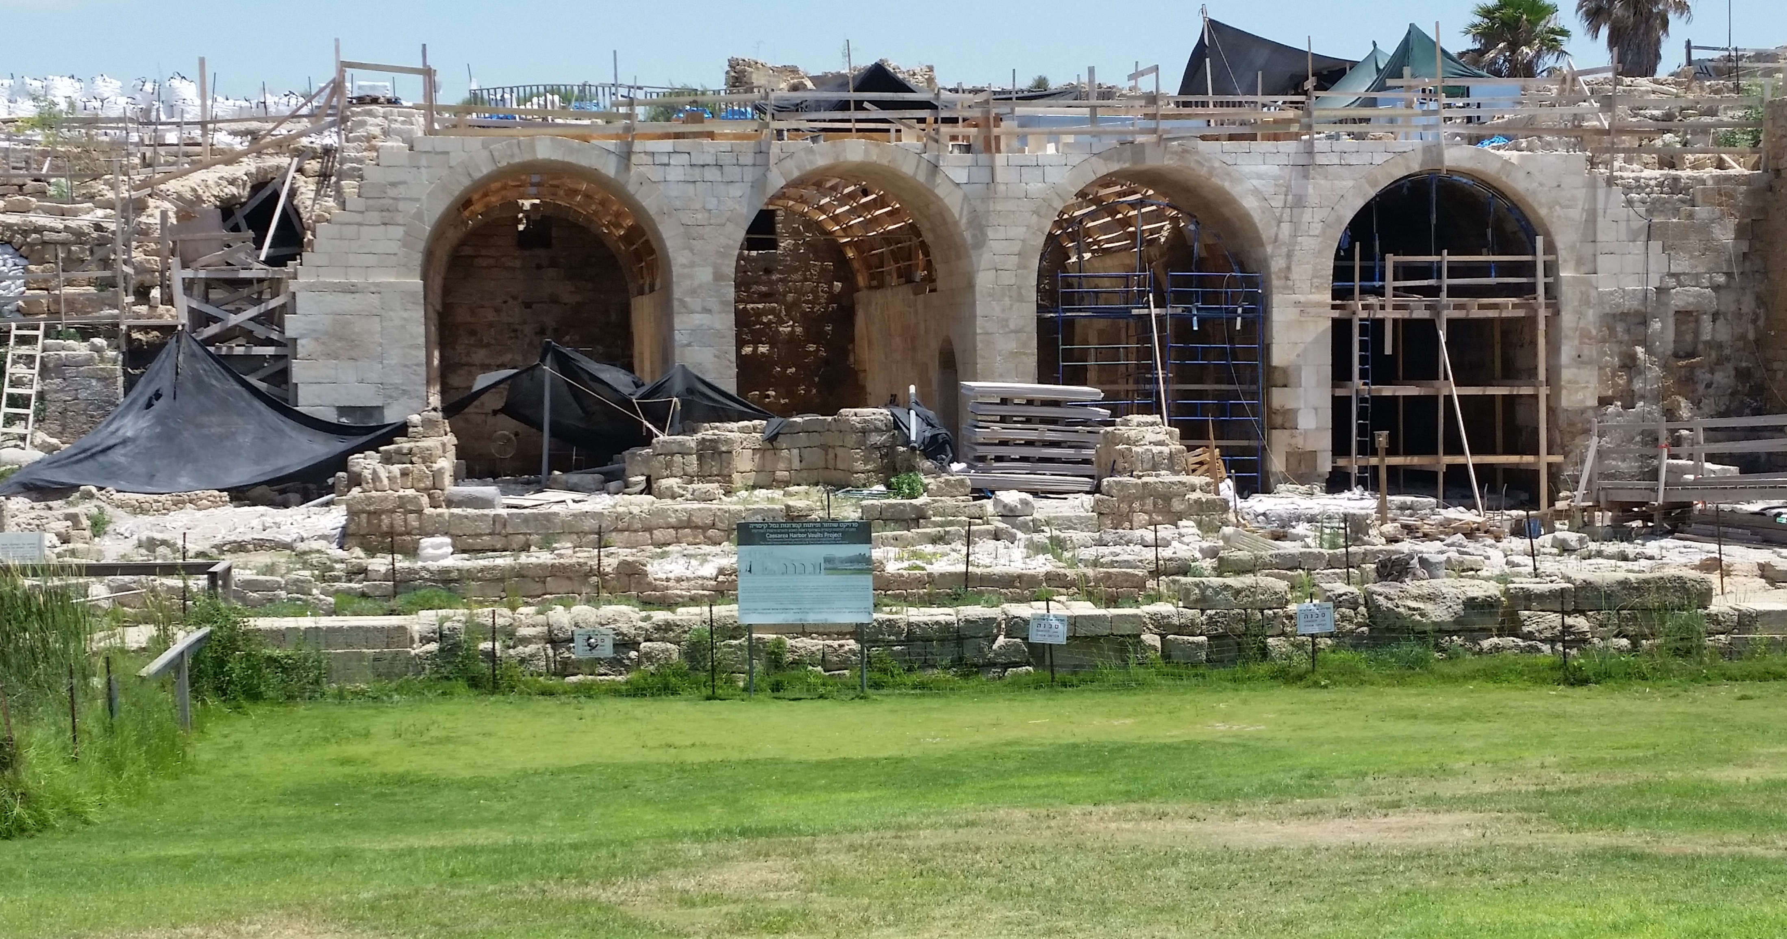
Caesarea Maritima [not Philippi]

Slide 12
Acts 21:10-14 [PJT]
10) Then, as we were waiting more days [than we expected], a prophet named Agabus came down from Judea, 11) and coming before us and taking the belt from Paul, bound his own feet and his hands and said, “These things the Holy Spirit says, ‘The man to whom this belt belongs, the Jews will bind similarly in Jerusalem and hand [him] into custody in the hands of the Gentiles.’” 12) So, upon hearing this, we and the locals [lit. “those of that place”] urged [counseled, encouraged, challenged] him not to go up to Jerusalem. 13) This is how Paul answered, “What is causing you to weep and crush my heart? Because I not only hold myself ready to be bound, but even to die in Jerusalem on behalf of the name of the Lord Jesus.” 14) Since he was not convinced, we ceased [arguing] and said, “The will belonging to the Lord come to be.” [PJT]

Slide 13
Reacting to Agabus

Slide 14
Summary from William H. Willimon
“The writer of Acts, with his stress upon the empowerment of the Spirit, corrects misconceptions which might have arisen about the cost of discipleship. The age of the Spirit has begun at Pentecost in the resurrection and ascension of Jesus. Yet, it does not end sickness, suffering, evil, injustice, ignorance, and rejection.”
[Willimon, William H., Interpretation: A Bible Commentary for Teaching and Preaching: Acts [Atlanta, GA: John Knox Press, 1988), p. 160.]

Slide 15
This One’s for Fred!
15) After these days, we packed up [mounted up?], going up to Jerusalem. 16) So, some of the disciples from Caesarea went along with us, guided us toward Mnason, someone from Cyprus, with whom we would lodge, an early disciple [long-standing]. [PJT]

Slide 16
One Step Forward / One Step Back

Slide 17
How’d That Work Out?

Slide 18
The Lord and the Apostle
Jesus and the Mob
Paul and the Mob
Accused of blasphemy vs. the Temple
“Crucify Him!”
Romans battered Jesus
Who? Are you king…?
Crowd interrupts
Accused of blasphemy vs. Temple (v. 28)
“Away with him!” (v. 36)
Mob battered Paul (v. 32)
Who? What have you…? (v. 33)
Crowd interrupts (v. 34)

Slide 19
Paul’s Defense (Parts 1 & 2) Schnabel, Eckhard J., Zondervan Exegetical Commentary on the New Testament: Book 5: Acts (Grand Rapids, MI: Zondervan Academic, 2012), p. 1568.
3. The facts of the case (narratio) (22:3–21) a. Paul’s life before his conversion (22:3–5) i. Paul’s Jewish credentials (22:3) ii. Paul’s activity as a persecutor of the followers of Jesus (22:4–5) b. Paul’s conversion (22:6–16) i. Paul’s encounter with Jesus of Nazareth on the road to Damascus (22:6–11) ii. Paul’s commission by God to be a witness of Jesus to the world (22:12–16)

Slide 20
Paul’s Defense (Part 3) Schnabel, Eckhard J., Zondervan Exegetical Commentary on the New Testament: Book 5: Acts (Grand Rapids, MI: Zondervan Academic, 2012), p. 1568.
c. Paul’s vision in the temple after his return to Jerusalem (22:17–21) i. Paul’s return to Jerusalem and his vision (22:17) ii. Jesus’ directive to leave Jerusalem because of the Jews’ unbelief (22:18) iii. Paul’s protest that he can be an effective witness in Jerusalem (22:19–20) iv. Jesus’ directive to Paul to go far away to the Gentiles (22:21)

Slide 21
Three Accounts of Paul’s Experience
Acts 9:1-19 | Acts 22:6-21 | Acts 26:12-18
Paul falls to ground in v. 4 | Paul falls to ground in v. 7 | All fall to ground in v. 14
Paul surrounded by the light v. 3 | Companions see the light v. 9 | Paul only saw the light v. 13
Companions hear the voice v. 7 | None heard the voice v. 9 | Paul only heard Aramaic words v. 14
Sent to Damascus for commissioning v. 6 | To Damascus for commission v. 10 | Commissioned in Temple vision vv. 16-17
Jesus is speaking vv. 15, 17 | Ananias is speaking vv. 14-16 | Jesus is speaking vv. 16-18

Slide 22
Comparison of Paul and Ezekiel
Call/ Commissioning | Ezekiel | Acts
Saw the divine Glory | 1:28 | 22:11
Heard revelatory voice | 1:28-2:8 | 22:7-10
Fall on ground | 1:28 | 22:07
Both stand on their feet | 2:1-2 | 22:10-11

