Slide 1
Preparing to Teach
Ecclesiastes 7-8 Did Qohelet(h) Really Say That?

Slide 2
Structure of Chapter 7
First Collection of Proverbs (7:1-14)
Personal Observations/Testimony (7:15-18)
Second Collection of Proverbs (7:19-22)
Observations on Wisdom/Righteousness (7:23-29)
Purpose of “Proverbs” = “More than banal truisms, proverbs employ concrete images as metaphors to evoke reflection and prompt prudent or moral action.
P. Brown, William. Ecclesiastes: Interpretation: A Bible Commentary for Teaching and Preaching (p. 71).

Slide 3
Many [Lohfink, Miller, Seow ] think the traditional form is used so that Qoheleth can subvert the black and white answers of traditional wisdom [Miller, Symbol, p. 133].
Better
Than…
1a = name, reputation
1b = day of death
2a = mourning
3a = aggravation, vexation
5a = reprimand of wise
8a = end of something
8b = patience
1a = expensive ointment
1b = day of birth
2a = feast, celebration
3a = celebration, ecstasy
5a = drinking songs of fools
8a = beginning of something
8b = arrogance

Slide 4
How Do Name/Death Fit Together? (7:1)
“Your reputation matters more than your aftershave, …” [Wright, Hearing, p. 80.]
“A good reputation is better than a fat bank account. Your death date tells more than your birth date.” [Peterson, The Message, 7:1]
שם = “SHEHM” = “name”
שמן = “SHEH-mehn” = “ointment”

Slide 5
The inescapable reality of death is for Qoheleth the point of departure for life (v. 2b). Death orients the self toward authentic, rather than false, living. [Brown, Ecclesiastes, p. 73.]
“² You learn more at a funeral than at a feast—After all, that’s where we’ll end up. We might discover something from it.” [Peterson, The Message, 7:2]
7:2 – Why is house of mourning better than the house of mirth? Because in the house of mourning, “…the living will learn the meaning of life.” [Peterson, Broadman, p. 119]

Slide 6
3) Aggravation is better than merriment because a sad face may lead to a glad heart. [CEB]
“Joy that is not born of sorrow is artificial. Such an observation is critical to Qoheleth’s larger analysis of joy, for it reveals that joy is not simply an antidote to the toilsome task of living, an opium for the toiling masses, as it were. To the contrary, like the phoenix rising from the ashes, true gladness emerges from sorrow (v. 3b). If anything, such joy, born from grief, is resilient to the harsh realities of life, much in contrast to the merriment of fools, whose perception is woefully limited. [Brown, Ecclesiastes, pp. 73-74.]

Slide 7
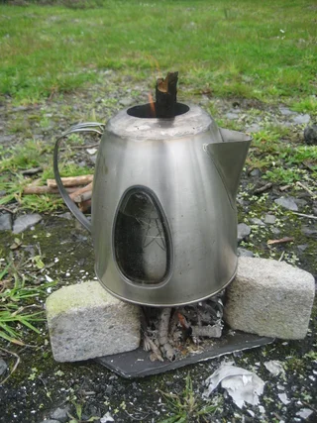
We Need Perspective
In a 1975 survey of 55 full-time comedians making six figures or more, 80%: “…repeatedly expressed the fear that if they were successful in analysis, to the point where their suffering was greatly relieved, they would then cease to be funny.” There was not only an observable correlation between mental distress and comedy, but the comedians themselves saw this distress as integral to their abilities.
4) Sages invest themselves in hurt and grieving. Fools waste their lives in fun and games. [Peterson, The Message, 7:4]
Fools don’t consider life seriously (v. 4)
Fools sing without reflection (v. 5)
Thorns burn-out quickly and make noise without providing much heat (v. 6)
הַסִּירִים תַּחַת הַסִּיר “nettles under kettles”

Slide 8
⁷ Oppression turns the wise into fools; a bribe corrupts the heart. [CEB]

Slide 9
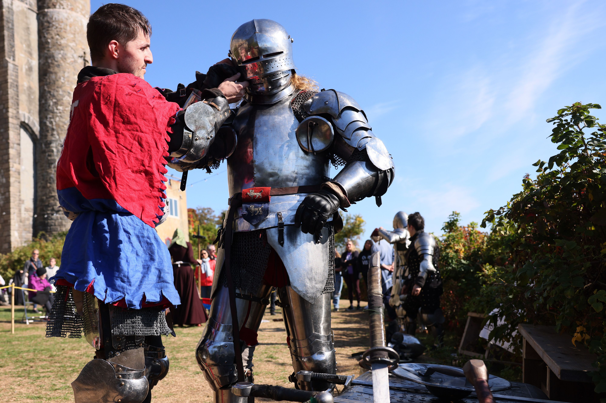
Too Much Expectation or Too Much Nostalgia
⁸ The end of something is better than its beginning. Patience is better than arrogance. ⁹ Don’t be too quick to get angry because anger lives in the fool’s heart. ¹⁰ Don’t ask, “How is it that the former days were better than these?” because it isn’t wise to ask this. [CEB]

Slide 10
“With” or “As?” (7:11-12)
¹¹⁻¹² Wisdom is better when it’s paired with money, Especially if you get both while you’re still living. Double protection: wisdom and wealth! Plus this bonus: Wisdom energizes its owner.
[Peterson, The Message, 7:11-12]

Slide 11
Probably NOT: “¹³ Take a good look at God’s work. Who could simplify and reduce Creation’s curves and angles To a plain straight line?” [Peterson, The Message, 7:13]
¹³ Consider God’s work! Who can straighten what God has made crooked?
¹⁴ When times are good, enjoy the good; when times are bad, consider: God has made the former as well as the latter so that people can’t discover anything that will come to be after them. [CEB]

Slide 12
Quick Summary of the Rest of the Chapter [Miller, Symbol, p. 134.]
1st Unit: Need for Moderation Concerning Righteousness and Wisdom (7:15-18)
2nd Unit: Wisdom of Righteousness and Others (7:19-22)
3rd Unit: Elusiveness of Wisdom and Righteousness/ Threat of Folly and Wickedness (7:23-29)

Slide 13
¹⁶ Don’t be too righteous or too wise, or you may be dumbfounded. [CEB]
Is the verse REALLY saying that “Sometimes, you have to be a little bit naughty…” [Wright, Hearing, p. 87 n3.]
If so, we can’t be “naughty” with:
Drunkenness (2:3)
Sensuality (2:8)
Oppression (3:16-17; 4:1)
Irreverence (5:1-2)
Dishonesty (5:4-6)
Greed (5:11-12)
Anger Issues (7:9)
Hypocrisy (8:10)

Slide 14
Wisdom and Righteousness Are Elusive Ecclesiastes 7:20 quoted in Romans 3:10 [CEB]
Wisdom better than 10 rulers (v. 19) “council of ten?)
²⁰ Remember: there’s no one on earth so righteous as to do good only and never make a mistake.
¹⁰ As it is written, There is no righteous person, not even one.
BUT, wisdom is elusive (v. 23)
THE woman is a trap (v. 26)

Slide 15
²⁹ See, this alone I found: God made human beings straightforward, but they search for many complications.[CEB]
Remember v. 13?
Humans can’t straighten God’s crooked lines?
But humans create “detours” of God’s good, well-drawn creation
Here, Qoheleth realizes the source of his incomprehension and the fault does not lie with God, but with human sin.

Slide 16
Remember Those Rhetorical Questions?
Who is wise? And who knows the meaning of anything? A person’s wisdom brightens the expression; it changes the hardness of someone’s face. [CEB]
They can emphasize the main point.
They can serve as warnings, “lest you…” [Seow, Ecclesiastes, p. 254.]
The idea that even the wise can’t know actually frames this chapter, see vv. 1, 7, 17. [Miller, Symbol, p. 136.]

Slide 17
Behavior in the Royal Court
If one thinks in the light of Proverbs 16:15 where the light of the king’s face is a sign of favor [Seow, Ecclesiastes, p. 278], or the problem of a downcast face in the royal presence, transition from 1a to 1b and 2 doesn’t seem as abrupt as often taken.

Slide 18
What IS This “Oath” in v. 2? What is the “evil matter,” “evil thing” in v. 3?
An oath made before God and affirming fidelity to the king
An oath sworn by God Himself promising support to the king via “divine grace”
An oath made to the “divine king” (king as a divine person or deity) [Rankin, O.S., Ecclesiastes, p. 69.]
The term “sacred oath” only appears here [Seow, Ecclesiastes, p. 279.]
Esarhaddon treaty: “You swear that you will neither listen to nor conceal any improper, unsuitable, or unseemly words concerning the kingship.” JBL 98:3 – See also Psalm 64:5-6

Slide 19
What Wisdom Can and Cannot Do!
Wise person uses discretion since there is a protocol [lit. “time and judgment” vv. 5-6] for everything
Wind (breath, spirit) v. 8a
Time (day) of death v. 8b
Ending war v. 8c
Extricating from wickedness v. 8d

Slide 20
¹⁰ Then I saw the wicked brought to their graves, with people processing from a holy place, while those who had lived honestly were neglected in the city. This too is pointless. [CEB]
All recognize that the delay of justice enabled the wicked
Might be wicked men who worship, come in, go out to do their own thing and boast of it away from the Holy Place [Rankin, Ecclesiastes, p. 71.]
wicked entered the holy place and boasted that they acted righteously
wicked were buried and everyone praised them
wicked were buried and their wickedness forgotten
the wicked were buried and those who were righteous were forgotten [Miller, Symbol, pp. 137-138.]

Slide 21
Imbalance in the World
“Happily, Qoheleth thought that God was generous beyond comprehension. The only problem was that the gifts seemed to follow no identifiable pattern, so that an element of arbitrariness prevailed.” [Crenshaw, Wisdom, p. 136.]
“In both 7:15–18 and 8:10–13, Qoheleth makes the case that indulgence in wickedness increases the likelihood of an untimely demise.” [Brown, Ecclesiastes, p. 89.]
Verses 12-13 seem to contradict each other, but it is likely that v. 13 is what the sage WISHES would happen, but v. 12 is what he “knows”/”sees” [Wright, Hearing, p. 99.]
Think of it as zwar-aber [although, but = paradox] [Miller, Symbol, p. 140.]

Slide 22
The only earthly good men and women can look forward to is to eat and drink well and have a good time—compensation for the struggle for survival these few years God gives us on earth. [Peterson, The Message, 8:15]
Not overindulgence, but
Similar to “buen provecho” in Spanish
“provecho” comes from aprovechar that means to use something wisely or take advantage of what has been provided to you.

Slide 23
Qoheleth’s Personal Frustration?
Qoheleth “…defiantly challenges sages who claim success in finding wisdom (Ecclesiastes 8:16-17).” [Crenshaw, Wisdom, p. 61.]
“Deprivation of sleep is a motif found in the ancient Near East for religious fervor; people who describe their total dedication to certain tasks speak of their efforts day and night and how they deprive themselves of sleep.” [Seow, p. 289.]

