Slide 1
Preparing to Teach Acts 14-15
Grace Chinese Christian Church Sunday School

Slide 3
Konya Dominantly Muslim Today

Slide 4
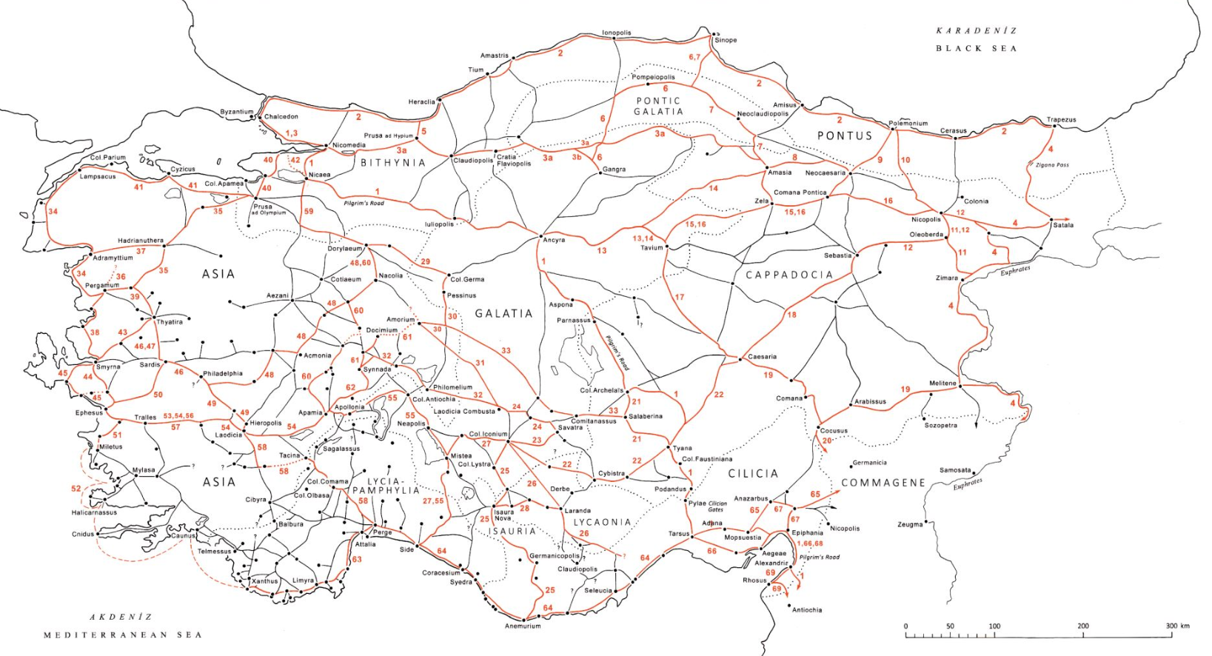
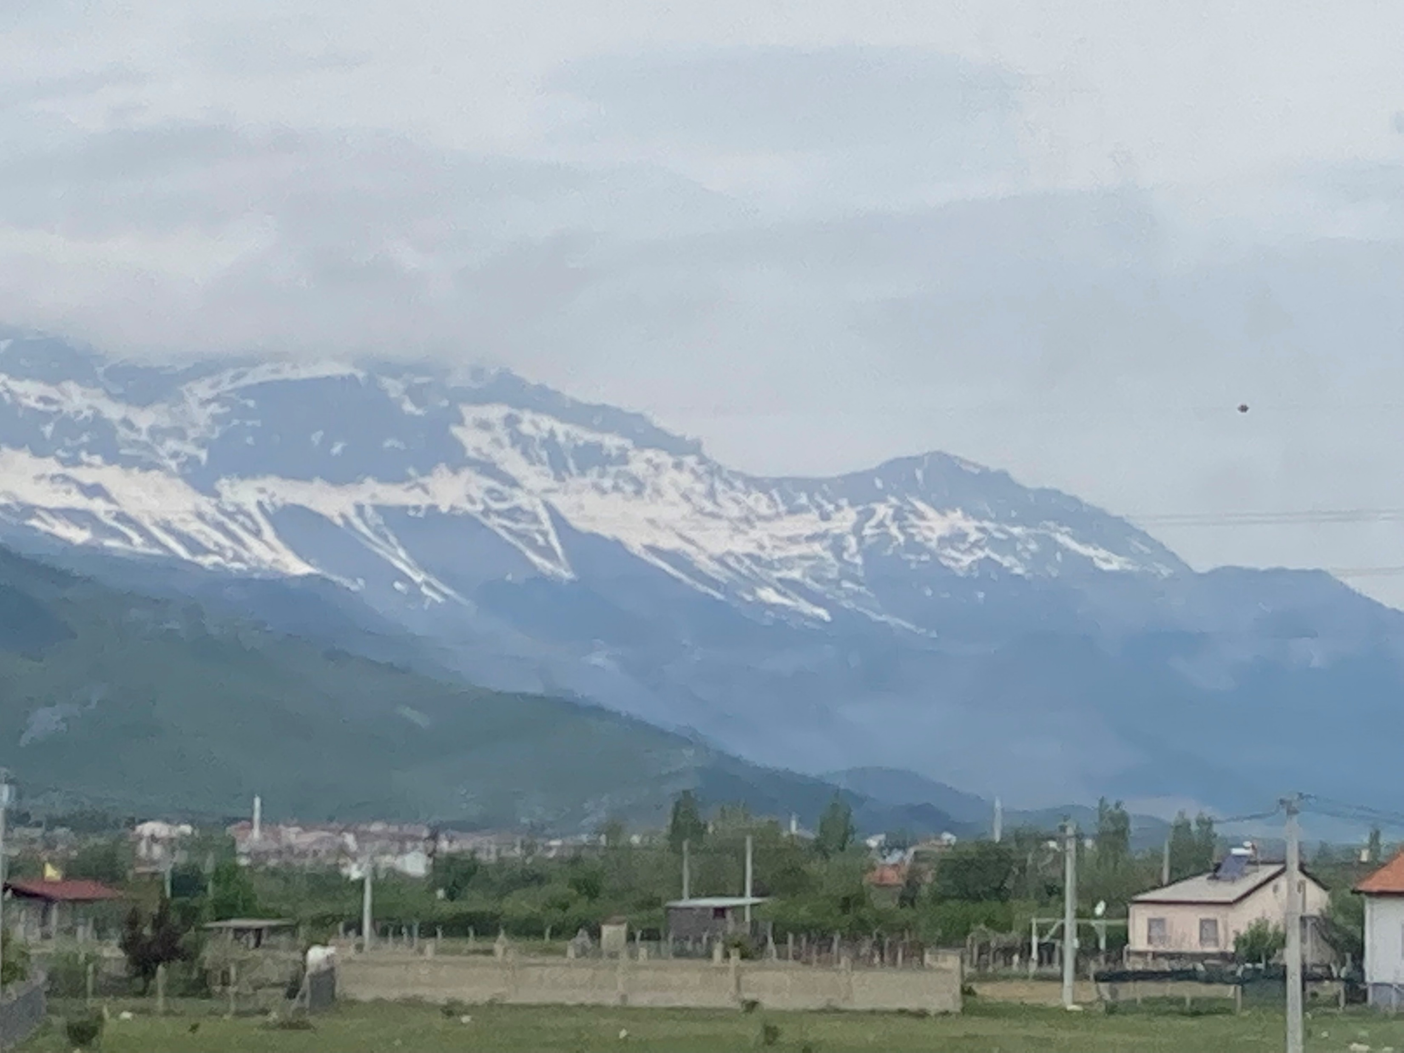

Slide 5
Three Hostile Verbs in Acts 14:2
ἀπειθήσαντες
ἐπήγειραν
ἐκάκωσαν
Literally “those who didn’t obey”
Literally “they raised up” as rapid movement, so “stirred”
Literally, “they made them evil” so “poisoned their minds”

Slide 6
A Cautionary Tale
Once there is disobedience,
Trouble is stirred up as a deflection
It doesn’t have to be based on the actual disobedience
Sin is not a solitary activity
Dissension disrupts and poisons the mind

Slide 7
Speaking BOLDLY Despite Opposition
“In this instance in Iconium, and in many another, there are signs that the work of the Lord was done in spite of circumstances. Sometimes a [person] makes [their] most lasting impression under circumstances which seem to be completely unfavorable.”
[Ferris, Theodore P., “Exposition, Acts of the Apostles” in Buttrick, G. A., The Interpreter’s Bible: Volume 9: Acts-Romans (Nashville, TN: Abingdon Press, 1984), p. 185.]

Slide 8
Traditional—Not Necessarily Biblical

Slide 9
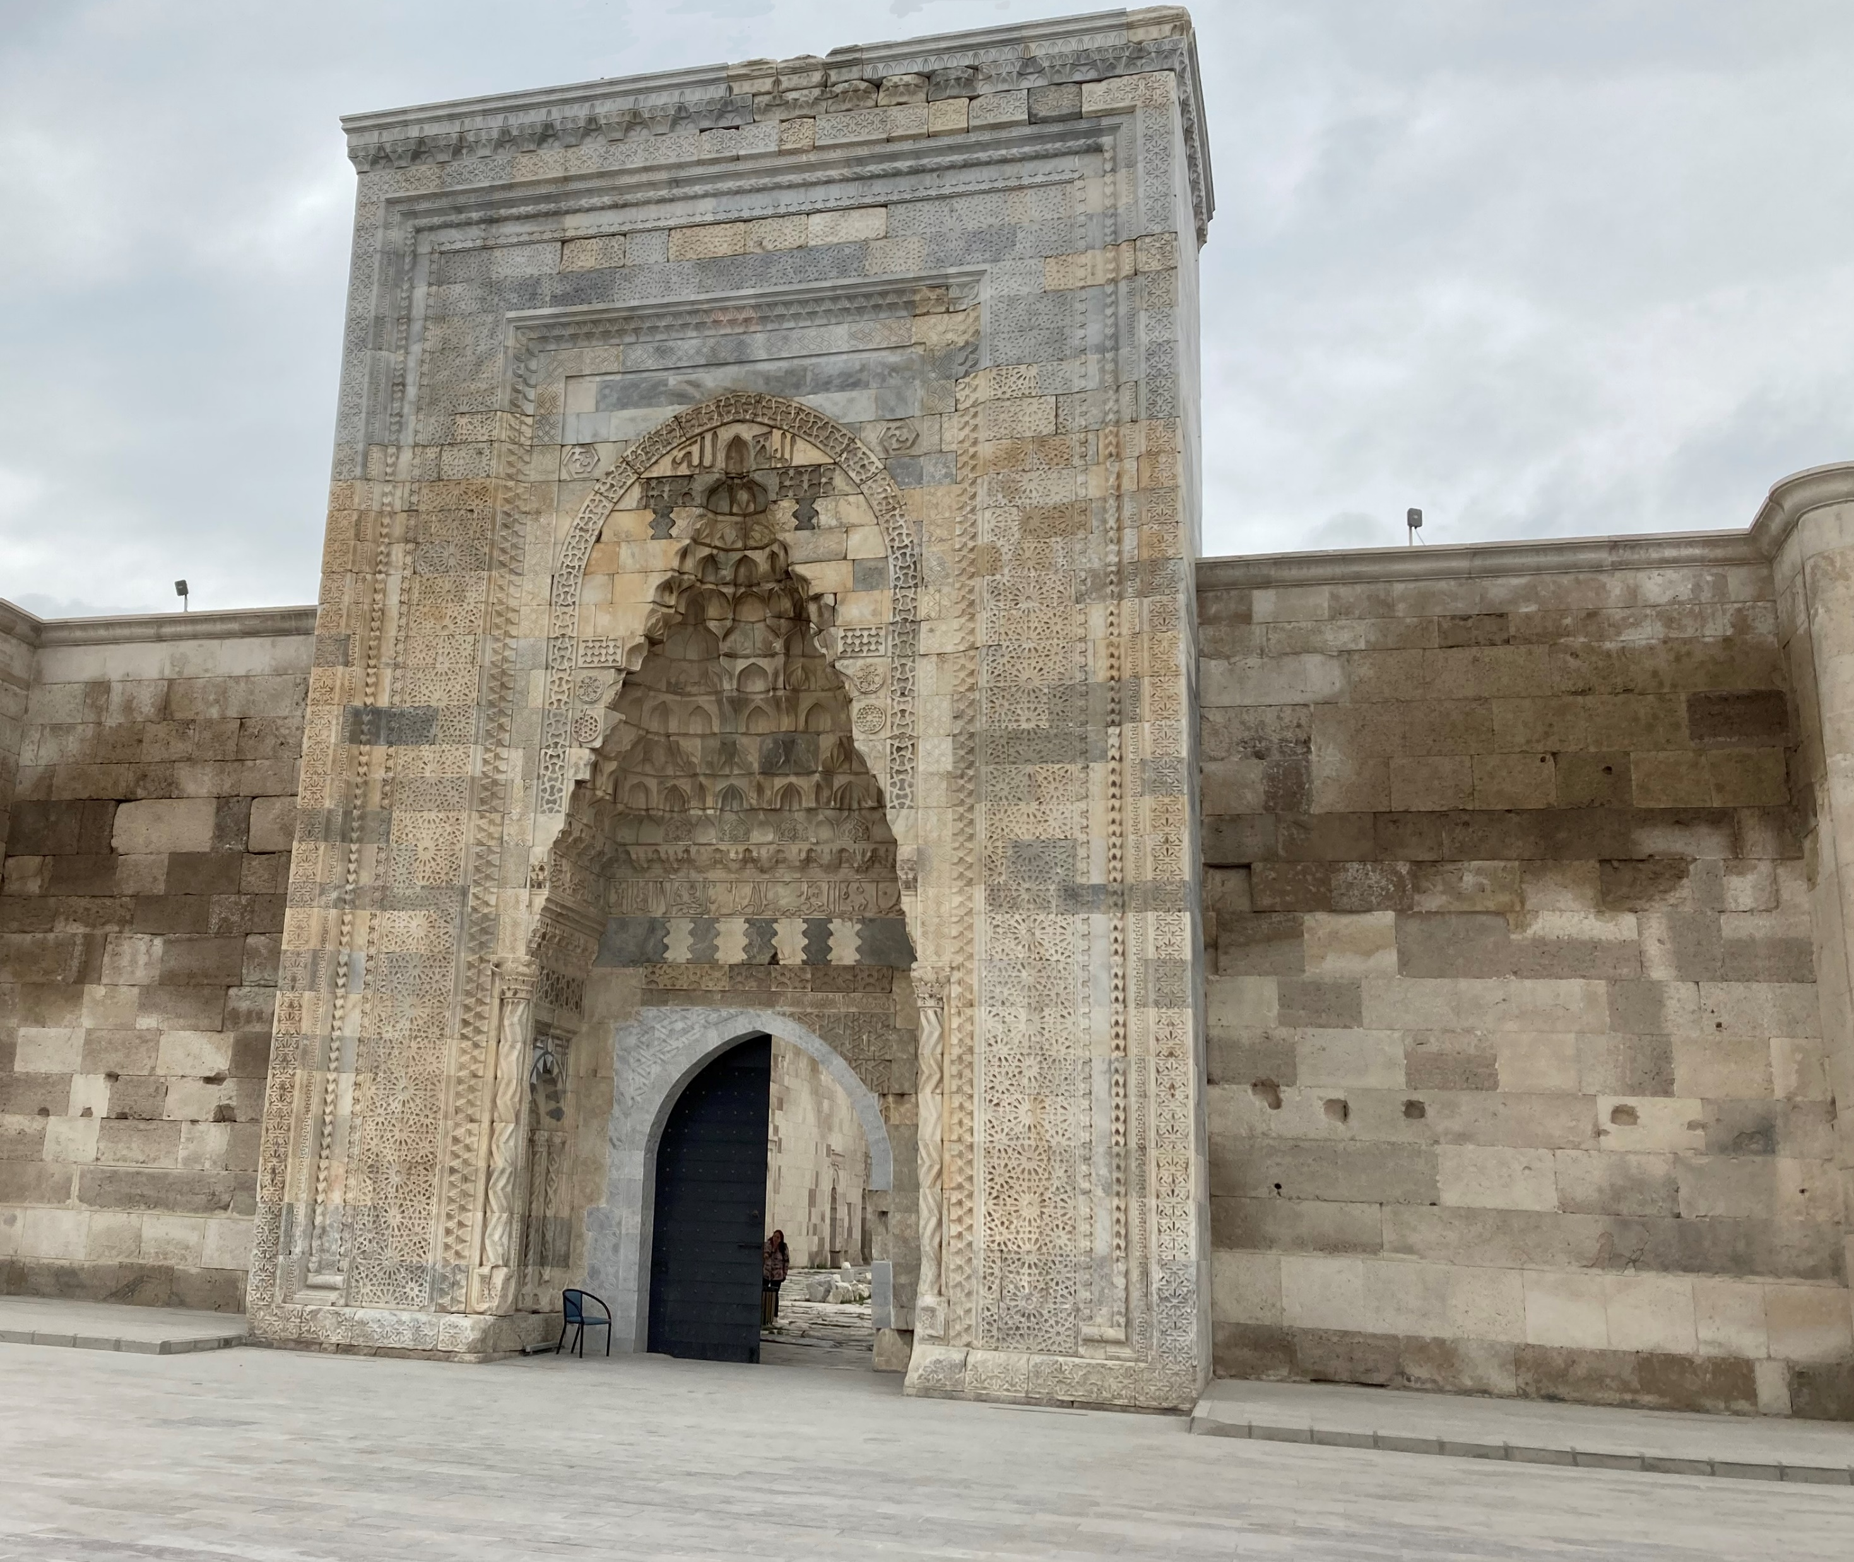

Slide 10
The Miracle at Lystra (and Aftermath)

Slide 11
The Stoning of Paul at Lystra

Slide 12
The Ugly Pattern of Persecution in Acts
Lystra (14:8-20)
Thessalonica (17:1-10a)
Beroea (17:10b-14)
Corinth (18:1-18)
Ephesus (19:8-10)

Slide 14
Paul’s Usual Practice
Revisit the churches to encourage and strengthen (and/or provide correspondence)
Provide for local church leadership, even as v. 23 is the first reference to elders/presbyters as an office in Acts
Joined in prayer and fasting as part of the commissioning process for these new elders
Preaching wherever possible
Reporting back (as at Antioch)

Slide 15
Spending Time in Perga and Attalia

Slide 16
Acts 15:1-2 / Dissension
Must be circumcised and accept Mosaic law to be saved (v. 10
CURS = κύνας
CORRUPTORS = κακοὺς
CASTRATORS = κατατομήν

Slide 17
Why Phoenicia and Samaria (v. 3)?
Phoenicians were non-Israelite (modern Lebanon)
Samaritans were “half-breeds” (only partially Israelite) who intermarried during the Exile
Remember that good Jews would rather go through Perea (now Jordan) to get to Galilee than through Samaria

Slide 18
Jerusalem Council

Slide 19
The Compromise Building on Noah
Avoid idolatry
Practice chastity
Avoid strangled meat
Meat with blood

