Slide 1
Preparing to Teach Acts 9-10
Grace Chinese Christian Church Workshop for Sunday School Teachers

Slide 2
NOTE: Luke Uses Cinematic Cuts
Philip in Samaria is balanced by Peter/John in Samaria
Philip 1) evangelizes the eunuch and 2) evangelizes through all the cities to Caesarea
Saul is 1) confronted/converted and 2) discipled
Peter performs miracles in 1) Lydda and 2) Joppa
God gives vision to 1) centurion and then, 2) Peter
Peter preaches in Caesarea and Holy Spirit to Gentiles

Slide 3
From Acts 8 - 9
8:26 Philip leaves Samaria to Gaza via Jerusalem
After baptism, Holy Spirit takes Philip away (v. 39)
Philip preaches in Azotes and all cities until (v. 40)
Philip comes to Caesarea (v. 40)

Slide 4
1) But Saul, still breathing threatening and slaughter toward the disciples of the Lord, came before the High Priest, [PJT]

Slide 5
Year | High Priests | Emperors | Governors | Key Relationship?
6 | Annas (Ananias) | Tiberias | Quirinius
15 | Ismael |  | Valorius Gratus
16 | Eleazar |  |  | son of Annas
17 | Simon |  |  | son of Annas
26 | Joseph (Caiaphas) |  | Pontius Pilate | Annas’ son-in-law
35 | Jonathan |  | Vitellius | son of Annas
37 | Theophilus | Caligula |  | son of Annas

Slide 6
2) he asked for himself, letters to the synagogues in Damascus, in order that if he would find anyone of the Way there, men or women, he might bring them bound helplessly to Jerusalem. [PJT]
Julius Caesar gave title of ethnarch to Hyrcanus II, giving authority over Jews all over the world
Over 100 years later, that authority was never canceled!

Slide 7
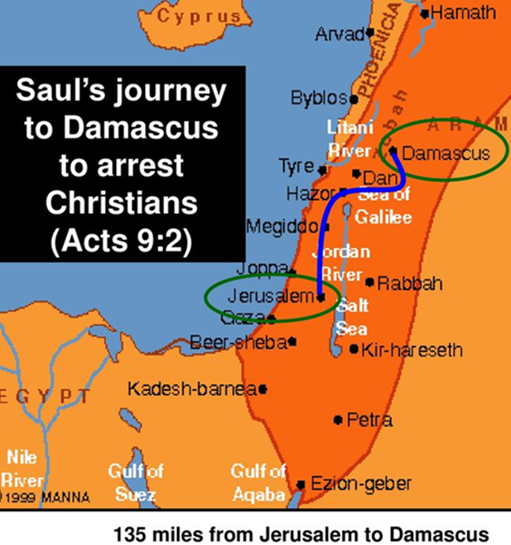
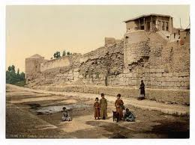
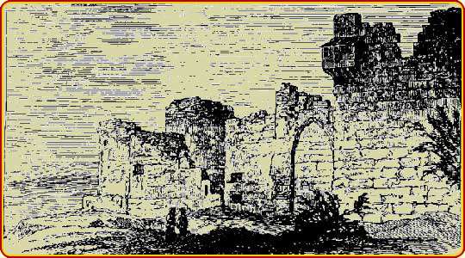
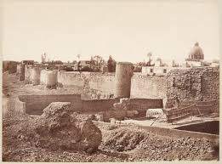
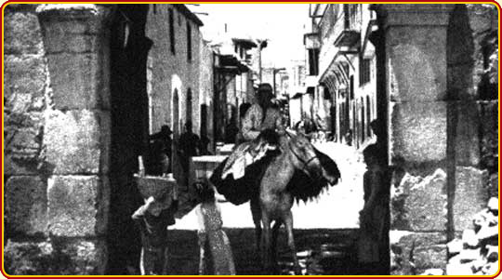
INHABITED SINCE 8000 BC
ROMAN GENERAL POMPEY, CLAIMED IT FOR THE ROMAN EMPIRE IN 65 BC
HAD A LARGE JEWISH POPULATION
CITY WALL HAD 7 GATES
150 miles from Jerusalem to Damascus

Slide 8
“The Way”
Even Jesus’ opponents knew He taught the Way of God (Matthew 22:16; Mark 12:14; Luke 20:21)
Greek translation of Hebrew חלכה or “walk”
Reference to the “way of the Lord” in Isaiah 40:3?
6x in Acts, it seems equivalent to the church (9:2; 19:9, 23; 22:4; 24: 14, 22)
Mostly hostile to the Way
“way of salvation” 16:17
“Way of the Lord” 18:25

Slide 9
3) Then, he was traveling and coming near to Damascus, suddenly a light from heaven flashed around him, [PJT]

Slide 10
Three Conversion Accounts
Acts 9 | Acts 22 | Acts 26
nearing Damascus (v. 3) | nearing Damascus (v. 6) | traveling to Damascus (v. 12)
high priest's letters to synagogues (v. 2) |  | commission from high priests (v. 13)
sudden light flashing from heaven (v. 3) | brilliant light flashed from heaven (v. 6) | dazzling light from heaven (v. 13)
dropped to the ground (v. 4) | dropped to the earth (v. 7) | all of us dropped to the earth (v. 14)
he heard a voice (v. 4) | I heard a voice (v. 7) | I heard a voice in Hebrew (v. 14)
"Saul, Saul, why do you persecute me?" (v. 4) | "Saul, Saul why do you persecute me?" (v. 7) | "Saul, Saul why do you persecute me?" (v. 14)
 |  | "it is hard for you to kick against the goad" (v. 14)
"Who are you, Lord?" (v. 5) | "Who are you, Lord?" (v. 8) | "Who are you, Lord?" (v. 15)
"I am Jesus you are persecuting" (v. 6) | "I am Jesus the Nazarene you are persecuting" (v. 8) | "I am Jesus you are persecuting" (v. 15)
companions heard voice, saw no one (v. 7) | companions saw light, heard no voice (v. 9)
Go to the city for directions (v. 6) | Go to Damascus for directions (v. 10) | Get up, stand, you're commissioned (v. 16)
could see nothing for 3 days (v. 9) | could not see because of dazzling light (v. 11)

Slide 11
Emphasis Established By Conversation

Slide 12
4) And he fell on the earth, hearing a voice saying to him, “Saul, Saul, why are you persecuting me?” [PJT]

Slide 13
Five Elements in the First Dialogue
Use of the name Saulos, repeated twice;
Present tense of persecution shows Saul is not voluntarily submitting on the ground [Note the use of first-person “Me” reflects equivalence between Jesus and “the Way”—the church;
Use of “Lord” in the context of theophany means the question was directed at OT Yahweh whether Yahweh or the “angel of the Lord”;
use of the name “Jesus” underlines the identity of Jesus, who speaks from the reality of God’s heavenly light, alive and active as risen, exalted Son of God (cf. Gal 1:16), intervening vs. Saul;
Jesus tells Saul to go to Damascus and wait for instructions!

Slide 15
Ananias Called to Disciple (9:10-19)

Slide 16
Five Aspects of Ananias’ Vision & Speech
Ananias recognizes Jesus and responds positively
Ananias is told to go to Saul and restore his sight (at a specific address in a well-to-do neighborhood, the street called Straight! –also known as the Street of Bazaars)

Slide 17
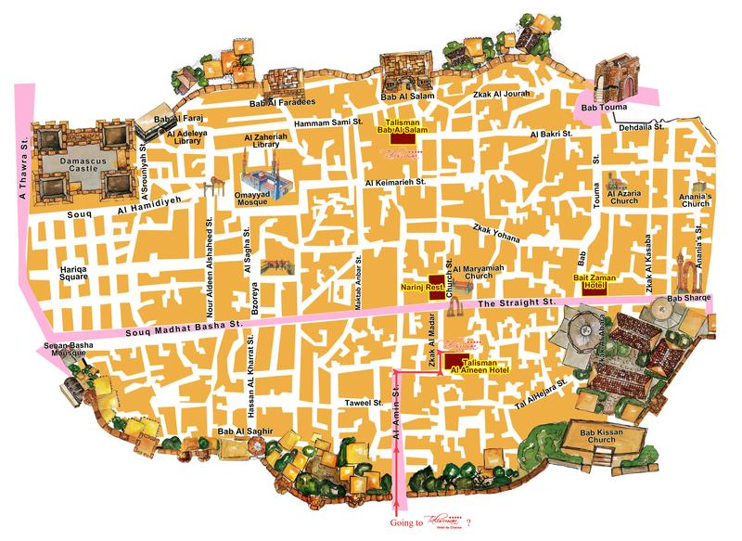

Slide 18
Five Aspects of Ananias’ Vision & Speech
Ananias recognizes Jesus and responds positively
Ananias is told to go to Saul and restore his sight (at a specific address in a well-to-do neighborhood)
Ananias objects to the commission
Fourth, Ananias calls the followers of Jesus “those who call upon your name,” people calling Jesus’ name in prayer.
Jesus responds that Saul/Paul is a “chosen vessel”

Slide 19
WE ARE SAVED FOR A PURPOSE (IT IS NOT JUST FIRE INSURANCE)
NON-JEWS
CAESAR, ROMAN AND JEWISH AUTHORITIES
JEWS

Slide 20
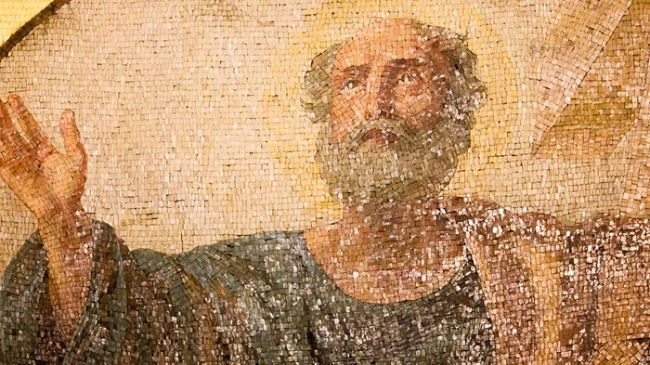
SAUL, From PERSECUTER to PREACHER

Slide 21
Peter’s Purpose

Slide 22
Joppa - Caesarea

Slide 23
The Scenes Found in Chapter 10
The vision of Cornelius (10:1–8)
The vision of Peter (10:9–16)
The messengers of Cornelius and Peter (10:17–23b)
The encounter of Peter and Cornelius (10:23c–33)
Peter’s sermon (10:34–43)
The conversion of the first Gentiles (10:44–48)

Slide 24
Responsibilities in Caesarea

Slide 25
Wealth in Caesarea

Slide 26
Peter’s Dream

Slide 27
Peter and Cornelius

Slide 28
The Significance of This Chapter!

