Slide 1
Preparing to Teach the Book of Hebrews I
Grace Chinese Christian Church
Skokie, IL

Slide 2
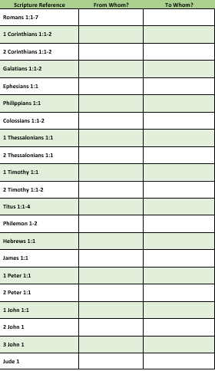
People Learn By Doing So, Let’s “Simulate”
An Exercise
Give each student physically
attending a sheet like this
Cut up one of the sheets into “fortune cookie”-sized strips” with just the scripture references
Have students draw one or more and look up the references to determine the sender (if stated) and the addressee (if stated)
Go verse-by-verse and get answers

Slide 3
What Is the First Difference Between Hebrews and the Letters in the Bible (and Ancient World)?
Let’s look at other letters in the Bible
From Paul (Romans 1:1, 1 Corinthians 1:1, 2 Corinthians 1:1,
Galatians 1:1, Ephesians 1:1, 1 Timothy 1:1, 2 Timothy 1:1, Titus 1:1,
Philemon 1) From Paul and Timothy (Philippians 1:1, Colossians 1:1)
From Paul, Silvanus (Silas), and Timothy (1 and 2 Thessalonians 1:1@)
From James (James 1:1)
From Peter (1 Peter 1:1), From Simon Peter (2 Peter 1:1)
From the Elder (2 John 1, 3 John 1)
From Jude (Jude 1)

Slide 4
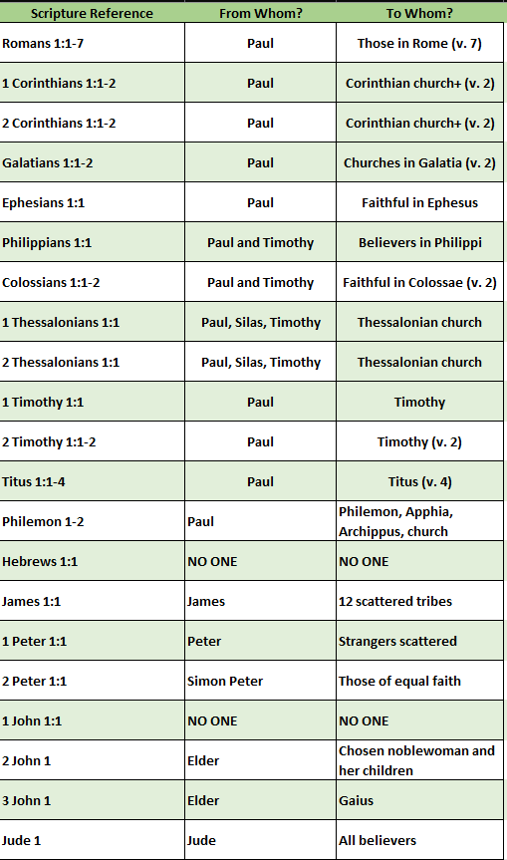
And Another Obvious Difference Between
Hebrews and Paul’s Letters
Romans 1:7 (all those in Rome)
1 and 2 Corinthians 1:1-2 (Corinthian church and more)
Galatians 1:1-2 (churches in Galatia)
Ephesians 1:1 (faithful in Ephesus), Philippians 1:1 (believers in Philippi)
Colossians 1:1-2 (faithful in Colossae)
1 and 2 Thessalonians (Thessalonian church)
1 Timothy 1:1 and 2 Timothy 1:1-2 (Timothy), Titus 1:1-4 (Titus)
Philemon 1-2 (Philemon, Apphia, Archippus, and the church)

Slide 5
What Difference Does It Make?
A letter has a more personal touch, suggestive that there is already a relationship or the sender would like a relationship
Even letters written to groups of people touched on personal concerns: announcements, defenses (apologies), news, plans,
requests, suggestions
Sermons or speeches are intended to influence those the speaker (or recorder of the sermon) may not know personally
Sermons or speeches are designed to address issues and convince
Sermons or speeches use rhetorical style and sound
Hebrews only features a farewell typical of a letter
Hebrews does sound a lot like a sermon

Slide 6
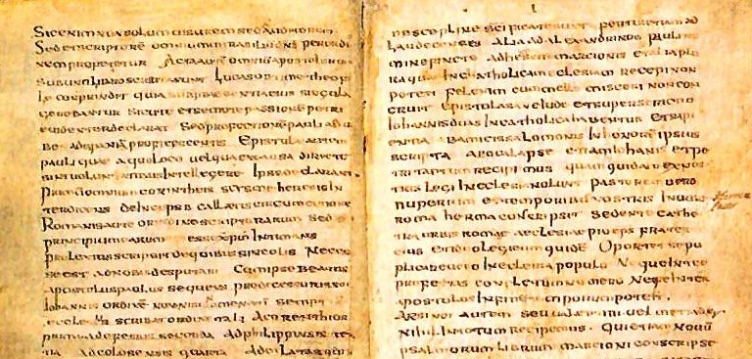
Does Authorship Matter?
“Doubts about Hebrews’ canonicity in the West were overcome when they were convinced it was the work of the apostle Paul.”
(Geisler, Norman. A Popular Survey of the New Testament (Grand Rapids, MI: Baker Books, 2007), p. 253)
Origen (3rd century) said the book sounded apostolic, but the Greek style too eloquent for Paul
It helps to know the author to assert credibility

Slide 7
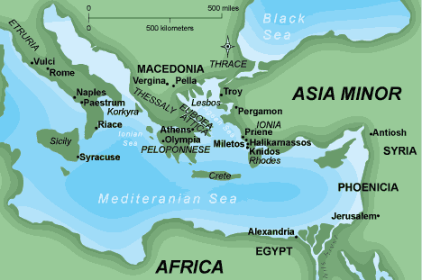
Pantaenus of Alexandria – A.D. 180

Slide 8
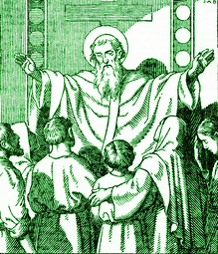
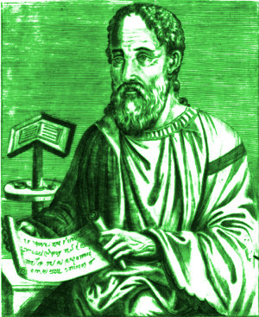
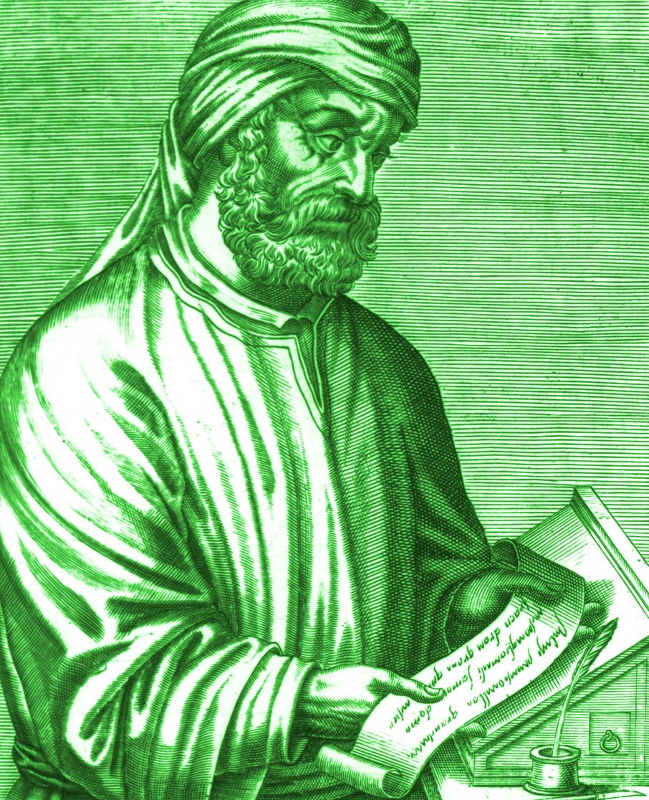
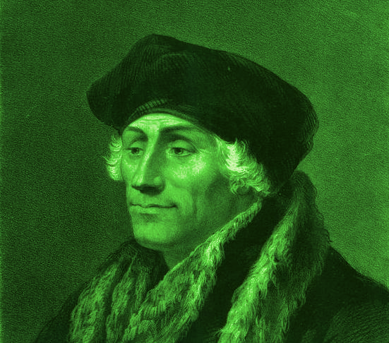
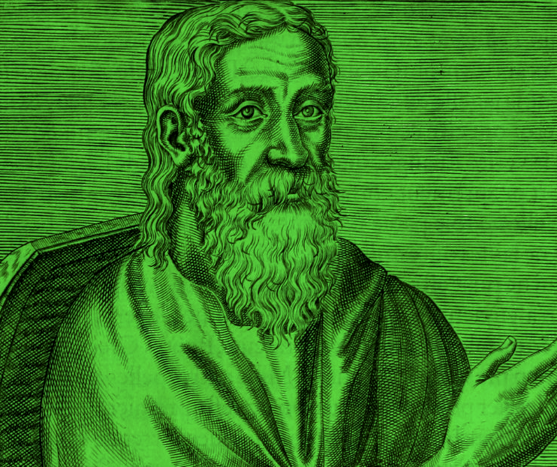
Historical Suggestions of Authorship
Clement of Alexandria, following Pantaenus his teacher, suggested Paul wrote in Hebrew (or Aramaic) and Luke translated to Greek
Tertullian (2nd-3rd century) believed that Barnabas wrote it
Irenaeus and Hippolytus (2nd century) and Origen (3rd) knew the book but denied that Paul wrote it
Eusebius (4th century) said some thought Clement of Rome and some thought Luke
Of Reformation leaders: Erasmus claimed Clement of Rome, Luther claimed Apollos, Calvin claimed Luke

Slide 9
But Do We Trust the Holy Spirit?
Why Paul not the likely author
Paul as Author?
Hebrews 13:22 “word of exhortation” used for sermon in Acts 13:15
20 titles for Jesus used without “in Christ” typical of Paul
Emphasis on priesthood here but no mention in Pauline work
Paul focuses on risen Christ
No emphasis on justification by faith
Hebrews appears as part of manuscript of 14 letters of Paul in late 4th century
Concluding verses 13:19-25 similar to Paul
Familiarity with Hebrew scriptures and building on them to glorify Jesus as Son of God
Desire to come and see the listeners personally

Slide 10
Who Was It Written To?
We don’t know for sure
“To The Hebrews” was added later because of all the details
on the Jewish law and the OT
It could have been written to Gentiles who didn’t know anything
about the Jewish faith and OT
It could have been written to Jewish Christians thinking of returning
to the “safer” Jewish faith because of persecution
Locations suggested: Samaria, Jerusalem, Antioch, Caesarea, Colossae, Ephesus, Alexandria, Qumran

Slide 11
So, Why is it in our Bibles?
It focuses on the superiority of God over all other options
It emphasizes relationship with God over ritual and doctrine
It deals with complacency regarding growing in God’s Truth
It emphasizes “hanging in there” despite persecution and the apparent delay in Christ’s coming
It warns against “religious drift” and complacency
It should be a spur to evangelism

Slide 12
Ways to Introduce the Book
What are some wrong ways that people think about Jesus?
Why do some people make fun of the idea that Jesus is
coming again?
What are some ways that Christians have a disadvantage in
worldly/secular society?
What are some reasons people leave the church, quit serving
in the church, or even claim to no longer believe in God?
What does Hebrews say about learning Bible and Theology?
What can we look at to encourage us in tough times?

Slide 13
But What’s It All About?
Here Are Some Ways to Look At It
Allegro – (1:1-4:13) vibrant, reasonably fast movement to capture attention and point to the rest / powerful first four verses, corrective to angelology, emphasis on salvation, emphasis on “hanging in there”
Andante – (4:14-6:12) slower pace with emotion / Jesus as great high priest, warning against immaturity and apostasy
Scherzo – (6:13-10:39) faster, but repetitive majestic pace / emphasis on God’s promises, Christ’s priestly role, warning vs. turning back
Presto – (11:1-13:19) dance-like reiteration of themes / roll call of faith/trust/faithfulness, applications of those examples
Coda – (13:20-25) Closing remarks with a challenge as stinger

Slide 14
Pheme Perkins (Boston College)
Prologue: God has spoken most eloquently in Son (1:1-4)
The Son’s superiority over the angels (1:5-14)
Exhortation: Don’t drift away from such a salvation (2:1-4)
Jesus’ suffering brings humanity to salvation (2:5-18)
Jesus is greater than Moses (3:1-6)
Exhortation: Don’t fall away like Israel in wilderness (3:7-4:13)
Jesus is the sympathetic high priest (4:4-5:10)
Exhortation: Do not be immature in faith (5:11-6:12)

Slide 15
Pheme Perkins’ Exhortation Outline (cont.)
God’s promises are confirmed by an oath (6:13-20)
Jesus is a high priest in the order of Melchizedek (7:1-10:18)
a) Melchizedek represents higher than Levitical priests (7:1-28)
b) Christ’s heavenly sanctuary is better covenant (8:1-13)
c) Christ’s sacrifice makes all sacrifices redundant (9:1-22)
d) Christ’s sacrifice has once-for-all effect (9:23-10:18)
Exhortation: Hold fast to your faith because there is no sacrifice for turning away from Christ (10:19-39)
Heroes of faith grasp the reality of heavenly things (11:1-40)
Exhortation: Persevere following Christ and others (12:1-13:19)
Letter-like closing (13:20-25)

Slide 16
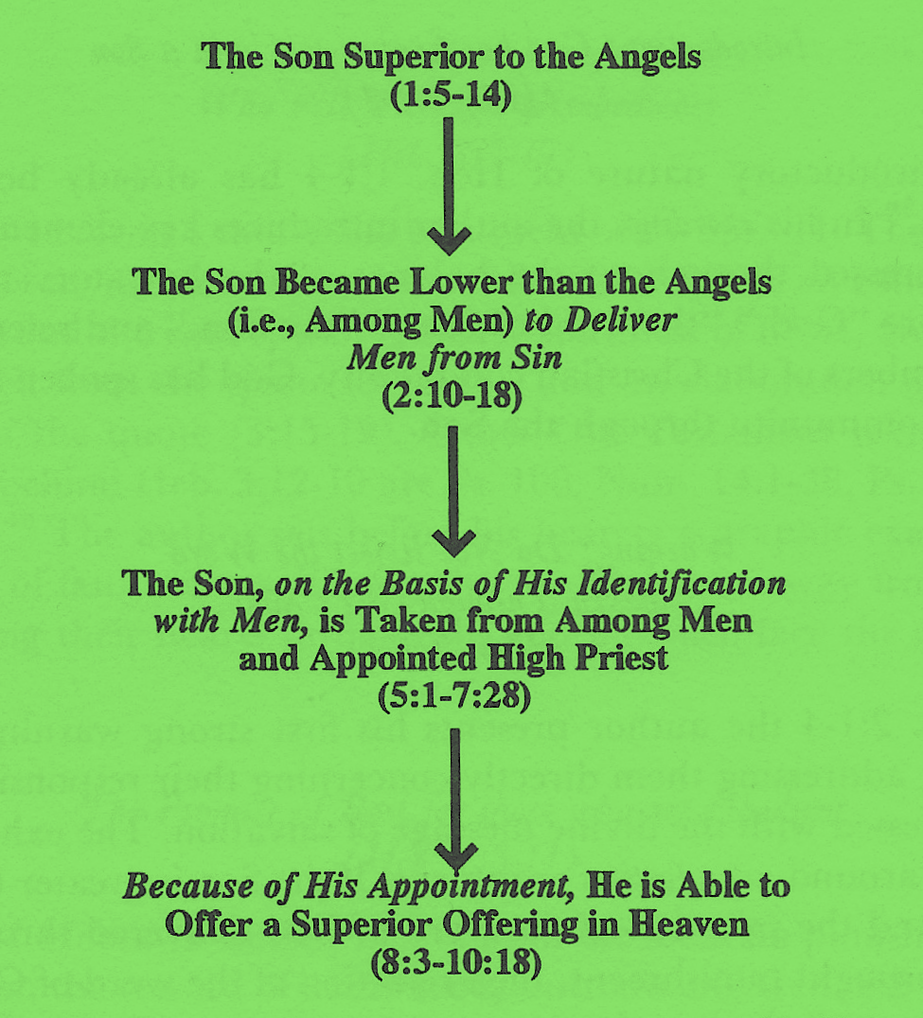
George Guthrie (Union University)

Slide 17
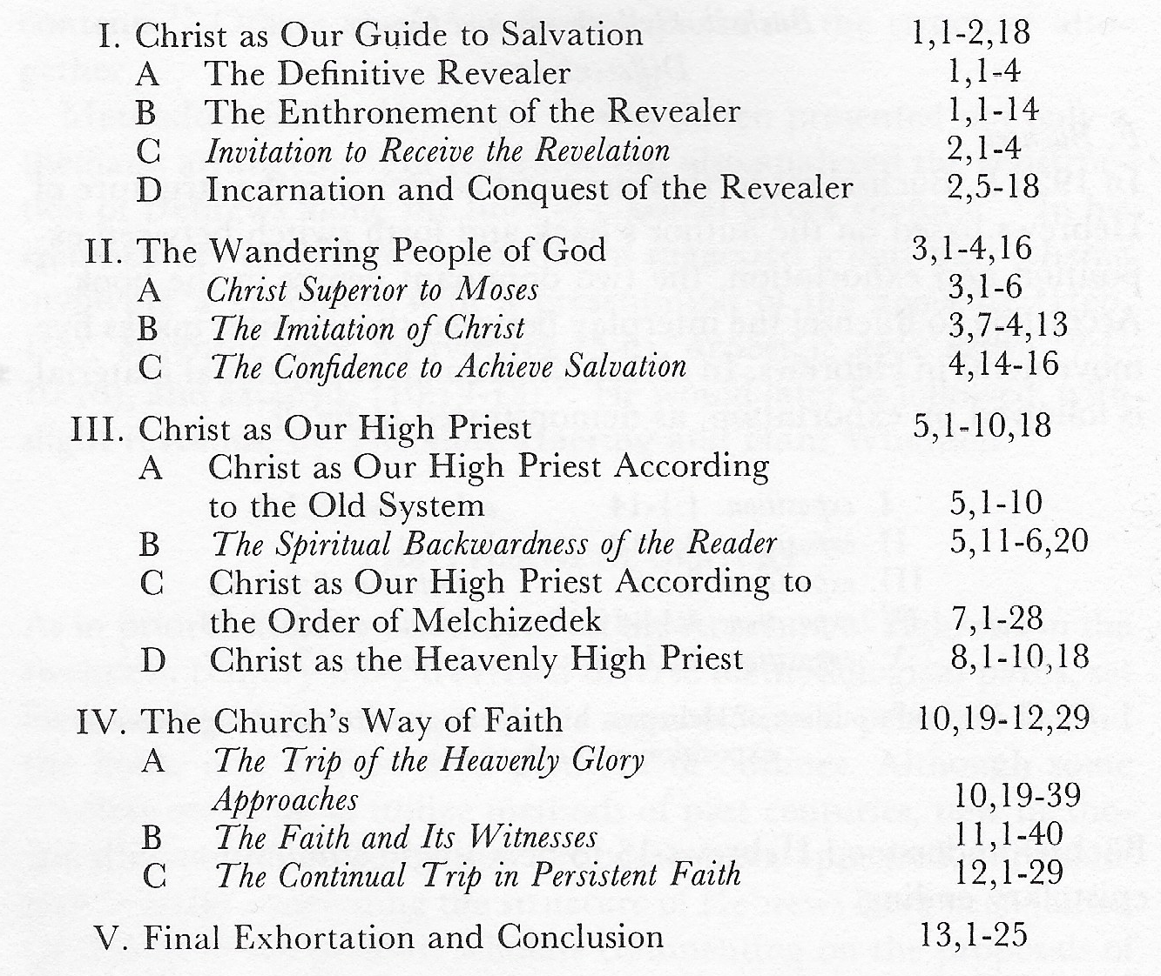
Rafael Gyllenberg (Abo University, Finland)

Slide 18
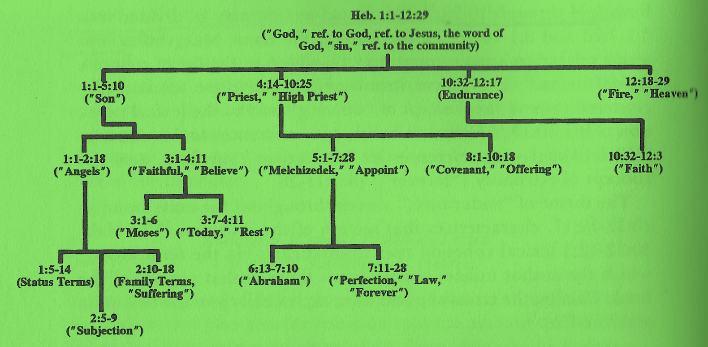
Guthrie’s Catchword Connections

Slide 19
Better Than κρεῖσσον 20x in New Testament 13x Here!
1:4 = Jesus better than the angels
6:9 = Faithful better than the apostate
7:7 = One blessing better than the one being blessed
7:19 = God has offered a better hope than the Law
7:22 = Jesus’ covenant better than the old
8:6 = Jesus’ ministry better than Levitical priests
8:6 = Jesus’ covenant better than theirs
9:23 = Heavenly matters require sacrifices better than the old

Slide 20
Better Than (continued) κρεῖσσον 20x in New Testament 13x Here!
10:34 = Believers possessions better and more lasting than Israel’s
11:16 = Heaven is a better country than Israel
11:35 = Resurrection is better than earthly life
11:40 = God’s plan is better than OT faith (for our benefit)
12:24 = Blood of Jesus is more eloquent [better than] the
blood of Abel

Slide 21
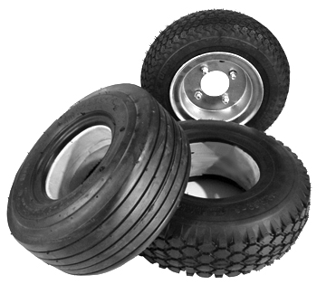
God’s Many Efforts
Πολυμερως = “pah-lee-meh-ROHS” and is the word from which we get the English word “polymer”
Polymers have
many components
(as in tire
compounds)

Slide 22

God’s Many Styles
Πολυτροπως = “poh-lee-TROH-pohs” and combines the prefix for “many” with the word from which we get the English word “trope”
A trope is one way
of saying, « figure
of speech »

Slide 23
Activity for Chapter 1
Give each student a blank paper and pen
Say that this is going to be a “race”
Ask them to list all of the Old Testament characters they
can think of to whom God talked (visions/dreams are okay)
Perhaps: Adam, Eve, Cain, Noah, Abraham, Jacob, Joseph,
Moses, Joshua, Elijah, Isaiah, Jeremiah, Ezekiel, etc.

Slide 24
Find the Old Testament Citations [Prophets?]
Verse 2 = Psalm 2:8
Verse 3 = Psalm 110:1
Verse 5 = Psalm 2:7
Verse 6 = Deuteronomy 32:43
Verse 7 = Psalm 104:4
Verses 8-9 = Psalm 45:6-7
Verses 10-12 = Psalm 102:25-27
Verse 13 = Psalm 110:1
Verse 14 = Psalm 34:7, 91:11

Slide 25
The Great Inheritance
Κληρονομον
Κεκληρονομηκεν
Heir to Everything (v. 2)
More Excellent Name He Inherited (v. 4)

Slide 26

The Author of Reality
αιωνας = “eye-OH-nahs” or “ee-OH-nahs”
In other words, there is nothing
we can experience that our
Lord doesn’t have a hand in!
From which we get the English word « eon »
Which could mean either « ages » or
« demigods » in Gnostic philosophy

Slide 27
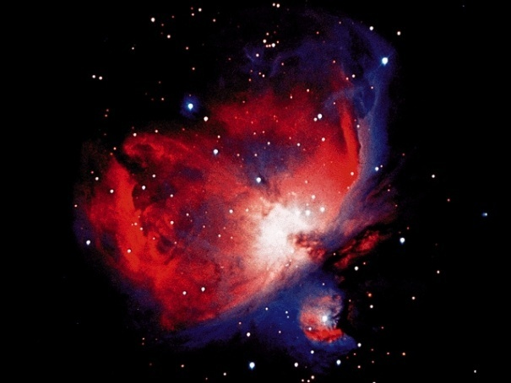
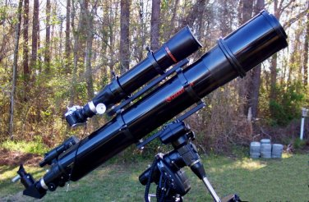
Divine Luminance
Just as humanity cannot
look directly at the “face
of God” and live…
Light Source
…we cannot usually look
directly into the source of
our light without having
some consequence.
We usually know light
by means of refraction
and reflection (as in
a telescope).
Jesus illuminates the essence of God in such a way that we can SEE God and yet LIVE!

Slide 28
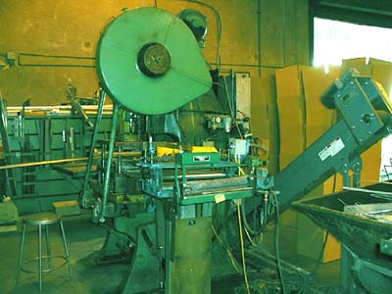
The “Plan” of God’s Essence
χαρακτηρ = “kah-rahk-TEER”
In other words, Jesus is the
model or template showing
how to be like God!
From which we get the English word
« character » and means either
verifiable likeness or model prototype

Slide 29
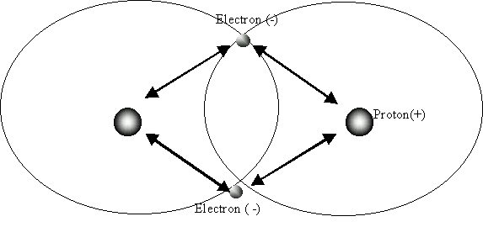
Bond of Being
He is the “bearer” of everything
[holding things together]
By means of His commands of Power
His instructions or commands
hold all of existence together
tighter than a covalent bond.

Slide 30
God’s Purifying Agent
Καθαρισμον = “kah-thah-rees-MOHN”
or “kah-tha-rihs-mahn”
Root of English word «catharization »
« Catharization » is the act of clearing
alien matter from an organic surface
A cardiac catharization uses a dye inserted through a leg vein and a radiograph to find where the biggest blockages are. A tiny cutting saw and a little vacuum remove the plaque and take it out of the body.
Sin is the « plaque » to be removed from our lives
Jesus is the « saw and vacuum »

Slide 31
Strong Right Hand
Right side was considered to be the favored side because
The left side was considered “sinister” (as witnessed by the Latin word)
So, the right side was a place of
honor, trust, and confidence
As a result, we see that the Father has ultimate confidence in the Son

Slide 32
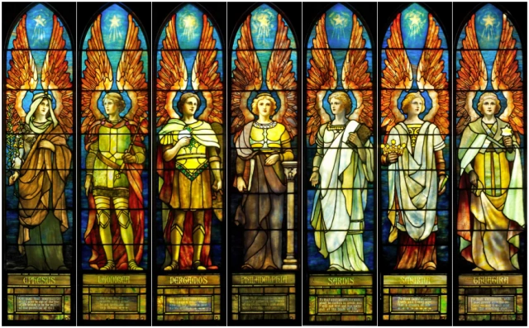
Why Better Than the Angels? “Sons of God?”
Uriel = God is my light
Raphael = God heals
Raguel = friend of God
Michael = Who is like God?
Saraqael = God is my Leader
Gabriel = God is strong
Remiel = God raises

