Slide 1
Preparing to Teach Hebrews VI Hebrews 10:24-11:22
Grace Chinese Christian Church of Skokie, IL

Slide 2
Look at the Transition from 10:19-25 to the shifts in 10:26-11:25!
10:19-25 = “Draw Near” and “Hold Fast”
10:26-31 = WARNING
10:32-39 = Positive Example from Hearers’ Past with Admonition to Endure to Receive Promise
11:1-25 = Positive Example of OT Faithful Guthrie, George, The Structure of Hebrews: A Text-Linguistic Analysis (Grand Rapids, MI: Baker Book House, 1994), p. 136.

Slide 3
The Positive Before the Negative
v. 22 = “draw near” [continued in 11:6]
v. 23 = “hold fast” [unwavering confession]
v. 24 = “motivate @ other” [to love and good works]
“…holding on to the ‘confession of hope’ must manifest itself in the visible witness of that hope, especially in terms of continued, open association with the ‘people of God,’ who live for that hope (as opposed to hiding or terminating those connections so as to escape the negative consequences of association with the name of Jesus (10:25, 37-39).” [DeSilva, David A. Perseverance in Gratitude: A Socio-Rhetorical Commentary on the Epistle to the Hebrews (Grand Rapids, MI: William B. Eerdmans, 2000], p. 341.]

Slide 4
The Positive Before the Negative
v. 22 = “draw near” [continued in 11:6]
v. 23 = “hold fast” [unwavering confession]
v. 24 = “motivate @ other” [to love and good works]
v. 25 = “meet”/ “encourage” [to encourage till THE day]

Slide 5
The Alternative: An Exodus of Rebellion
Unwilling vs. defiantly [“with a high hand” as in Numbers 15:30]
Present (continuous) tense
See verse 29 where one is “stomping all over the Son of God”
It is a deliberate blasphemy.
There is no cure!

Slide 6
Interpret This Sin in Its Context
“In the context of Hebrews, the most likely understanding of ‘deliberate sin’ is that it is the conscious, intentional, and permanent rejection of Christ. After all, there can be no salvation outside Christ. And it seems that the original readers of Hebrews were facing temptation to reject Christ in the face of persecution (10:32-36).” [Campbell, Constantine R. and Jonathan T. Pennington, Reading the New Testament as Christian Scripture: A Literary, Canonical, and Theological Survey (Grand Rapids, MI: Baker Academic, 2020), p. 319.]

Slide 7
A Word of Caution
“…anyone worried about committing the unforgivable sin or becoming apostate, hasn’t done so. Apostates are by definition hardened to God and arrogant to what He has said by the Son.” Jobes, Karen H., Letters to the Church: A Survey of Hebrews and the General Epistles (Grand Rapids, MI: Zondervan, 2011), p. 141.]

Slide 8
Verse 27 uses a personification of fire (echoing well with Isaiah 33:14’s frightening fire of judgment and that of Deuteronomy 32:22, as well as Revelation’s lake of fire
Rhetorical technique is to take something expected and make it “alive” to be more alarming
Death sentence in Moses’ Law (v. 28) required enough witnesses to collaborate, but apostates faced witness of Holy Spirit and the church
Modern illustration of “stomping all over Son of God” in Jan Valtin’s Out of the Night (1942)

Slide 9
Luke 16:21-31

Slide 10
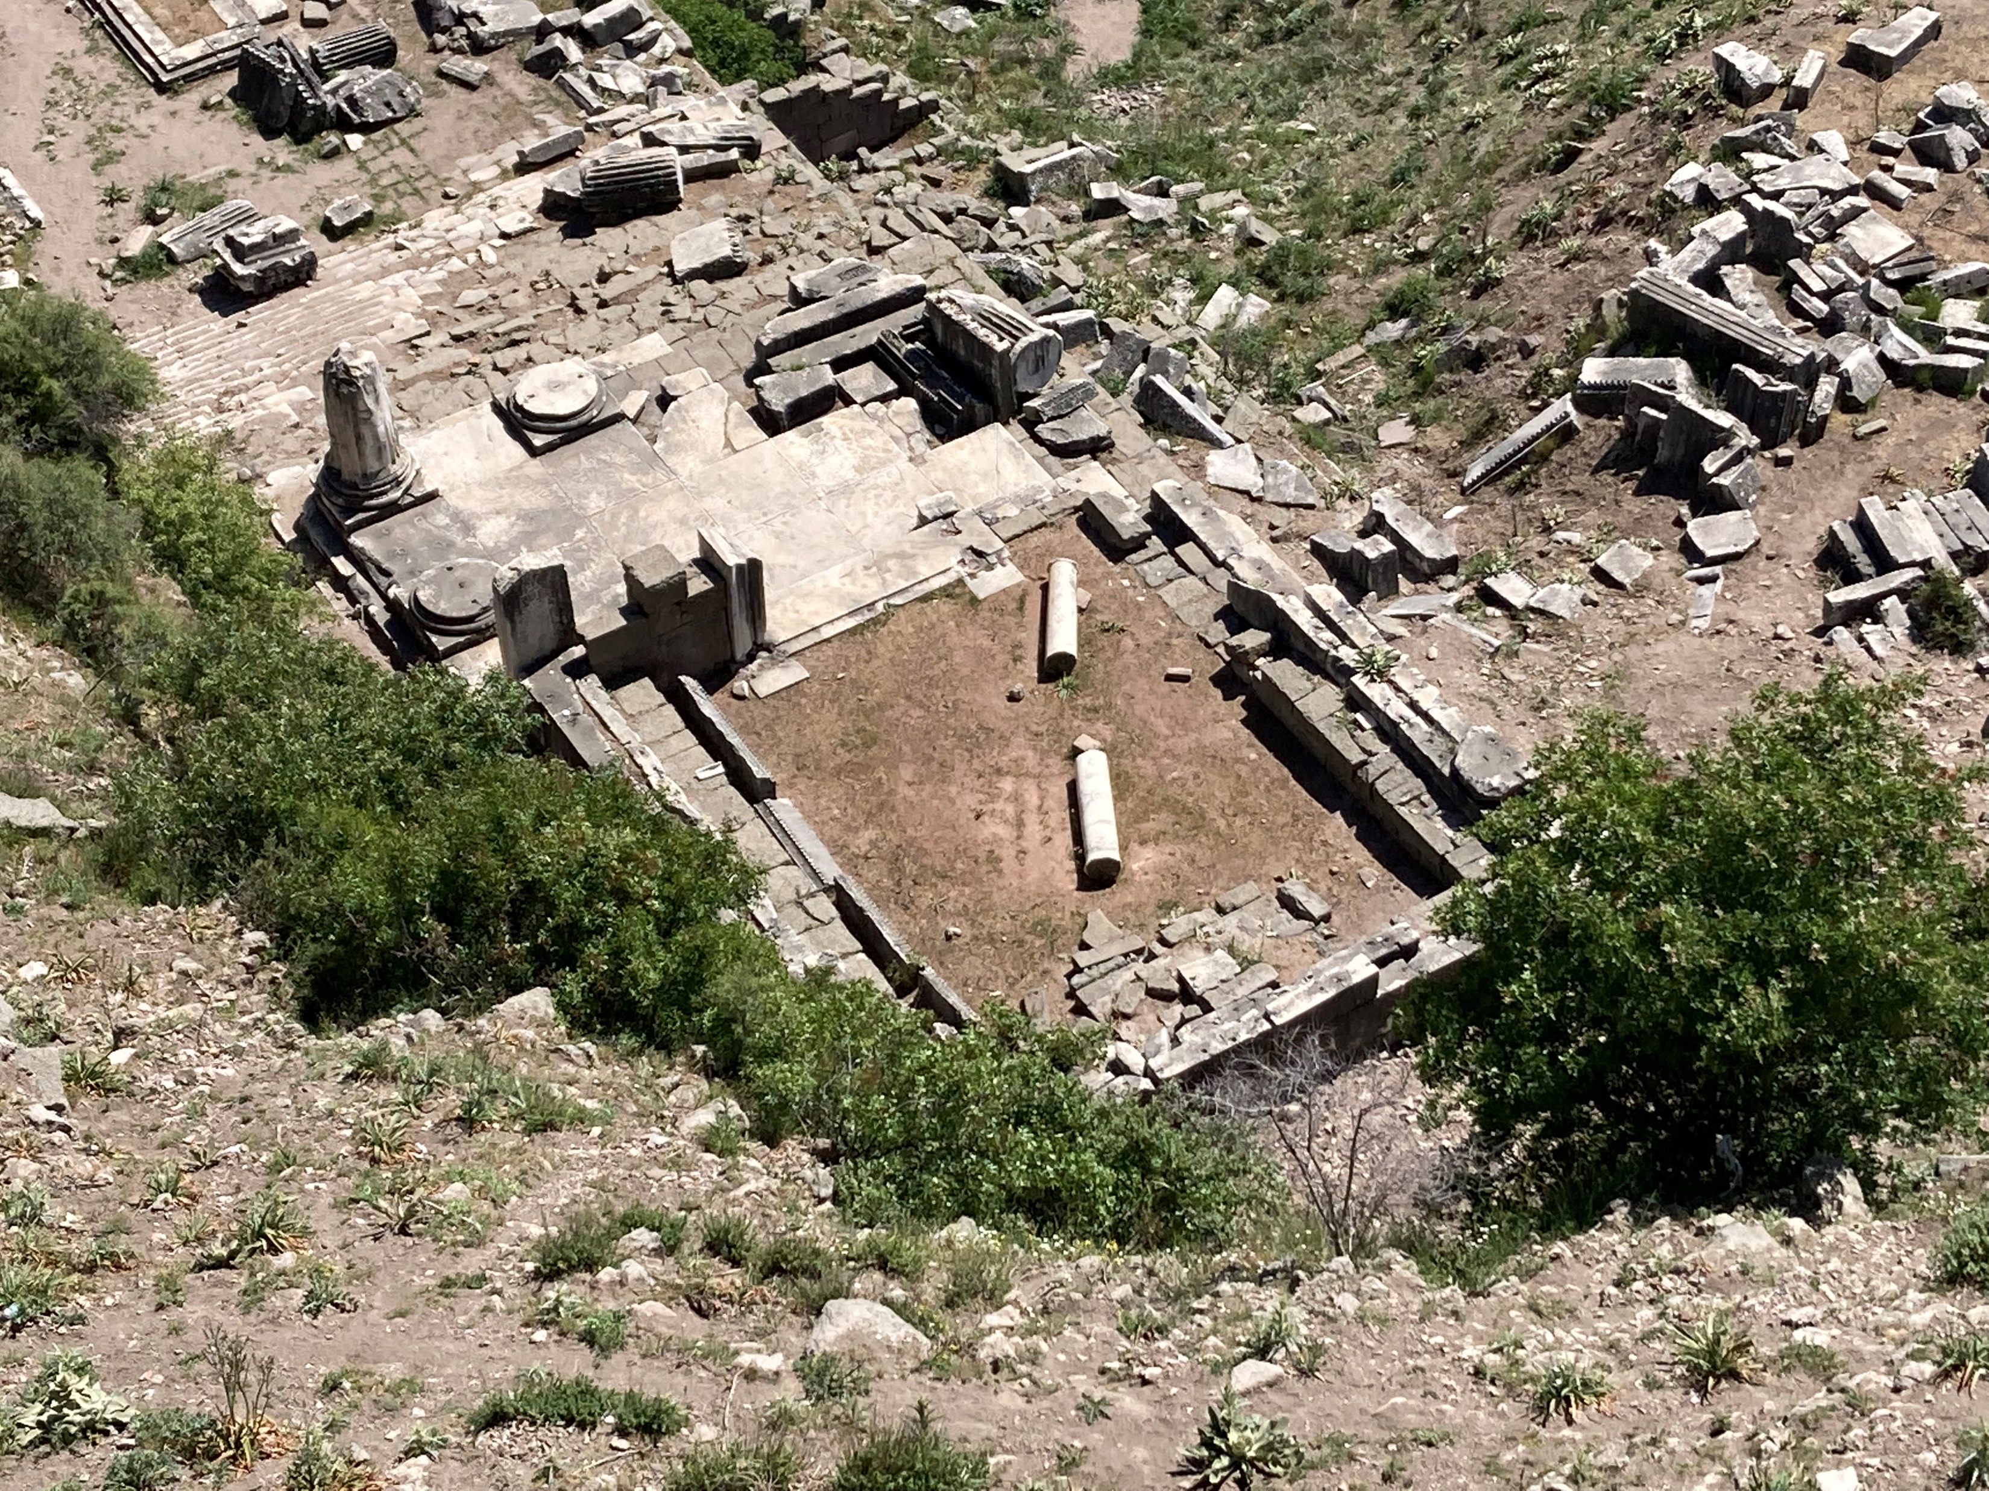
Positives in Hebrews 10:32-39
Stood ground under pressure (v. 32)
Insulted and abused (v. 33) (Verb has the word theater in it for public spectacle)

Slide 11
5 Positives in Hebrews 10:32-39
Stood ground under pressure (v. 32)
Insulted and abused (v. 33)
Fellow-sufferers with other victims (v. 33)
Showed sympathy for prisoners (v. 34)
Didn’t panic when wealth confiscated (v. 34) (because trusted God’s promises more)

Slide 12
Quoting Habakkuk 2:3-4 in Hebrews 10:37-38

Slide 13
Verse 39
“The thought of the text is substantially this—those who believe win their souls; they acquire them for their possession. We talk colloquially about ‘people that cannot call their souls their own.’ That is a very true description of all men who are not lords of themselves through faith in Jesus Christ. ‘They who believe to the gaining of their own souls’ is the meaning of the writer here.”
[Maclaren, Alexander, Expositions of Holy Scripture: Volume XV: Second Timothy, Titus, Philemon and Hebrews, Epistle of James (Grand Rapids, MI: William B. Eerdmans, 1942), p. 99.]

Slide 14
Faith IS Substance (Hebrews 11:1)
“The very first thing we must learn about faith is that it is substance. Faith is not glorified imagination and faith is not some cloudy, ephemeral experience. Faith is reality. 'Our text, says , 'Faith is the substance…’" Pastor Johnny
“Faith enables the believing soul to treat the future as present and the invisible as visible.” Manley Beasley
“Faith is believing something that is not yet so to be so in order that it may become so.” George Bradley

Slide 15
So, How Is Faith PURE?

Slide 16
Faith is Evidence
Fides est habitus mentis, quo inchoatur vita eterna in nobis, faciens intellectum assentire non apparentibus. – Aquinas “Faith is a mental attitude, by which eternal life begins in us, making the intellect agree with what isn’t apparent.”

Slide 17
Verse 3 – Creation from the Invisible

Slide 18
Faith and Sacrifices (v. 4)

Slide 19
Enoch Walking with God (vv. 5-6)
Example of living
Pleased God by faith
Impossible to please God without faith
Faith in His being (v. 6)
Faith in His benevolence (v. 6)

Slide 20
Partnering with God (v. 7)
Involved awe (fear?)
Accomplished for family
Critiqued world
Became an heir of righteousness by faith

Slide 21
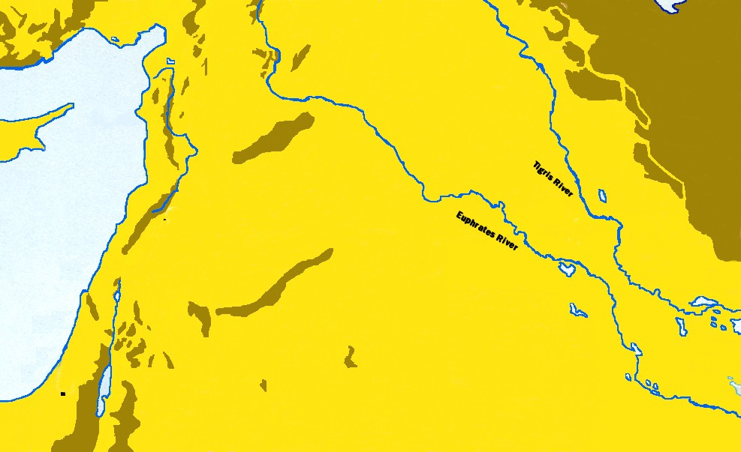
HARAN
DAMASCUS
UR
Leaving the FAMILIAR, the COMFORTABLE

Slide 22
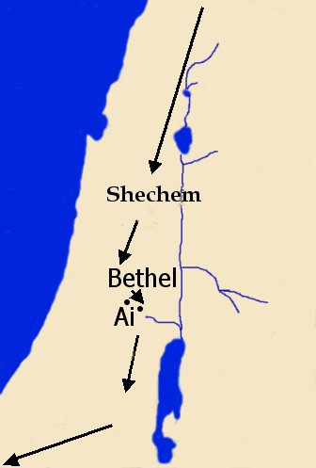
Abram camped near the sacred tree, BUT builds an altar in the midst of those his “seed” will conquer!
Abram camped between Bethel (“House of God”) and Ai (“Ruin”), builds an altar in the middle where God’s people always live!
Notice the missing altars when he leaves the land of promise!
Faithful in Worship!

Slide 23
IRONY OF SUCCESS (13:6)
“But the land could not support them while they stayed together, for their possessions were so great that they were not able to stay together.” Genesis 13:6 NIV

Slide 24
Abram’s Faith Journey

Slide 25
Jacob and Joseph

