Slide 1
Preparing to Teach Hebrews X
Hebrews 12-13

Slide 2
Adapted in Jobes, Karen H., Letters to the Church: A Survey of Hebrews and the General Epistles (Grand Rapids, MI: Zondervan Academic Publishing, 2011), p. 127, from Westfall, Cynthia Long, A Discourse Analysis of the Letter to the Hebrews: The Relationship between Form and Meaning, Library of New Testament Studies 297, Studies in New Testament Greek (London: T&T Clark, 2005), p. 298.
Let's Hold On | Let's Draw Near | Let's Go Forward
Pay closer attention to what we've heard (2:1) | Approach the throne of grace for mercy and help (4:16) | Be anxious so no one fails to reach the Sabbath rest (4:1)
Hold tight to our confession [of Jesus as Lord] (4:14) | Approach "Holy of Holies" cleansed and ready (10:22) | Be active toward reaching that rest and don't disobey (4:11)
Hold tight to our faith because of His reliability (10:23) | Worship/serve God with awe and gratitude (12:28) | Move from rudimentary doctrines to maturity (6:1)
 | Be willing to suffer [outside the camp] with Jesus (13:12) | Consider how to stimulate each other's good works (10:24)
 | Constantly praise, do good, and share (13:15-16) | Finish the race we started (12:1)

Slide 3
Cloud (or Crowd) of Witnesses
Hebrew 12:1 Imagery of a crowd at a sporting event such as this stadium from the Delphic Games in Greece.
Yet, this crowd is made up of those who held to the faith in the past as an encouragement for us to hold to the faith in the future.

Slide 4
12:1b “Let’s take off what gets in the way!”
love of temporal life
care for earthly things
riches and temporal wealth
worldly honor and entitlements
worldly delights and pleasures.

Slide 5
12:1c “as well as the sin that entangles [restricts], exerting ourselves under strict control in the competition set before us”

Slide 6
Pole Position and Victor of Our Faith (12:2)

Slide 7
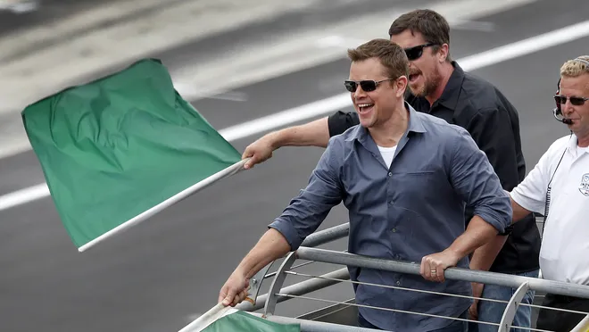
Comparison of Jesus and Believers (12:2b-11)
Jesus
Believer
Endured the cross (2b)
Downplayed the shame (2b)
Sitting on right hand of God (2b)
Endured hostility (3)
Not yet martyred (4)
Forgotten Proverb 3:11-12 (5-6)
Reminder/Rev. 3:19 (echoed in 6)
Must endure discipline (7)
Not yet completed (10-11)
Brings fruit of peace (11)

Slide 8
“Victory Hill” as Spiritual Parable (10-13)

Slide 9
What Idea is Repeated in Hebrews 12:11, 14?
Peaceful (v. 11) and peace (v. 14)
With the opposite in verse 15 (trouble)
Work for peace for everyone (v. 14)
Many becoming defiled from bitterness (v. 15)
Holiness to prepare for God’s presence (v. 14)
Defiled (being unclean/unworthy) (v. 15)

Slide 10
Could Esau Repent? (12:16-17)

Slide 11
Proximity of God’s Presence (12:18-21)
Phenomena in Hebrews 12:18-21 |  | Old Testament Background
1. _____ even beasts can't touch (20) | A. | Exodus 19:16 ("a very loud trumpet blast")
2. _____ a tempest or storm (18) | B. | Deuteronomy 4:11 ("wrapped in darkness, …")
3. _____ trumpet sounds long blast (19) | C. | Exodus 20:21 ("people stood afar off, while Moses…"
4. _____ a blazing fire (18) | D. | Deuteronomy 9:19 ("I was afraid…"), perhaps
5. _____ darkness, gloom (18) | E. | Exodus 19:13 ("whether human or …")
6. _____ can't hear voice again (19) | F. | Deuteronomy 5:25-26 ("…if we hear…we shall die")
7. _____ could not endure (20) | G. | Exodus 20:18 ("mountain smoking"), Dt. 4:11
8. _____ even Moses afraid (21) | H. | Exodus 19:16 ("thunders and lightning")
E
H
A
G
B
F
C
D

Slide 12
Greater Than, Superior To, Better Than

Slide 13
The Unshakable Kingdom (12:25-29)
Why would God shake once more and add the heavens?
As flour is “aerated” through sifting…
God’s shaking opens up spiritual opportunities
As flour is “conformed for consistency (flavor and texture)…
God’s shaking allows maturation and consecration

Slide 14
A Quick Look at Hebrews 13
13:1 - 6 -- Ethical Instructions
13:7-19 – Leadership and Organizational Concerns
13:20-21 – Benediction
13:22-25 – Addendum to Hebrews as Letter [Guthrie, George H., The Structure of Hebrews: A Text-Linguistic Analysis (Grand Rapids, MI: Baker Books, 1994), p. 134.]

Slide 15
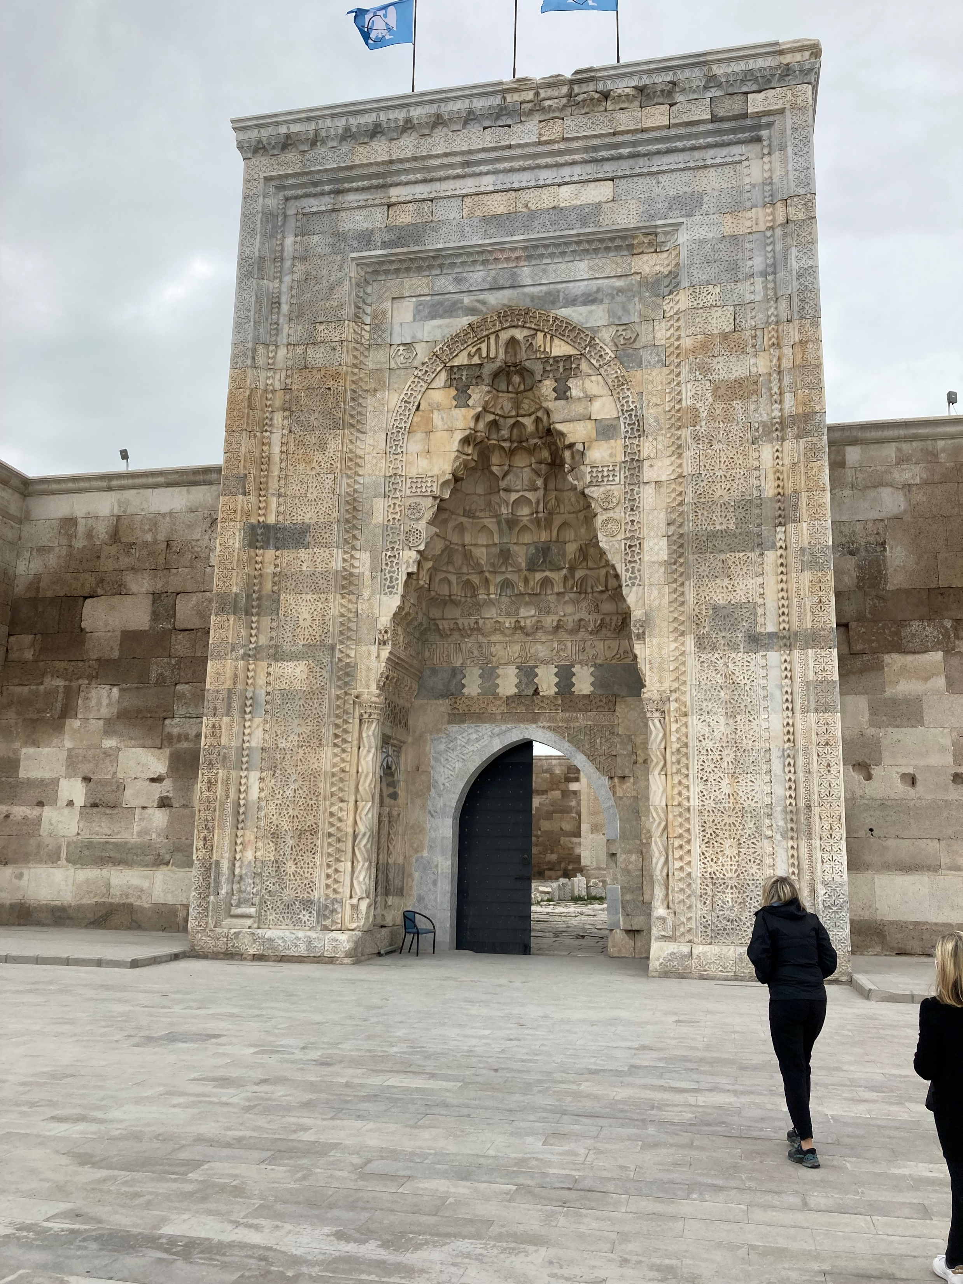
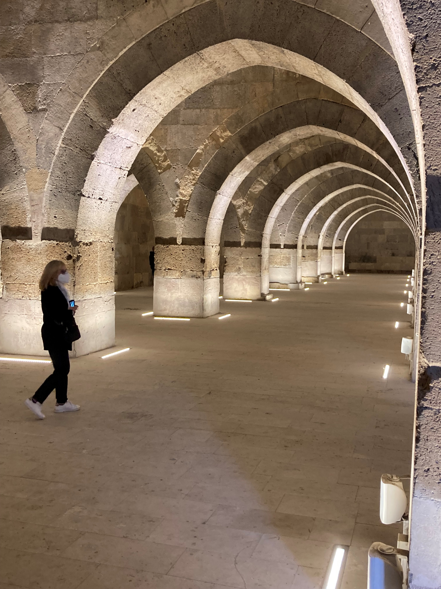
Ethical Instructions (13:1-6)
Let familial-style caring endure (v.1)
Meet needs outside the church (v. 2), as well. (even taking care of God’s “angels”)
Remember those in prison (v. 3), as though you are with them [solidarity]
Value marriage and don’t profane the sexual act (v. 4)
Trust in God’s faithfulness (quoting Deuteronomy 31:6 and Psalm 118:6)

Slide 16
Finding Leadership
Measure the leaders against the servant-leadership model seen in early Christian leaders (v. 7) and the example of Christ Himself (v.8)
Measure the leaders by their consistent, not strange or novel, teachings (v. 9) a) diet might mean a reversion to keeping Jewish law b) many cults distinguish themselves by diet c) compare God’s altar versus “the tent” (v. 10)
Measure by our willingness to sacrifice ourselves (outside the camp—vv. 11-13) as Jesus did
Watch out for those building empires here (see v. 14)

Slide 17
Adapted in Jobes, Karen H., Letters to the Church: A Survey of Hebrews and the General Epistles (Grand Rapids, MI: Zondervan Academic Publishing, 2011), p. 127, from Westfall, Cynthia Long, A Discourse Analysis of the Letter to the Hebrews: The Relationship between Form and Meaning, Library of New Testament Studies 297, Studies in New Testament Greek (London: T&T Clark, 2005), p. 298.
Let's Hold On | Let's Draw Near | Let's Go Forward
Pay closer attention to what we've heard (2:1) | Approach the throne of grace for mercy and help (4:16) | Be anxious so no one fails to reach the Sabbath rest (4:1)
Hold tight to our confession [of Jesus as Lord] (4:14) | Approach "Holy of Holies" cleansed and ready (10:22) | Be active toward reaching that rest and don't disobey (4:11)
Hold tight to our faith because of His reliability (10:23) | Worship/serve God with awe and gratitude (12:28) | Move from rudimentary doctrines to maturity (6:1)
 | Be willing to suffer [outside the camp] with Jesus (13:12) | Consider how to stimulate each other's good works (10:24)
 | Constantly praise, do good, and share (13:15-16) | Finish the race we started (12:1)

Slide 18
Leaders Held Accountable (13:17-18)

Slide 19
Recurring Themes in 13:20-21
Peace
Jesus raised from the dead
Blood of the eternal covenant
Do His will

