Slide 1
The Segue from Acts 18-20
Preparing to Teach Acts

Slide 2
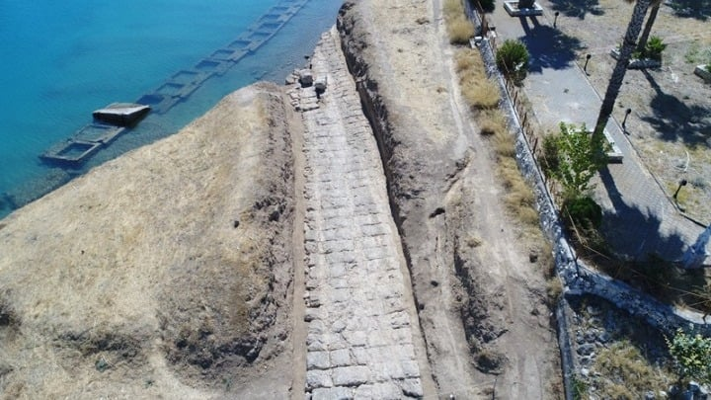
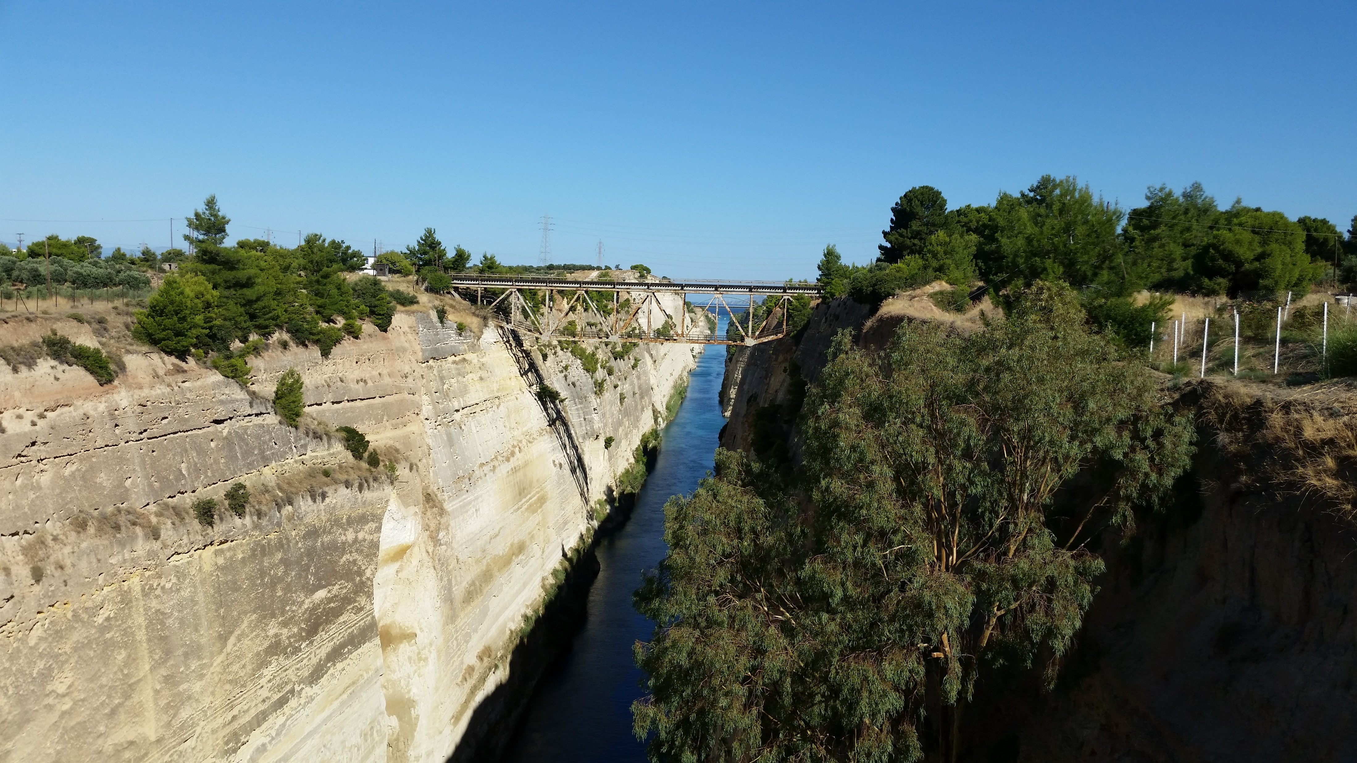
The Vow at Cenchrae (Acts 18:18)

Slide 3
Nazarite Vow Numbers 6:1-21
Idea of separation TO the LORD (v. 2)
Idea of separation from wine/strong drink and even grapes/vinegar (vv. 3-4)
Idea of distinctiveness through not shaving/cutting hair (v. 5)
Separation from dead bodies (v. 6)
Concludes with burnt offering, sin offering, and peace offering (vv. 13-17)
Shave at the door of the tabernacle and burn hair in the fire for the peace offering (v. 18)

Slide 4
Turning for Home!

Slide 5
Initial Ministry in Ephesus

Slide 6
διελεχθη (pronounced “dee-eh-LEHK-thee”)

Slide 7
Learned Apollos of Alexandria

Slide 8
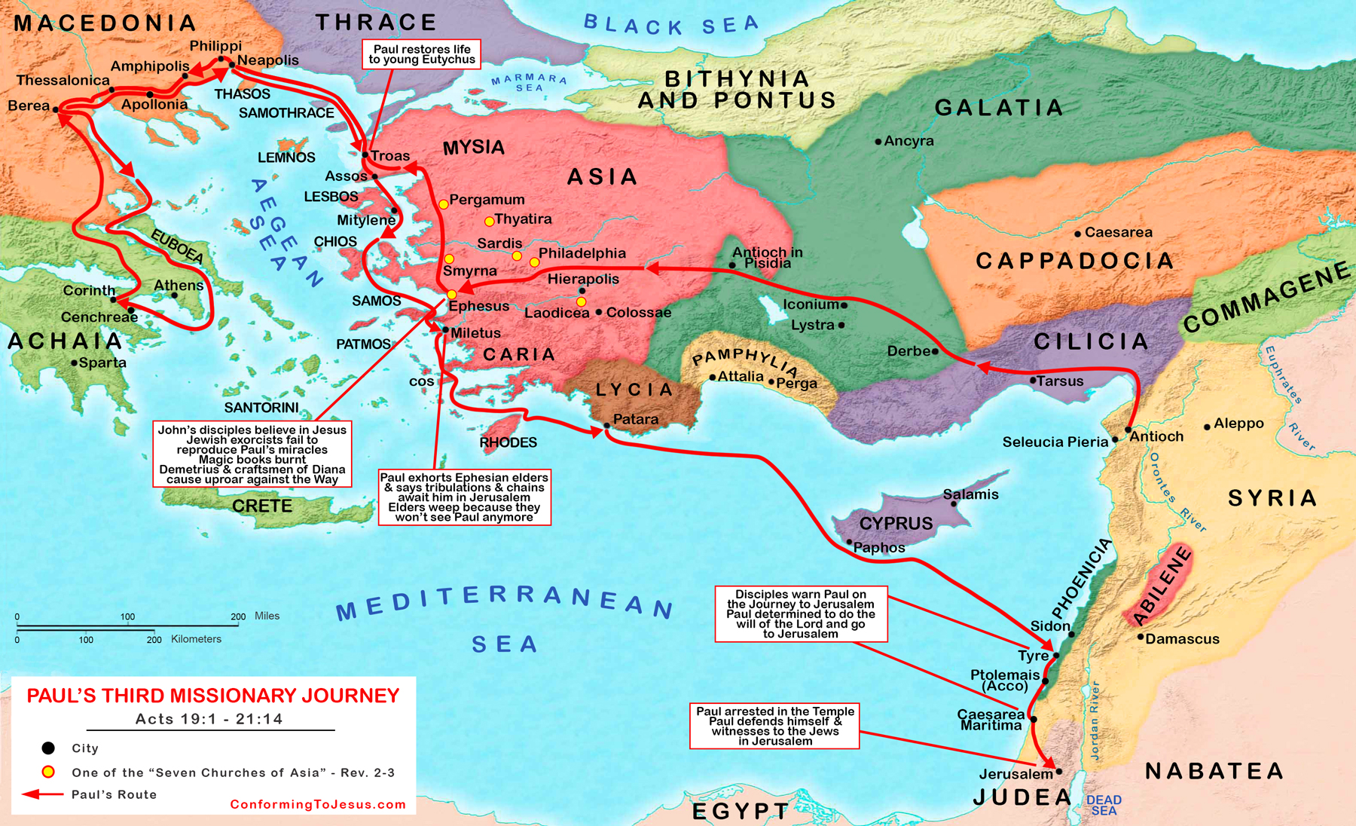
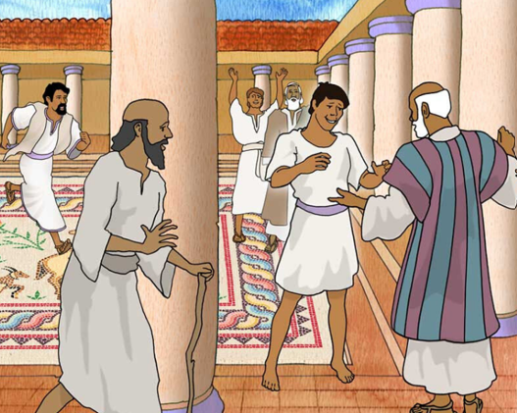
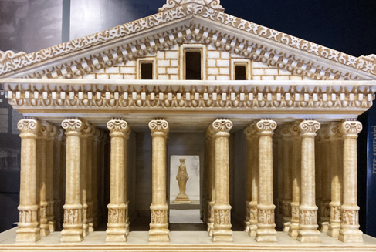
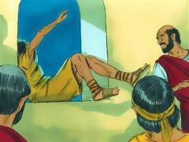
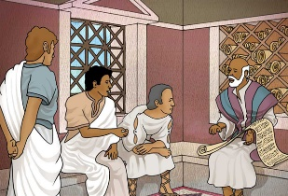
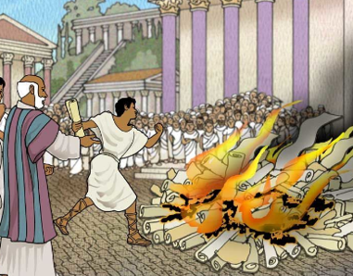
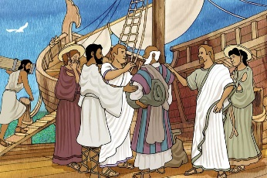
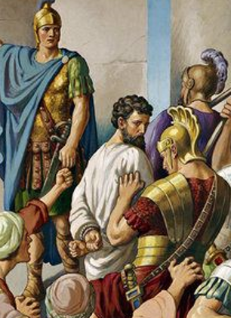

Slide 9
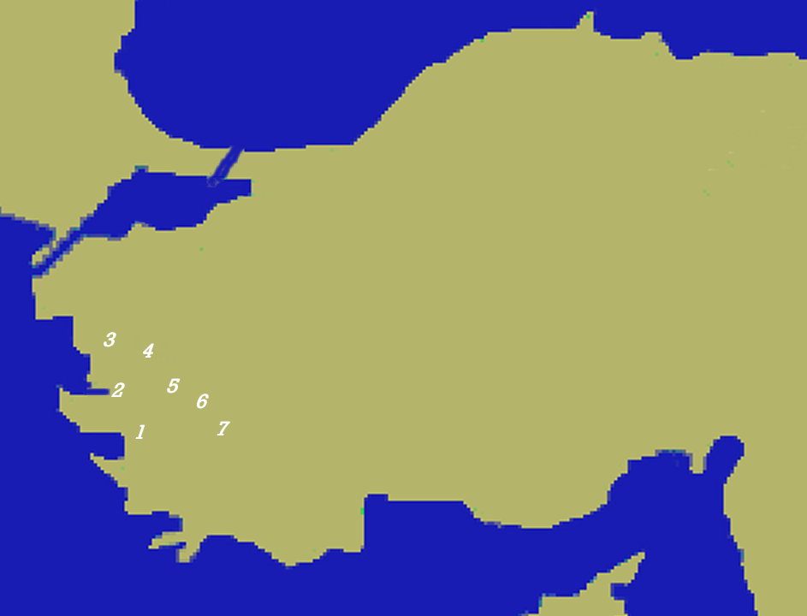
Churches of Asia Minor
Churches of Asia Minor
Pergamum
Thyatira
Sardis
Smyrna
Philadelphia
Laodicea
Ephesus
The letters in the Book of Revelation reflect a Roman courier route and suggest that Ephesus was of primary importance.

Slide 10
Bouleterion = Government Assembly

Slide 11
Trade by Land and Sea

Slide 12
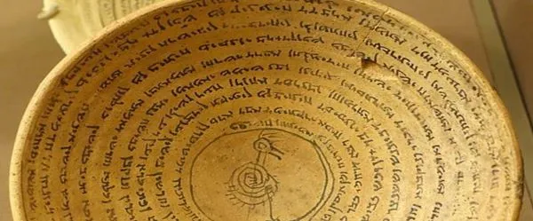
The Cult of Artemis

Slide 13
Paul’s Ministry in Ephesus
Three (3) months in verse 8
Two (2) years in verse 10
Three (3) years in verse 21
We don’t know if Luke didn’t list all of the intervals or if the three (3) years is the 27 months rounded up

Slide 14
Old Testament “Spirit of the Lord”

Slide 15
“Separating” to Hall of Tyrannus

Slide 16
Probable Chronology
Date (ca.) | Action | Scripture
Late Summer AD 52 | Paul arrives in Ephesus | Acts 19:1
 | Conversion of incomplete disciples | Acts 19:1-7
 | 3 months in synagogue | Acts 19:8
 | 2 years in Hall of Tyrannus | Acts 19-9-10
Winter AD 52-53 | Ephesian missionary outreach | Acts 19:10
 | Ephesian church grows | Acts 19:20
Spring AD 53 | Epaphras starts Colossian church | Colossians 1:7
 | Hieropolis and Laodicea | Colossians 4:12

Slide 17
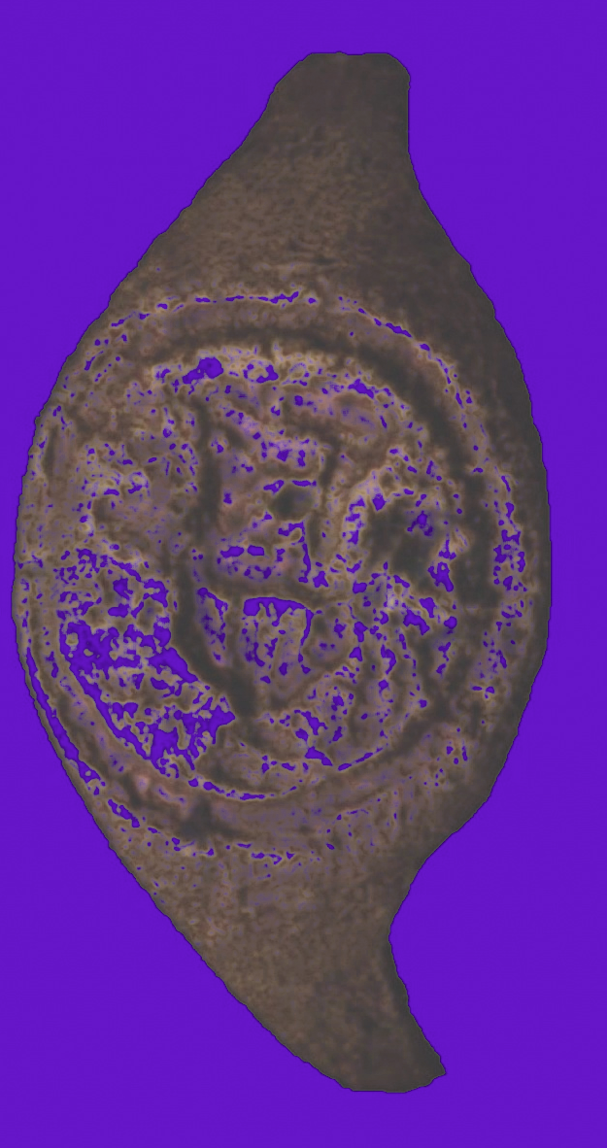
Jews and “Magic”
“He put a ring that had a root of one of those sorts mentioned by Solomon to the nostrils of the demoniac, after which he drew out the demon through his nostrils, and when the man fell down immediately, he abjured him to return into him no more, making still mention of Solomon, and reciting the incantations which he composed.” Flavius Josephus, Antiquities of the Jews Book VIII, Chapter 2, Paragraph 5

Slide 18
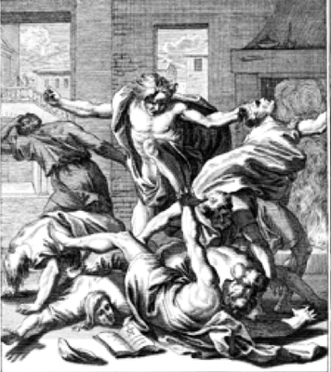
Avoiding Phony Power
1. It’s Relationship, Not Formula
2. It’s Faith, Not Ritual
7
The “right” symbolic # (3 +4)
The “right” agents (sons)
The “right” authority Sceva’s name means “prepared” Claimed to be a high priest

Slide 19
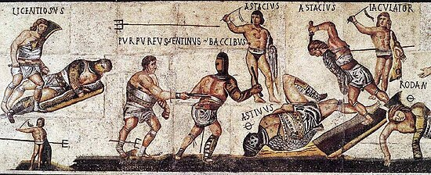
Avoiding Phony Power
Sceva’s name means “prepared” / “protected” From gladiator term “Scaeva” (left-handed) Claimed to be a high priest

Slide 20
“I ADJURE You by the name of Jesus”
ορκίζω is only used here and in Mark 5:7 in the New Testament
Root idea is forcing one to take an oath or binding them to something (like a name of power)
Notice that the verb is part of the noun used for exorcists (εξορκιστ͡ων)

Slide 21
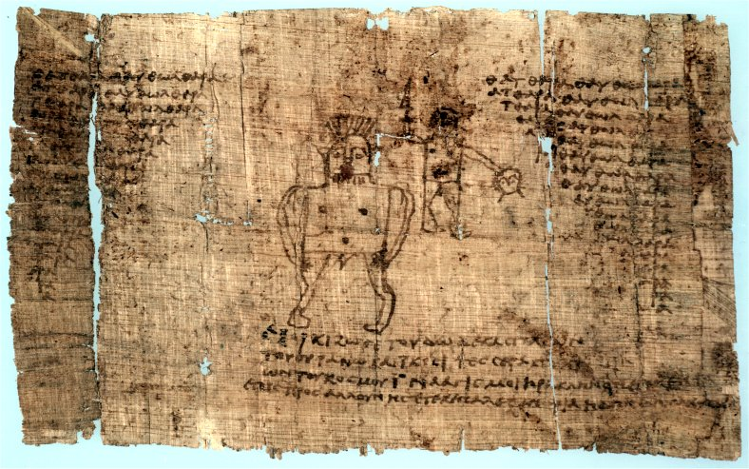
Paris Magical Papyrus

Slide 22
DISAPPOINTMENT
H

Slide 23
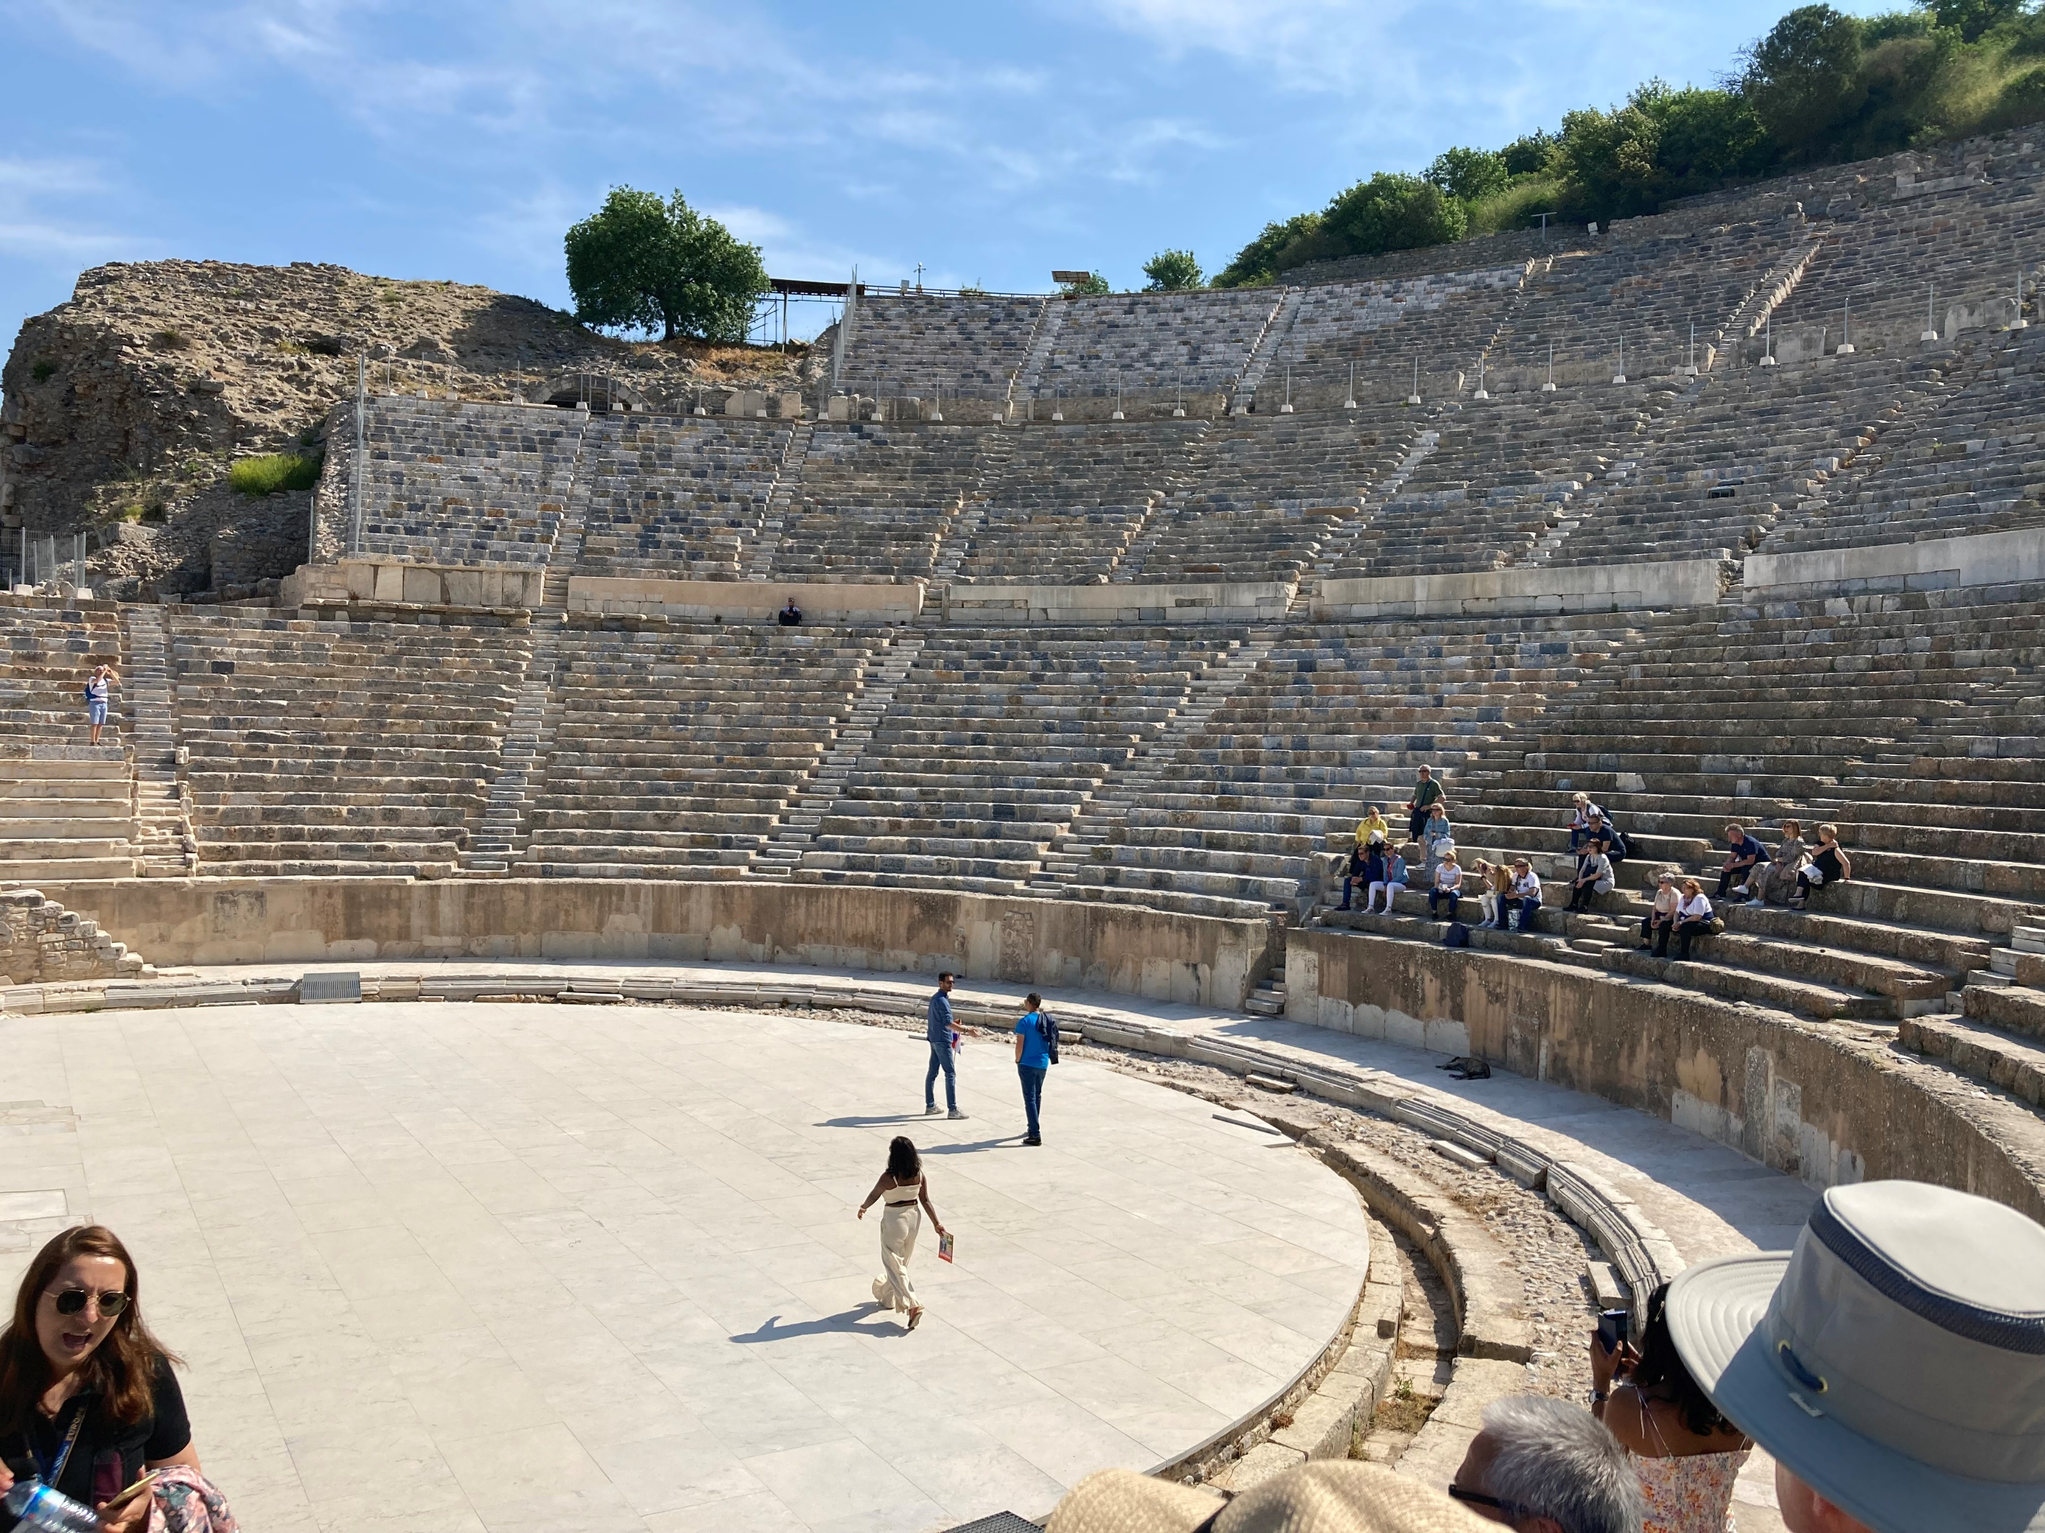
Venue for Vitriol (vv. 30-34)

Slide 24
Restoring Order (vv. 35-41)
He created a consensus (vv. 35-36)
He declared the innocence of Paul and company (v. 37)
He invited Demetrius to use the established procedures (vv. 38-39)
He warned of penalty for mob behavior (v. 40)

Slide 25
Lessons from Demetrius
Opposition to God’s work is inevitable
Opposition incubates when people are uncomfortable with the COST of God’s work
When God puts something on your heart, don’t hesitate until FORCED
When inclined to do something, ensure it’s God’s will instead of feeding your ego

Slide 26
Cast of Characters
Sopater, Son of Pyrrhus, from Berea
Aristarchus and Secundus from Thessalonica
Gaius from Derbe
Timothy from Lystra
Tychicus and Trophimus from Asia
Titus of Corinth (II Cor. 8:6-24)?

Slide 27
Who Are These Guys?
Aristarchus suffered and was imprisoned with Paul (Acts 19, Colossians 4:10)
Gaius, most common Roman first name
Timothy was Paul’s “intern”
Tychicus served (Col. 4:7-8)
Trophimus suffered endangerment and illness (II Timothy 4:20)

Slide 28
Encouragement & Training

Slide 29
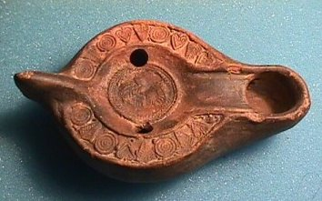
What About the Lamps?
Does the number of lamps indicate that it should have been well-lit enough to keep Eutychus awake?
Does the number of lamps suggest lots of smoke?
Why would the window seat get hit?

Slide 30
Comparison Intended?

Slide 31
The Real Miracle

Slide 32
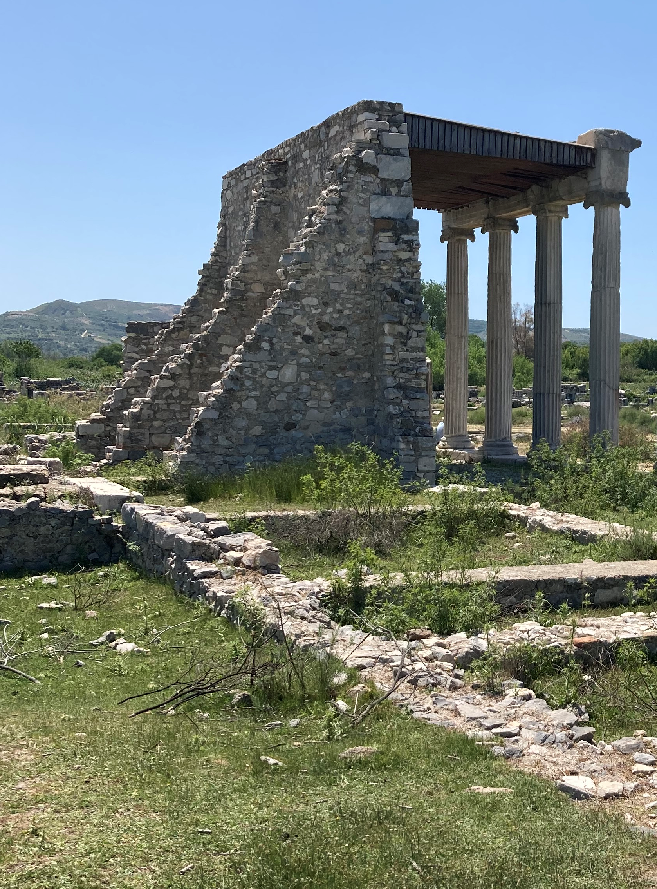
Paul’s Farewell Address

Slide 33
Free of WHAT?!
Some manuscripts read, “I am innocent of any man’s BLOOD.”
ἁίματος
Others read, “I am innocent of any man’s SIN.”
ἁμαρτίας
Which is it?
Isn’t it really BOTH?

Slide 34
Be On the Lookout for Wolves!
Sheep are DUMB animals
God used them in both OT and NT to represent God’s people (Israel and church)
Shepherds stand between wolves and the flock
Without proper shepherds the flock can be led to destruction

Slide 35
Ways Wolves Devour
Devouring joy with negative commands not supported by scripture
Devouring energy with arguments and debates that are trivial to scripture
Devouring fellowship with competitive self-righteousness
Deadening fellowship with a lack of honesty and inability to love
Destroying fellowship with accusation and innuendo
Devouring trust with gossip and assumption
Destroying intellectual honesty with slothful logic and bogus faith
Devouring church resources with irresponsible stewardship

Slide 36
What Shall This One Do?
When God challenges, are we willing to move forward even if we know it will be inconvenient?
Are we willing, when necessary, to say farewell to comfortable situations and those we love?
Are we committed to FINISHING?
Are we aware of potential wolves in our lives?
Are we allowing God’s work in our lives to build up His kingdom or our reputation?

