Slide 1
The ruin of babylon
Revelation 17

Slide 2
Who ARE These Guys?
Ashcraft, Morris – Professor of Theology, Midwestern Baptist Theological Seminary
Beasley-Murray, George R. – Principal of Spurgeon’s College, London and Professor of New Testament, The Southern Baptist Theological Seminary
Bowman, John Wick – Ph.D. The Southern Baptist Theological Seminary and post-graduate (Fulbright scholar) University of Zurich
Caird, G. G. – Principal of Mansfield College, Oxford University
Carroll, B. H. – Founder, Southwestern Baptist Theological Seminary
Charles, R. H. –Professor of Greek, Trinity College (Dublin, Ireland)
Hendriksen, William – New Testament Professor, Calvin Theological Seminary
Ladd, G. E. – New Testament Professor, Fuller Theological Seminary
Lindsey, Hal – Christian Zionist and Dispensational Author
Metzger, Bruce – Professor of New Testament and Greek, Princeton University
Morris, Leon – Principal of Ridley College, Melbourne
Palmer, Earl – Pastor Emeritus, University Presbyterian, Seattle
Reddish, Mitchell – Chairman of Religious Studies, Stetson University
Rist, Martin – New Testament Professor / Iliff School of Theology
Robertson, A. T. – Professor of New Testament, The Southern Baptist Theological Seminary
Summers, Ray – Professor of New Testament and Greek, Southwestern Baptist Theological Seminary and Baylor University
Swete, H. B. – Regius Professor of Divinity, Cambridge University
Talbot, Louis T. – President, Talbot Theological Seminary
Woodbridge, Charles J. – Presbyterian Missionary to French Cameroons

Slide 3
She has made all nations drink of the wrath of her fornication!
Look, there they come, riders, horsemen in pairs!
Then he responded, “Fallen, fallen is Babylon; and all the images of her gods lie shattered on the ground.” Isaiah 21:9 (NRSV)

Slide 4
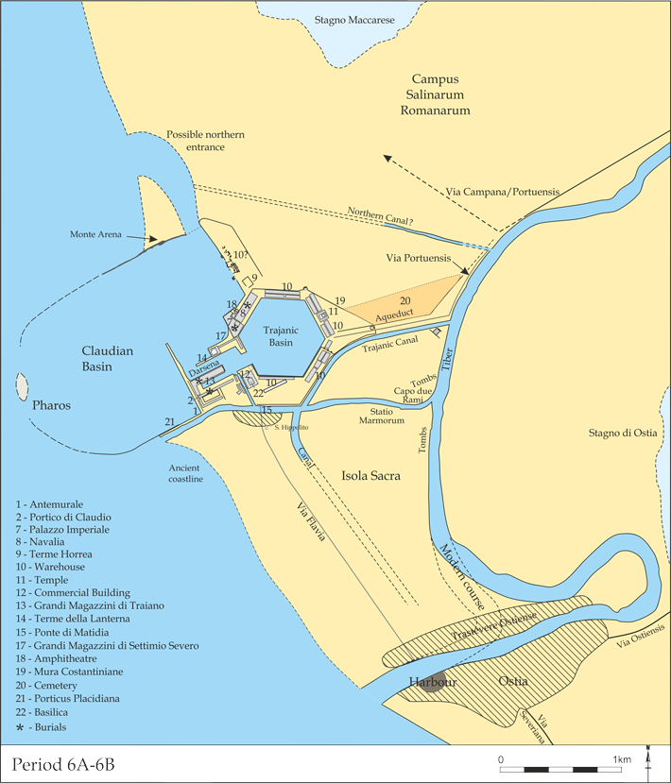
“And one of the seven angels who had the seven bowls came and spoke with me, saying, ‘Come here, I shall show you the judgment of the great harlot who sits on many waters.’” (v. 1 NASB)

Slide 5
Many Waters?
¹³ O you [Babylon] who dwell by many waters, Abundant in treasures, Your end has come, The measure of your end. --Jeremiah 51:13 NASB
John explains in Revelation 17:15

Slide 6
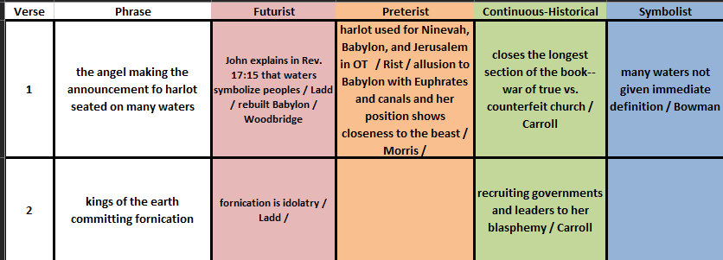

Slide 7
So, what about this “harlot?”
“Come down and sit in the dust, O virgin daughter of Babylon; Sit on the ground without a throne, O daughter of the Chaldeans! For you shall no longer be called tender and delicate.” Isaiah 47:1 NASB
^{“7} Babylon has been a golden cup in the hand of the Lord, Intoxicating all the earth. The nations have drunk of her wine; Therefore the nations are going mad. ⁸ Suddenly Babylon has fallen and been broken; Wail over her! Bring balm for her pain; Perhaps she may be healed. ⁹ We applied healing to Babylon, but she was not healed; Forsake her and let us each go to his own country, For her judgment has reached to heaven And towers up to the very skies.” Jeremiah 51:7-9

Slide 8
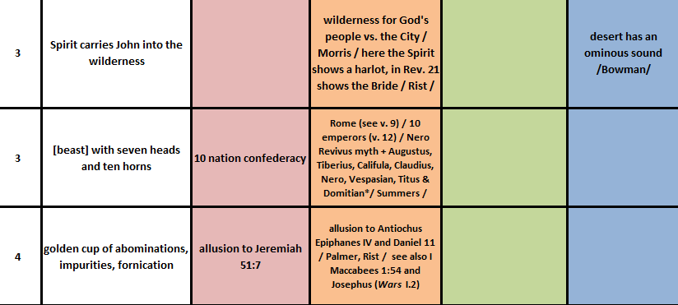

Slide 9
Mother of Harlots Abominations of Earth
Messalina – meretrix augusta
Antiochus Epiphanes IV

Slide 10
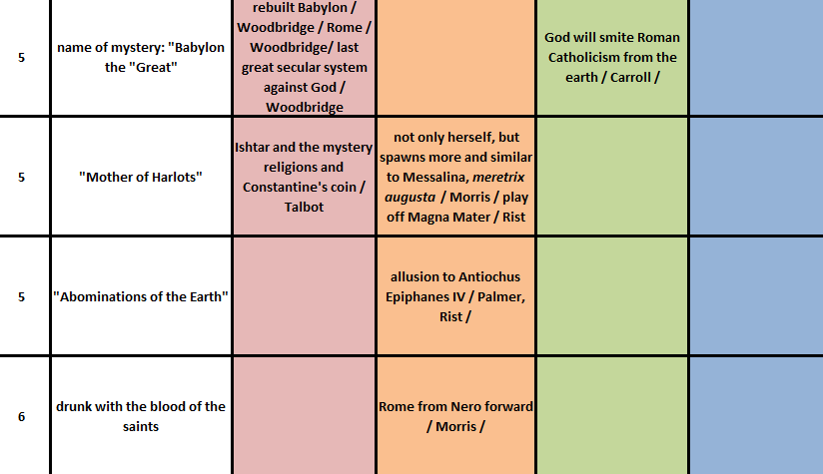

Slide 11
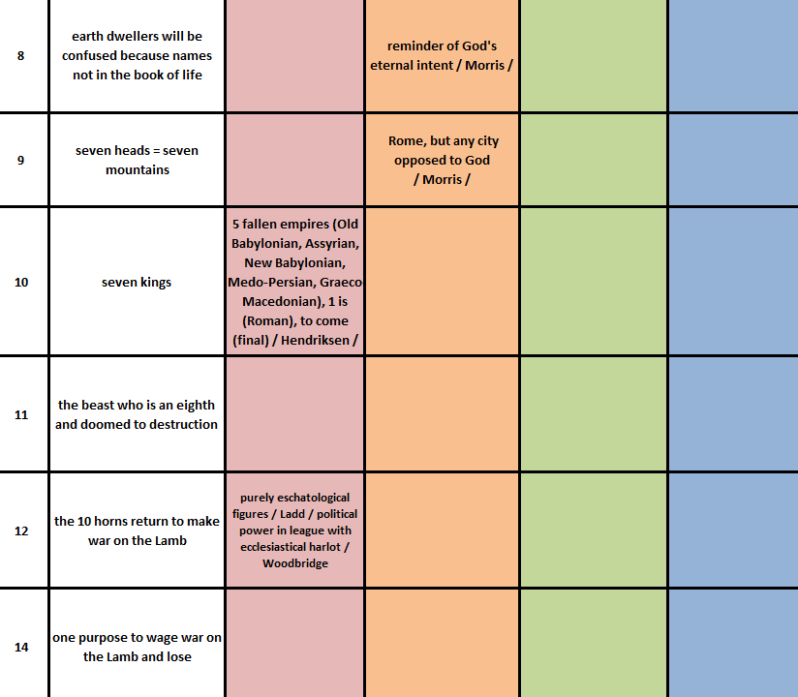

Slide 12
