Slide 1
Watch Your Step
Preparing to Teach Ecclesiastes 5 and 6

Slide 2
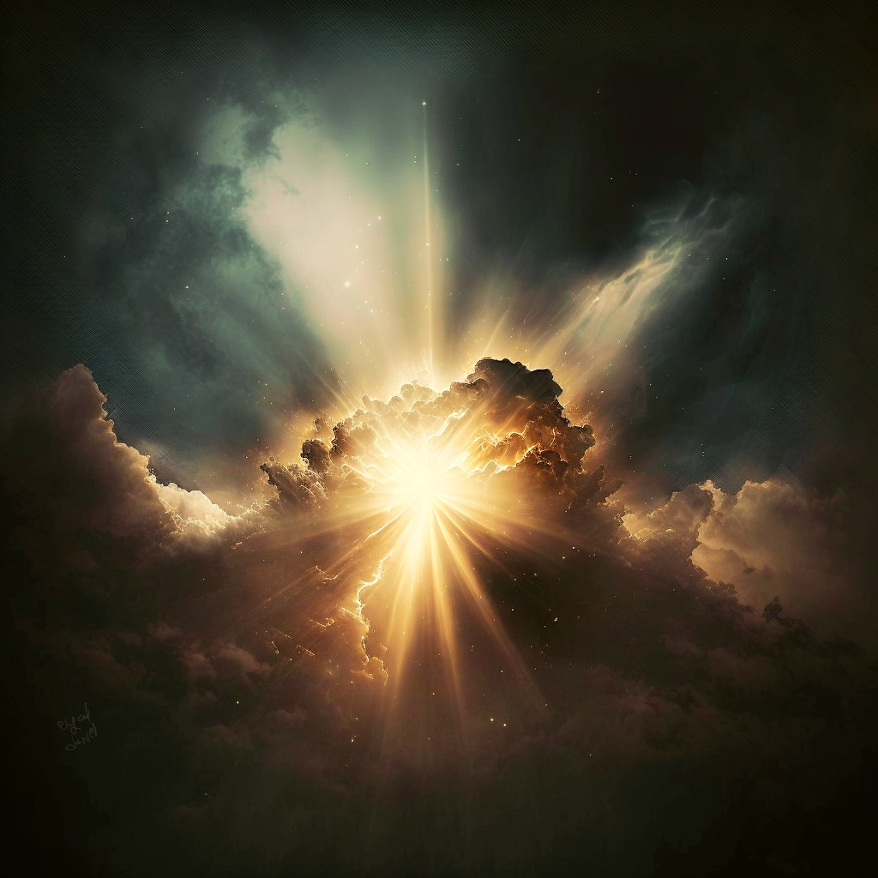
An Emphasis on God
How many times is God mentioned in this passage?
Why is the generic name of God mentioned instead of using God’s personal name, Yahweh?
Lest you think it meant the generic “gods,” 8 of those times, it is used with the definite article, the, meaning ONE.
11
or 10 depending on your version

Slide 3
Watch Your Step!
Positive Steps | Negative Steps | Both
Job 23:11
Proverbs 1:15-16
Psalm 1:1
Proverbs 4:12
Proverbs 4:27
Psalm 119:1
Proverbs 5:5
Psalm 119:101
Proverbs 6:18
Proverbs 19:2

Slide 4
Be Careful in Approaching God’s Presence
What is the “fool’s sacrifice?”
Psalm 40:6-8 tells us it is sacrificing things without having God’s will in one’s heart
Samuel rebukes King Saul by saying God values obedience more than sacrifice (1 Sam. 15:22)
Hosea 6:6 says God values loyalty over sacrifice

Slide 5
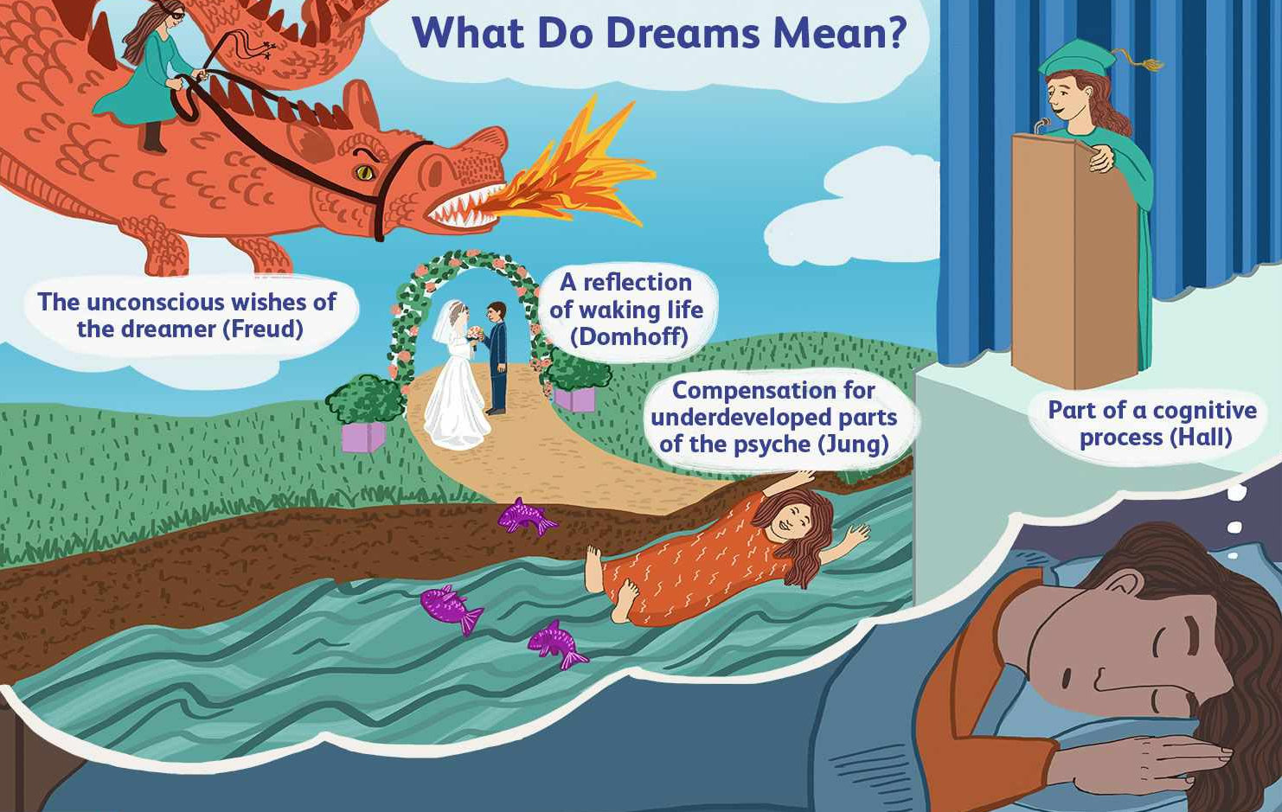
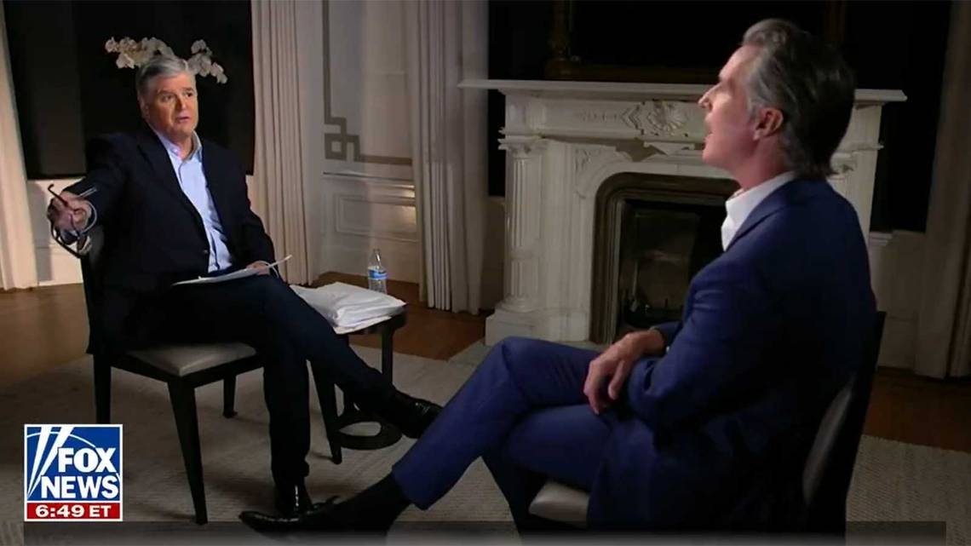
Fools Don’t “Read the Room”
Speaks too quickly
Speaks impulsively
Speaks too much

Slide 6
The Wise Man and Deuteronomy
Ecclesiastes 5:4-5
Deuteronomy 23:21-22
When you make a vow to God, do not be late in paying it…
It is better that you should not vow than to vow and not pay
When you make a vow to the LORD, your God, you shall not delay to pay it…
If you refrain from vowing, it won’t be a sin in you
Make no oath at all, either by heaven, for it is the throne of God… Matthew 5:34

Slide 7
Don’t Let Your Speech Cause You to Sin
“messenger”
Some versions say “angel” and some say “messenger of God”
May refer to those who came around to check on those who made vows
Dangerous to say “It was a mistake” and try to rationalize not following through

Slide 8
Watch Out for Dreams, Words, & Vapor!
“The first part of v. 7 is very difficult to interpret. It seems to be a warning against a religion which consists in a multitude of futile dreams and words…” [Peterson, Wayne H. “Ecclesiastes” in Allen, Clifton J. (ed.) The Broadman Bible Commentary: Volume 5: Proverbs-Isaiah (Nashville: Broadman Press, 1971), p. 116.]

Slide 9
Don’t Be Shocked at Human Corruption (versus God’s Authenticity)

Slide 10
The Problem with Riches

Slide 11
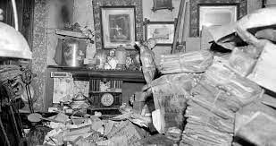
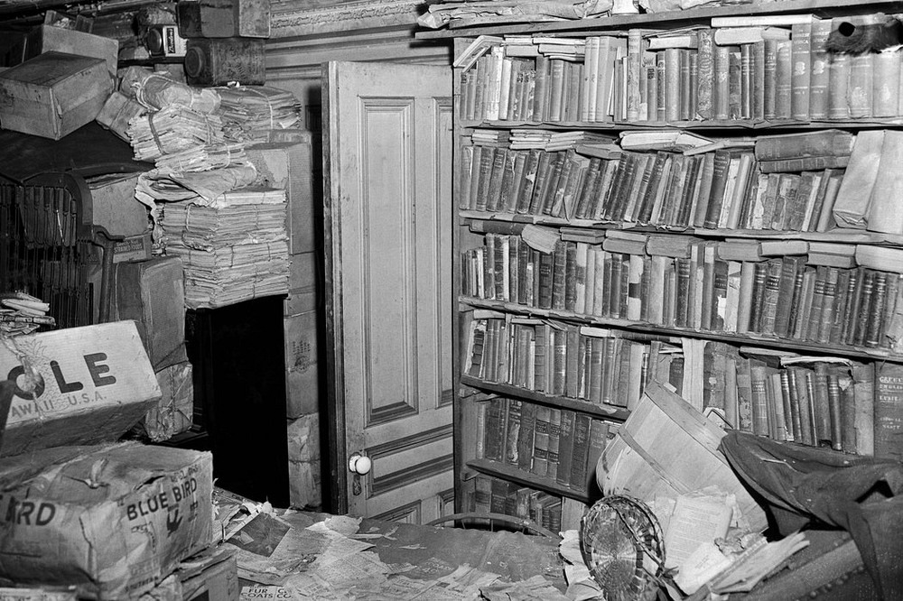
A Cautionary Parable (vv. 13-15)
“Naked I came from my mother’s womb, And naked I shall return there. The Lord gave and the Lord has taken away. Blessed be the name of the Lord.” Job 1:21 [NASB]
Hoarding is to one’s detriment

Slide 12
A Cautionary Parable (vv. 13-15)
“Naked I came from my mother’s womb, And naked I shall return there. The Lord gave and the Lord has taken away. Blessed be the name of the Lord.” Job 1:21 [NASB]
Hoarding is to one’s detriment
Greed leads to poor investments (frauds?)
Nothing to leave as a legacy
It seems unfair to come full circle (naked to naked)
Laboring for wrong priorities = darkness, irritation, resentment

Slide 13
Summary of the Parable
“Since our lives are spent between two moments of nakedness, it is best to travel light.” [John Stott, quoted in Wright, Christopher J. H., Hearing the Message of Ecclesiastes, p. 70.]

Slide 14
The Antidote? (18-20)
“To accept life as God has given it, and to respond positively to that gift of life is his form of faith.” [Scott, R. B. Y., The Way of Wisdom in the Old Testament (New York: Macmillan and Company, 1971), p. 187.]
“Not only is there nothing left for man but present enjoyment, but even for this he is dependent upon God.” [quoted in Tremper III, The New International Commentary on the Old Testament: The Book of Ecclesiastes (Grand Rapids, MI: William B. Eerdmans, 1998), p. 168.]

