Slide 1
Courtroom Drama
Preparing to Teach Acts 25 and 26

Slide 2
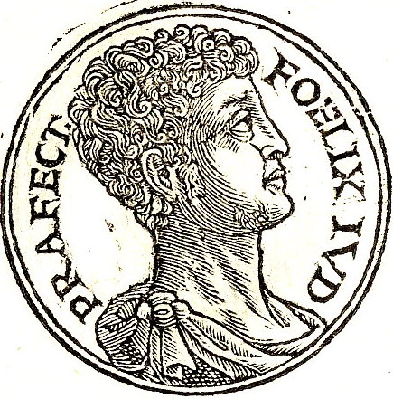
Remember Last Time?
“Now as for the affairs of the Jews, they grew worse and worse continually, for the country was again filled with robbers and imposters, who deluded the multitude.” [Josephus, Flavius, The Life and Works of Josephus: Antiquities of the Jews: Book XX, Chapter 8, Paragraph 5 (William Whiston, trans.) (Philadelphia, PA: John C. Winston, Co., 1957), p. 595.]

Slide 3
Felix Loses Imperial Favor

Slide 4
Lessons to be Learned [Schnabel, Eckhard J., Zondervan Exegetical Commentary on the New Testament: Book 5: Acts (Grand Rapids, MI: Zondervan Academic, 2012), pp. 1712-1713.]
Need for a clear conscience before God and before the people (Acts 24:16)
Need for faith and commitment to God and his revealed Word in Scripture (Acts 24:14)
Need for belief in Jesus as Israel’s Messiah and Savior in the coming judgment (Acts 24:14, 24)
Need for confidence in God’s vindication of them and their ministry

Slide 5
Porcius Festus Replaces Antonius Felix
AD 55/56 (CE) Pallas’ lost influence
AD 58/59 (CE) Numismatic hints
AD 59/60 (CE) Continuing imprisonments dating from Felix to AD 64
AD 60/61 (CE)

Slide 6
Rapprochement with Jewish Leaders

Slide 7
Some Things to Remember

Slide 8
Luke’s 4 Key Verbs Describing the Jews
They accused Paul (verb = exposing) – v. 2
They urged, implored, cajoled Festus – v. 2
They petitioned a favor – v. 3
They were planning, organizing – v. 3
[Schnabel, p. 1736.]

Slide 9
Intent for Fair Trial = IF ἄτοπον

Slide 10
The Appeal (v. 11)
Grounded in provocatio ad populum (449 BC (BCE) which was an appeal to the general population
As well as apellatio which was an appeal to a “bench” of equivalent colleagues or a supervising magistrate
We presume (though Hans Conzelmann isn’t sure) that in the imperial court, Caesar’s authority subsumed both of these opportunities

Slide 11
“If then I am a wrongdoer, and have committed anything for which I deserve to die, I do not seek to escape death: …” Paul in verse 11

Slide 12
With Much Ostentation

Slide 13
Paul’s Defense (Acts 26:2-23)
Exordium – Fortunate in Agrippa’s expertise and patience (vv. 2-3)
Refutatio – Paul’s Pharisaic training, background, and hope for resurrection (vv. 4-8)
Narratio – Part I: Paul’s persecuting zeal / Part II: his experience of the heavenly light/voice (vv. 9-18)
Propositio – Paul preached in Damascus and to Gentiles (vv. 19-20)
Peroratio – Jews persecuted him, but God protected him (vv. 21-23)

Slide 14
Three Accounts of Paul’s Experience
Acts 9:1-19 | Acts 22:6-21 | Acts 26:12-18
Paul falls to ground in v. 4 | Paul falls to ground in v. 7 | All fall to ground in v. 14
Paul surrounded by the light v. 3 | Companions see the light v. 9 | Paul only saw the light v. 13
Companions hear the voice v. 7 | None heard the voice v. 9 | Paul only heard Aramaic words v. 14
Sent to Damascus for commissioning v. 6 | To Damascus for commission v. 10 | Commissioned in Temple vision vv. 16-17
Jesus is speaking vv. 15, 17 | Ananias is speaking vv. 14-16 | Jesus is speaking vv. 16-18

Slide 15
Mad or Naïve? (vv. 24-29)

Slide 16
Lessons to be Learned [Schnabel, Eckhard J., Zondervan Exegetical Commentary on the New Testament: Book 5: Acts (Grand Rapids, MI: Zondervan Academic, 2012), pp. 1712-1713.]
Need for a clear conscience before God and before the people (Acts 24:16)
Need for faith and commitment to God and his revealed Word in Scripture (Acts 24:14)
Need for belief in Jesus as Israel’s Messiah and Savior in the coming judgment (Acts 24:14, 24)
Need for confidence in God’s vindication of them and their ministry

