Slide 1
Friday Night Justice
Social and Individual Justice in Amos and Hosea First Session – Broad Strokes

Slide 2
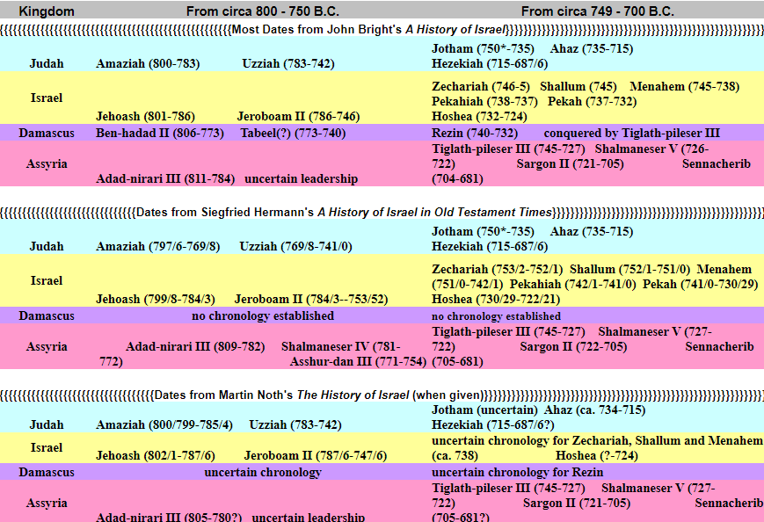

Slide 3
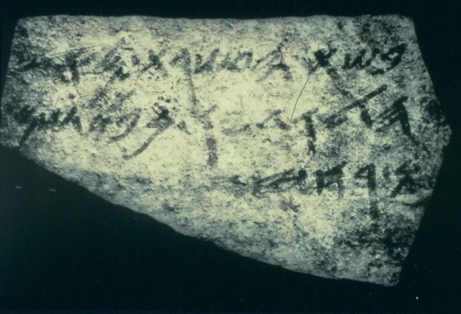
Jeroboam II (786-746) – King of Israel
Hamath
Assyria
Expanded borders from Hamath to Dead Sea area (II Kings 14:25)
Pacified the Moabites (II Kings 14:25)
System of Royal Tribute (wine/oil) as shown in the Samarian ostraca
Moab
Sea of Arabah

Slide 4
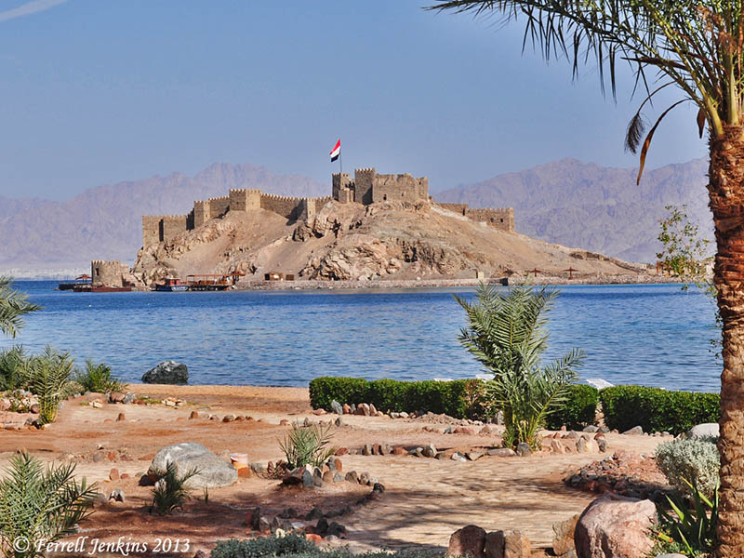
Uzziah/Azariah (783-742*) King of Judah
After short regency* over Jotham, his death triggered Isaiah’s call
II Chronicles 26:6 cites conquest of Philistine lands
II Chronicles 26:7 recounts his neutralizing of Ammonite and Moabite lands
II Kings 15:22 cites rebuilding the seaport of Elath (Ezion-Geber)
II Chronicles 26:9-10 states he rebuilt fortifications and expanded agricultural and viticultural wealth
II Chronicles 26:11-15 built military infrastructure

Slide 5
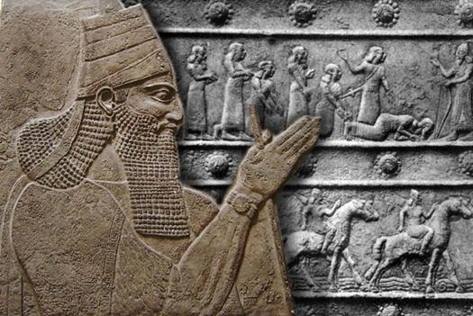
Tiglath-Pileser III (745-727) – Assyrian Emperor
Also known as “Pulu/Pul”
Reduced Damascus ca 740
Reduced Hamath ca 738
Heir required tribute from Samaria (aka Israel, the northern kingdom)

Slide 6
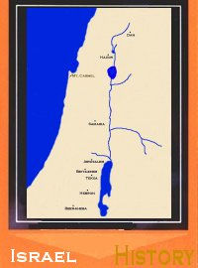
Scorecard on Israel
Founded in Jeroboam I’s revolution ca. 933 B.C.
Oppressed by Syria from 814 B.C. until mid-8th century B.C. under Jeroboam II
Murderous royal conspiracies until 734 B.C.
Assyria deported residents of Gilead, Galilee and Naphtali in 734 B.C.
Samaria fell in 722-721 B.C.

Slide 7
Scorecard on Judah
Lost Israel under Rehoboam 933 B.C.
Peace with Israel from 875 B.C. until turn of 8th century when Jehoash attacked Jerusalem
Uzziah extended borders
Ahaz paid tribute to Tiglath-pileser III of Assyria in 734 B.C.
Jerusalem conquered circa 597 B.C. by Chaldeans

Slide 8
Other Players
Syria not a player after mid-8th century
Philistia not a player after mid-8th c.
Phoenicia reduced to tributary status after Assyrian rise to power
Edom reduced in power/influence, but managed to betray Judah during the fall of Jerusalem

Slide 9
Simple Outline of Amos
Superscription
Amos 1:1-2
Sealed Tightly
Oracles vs. Everyone
Amos 1:3-2:16
Spiritual Preserves
Sermons for All
Amos 3:1-6:14
Defining Visions
Amos 7:1-9:8b
Solid Bottom or Foundation
Word of Hope Amos 9:8c-15

Slide 10
The Sevenfold Structure
Amos 1:1-2 (Setting the Stage)
Amos 1:3-2:16 (7 Oracles + 7 Sins of Israel) God speaks 14 times
Amos 3:1-15 (7 Questions and More) God speaks 7 times
Amos 4:1-13 (2 Indictments + 7 Actions) God speaks 7 times
Amos 5:1-6:14 (Human versus Holy) God speaks 7 times
Amos 7:1-8:3 (4 Visions and Opposition) God speaks 7 times
Amos 8:4-9:15 (Words about “The End” Bring About Hope) God speaks 7 times

Slide 11
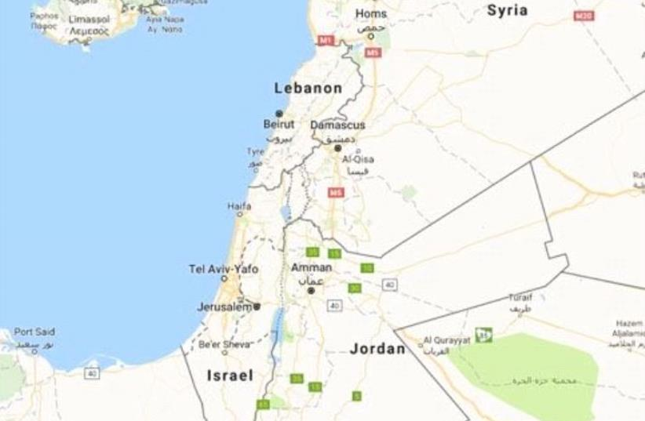
1.
3.
*.
5.
6.
2.
7.
4.

Slide 12
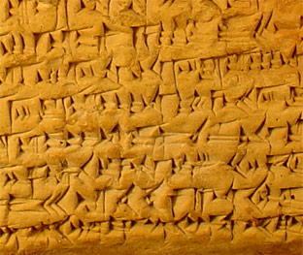
Assyrian Tablet with Oracle (SAA 9 8)
 | dib-bi [ša KUR.NIM.MA].⸢KI*-a-a
o 2 | ki-i an-[ni-i DINGIR] -qab-bi
o 3 | ma-a at-ta*-[lak at]-tal-ka
o 4 | šú 06-šú iq-[ṭi]-bi id—da-a-te
o 5 | ma-a TA^{v} UGU GIŠ.[nàr]-an-ti at-tal-ka
o 6 | ma-a MUŠ ša ina ŠÀ-bi-šá as-sa-ad-da
o 7 | ab-ta-taq ù ma-a GIŠ.nàr-an-tu
o 8 | aḫ-te-pi ù ma-a KUR.NIM.MA.KI
o 9 | a-ḫap-pi :. o* Á.2-MEŠ-šú TA^{v} kaq-qir
r 1 | i-sap-pan ma-a ki-i an-ni-i
r 2 | KUR.NIM.MA.KI a*-gam-mar
 | rest uninscribed
Words [concerning the Elam]ites.
⁽²⁾ [God] says as follows:
⁽³⁾ "I have go[ne and I ha]ve come."
⁽⁴⁾ He s[ai]d (this) five, six times, and then:
⁽⁵⁾ "I have come from the [m]ace. I have pulled out the snake which was inside it, I have cut it in pieces, and I have broken the mace."
⁽⁸⁾ And (he said): "I will destroy Elam; its army shall be levelled to the ground. In this manner I will finish Elam."

Slide 13
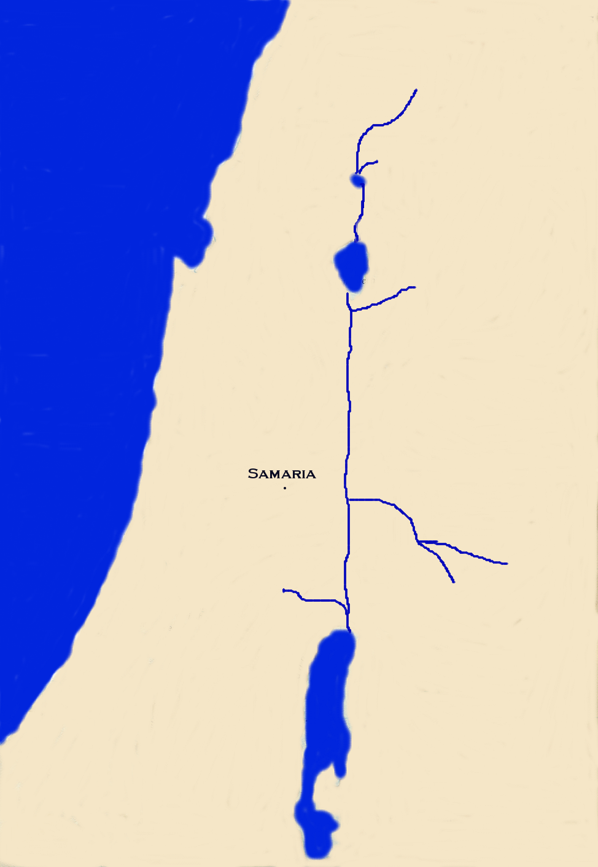
Damascus
*Damascus: Threshing with sharp instruments (1:3)

Slide 14
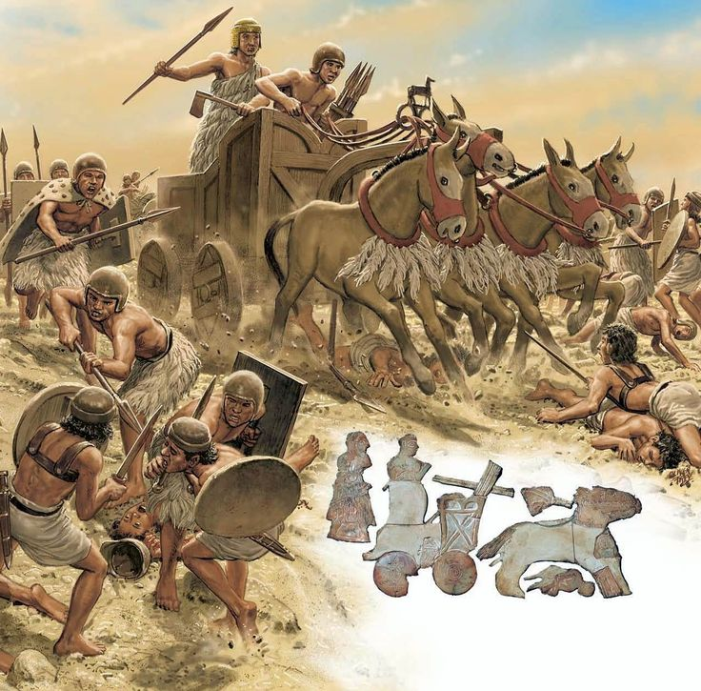
“My prancing steeds, trained to harness, plunged into their welling blood as into a river; the wheels of battle chariots were bespattered with blood and filth. I filled the plain with corpses of their warriors like herbage.” [neighboring king to Syria]

Slide 15
Similar to WWI’s Cambrai

Slide 16
*Damascus: Threshing with sharp instruments (1:3)
Damascus
Tyre
*Gaza: Engaging in slavery for profit (1:6)
*Tyre: Ignoring the covenant of brothers (1:9)
Gaza

Slide 17
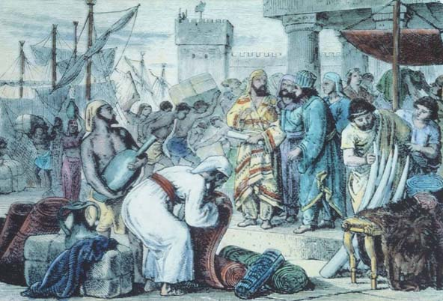

Slide 18
*Damascus: Threshing with sharp instruments (1:3)
Damascus
*Gaza: Engaging in slavery for profit (1:6)
Tyre
*Tyre: Ignoring the covenant of brothers (1:9)
*Edom: Waging war with no compassion (1:11)
Ammon
*Ammon: Using genocide as a weapon (1:13)
*Moab: Desecrating a royal grave (2:1)
Moab
Gaza
Edom

Slide 19
Ashurnasirpal of Assyria Demonstrates Atrocities
"I cut off their heads; I burned them with fire; a pile of living men and of heads over against the city gate I set up; men I impaled on stakes; the city I destroyed...I turned it into mounds and ruin heaps; the young men and maidens I burned."

Slide 20
*Damascus: Threshing with sharp instruments (1:3)
Damascus
*Gaza: Engaging in slavery for profit (1:6)
Tyre
*Tyre: Ignoring the covenant of brothers (1:9)
*Edom: Waging war with no compassion (1:11)
Ammon
*Ammon: Using genocide as a weapon (1:13)
Judah
*Moab: Desecrating a royal grave (2:1)
Moab
*Judah: Rejecting the Torah of Yahweh (2:4)
Gaza
Edom

Slide 21
IGNORING THE TORAH OF GOD

Slide 22
Repetition
I will send fire (1:4)
I will send fire (1:7)
I will send fire (1:10)
I will send fire (1:12)
I will kindle fire (1:14)
I will send fire (2:2)
I will send fire (2:5)

Slide 23
Modern Interpretations?
Threshing with iron instruments (1:3)
Engaging in slavery for profit (1:6)
Ignored the covenant of brothers (1:9)
Waging war without compassion (1:11)
Genocide against unborn children (1:13)
Desecrating royal grave and corpse (2:1)
Disregarding the Torah of Yahweh (2:4)
Immoral military technology and actions?
Abusing dignity at work?
Diplomatic deceit/treachery?
Dehumanizing enemies?
Abusing women and children? No-win social-economic policies?
Humiliating one’s enemies?
Ignoring God in daily life even though one may attend church?

Slide 24
Before We Get To Israel Proper:
“Truth and justice are very old ideas, but they came to mean something new when they became incarnate in Israel’s history, a history which originated in the will of God and moved toward a culmination determined by the will of God. Not in Egypt or Babylon or Assyria, and not even in Greece, could the ethical teaching of the prophets have made its appearance because it is not just the communication of ideas but is the flowering of lives lived in conscious fellowship with God and within a human fellowship which had been created by Him as a special medium of His revelation.” --Theodore H. Robinson, “The Basis of the Ethical Teaching of the Prophets” in Rowley, H. H. (ed.) Studies in Old Testament Prophecy, p. 156.

Slide 25
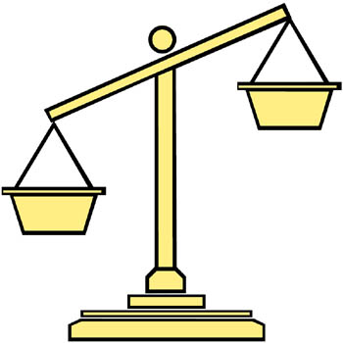
Seven Verbs for Israel’s Sins
1) “sell” (v. 6a),
2) “sell” (implied, v. 6b),
3) “trample” (v. 7),
4) “turn away” (v. 7)
5) “go in” (v. 7)
6) “recline” (v. 8)
7) “drink” (v. 8)

Slide 26
Slavery
Prisoners of war were often kept as slaves (Deuteronomy 21:10-14).
The law allowed Israel to purchase foreign slaves (Leviticus 25:44-45).
Israelites could become slaves through special circumstances (Leviticus 25:40).
Slaves are treated differently than employees (Leviticus 25:10-11).
All were to be set free in the Jubilee year (Leviticus 25:40, 51-52).

Slide 27
Fertility Cult / Immorality
Used magical rites, often involving sexual intercourse, to “guarantee” good crops and plenty of children
Involved temple prostitutes, both male and female, to engage in ritual sex
Practiced ritual laceration to work gods into blood lust or convince them of one’s sincerity
Usually tied to “thunder gods” because of the need for rain.
Tied to both seasonality and to the land, so God forbid Israelites to worship the gods of the land.

Slide 28
The Irony of Israel’s Rebellion and Punishment
Called out of slavery
Called special persons called Nazirites
Gave great victory over strong warriors
Led Israel to the land of promise
Engaged in slavery
Gave wine to those who did not drink
Strong shall become weak
Even the warriors shall flee naked

Slide 29
Traditional Idea of Security
God’s Upside-Down Judgment
Speed avoids trouble
Strong get stronger
Heroes save themselves and others
Archers in solid position hold off foes at range
Fast runners retreat easily
Cavalry retreats easily
High morale brings success
Speed doesn’t aid escape (v. 14)
Strong have no foundation (v. 14)
Heroes can’t even save themselves (v. 14)
Archers don’t have solid position from which to stand and fire (v. 15)
No escape for fast runners (v. 15)
Cavalry can’t get away (v. 15)
High morale will become low and they will run away with nothing (v. 16)

Slide 30
Sounds Like…
סופה
Two storm words in 1:14 begin with the “S” sound, suggesting the whistling wind.
“Soo-fah” sounds a lot like Safieh.
מלחמה
The word for “battle” sounds a lot like:
מלכם
The word for “their king” which, in turn, sounds like”
מלכם
The name of a pagan god.

