Slide 1
Jesus Christ, His Only Son, Our Lord
Exploring The Apostles’ Creed V English Ministry Grace Chinese Christian Church

Slide 2
“For no man can lay a foundation other than the one which is laid, which is Jesus Christ.” 1 Corinthians 3:11 NASB
“Jesus is God with a human face.”
“If theology were a maze, every corner and every turn would lead to Jesus. If anything does not, it is not Evangelical Theology.” --Michael E. Bird Evangelical Theology lectures
“Christology is key to theology. Christology is a stumbling block to modern consciousness.” --Richard B. Cunningham Christology lectures

Slide 3
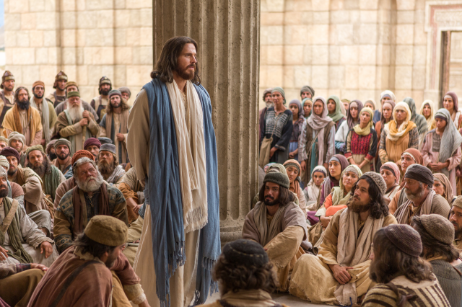
“In the beginning was the Word, and the Word was in company with God, and the Word was GOD!” (John 1:1 Pastor Johnny’s Translation)
“I and the Father, We are one.” (John 10:30 PJT) “Thomas answered and said to Him, “My Lord and my God!” (John 20:28 PJT)
D. A. Carson says, “God’s own fellow” and “God’s own self”
Udo Schnelle says we understand Jesus Christ through “this perfect unity with God and its expression,” noting that John 10:30 is the exact center of John
Frank Stagg notes that even though Word is used, His nature is declared in John 20:28

Slide 4
Scriptural Ideas on the Role of Jesus the Son
Scripture Reference
Pre-existent Activity
1 Corinthians 8:6
Colossians 1:16
Hebrews 1:2
1 Corinthians 10:4
John 3:17
Galatians 4:4
Romans 8:3
1 John 4:10
Through whom all made
In whom all created
Also made the world
Supplied Israel in wilderness
Sent to provide salvation
Sent in fullness of time
Sent as offering for Sin
Sent as propitiation for Sin

Slide 5
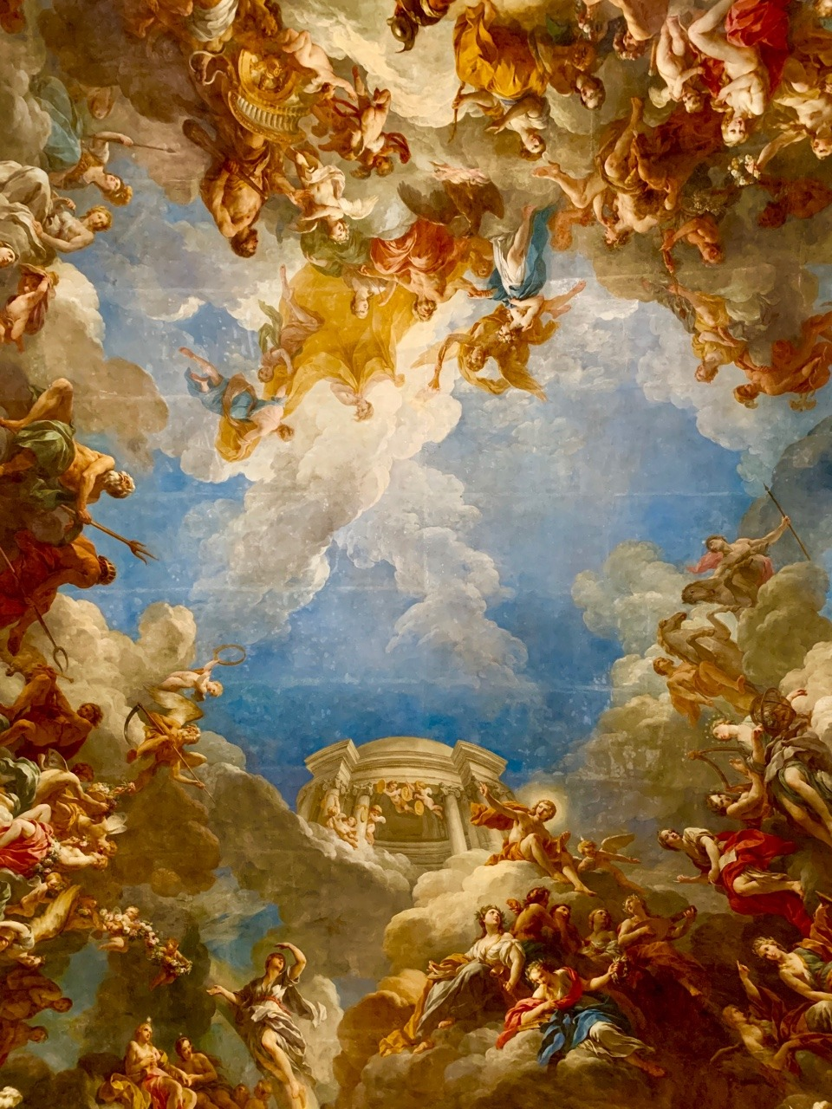
“Adoptionism” Diagrammed
Adopted as Christ/Lord
Increases in wisdom, stature, favor
Human Jesus
More pagan than Christian!

Slide 6
Pagan Versions of “Adoption/Apotheosis”

Slide 7
Subordinationism
FATHER
SON
SPIRIT

Slide 8
Continuity of PERSON
“The heavenly Son of God in becoming man did not become someone else. In some deep core of personal existence he must have been as a man what he had been before. And since what he had been before was absolutely unique, there must have been something absolutely unique in the nature of his manhood.” --John Knox, The Humanity and Divinity of Christ: A Study of Pattern in Christology, p. 43.

Slide 9
Philippians 2:5-7
Christ/Lord
Pre-existent Son
Increases in favor, wisdom, stature
Empties Divine Attributes/Power
Human Jesus
Divine Jesus
form

Slide 10
Philippians 2:6 & 9 (Hymn Verses?)
Who existed in the form of God Not as booty to be seized (or prize to be grasped) To be in equality with God (Philippians 2:6)
And so, God has “super-exalted” him And given to him The name that is above every name (Philippians 2:9)

Slide 11
A Possible Christology*
Kenosis: The idea that the pre-existent Christ negated enough divine privilege and power that He could become an authentic human and conquer sin.
Pre-existent Christ
Lord Jesus Christ
Exalted
Emptied
Jesus the Man
Yet, still One with the Father in holiness, love, righteousness.
*This classic theology needs some modification to avoid problems.

Slide 12
Philippians 2:7a* & 10 (Hymn?)
But, he emptied HIMSELF, Taking the form of a slave, Becoming in the likeness of humanity (2:7a)
In order that in the name of Jesus, Every knee should bow, The ones in the heavenly dimension, on earth, and those beneath (2:10)

Slide 13
What Jesus the Son Reveals to US
The Incarnation showed what God is like.
The Incarnation demonstrated the revealing love of God.
The Incarnation showed God reaching out to humanity, seeking them/us.
The Incarnation epitomized God’s purpose for all of us as demonstrated in Jesus.

