Slide 1
Luxurious Shallowness
Friday Night Justice
Amos 4:1-13

Slide 2
Comparing Amos and Hosea
Amos Reference | Amos Accusation | Hosea Reference | Hosea Accusation
Amos 3:5 | There is a cause and effect when a bird is snared in a trap or net. | Hosea 7:11-12 | God's people are as dumb as doves, so God will use a net of judgment to snare them.
Amos 3:4, 8 | Yahweh is a lion poised to rend Israel limb-by-limb if she doesn't repent | Hosea 13:7
Amos 4:1 | oppression for the sake of supporting a luxurious lifestyle | Hosea 13:6
Amos 4:4 | sacrifices offered without the appropriate lifestyle | Hosea 6:6, 8:13, 9:4
Amos 4:6-7 | God will punish with famine and harsh economic circumstances | Hosea 9:2-3
Amos 4:11 | God has already punished them with overthrown cities, but with more on the way, only a burning stick survives | Hosea 9:6, 11:6
Amos 5:19 | The Day of the Lord will be like fleeing from Yahweh's lion but facing Yahweh's bear | Hosea 13:8
God is like a lion or leopard waiting for Israel as His prey.
As Israel prospered, the wealthier they got, the less they thought about God.
God isn’t pleased with and won’t accept sacrifice without godliness.
Israel won’t be able to enjoy her grain or wine, but have non-kosher P.O.W. food.
Egypt will devour them as their valuables prove to be abandoned; the sword will fall upon Israel’s cities.
God’s judgment is as certain as when a mother bear has lost her cubs.

Slide 3
Cows of Bashan?
Doesn’t make sense from modern view
Not calling women “fat” or saying they “waddle”
To a stockman, were valuable and beautiful
Shapely and well-fed?
Because Baal was often pictured as a bull?
May have pictured husbands as “studs”
May have meant that they were cult prostitutes
For certain, God judged the women, too!
What comes to your mind when these wives demand that their husbands (“lords”) bring drink? (v. 1)
22

Slide 4
Manipulation!
If you really love me…we’ll have a new house, new car, baby, new furniture, etc.
If you really love me…we’ll go on this luxury vacation, move to a better neighborhood, party with my friends, etc.
If you really love me…you’ll get a new job, buy some new outfits, go back to school, buy me some jewelry/furs, etc.
If you really love me…you’ll pay more attention to me, you’ll give up your ambition and your friends for me, you’ll give up your principles (your ethics, your faith) to please me…
NONE of which is LOVE, but ALL of which is MANIPULATION!

Slide 5
OPPRESSION? (Part I)
midst
Amos 3:9 states that OPPRESSIONS are in Samaria’s ______________ (ASV, KJV, NASB, NEB, NRSV).
Dishonest merchants, with deceitful ______________ (ASV, D-R, KJV, NASB, NRSV), love to OPPRESS (Hosea 12:7 (E)).
In Samuel’s farewell speech (I Samuel 12:3), he asked whom he had DEFRAUDED (the same word translated OPPRESSED in Amos 4:1) and whom he had OPPRESSED (the word translated CRUSHED in Amos 4:1). He also asked from whom he had taken an __________ or a donkey.
Proverbs 14:31 states that those who OPPRESS the poor, insult their __________.
balances/scales
ass
Maker

Slide 6
OPPRESSION (Part II)
If Israel disobeyed God’s commandments, Deuteronomy 28:33 stated that foreigners would eat their produce and they would be continually ABUSED (the word used in Amos 4:1 for OPPRESS) and _________________ (ASV, D-R, HOL, KJV, NASB, NKJV, NRSV, RSV).
Hosea (5:11) said that Ephraim (Israel) was OPPRESSED and _______________ (same as word for CRUSHED in Amos 4:1) in judgment (D-R, KJV, NKJV, NRSV).
Isaiah 42:3 (ASV, D-R, HOL, KJV, NASB, NEB, NIV, NRSV) states that the servant of God will not damage a ___________________ (same root as verb for CRUSHED in Amos 4:1) reed.
crushed
broken
“Oppression is more than getting ahead; it is doing damage to someone. (v. 1)
bruised

Slide 7
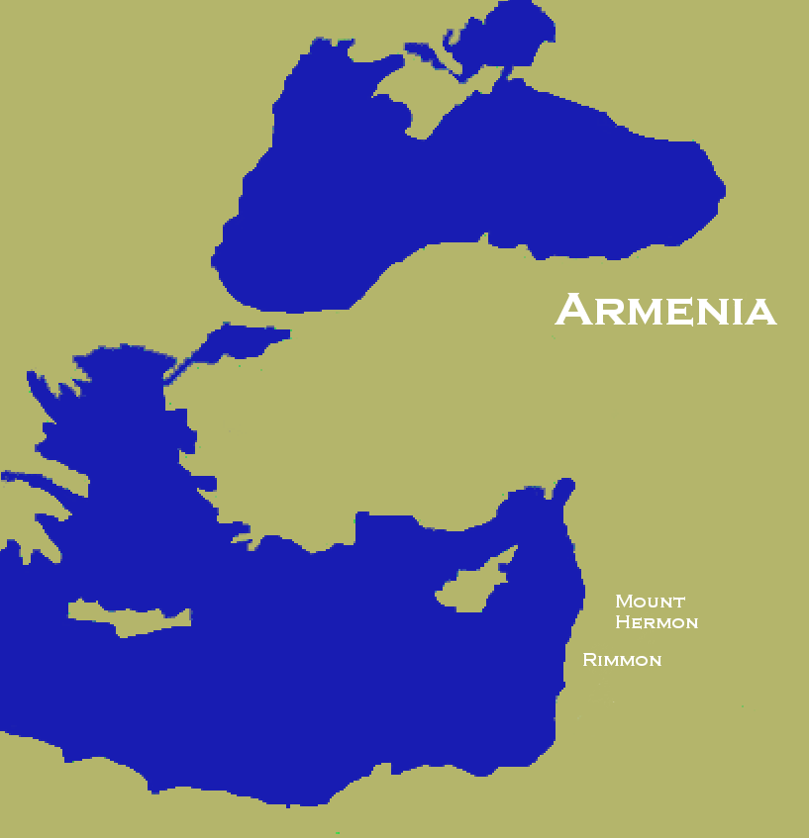
Oh, Harmon Where Art Thou?
We don’t know an ancient Harmon. Armenia?
Mt. Hermon? (change one vowel).
It might mean, as in the Septuagint, Rimmon—a cult for a pagan fertility god...
…suggested these women and all Israelites were sacred prostitutes
Naked? (Change “ha” to “ah”
Dungheap? (Change “har” to “hahd”)
It definitely meant that Israel would be taken captive and go into exile.
23

Slide 8
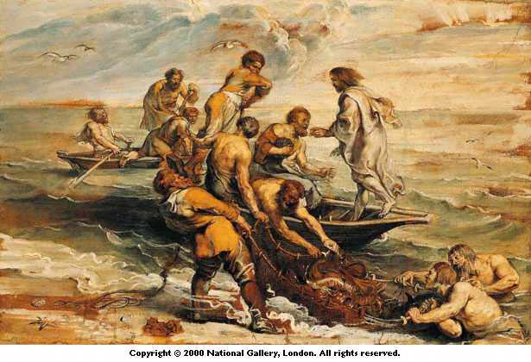
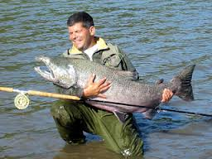
By Hooks [Shields?] and Fish Hooks

Slide 9
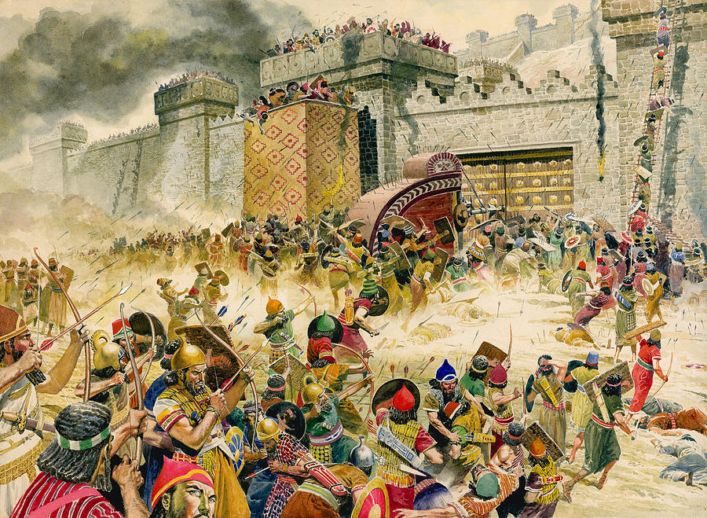
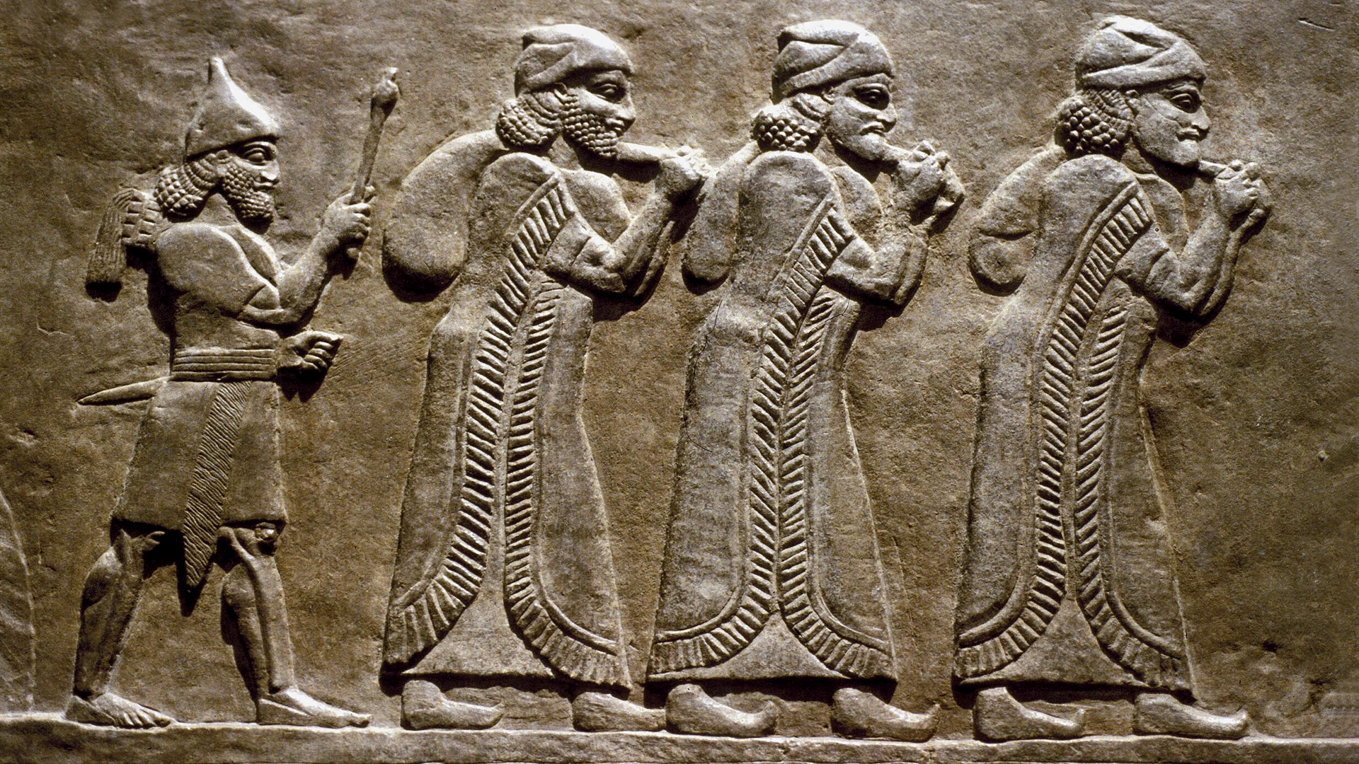
Amos (ca. 747), Tiglath-Pileser III (Pul) (740), Hamath (738),
Gaza (734), No. Israel (733), Shalmaneser V (727), Samaria (722)
(27,280 Israelites Deported)
Sargon II (722), Deportation (722/721)

Slide 10
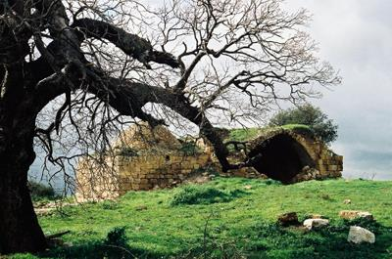
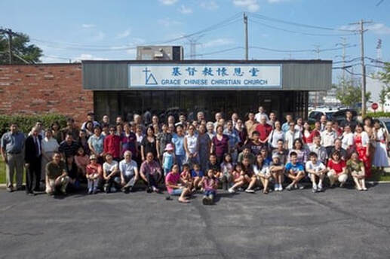
Come to Church and Sin!

Slide 11
Come to Church and Sin!
Israel profaned God’s name
Israel hedged her “faith” with other beliefs
Israel proclaimed God’s blessing while disobeying God
Israel’s priests said that God would never judge her for her sins
Israel brought tithes and offerings as insurance against crop failure and bad business deals
Why do we pray?
Why do we sing?
Why do we praise? Thank?
Why do we say prayers and creeds? Baptize? Take Communion?
Why do we have an offering?
25

Slide 12
“Go Over The Line” and …
…Gossip
…Judge
…Commit Idolatry (People, Doctrine, Tradition)
…Fantasize (Power, Influence, Wealth, Sex)
…Steal (from God or even each other)
…Rebel (reject God’s guidance/commands)

Slide 13
Consequences of Failures to Return
Famine (4:6)
Drought (4:7)
Blight and Insects (4:9)
(Green is not “liberal”)
Plague (4:10)
Revolution (4:11)
I Kings 17:1
I Kings 17:1
See God’s promise I II Chronicles 7:13-14
King David DID return in II Samuel 24:21
Jeroboam I and King Jehu of Israel
26

Slide 14
What Was God’s Purpose?
(v. 6) But you didn’t return to me – The very word of God
[“A saying of Yahweh”]!
(v. 8) But you didn’t return to me – The very word of God
[“A saying of Yahweh”]!
(v. 9) But you didn’t return to me – The very word of God
[“A saying of Yahweh”]!
(v. 10) But you didn’t return to me – The very word of God
[“A saying of Yahweh”]!
(v. 11) But you didn’t return to me – The very word of God
[“A saying of Yahweh”]!

Slide 15
Repentance / Turning Back
Real repentance requires confession
Confession may be secret (sins vs. God)
private (sins vs. individuals, a few)
public (sin vs. the church)
“The reason why we are to uncover our sins is not only that God may forgive them, but that we may forsake them. There is a closer link than we often realize between confessing of sins and the forsaking of them. How can we expect to overcome in the future if we do not deal seriously with our failures of the past?”
--John R.W. Stott, Confess Your Sins: The Way of Reconciliation, p. 19

Slide 16
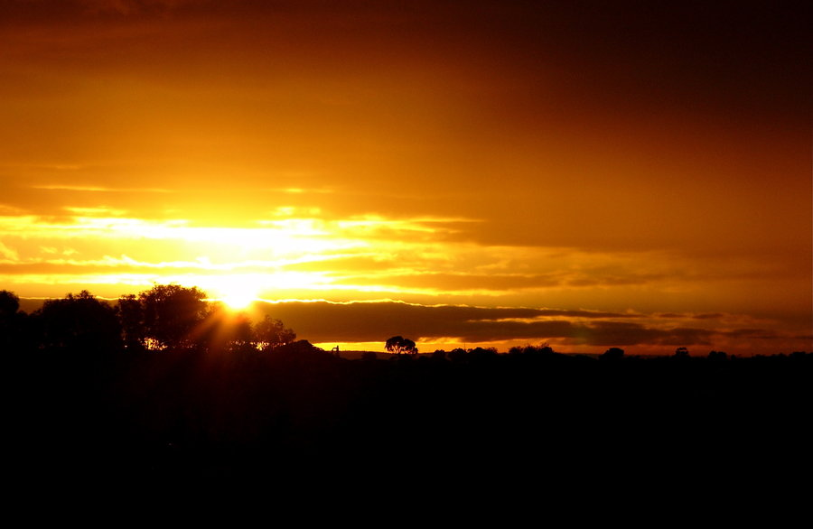
13) BECAUSE, check it out, the One who sculpted the mountains,
the One who created, as only God can, the wind,
And the One who revealed to humanity what [were] His thoughts, the One who made the dawn, brightness,
And the One who travels on the high places of the earth--
Yahweh, God of Armies, is His name.
(Pastor Johnny’s Translation)

