Slide 1
Maker of Heaven and Earth
Apostles’ Creed Study Grace Chinese Christian Church

Slide 2
Avoiding Sidetracks
“The emphasis on the story of Creation at the beginning of the Bible has constantly led theologians to forsake the rule which they would otherwise follow namely, that the basis of all Christian articles of faith is the Incarnate Word, Jesus Christ.” [Brunner, Emil, The Christian Doctrine of Creation and Redemption: Dogmatics: Volume II (Philadelphia, PA: The Westminster Press, 1952), p. 6.]

Slide 3
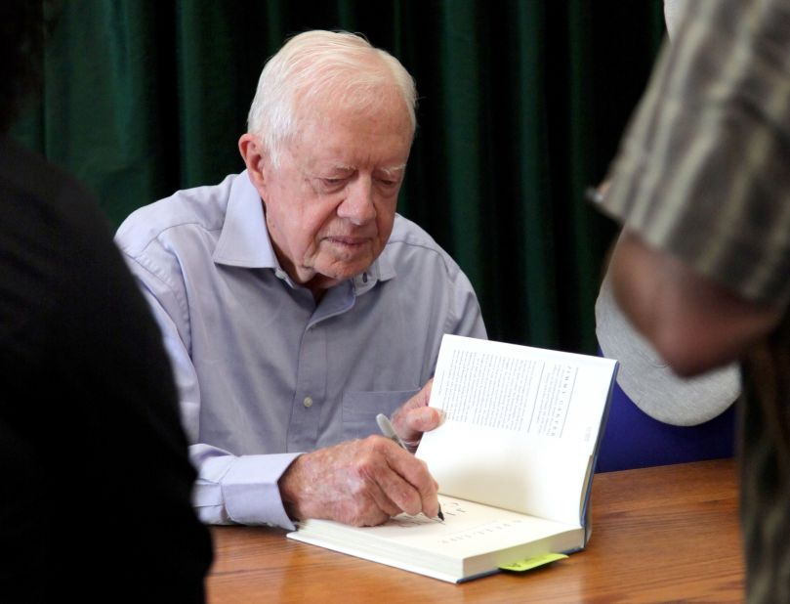
⁶ yet for us there is but one God, the Father, from whom all things came and for whom we live; and there is but one Lord, Jesus Christ, through whom all things came and through whom we live. [1 Corinthians 8:6 NIV]

Slide 4
…God, in whom he believed—the God who gives life to the dead and calls into being things that were not. [Romans 4:17b NIV]

Slide 5
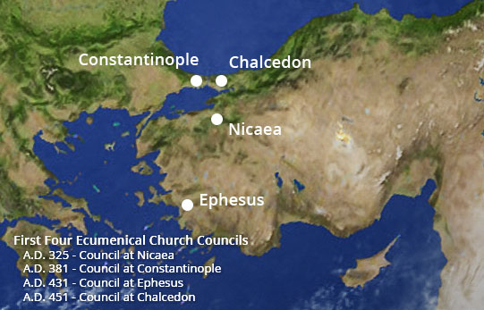
Evolution of the Creeds
Roman Apostles (c. 340) | Gallican Apostles (c. 244) | Caesarean (c. 325) | Nicean (c. 325) | Chalcedon (c. 451)
I believe in God almighty (Rufinus, c 400 read "Father almighty") | I believe in God the Father almighty | We believe in one God, the Father All-sovereign, | We believe in one God the Father All-sovereign | We believe in one God
 |  | the maker of things visible and invisible; | maker of all things visible and invisible; | maker of heaven and earth, and of all things visible and invisible;

Slide 6
Two Quick Comparisons
Old Testament
New Testament
¹⁰ Do we not all have one Father? Did not one God create us? Why do we profane the covenant of our ancestors by being unfaithful to one another? [Malachi 2:10 NIV]
⁴ The Spirit of God has made me; the breath of the Almighty gives me life. [Job 33:4 NIV]
¹⁰ In bringing many sons and daughters to glory, it was fitting that God, for whom and through whom everything exists, should make the pioneer of their salvation perfect through what he suffered. [Hebrews 2:10 NIV]
¹⁶ For in him all things were created: things in heaven and on earth, visible and invisible,… [Colossians 1:16 NIV]

Slide 7
“We can aver that whereas the Father is the ground of creation, the Son is the principle of creation, and the Spirit is the divine power active in creation.” [Bird, Michael F., What Christians Ought to Believe: An Introduction to Christian Doctrine Through the Apostles’ Creed (Grand Rapids, MI: Zondervan Academic, 2016), p. 71.]

Slide 8
Absolute Order Absolute Chaos
Leads to:
Meaninglessness
Pure necessity
Predictability [Watkin, Christopher, Biblical Critical Theory (Grand Rapids, MI: Zondervan Academic, 2022), p. 74.]
Leads to:
Meaninglessness
Pure chance
Unpredictability

Slide 9
Hebrew Words Used for Creation
ברא | create
עשה | accomplish
יצר | shape
יסד | establish

