Slide 1
Preparing to Teach Ecclesiastes 11 & 12
Grace Chinese Christian Church Bible Teachers’ Seminar

Slide 2
1) Send out your bread upon the surface [lit. “face”] of the waters BECAUSE in many days, you may find it. [PJT]

Slide 3
2) Give a portion to seven, and even to eight, BECAUSE you don’t know what catastrophe [or “evil”] may come upon the land. [PJT]
X, X + 1
A portion to 7, even 8!
Amos 1 and 2: “For 3 rebellions, and for 4”
Proverbs 30:18: 3 things too wonderful, a 4th I don’t understand (also v. 21)
Micah 5:4: recruit 7 shepherds, 8 princes

Slide 4
3) If the clouds are full, rain will pour out upon the land [or “earth”]; if a tree falls to the south or if to the north, the place the tree has fallen, there it is. [PJT]

Slide 5
4) One watching the wind doesn’t sow [the seed] and the one looking at the clouds doesn’t harvest. [PJT]

Slide 6
5) Just as you don’t know what the way of the spirit [“breath” or “life-breath”] as the bones fill the womb so you do not know the accomplishments of God Who accomplishes everything. [PJT]
“5) In the same way that you do not know what is the way of the wind or how the bones are formed in the mother’s womb, so you do not know the work of God, who does all things.” [Longman, Tremper III. The New International Commentary on the Old Testament: The Book of Ecclesiastes (Grand Rapids, MI: William B. Eerdmans, 1998), p. 254.]

Slide 7
Preparation for Verse 6
“Nevertheless, the strong foundational perspective of verse 5 (the conviction that even what we cannot understand can still be the work of God) means we can turn life’s unpredictabilities not into paralysis, but into opportunities (v. 6).” [Wright, Christopher J. H., Hearing the Message of Ecclesiastes: Questioning Faith in a Baffling World (Grand Rapids, MI: Zondervan House Publishing, 2023), p. 123.]

Slide 8
6) In the morning, sow your seed and for the evening don’t take back your hand BECAUSE you don’t know whether this one or that one will be advantageous or if the two of them will be just as good. [PJT]

Slide 9
7) So, light is sweetness and [it is] good to see the sun. [PJT]
Remember the Hebrew idea of Sheol
Note that the word for “darkness” is used to represent death in v. 8
Think about how Qoheleth uses “under the sun” to represent life on earth throughout the book
Some think that “sun” simply represents “pleasantness”
It seems best to take it as an introduction to verse 8 and the alternative

Slide 10
So, Think of the Alternative
8) BECAUSE if a person lives many years, the person should rejoice in all of them, BUT should remember the days of darkness because they are many, all that comes is a wisp [breath]. [PJT]
“Growing old is not for most people. It’s too trying. One daren’t eat this or do that, or even bend over to smell the garden flowers, for fear one’s back won’t straighten up. …Well, it’s most certainly better than the alternative.” [Todd, Charles. A Fearsome Doubt (New York: Bantam Books, 2002), p. 54.]

Slide 11
“Life is to be lived with joy and by following what our heart desires (v. 9a).” (Wright, p. 125)
9) Rejoice, young person, in your youthfulness and let your will be positive [or “heart” be merry] in the days of your vitality [same root as “young person”]. So, walk in the way of your will and the vision of your eyes, but know that upon all these things, God will bring you to judgment. [PJT]
IS Qoheleth speaking with a forked tongue here?
DID orthodox editors, shocked at his advice, try to rein things in with an additional phrase?

Slide 12
10) So, remove frustration from your determination [lit. heart] and send away pain from your physical body [lit. flesh] BECAUSE youthfulness and youthful looks [lit. “black hair”] are a wisp. [PJT]

Slide 13
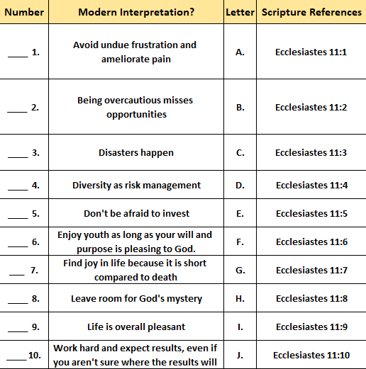
J
D
C
B
A
I
H
E
G
F

Slide 14
ברא = “bah-RAH” = Special Creation

Slide 15
Targum of Ecclesiastes 12:2-3
Sun = brightness of face
Moon = picture of cheeks
Stars = pupils of the eye
All affected by the aging process
Clouds = eyelids while rain = tears
Keepers of the house = hands or arms (slaves?)
Valiant men = the back or knees (free men?)
Grinders = teeth (women?)
Windows = eyes (older women?)

Slide 16
Allegories of Ecclesiastes 12:4-5
Double doors = closed to trade [or ears?]
Sound of the mill = business shut down [diminished hearing?]
Sound of a bird = solitary bird filling the silence where… (light sleeping or rising timbre of voice)
Daughters of song bowed = no more festive energy (hearing)
Afraid of height = balance issues
Terror of road = hesitance to go anywhere
Almond blossom = white hair
Locust tree = impotence or insect dying after giving birth
Caper fruit = aphrodisiac doesn’t work

Slide 17
Bonus Slide A: The Eschatological Allegory Brown, William P. Ecclesiastes: Interpretation: A Bible Commentary for Teaching and Preaching (pp. 108-109)
I. Demise of the Cosmos verse 2 a. Cosmic darkness b. Clouds II. Demise of the Domicile verse 3 a. Incapacitated male “guardians” b. Diminished female “grinders” c. Dimmed female “onlookers” III. Demise of Commerce verse 4a a. End of commercial traffic b. Decline of the mill sound

Slide 18
Bonus Slide B: The Eschatological Allegory Brown, William P. Ecclesiastes: Interpretation: A Bible Commentary for Teaching and Preaching (pp. 108-109)
IV. Rise/Demise of the Natural Realm verses 4b-5a a. Rise of bird songs b. Terror everywhere c. Decay and impotence V. Demise of the Individual verses 5b-7 a. Entrance into the eternal home b. Broken symbols of life c. Return to life’s genesis

Slide 19
6) Until the silver cord is snapped and the golden bowl is smashed; and the pitcher is broken against the well, and the jug smashed at the pit. [Alter, Robert. The Wisdom Books, p. 389]

Slide 20
Dust Returns to Dust (vv. 7-8)
19) By the sweat of your face you shall eat bread till you return to the ground, for out of it you were taken; you are dust and to dust you shall return.

Slide 21
What Qoheleth Did!
אזן = (piel) pondered
חקר = (piel) searched out
תקן = (piel) set in order (many proverbs)

