Slide 1
Preparing to Teach Acts 11
Grace Chinese Christian Church
Sunday School Teachers’ Workshop

Slide 2
Content Overviews
Perkins:
I. Peter defends conversion of Gentiles in Jerusalem (Acts 11:1-18)
II. Church at Antioch (Acts 11:19-30)
Geisler: The Transition of the Church—Greeks (chapters 8-12)
A. The three conversions (8:1-11:18)
1. Eunuch, an Ethiopian (8:26-39)—a son of Ham
2. Saul, a Tarsian (9:1-19) – a son of Shem
3. Cornelius, an Italian (10:1-11:18) – a son of Japheth
B. The two persecutions (11:19-12:25)
1. Because of Stephen (11:19-30)
2. Because of Peter (12:1-25)

Slide 3
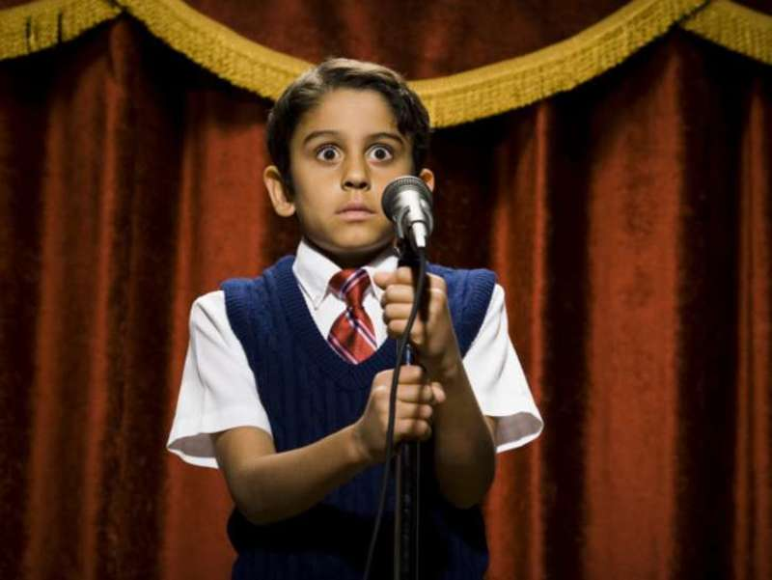

Ever Been “On the Spot?”

Slide 4
Setting the Stage
So, the apostles and the brothers [and sisters], those who were in Judea, heard that the Gentiles had received the Word of God. 2) So, when Peter went up to Jerusalem, those of the circumcised created division against him, 3) saying that “You went in the presence of men who had no circumcision and dined with them.” [PJT]

Slide 5
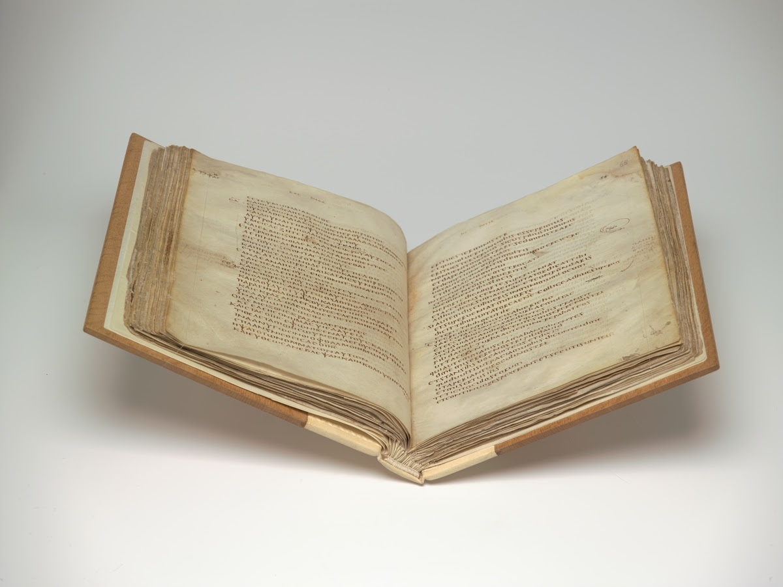
How Urgent Was Peter’s Trip?
Some manuscripts read:
2) Now Peter had for a long time desired to go up to Jerusalem. And having called the brethren and strengthened them, making much discourse through the country, he told them of the grace of God. [Bezae codex, some Old Latin, Vulgate, Syriac, and Coptic versions]

Slide 6
Setting the Stage
So, the apostles and the brothers [and sisters], those who were in Judea, heard that the Gentiles had received the Word of God. 2) So, when Peter went up to Jerusalem, those of the circumcised created division against him, 3) saying that “You went in the presence of men who had no circumcision and dined with them.” [PJT]

Slide 7
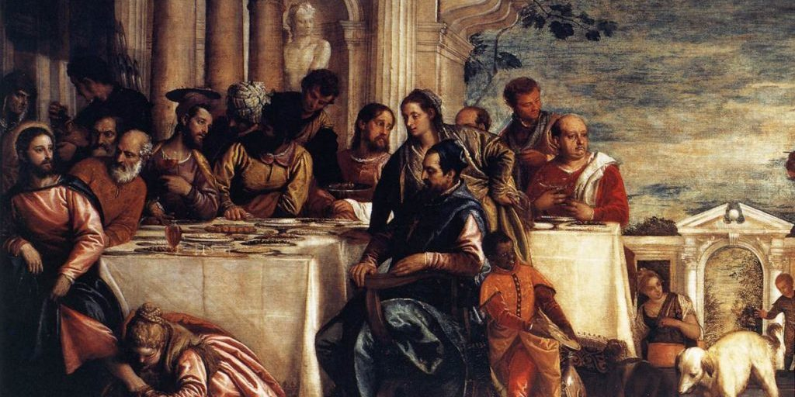
The Same Accusation (Luke 15:2)

Slide 8
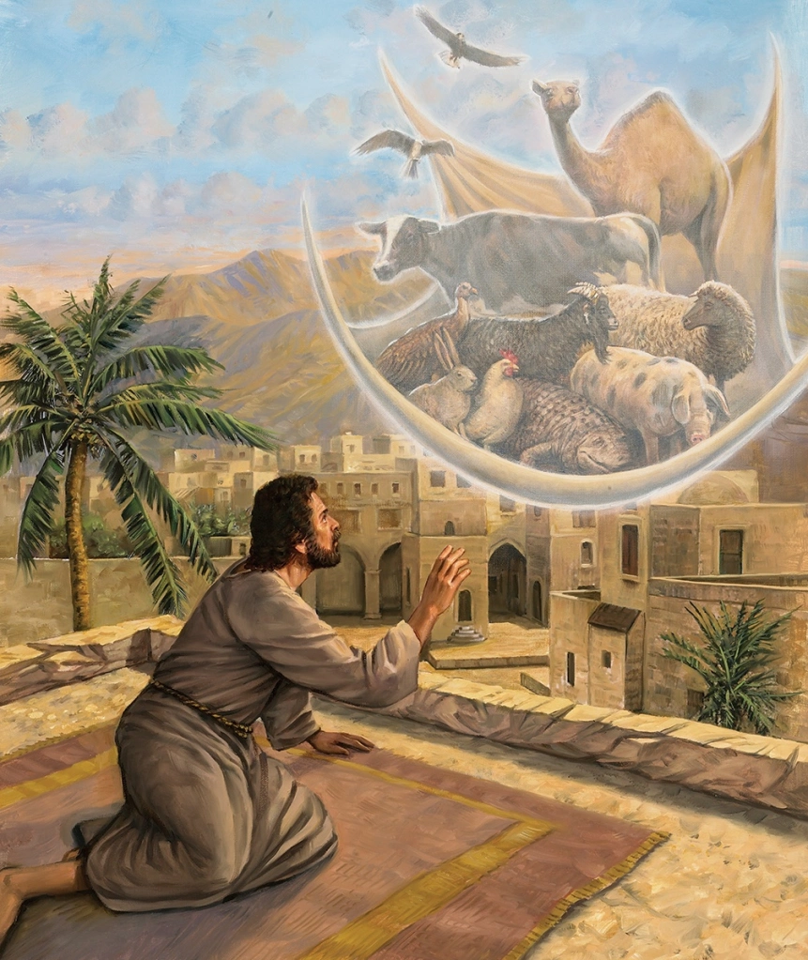
Peter Initiates His Defense
4) So, Peter initiated, expounding [lit. “he expounded”] this matter in order, saying:
5) “I was in the city of Joppa praying and, in an ecstatic experience, I saw a vision, a vessel came down, something like a great sheet let down from the heavens by four corners and it came expressly to me. 6) When I had focused [lit. “fashioned”] my eyes, I was concentrating, then I saw quadrupedal creatures from earth, beasts of prey, and the birds of the heavens.
7) And then, I heard a voice saying to me, ‘Rise, Peter, kill [as in sacrifice] and eat.’ [PJT]

Slide 9
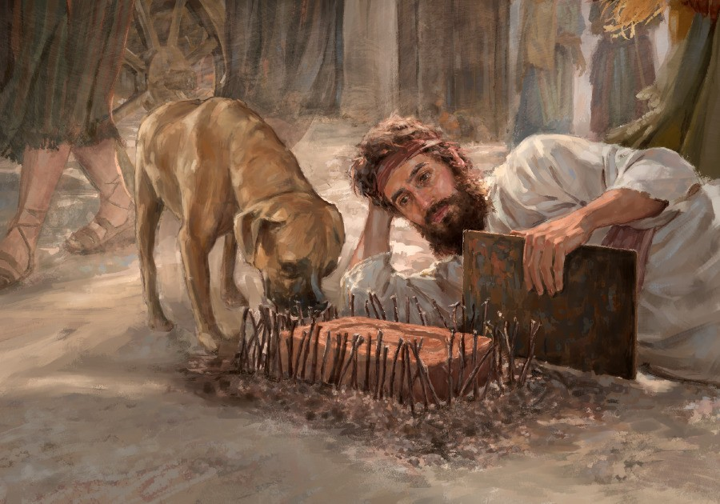
Call-Back to Ezekiel 4
8) But I said, ‘No way, Lord, because nothing common or non-kosher [“unclean”] has entered into my mouth.’ 9) But the voice answered a second time out of heaven, ‘What God has cleansed, is not common.’ 10) So this happened three times and all were drawn up again into the heavens. 11) So, check it out, immediately there were three men arrived at the house where I was, commissioned from Caesarea to me. [PJT]

Slide 10
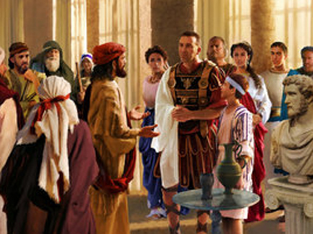
12) But the Spirit said to me, ‘Go along with them, making no distinction [no separation, no division].’ So, these six brothers went with me and we entered into the man’s house. [PJT]
Spirit-led
Divine order “no division”
6 + 1 = 7
Demonstration of God’s
approval

Slide 11
Emphasis on the Holy Spirit
13) So he told us how he had seen the angel standing in his house and saying: ‘Commission messengers to Joppa and compel Simon, the one called Peter, to come. 14) That one will speak words to you in which you and everyone in your house will be saved.’ 15) Then, as I initiated speaking, the Holy Spirit fell upon them just as upon us at the beginning. [PJT]
“He compares the experience of the Gentiles with that of the group in the upper room, rather than with that of the first converts from Judaism: there is nothing that might suggest a status as ‘second-class citizens’ for the Gentiles.” – [I. Howard Marshall, p. 197.]

Slide 12
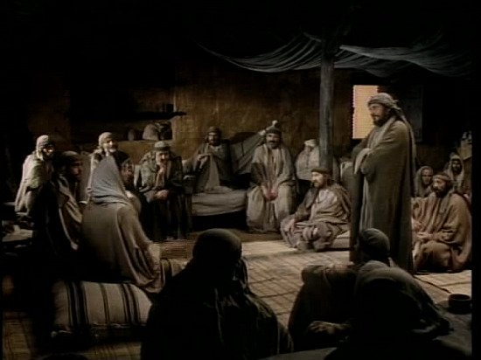
18) Then, when they heard these things, they were silent and gave glory to God saying, “So then, God gave repentance toward Life to the Gentiles. [PJT]
16) So, I remembered the words that the Lord spoke to us saying, ‘John immersed with water, but you will be immersed by the Holy Spirit.’ 17) If, therefore, God gave them the same gift as to us upon believing in the Lord Jesus Christ, who was I to be able to hold back God?’ [PJT]

Slide 13
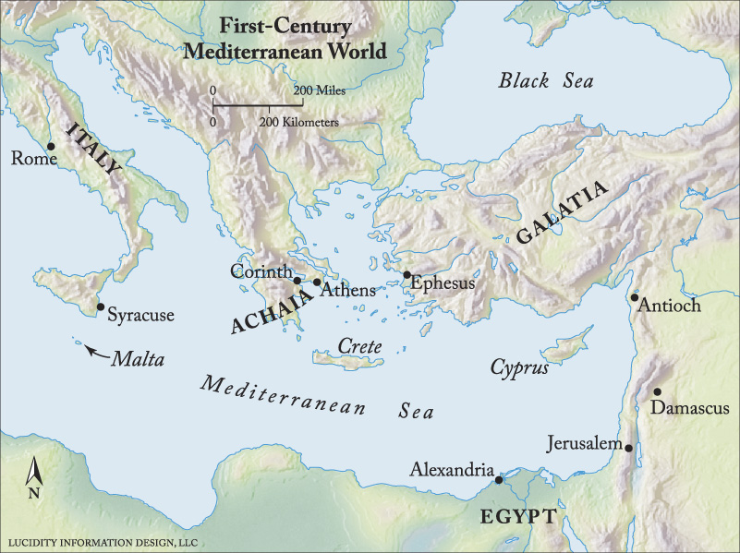

Slide 14
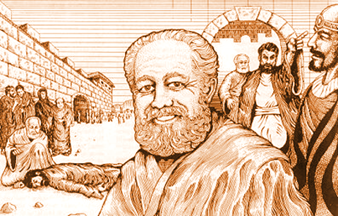
Coming Full Circle
Barnabas sent to confirm (v. 22)
Saw God’s grace and
encouraged spiritual
development (v. 23)
God affirms Barnabas’ mission
with positive results (v. 24)
Barnabas recruits Saul in Tarsus
(v. 25)
Saul joins team (vv. 25-26)

Slide 15
26) And when he had
found him [Saul/Paul], he
brought him to Antioch.
So it happened that they
assembled themselves
together with the church
for a full year and they
taught a lot of people.
And the disciples were
called “Little Christs” first
in Antioch. [PJT]

Slide 16
27) And in those days,
prophets came down
from Jerusalem to Antioch.
28) So, one of them
named Agabus rose up
and presaged by means
of the Spirit that there
would be a huge famine
upon the whole world,
and this took place in the
days of Claudius. [PJT]

Slide 17
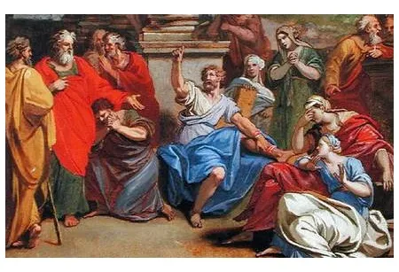
Remember Agabus for Acts 21:10

