Slide 1
Preparing to Teach Acts 12-13
Grace Chinese Christian Church Skokie, IL

Slide 2
Persecution Precedes Progress

Slide 3
Which Herod is Which?
Pheroras Herod’s brother
Antipater III
Alexander
Aristobulus

Slide 4
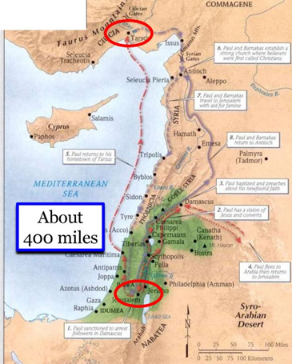
Acts 12:1-2 [PJT]
1) Around that opportune moment [or season], Herod the King [Agrippa I] thrust [literally threw] his hands upon some from the church to accomplish evil [against them], 2) killing James the brother of John with a sword.

Slide 5
Why James? We understand Peter!
Jesus answered, “You will drink the cup I drink and be baptized with the baptism I am baptized with…” Mark 10:39b [NIV]
James = 1st recorded martyr
Papias of Hieropolis wrong see John 21:22

Slide 6
3) So, seeing it was well-received by the Jews, he added on to seize Peter, but it was the days of unleavened bread. [PJT]

Slide 7
4) So, when he had seized him, he placed him in prison, handed over to a guard of 16 soldiers [four groups of four] guarding him in prison, thinking that after the Passover, he would bring him out to the people. [PJT]

Slide 8
5) Therefore, Peter was closely guarded in prison, BUT extended prayer was being made to God concerning him by the church. [PJT]

Slide 9
Answer to Prayer: Acts 12:6-8 [PJT]
6) On the night before Herod was bringing Peter out [for trial], Peter was constricted by two chains and sleeping [while] guards kept watch over the prison.
7) So, check it out, the Angel of the Lord stood by him and a light shined in the room. He hit Peter on the side and awakened him saying, “Get up in a hurry.” The chains fell off his hands.
8) Then, the angel said to him, “Tie [your robe] and put on your sandals. Then, he did it, and [the angel] said to him, “Wrap your garments around yourself and follow me.”

Slide 10
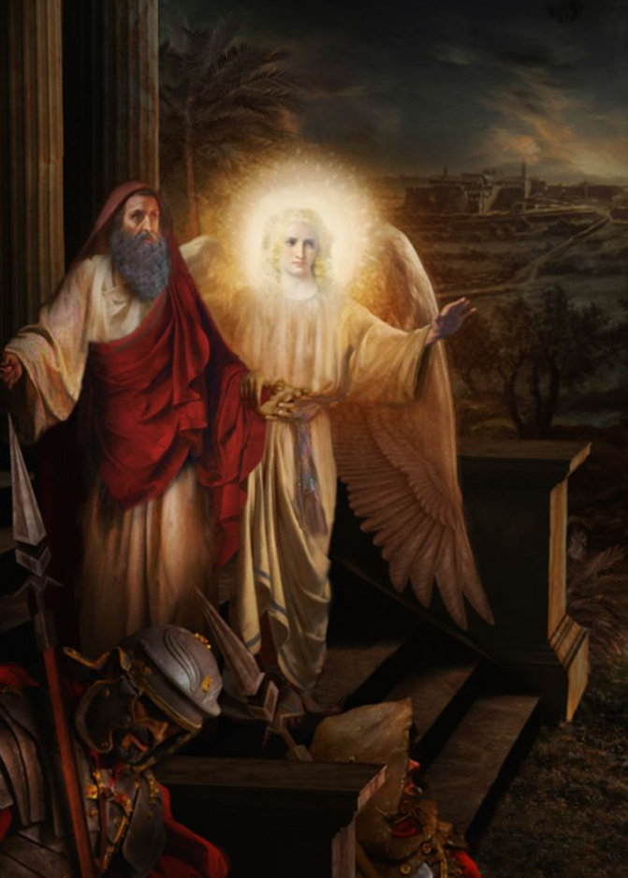
Details Worth Remembering!
Thought it was a vision (v. 9)
1st and 2nd guardposts, not unusual, within prison (v. 10)
Outer gate opened αὐτομάτη = automatic (v. 10)
On the street, the angel departed (v. 10)
Confessed God’s work (v. 11)
Went to worship (v. 12)

Slide 11
Sadly Typical!
Rhoda recognizes his voice and gets excited (v. 14)
Despite prayer, they thought she was crazy (v. 15)
They sought alternate explanation (angel, messenger) (v. 15)
Peter kept knocking (v. 16)
Saw and were astonished (v. 16)
Shared and confirmed (v. 17)

Slide 12
International Crisis (vv. 19b-23)

Slide 13
Segue to the Next Expansion

Slide 14
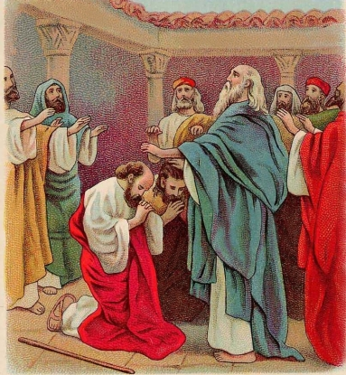

Slide 15
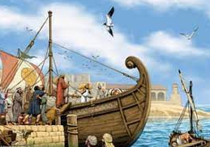
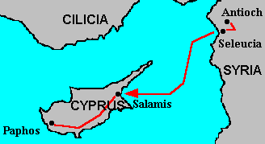
Ca. 16 mi.
ONLY 130 MILES BETWEEN SELEUCIA – SALAMIS (MAYBE A-DAY’S JOURNEY)
Ca. 100 mi.

Slide 16
Opening Wider to the Gentiles
Sergius Paulus
In favor of Caesar Claudius
Proconsul of Senatorial province
Bar-Jesus [“son of God saves”]
Elymas [“skillful,” “wise”]
“crooked as a corkscrew” reads The Message paraphrase
Paul’s name change?

Slide 17
Important Concept = Satan’s Fall
“The author of Luke-Acts extends the picture to characterize the apostolic mission of the post-Easter church as well. Satan’s ‘fall’ is revealed in the successive humiliation of his allies, the demons and the magicians. … Paul’s effective curse on Elymas the Magus, ending the latter’s rivalry in the court of Sergius Paulus (Acts 13:4-12), is a further example, along with Paul’s exorcism of the python-spirit from the slave girl in Philippi (ruining her masters’ fortune-telling business, 16:16-21), and the spontaneous burning of magical scrolls by converts (worth fifty thousand silver coins! 19:18-19).” [Meeks, Wayne A., The Origins of Christian Morality: The First Two Centuries (New Haven, CT: Yale University Press, 1993), p. 116.]

Slide 18
From Cyprus to Turkiye (Perga, Pamphilia)

Slide 19
Paul’s Sermon
God’s goodness to Israel (vv. 17-22)
Fulfillment of Messianic Promise in Jesus (vv. 23-37)
Forgiveness of sin through Christ (vv. 38-41)
Positive Response (vv. 42-49)
Counter-response in Persecution (vv. 50-52) (but filled completely with joy through the Holy Spirit)

