Slide 1
Preparing to Teach Acts 16 with Transition
Grace Chinese Christian Church Skokie, IL Dr. Johnny L. Wilson

Slide 2
Anticipating the 2nd Missionary Journey
35) So, Paul and Barnabas remained in Antioch, teaching and evangelizing the word of the Lord along with many others. 36) But after some days, Paul said to Barnabas, Let’s turn back and look after the brothers [and sisters] according to all the cities in which we proclaimed the word of the Lord. “How do they have it?” [fig. “How are they doing?”] [PJT]

Slide 3
Pay Attention to the Verbs
έπιστρέϕαντες [eh-pihs-TREH-fahn-tehs]
Go back OVER [that is, “return”]
ἐπισκεψώμεθα [eh-pihs-kehp-SOH-meh-thah]
to look over, oversee, or care for.
The work wasn’t finished yet!

Slide 4
37) But Barnabas wanted to take along with them John who is called Mark. 38) But Paul considered it improper to take the one who abandoned them from Pamphylia and hadn’t gone with them to the work. [PJT]
Barnabas
Paul

Slide 5
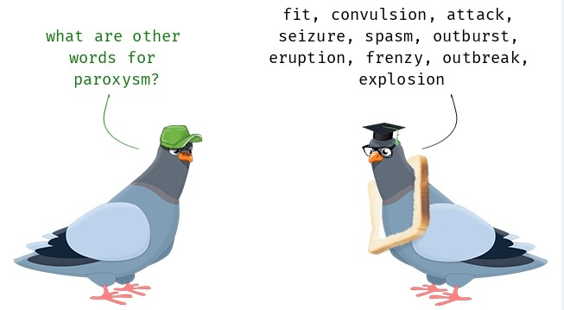
39) So, a dissension occurred such that they severed themselves from each other, Barnabas taking Mark and sailing out for Cyprus, 40) Paul chose for himself, Silas, and left, entrusted [handed over] to the grace of the Lord from the brethren. 41) So, he went through Syria and Cilicia strengthening the churches. [PJT]
παροξυσμὸς [pah-ruhx-suhs-MOHS]
“paroxysm”

Slide 6
NOT Paul’s Final Opinion on Mark
“²³ Epaphras, who is in prison with me for the cause of Christ Jesus, greets you, ²⁴ as well as my coworkers Mark, Aristarchus, Demas, and Luke.” [Philemon 23-24 CEB]
^{“11} Only Luke is with me. Get Mark, and bring him with you. He has been a big help to me in the ministry.” [2 Timothy 4:11 CEB]

Slide 7
39) So, a dissension occurred such that they severed themselves from each other, Barnabas taking Mark and sailing out for Cyprus, 40) Paul chose for himself, Silas, and left, entrusted [handed over] to the grace of the Lord from the brethren. 41) So, he went through Syria and Cilicia strengthening the churches. [PJT]

Slide 8
1) Then, he came to Derbe and Lystra, and check it out, a disciple was there named Timothy, son of a Jewish woman who believed, but a Greek father. 2) The brothers from Lystra and Iconium witnessed positively toward him. [PJT]

Slide 9
3) THIS ONE [Timothy], Paul wanted to go with him, and took him [and] circumcised him because of the Jews that were in those places because they all knew that his father was Greek. [PJT]
Had been a disciple
Members from Lystra AND Iconium offered character witness
Despite his mixed heritage, was willing to undergo circumcision as per 1 Corinthians 9:19-20

Slide 10
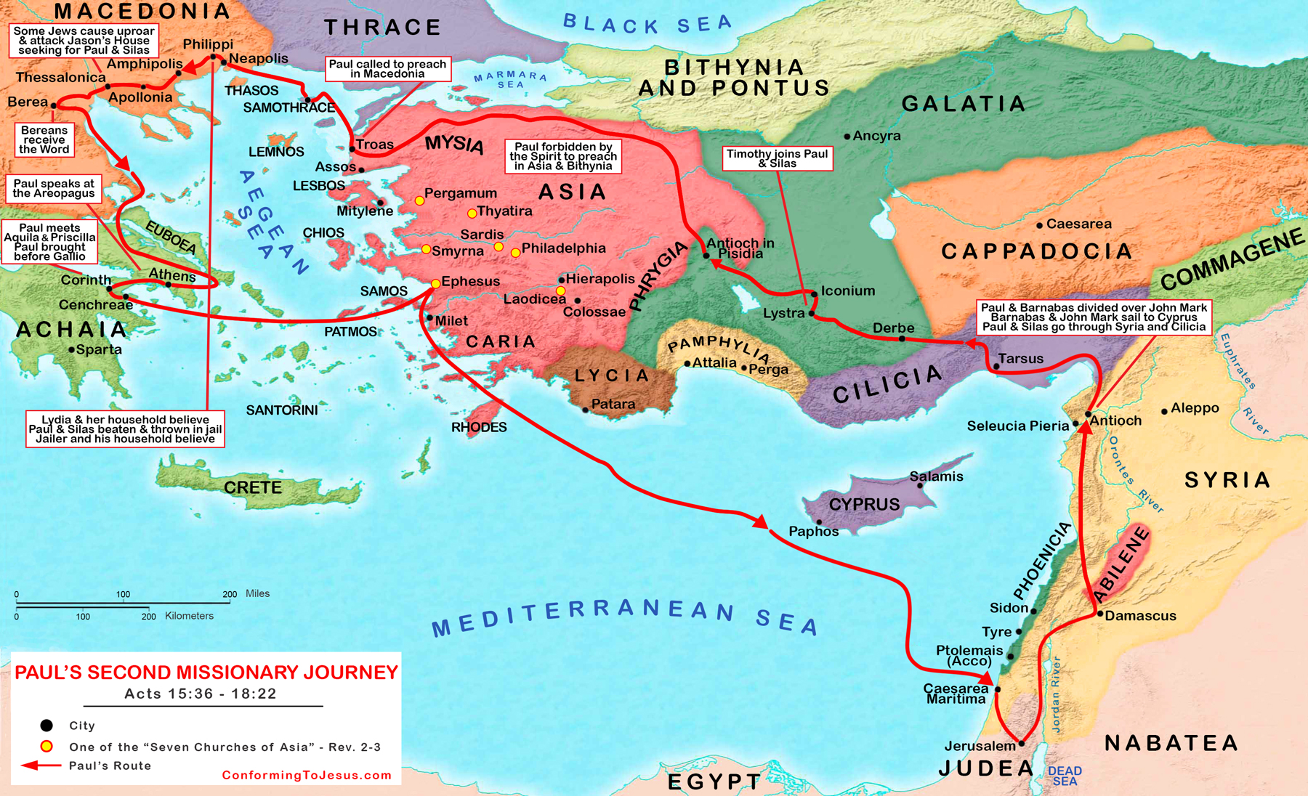
WHERE WE’RE HEADED:
GRACE CHINESE CHRISTIAN CHURCH

Slide 11
Three Levels of Direction?
3. Vision (Acts 16:9)
2. Spirit of Jesus suffered them not (Acts 16:7)
1. Forbidden of the Holy Spirit (Acts 16:6)

Slide 12
Interpreting the Levels
Holy Spirit forbids
Spirit of Jesus (wording not in later texts, but in earlier ones)
Vision
Inner voice? Counselor/Teacher? Scripture? Dream?
Vision of Jesus? Remembered teaching of the Lord?
Dream? Sense of Need? Sense of Possibility? Symbol?

Slide 13
Paul’s Visions
Acts 18:9-10
Acts 22:17-21
Acts 23:11
Acts 27:21-26

Slide 14
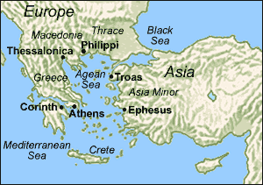
Neapolis and Philippi (Kavalla)

Slide 15
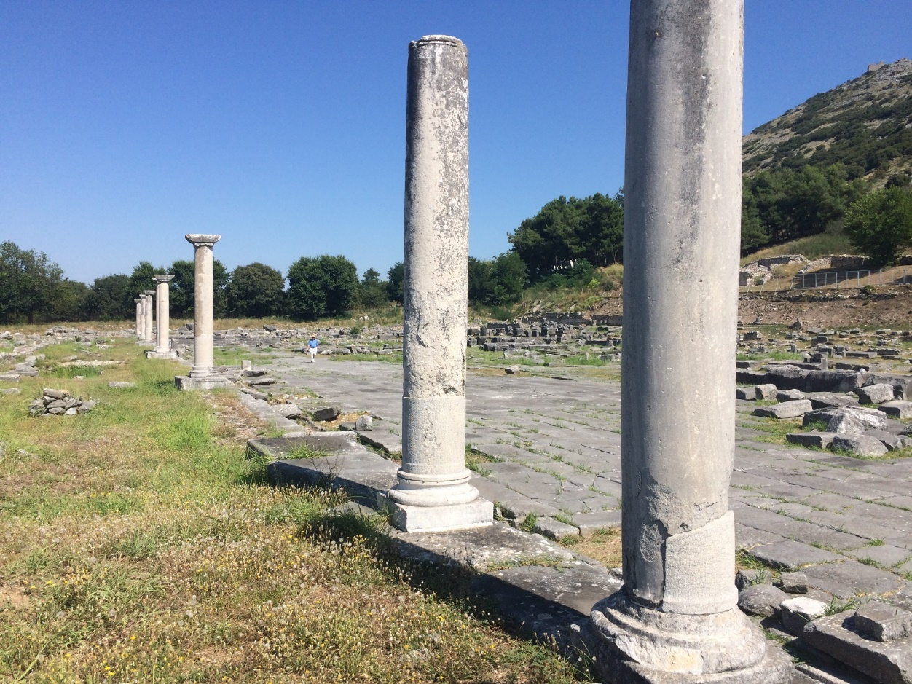
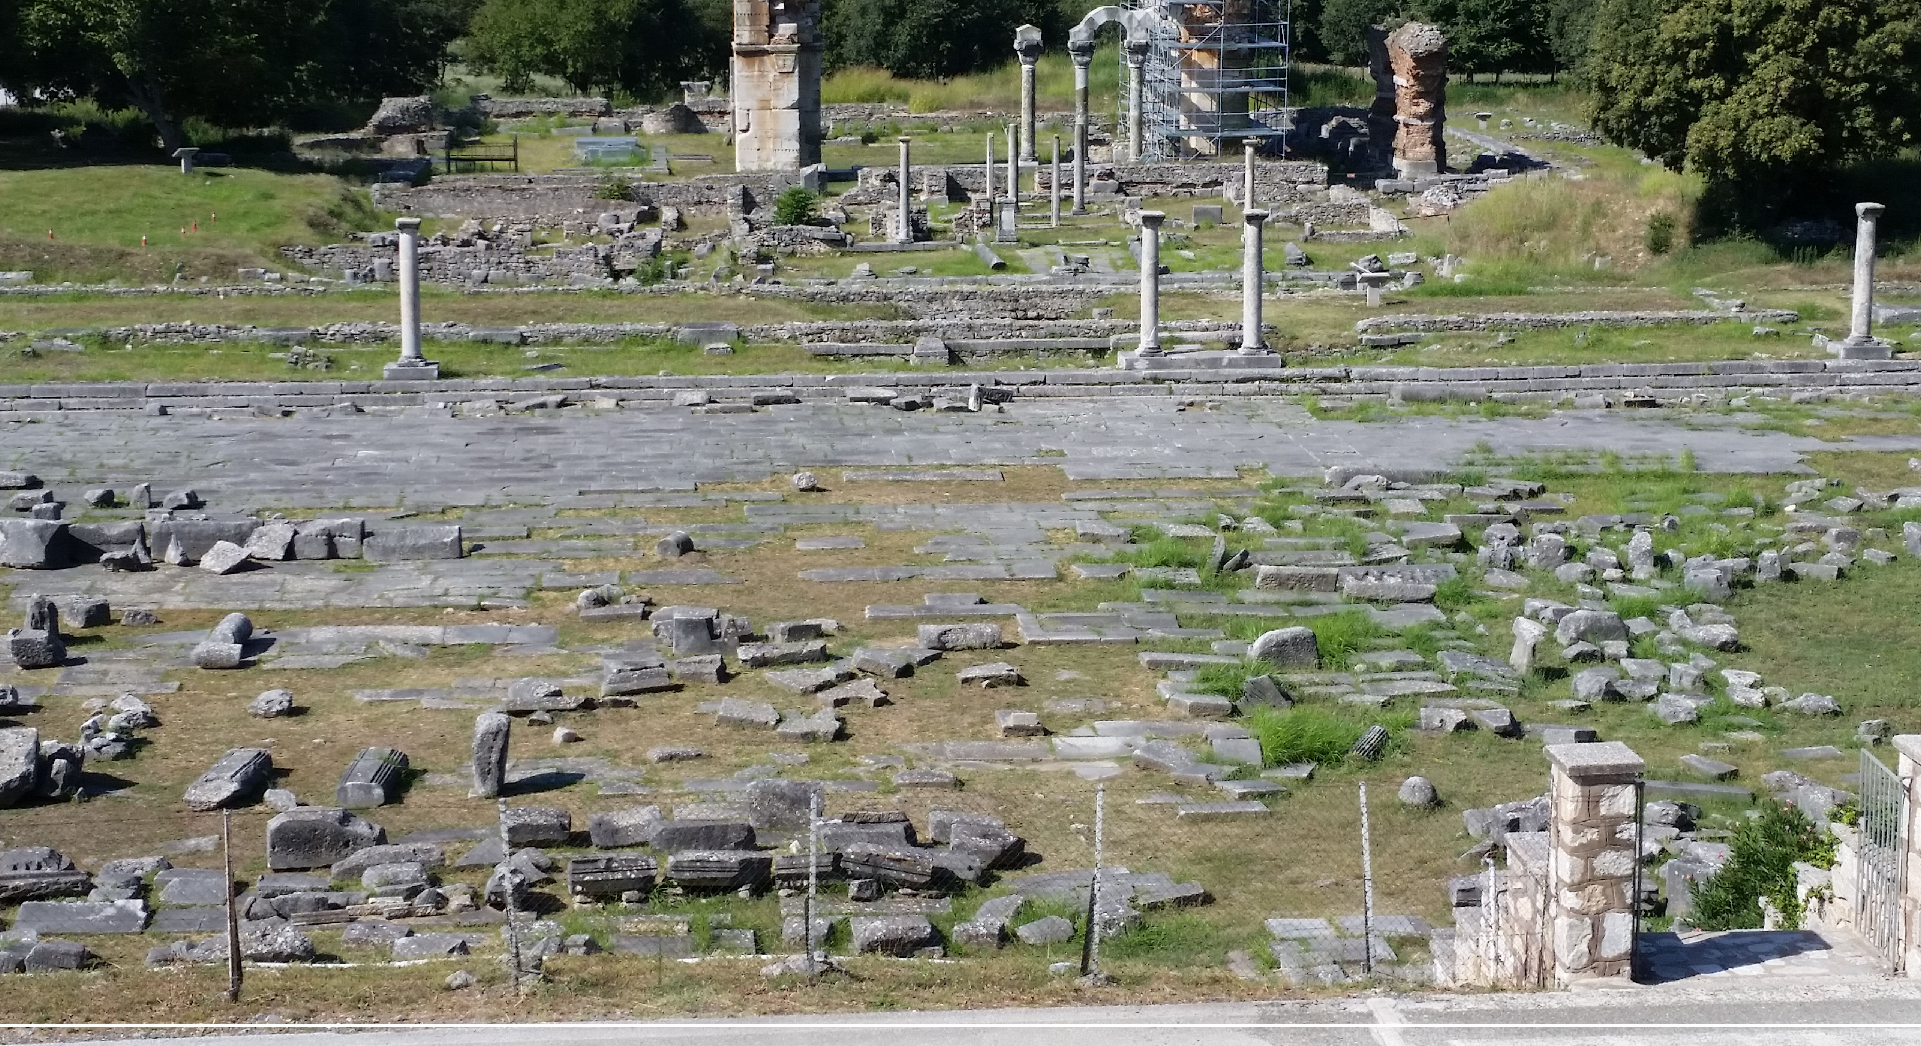
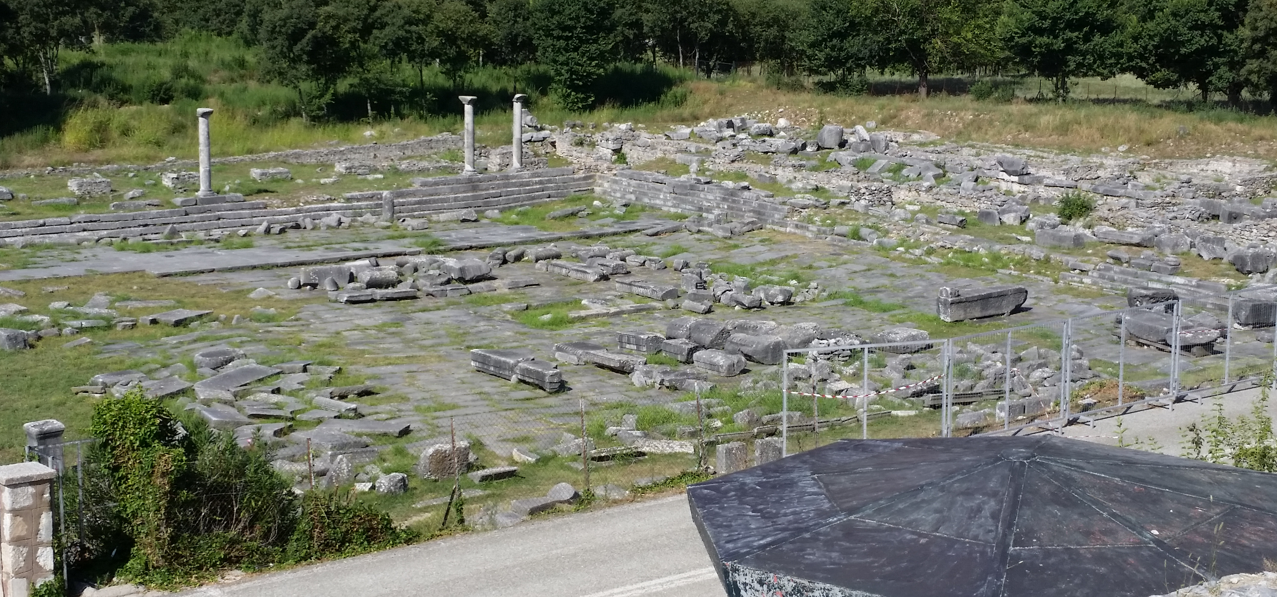
AT THE FORUM (= PUBLIC PLAZA):

Slide 16
14) And there was a woman named Lydia, a dealer in purple cloth from the city of Thyatira and worshipper of God was listening, the Lord opened her will [lit. “heart”] double-wide [the verb is an old Greek word combining “two” and “wide”—Robertson, p. 252.], holding her attention to the utterances of Paul. [PJT]

Slide 17
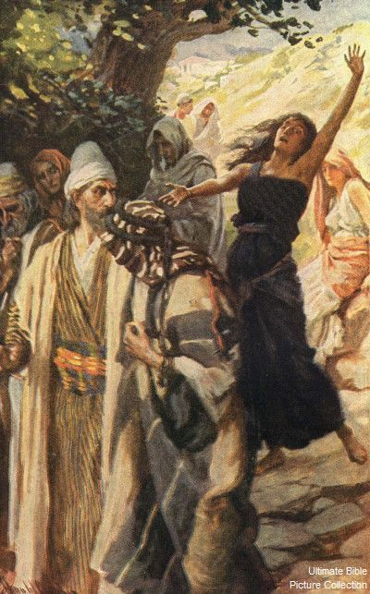
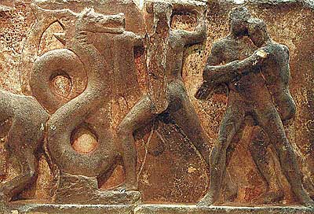
Spirit of a Python

Slide 18
Antisemitism Used as an Excuse!

Slide 19
Roman Citizenship Forms an Entree

