Slide 1
Opposition and Opportunity
Preparing to Teach Acts 17-18 Grace Chinese Christian Church Skokie, IL

Slide 2
Along the Via Egnatia [Acts 17]

Slide 3
At Philippi

Slide 4
Along the Via Egnatia [Acts 17]

Slide 5
To Amphipolis

Slide 6
Along the Via Egnatia [Acts 17]
Apollonia

Slide 7
Significant Trade and Culture

Slide 8
Acts 17:1-2 [Anchor Bible, AB]
¹Now Paul and Silas traveled by way of Amphipolis and Apollonia and came to Thessalonika, where the Jews had a synagogue. ²Paul went there, as was his custom, and for three sabbaths he conversed with them on the scriptures.

Slide 9
Acts 17:3-4 [Anchor Bible]
³expounding and explaining that the Messiah was bound to suffer and rise from the dead, and saying, “He is the Messiah, this Jesus of whom I tell you.” ⁴Some of them were convinced and joined Paul and Silas, together with a large number of the God-fearing Greeks and not a few prominent women.
παρατιθέμενος
pah-rah = alongside
tih-THEH-meh-nohs = setting down or placing
Providing a comparison test between the scripture and what he was saying
A good teaching model

Slide 10
Acts 17:5 [AB] – Why Jason?
⁵But the Jews were jealous, took with them some worthless persons from among the idlers in the marketplace, and gathering a crowd, threw the city into an uproar. Attacking Jason’s house, they sought to bring Paul and Silas before the municipal assembly. [AB]

Slide 11
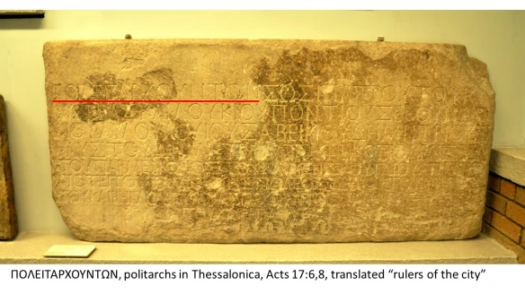
Acts 17:6-7 [Anchor Bible]
⁶When they did not find them, they dragged Jason and some of the brethren to the politarchs, shouting: “These men who stir up trouble in our part of the world have come here also. ⁷Jason has received them as guests, and they are all acting against the decrees of Caesar, saying that another, one Jesus is king. [AB]

Slide 12
Along the Via Egnatia [Acts 17]
Berea

Slide 13
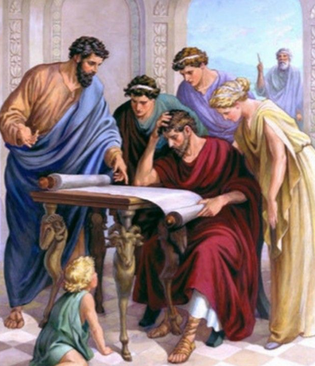
Acts 17:10-12 [AB]
¹⁰The brethren immediately sent both Paul and Silas away by night to Berea; and when they had arrived, they went to the Jewish synagogue. ¹¹The Jews there were more courteous than those in Thessalonica, and some of them received the word with great interest, and every day examined the Scriptures to see whether it was true. ¹²Many of them and some of the most respected Gentile women and men believed. [AB]

Slide 14
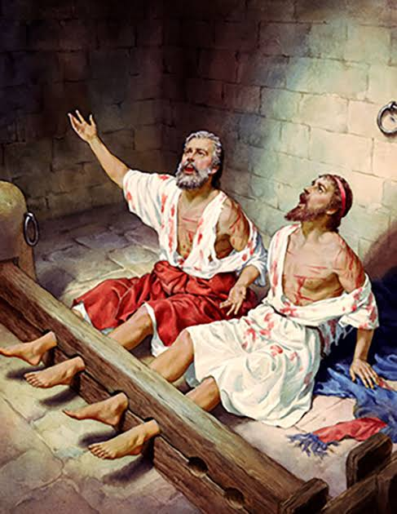
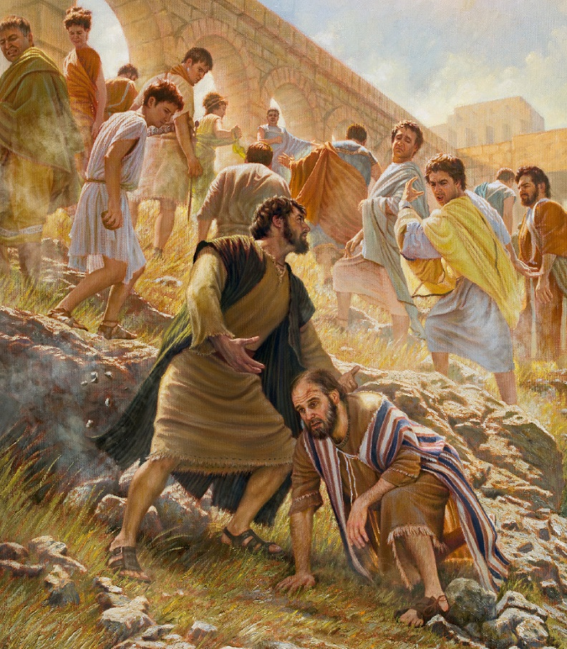
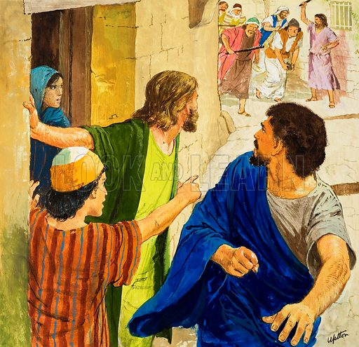
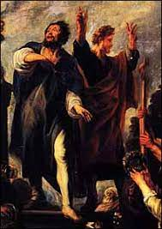
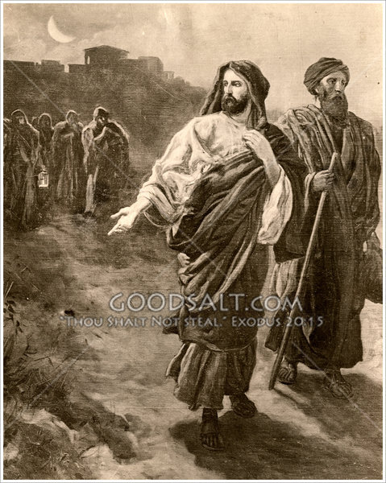
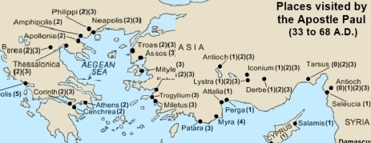
¹³But when the Jews in Thessalonica learned that the word of God was preached by Paul in Berea as well, they came there too and stirred up a riot among the crowds. [AB]
Pisidian

Slide 15
Modern Questions
If I ask you WHO is God?
You have no trouble answering “Father,” “Creator,” “Jesus,” or “Holy Spirit”
If I ask you WHAT is God?
It’s a little tougher, you might answer “Spirit, Life Force, Love,” or something else
If I ask you WHAT DIFFERENCE does God make in your life, that might be even harder

Slide 16
What’s in Athens?

Slide 17
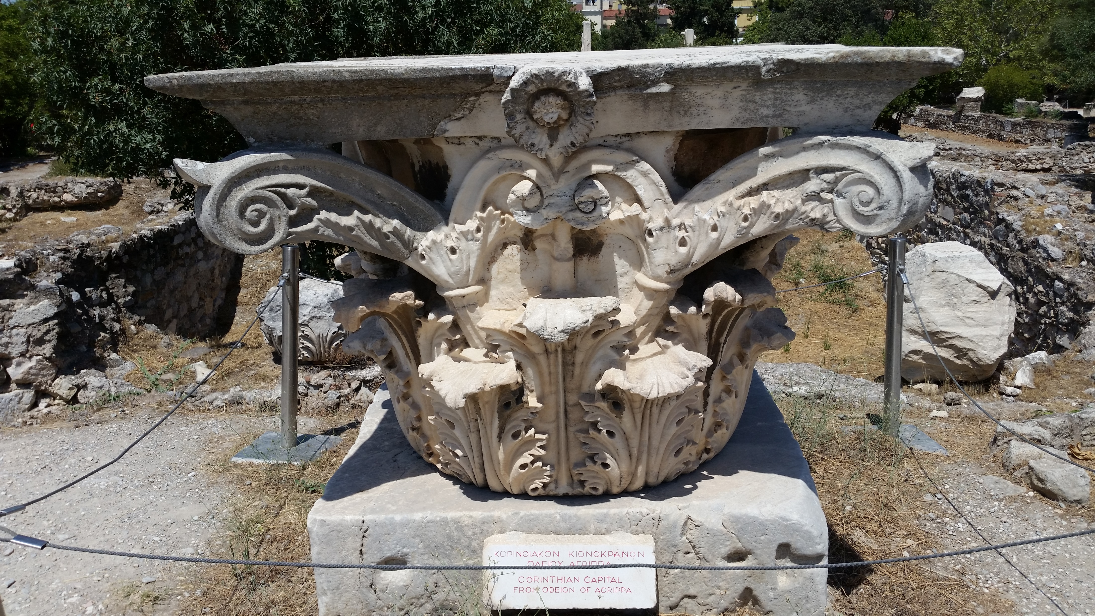
In the Agora

Slide 18
¹³But when the Jews in Thessalonica learned that the word of God was preached by Paul in Berea as well, they came there too and stirred up a riot among the crowds. [AB]

Slide 19
Two Philosophical Schools
Epicurean School
Stoic School
Believed that pleasure was ultimate purpose in life
BUT believed that excess spoiled pleasure in the end
SO, advocated a disciplined life in order that one could enjoy more
Epicurus followed an atomic theory and believed gods were unnecessary and irrelevant to human life
Believed that virtue was the ultimate good
BUT virtue was tied to the “ideal” not the physical
SO, advocated finding in human reason that which was identical to divine reason
Divine reason (associated with Zeus) ruled the universe

Slide 20
God According to God: A Physicist Proves We’ve Been Wrong About God All Along
“I am not certain who said that if you can only afford one newspaper, read the opposition. Whoever urged this, it is superb advice. Let’s look at what bona fide skeptics, purebred materialists, have to teach about our cosmic genesis. As certain as I am that there is a metaphysical dimension active in our world, so are they convinced of the exact opposite…” p. 7

Slide 21
Paul’s Opening Words

Slide 22
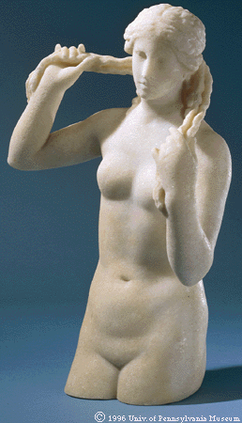
Typical Greek Gods & Goddesses

Slide 23
To An “Unknown God”

Slide 24
Romans | 1 | 17 | "in it" = the gospel
Romans | 6 | 4 | "with Him" we were buried in baptism
Romans | 6 | 8 | "with Him" if we died with Him, we'll live with Him
I Corinthians | 1 | 5 | "by Him" you were made rich in everything
I Corinthians | 2 | 11 | who knows what's in a man except the "spirit that is in him"
II Corinthians | 1 | 19 | "Yes" has come about "in Him"
II Corinthians | 1 | 20 | every one of God's promises has become "Yes" "in Him"
II Corinthians | 5 | 21 | that we could become righteousness "in Him"
II Corinthians | 13 | 4 | we also are weak "in Him" but we are living WITH Him
Ephesians | 1 | 4 | He chose us "in Him" before the foundation of the world
Ephesians | 1 | 9 | God's good pleasure planted "in Him"
Ephesians | 1 | 10 | God brought everything together "in Him"
Ephesians | 2 | 15 | God created one "new man" in Him
Ephesians | 6 | 20 | Paul wants to speak as boldly "in Him" as is required
Philippians | 3 | 9 | our righteousness can only be found "in Him"
Colossians | 1 | 16 | because "by Him" everything was created
Colossians | 1 | 17 | "by Him" or "in Him" all things hold together
Colossians | 1 | 19 | the fullness of everything dwells "in Him" by God's will
Colossians | 2 | 6 | those who have received Christ need to learn to walk "in Him"
Colossians | 2 | 7 | believers need to be rooted and edified "in Him"
Colossians | 2 | 9 | "in Him" the full reality of everything becomes actual (bodily)
Colossians | 2 | 10 | believers have been filled to overflowing "by Him" or "in Him"
Colossians | 2 | 15 | Christ triumphed over hostile powers "in Him" or "by Him"
II Thessalonians | 1 | 12 | we glorify the name of Christ Jesus and we, in turn, "in Him"/by "Him"

Slide 25
Left Athens
This is not the typical verb for moving on
This verb is used in classical Greek for dividing up and separating
In short, Paul “divorced” himself from Athens and moved on to Corinth
He probably didn’t feel too good about the mission trip, so far
But Corinth was an important opportunity

Slide 26
49 A.D.
Iudaeos impulsore Chresto assidue tumultuantis Roma expulit.
“Since the Jews constantly made disturbances at the instigation of Chrestus, he [Claudius] expelled them from Rome.” Suetonius, Life of Claudius, xxv.4

Slide 27
Aquila and Priscilla or Priscilla and Aquila?

Slide 28
Tent-Making

Slide 29
Ministry in Corinth

Slide 30
The Results
A house church is formed at Titius Justus’ house (Gaius Titius Justus?)
The former leader of the synagogue is saved and baptized (Crispus)
The adopted brother of Seneca (the philosopher) sets a precedent of allowing Christianity to have the same legitimacy as Judaism (for about 12 years)

