Slide 1
Preparing to Teach
Acts 23-24
Grace Chinese Christian Church
Skokie, IL

Slide 2
Scenes in Acts 23 and 24
Scene 1 – Paul and Ananias the High Priest
Scene 2 – Paul Takes a Side in the Sanhedrin
Scene 3 – Counterpoint of Jesus versus Jews
Scene 4 – Paul’s Nephew Saves the Day
Scene 5 – Claudius Lysias sends Paul away by Night
Scene 6 – Antoninus Felix agrees to hear the case
Scene 7 – Charges against Paul
Scene 8 – Paul’s Defense
Scene 9 – Felix’s Inconclusive Verdict

Slide 3
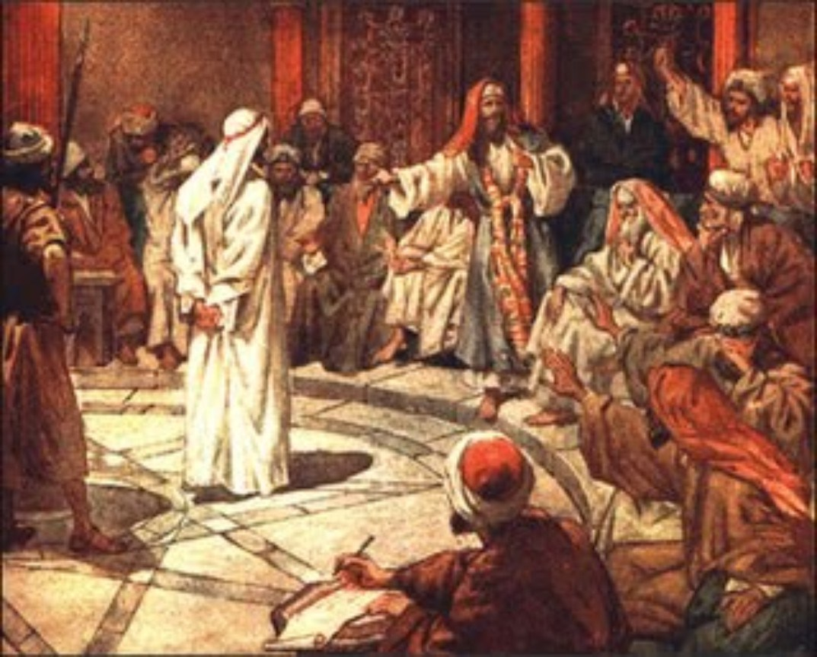
Scene 1: Ananias, Paul, Sanhedrin
Paul’s bold look (v. 1)
4 point defense (v. 1)
a) conformity w/ God’s law
b) lived God’s standard
c) total (all) obedience
d) through the present
Ananias orders a strike on the mouth

Slide 4
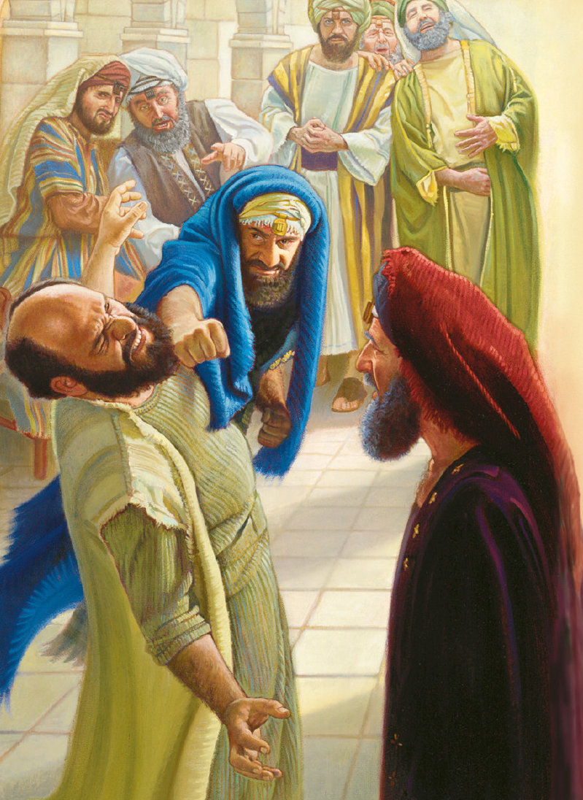
Violence and Cursing?
Order to strike Paul (v. 2)
Paul’s call on the Lord to strike
Ananias (v. 3)
Like Moses’ “curses” in Deuteronomy 28 if Israel abandons God
“whitewashed wall” conveys
Ezekiel 13:8-15 and Matthew 23:27

Slide 5
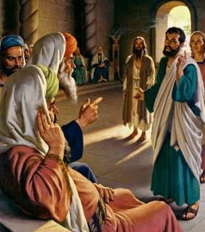
Scene 2: Paul Takes a Side in the Sanhedrin
Divided between Sadducees as Roman sympathizers and Pharisees as silent protestors vs. Rome
Divided between the Pentateuch only Sadducees and the Pharisees who “interpreted” the Law
Divided by the no-supernatural Sadducees and the open to angels and resurrection Pharisees

Slide 6
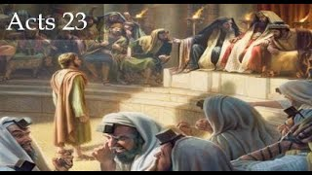
Paul’s Stratagem
Intentionally divide and conquer?
Build sympathy with the Pharisaic minority?
Use general belief in resurrection to bridge divide between Judaism and Christianity and lead to Jesus’ resurrection?
Have some see him as “victim” because of being in the minority and believing in resurrection?

Slide 7
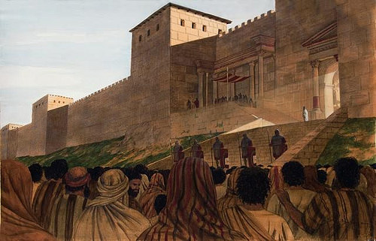
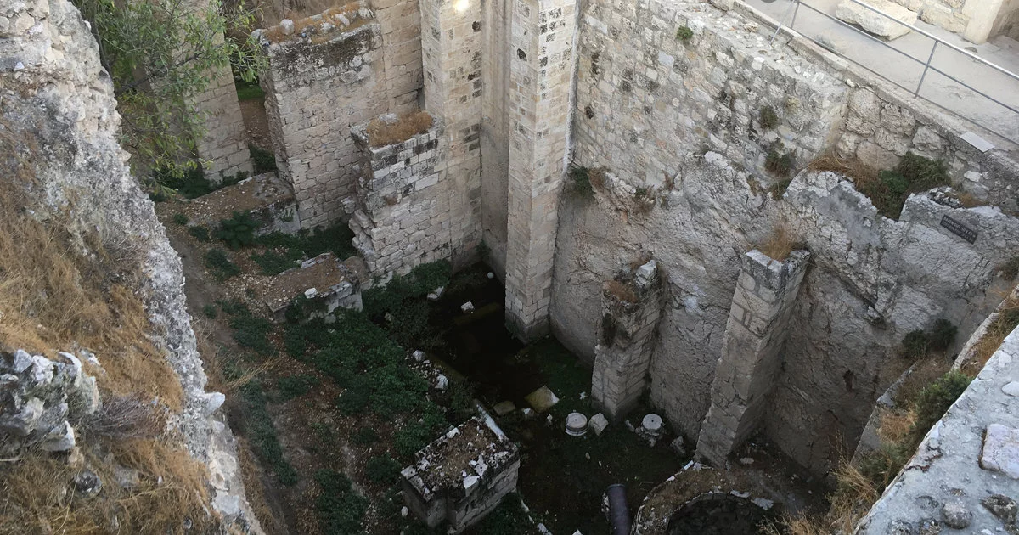
Safe in Antonia Fortress, But in Custody

Slide 8
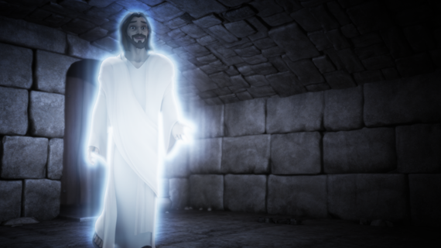
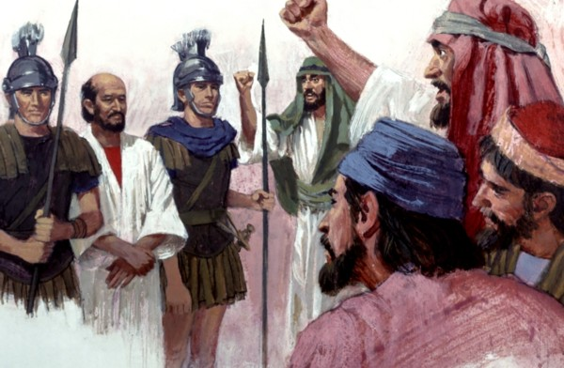
Scene 3—Jesus’ Assurance vs. Jews’ Action

Slide 9
The Unholy Plot
The verb for binding the oath incorporates the word “anathema” – a curse for unbelievers
The fasting, especially with drinking, indicates that they felt an urgency – possibly worried about unraveling
40 = 4 (natural order) * 10 (sufficiency)
Even the priests are complicit

Slide 10
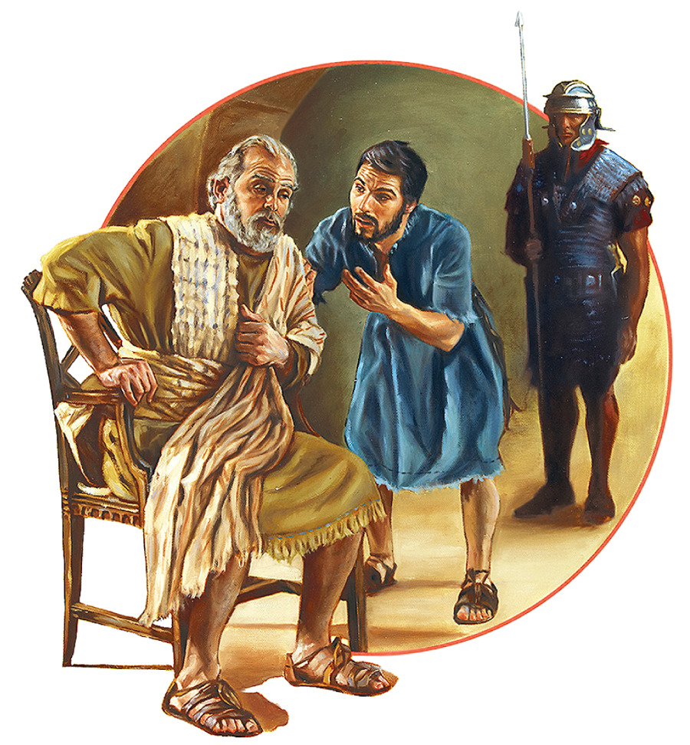
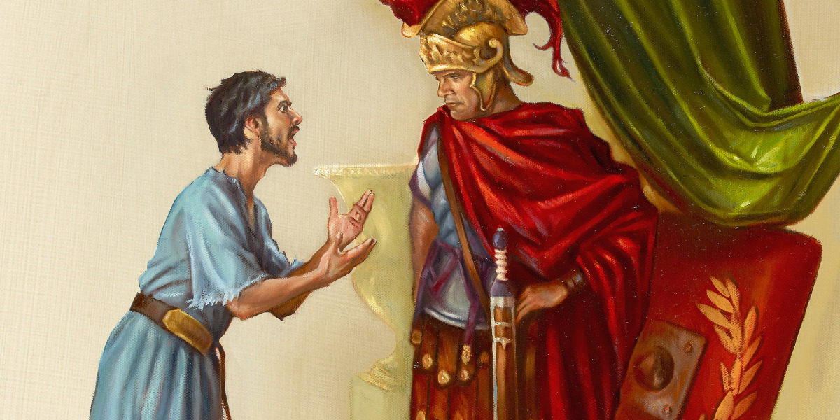
Scene 4 – Paul’s Nephew Saves the Day

Slide 11
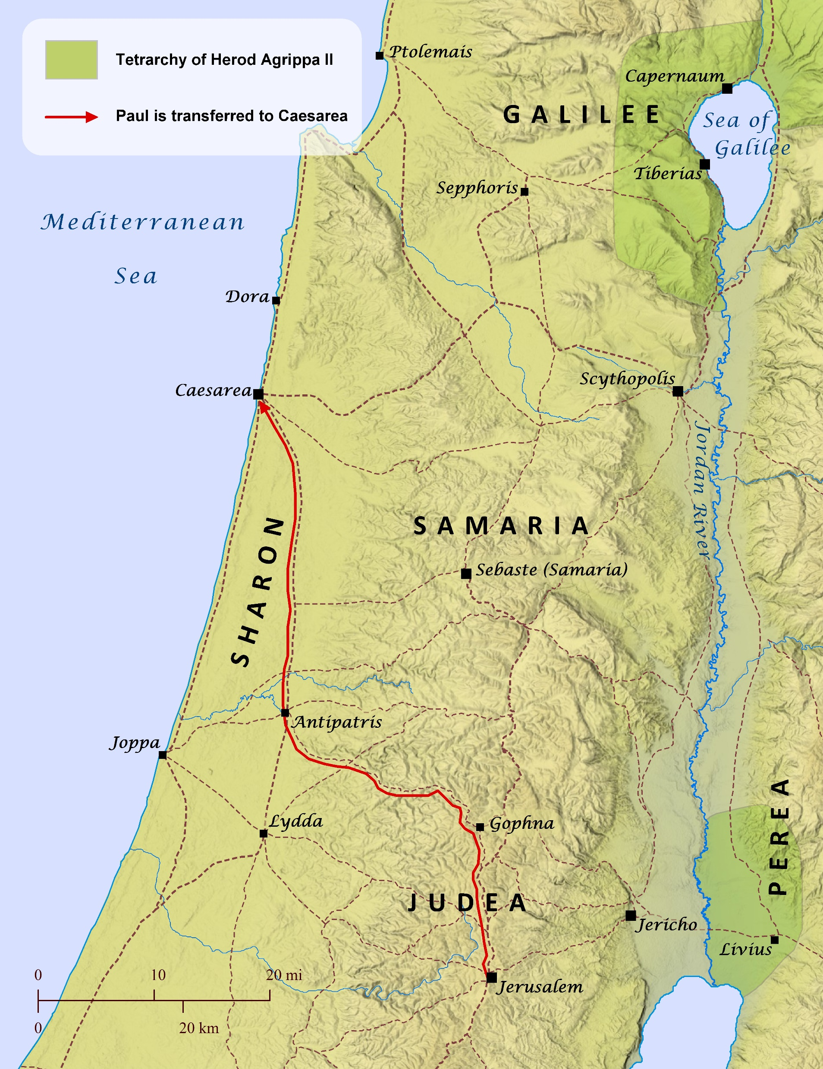
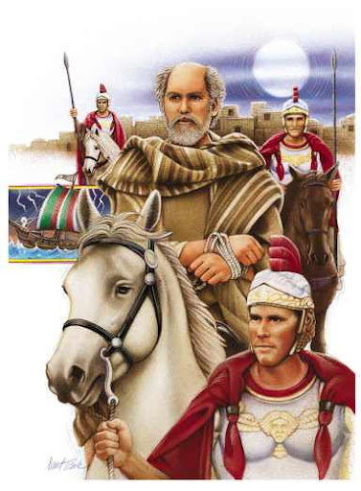
Scene 5 – The Escort in the Night

Slide 12
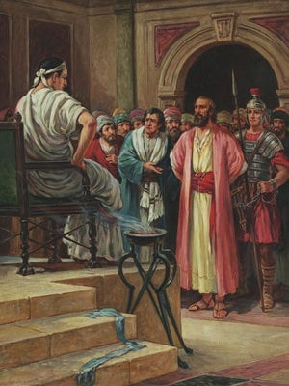
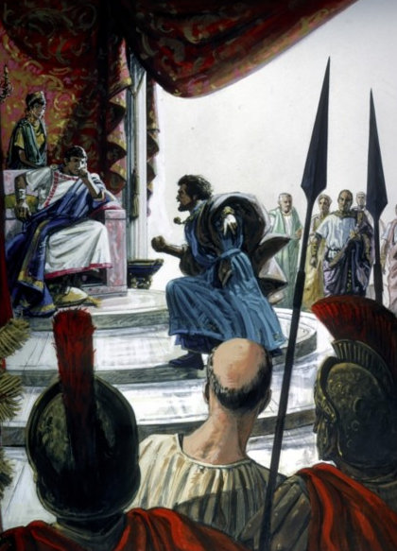
Scene 6 – Felix Agrees to Hear the Case

Slide 13
Scene 7 – List of Charges Against Paul
24:2b-3 Complimentary Exordium
24:5a Pestilent (adjective applied by Caesar Claudius to Jewish unrest)
24:5b Agitator
24:5c Ringleader of the Nazarenes
24:6 Defiler of the Temple

Slide 14
Scene 8 – Paul’s Defense
24:10b Outdoes Tertullus’ Brevity in his Exordium
24:11 Narratio: “just the facts—12 days since he went to worship
24:12-13 Probatio (Proof)
no dispute, no unrest
24:14-18 Refutatio (Refutation) All good till Asian Jews arrived
24:19-21 Peroratio Lack of witnesses and religious issue!

Slide 15
What ARE The Facts?
List of Days | Reference in Acts | Activity
First Day | 21:17 | Arrival in Jerusalem
Second Day | 21:18 | Meeting with James and elders
Third - Ninth Days | 21:27 | Seven days of purification
Tenth Day | 22:30 | Sanhedrin hearing
Eleventh Day | 23:11-12 | The plot to assassinate Paul
Twelfth Day | 23:31-33 | Transfer (escape to Caesarea
13-17th Day | 24:01:00 | Hearing after five (5) days
Adapted from Keener, Craig, Acts: An Exegetical Commentary: Volume 4:
24:1-28:31 (Grand Rapids, MI: Baker Academic, 2015, p. 3392.

Slide 16
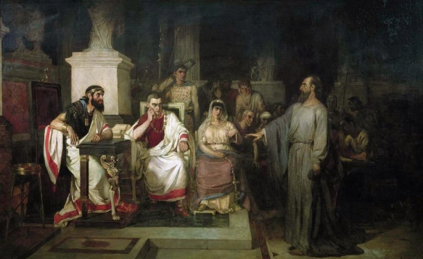
Scene 9 – Before Felix and Drusilla

