Slide 1
Preparing to Teach Acts 27-28
Grace Chinese Christian Church of Skokie, IL

Slide 2
“one of the most dramatic sections in Acts” --French L. Arrington
“as graphic a piece of descriptive writing as anything else in the Bible.” – F. F. Bruce
“among the finest pieces of descriptive writing in the New Testament.” – F. J. Foakes-Jackson
“no other part of the New Testament that can equal its vividness.” –T. C. Smith

Slide 3
Is Paul a “Reverse Jonah?”
JONAH | Verse(s) | PAUL | Verse(s)
flees call to west (ends of earth) | 3 | follows call west (unhindered) | 28_31
great storm/walking, raging | 4, 13 | typhoon-like wind | 14
ship thought to be shattered | 4 | ship aground / shatters | 41, 44
hurl cargo overboard | 5 | throw cargo overboard | 18
fears God (negative?) | 9 | belongs to/worships God | 23
cause of storm/danger | 7, 12 | cause of salvation/protection | 23-24
crew saved after Jonah tossed | 15 | saved by swimming/floating | 43-44

Slide 4
Notice Cohorts Are Numbered, Not Named

Slide 5
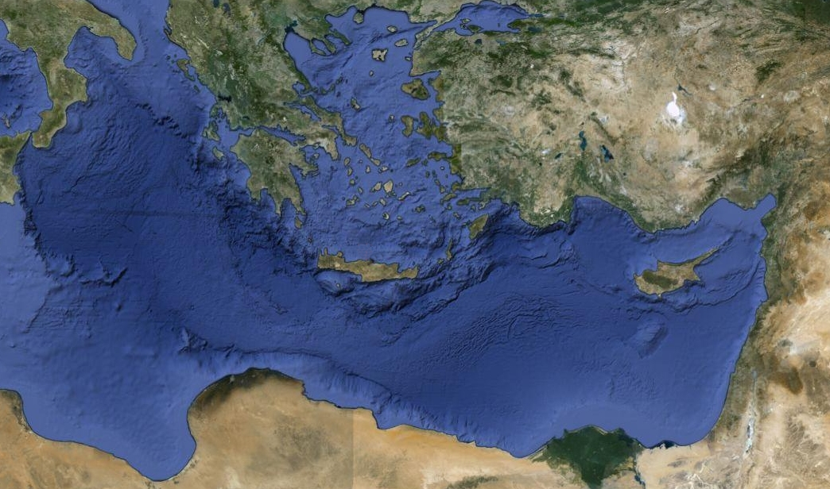
.
Adramyttium
Pamphylia
Myra
Cilicia
Sidon
Caesarea
Which Way Did He Go?

Slide 6
Fellow-Travelers
Julius
Certain other prisoners
Aristarchus of Thessalonica (Colossians 4:10; Philemon 24)
“us”

Slide 7
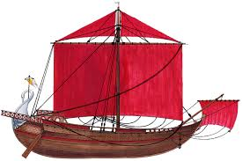
.
Adramyttium
Pamphylia
Myra
Cilicia
Sidon
Caesarea
Which Way Did He Go?

Slide 8
.
Adramyttiu
Pamphylia
Cnidus
Myra
Cilicia
Lasaos Fair Harbor
.
Salmona
Sidon
Caesarea
Which Way Did He Go?

Slide 9
Why Didn’t Anyone Listen?
experience (God affirms or corrects knowledge based on what we have done);
intuition (the Holy Spirit makes us aware of things about which we aren’t consciously aware);
knowledge (the Holy Spirit reminding us of what we’ve already learned and helping us apply it—especially the Bible); and
spiritual insight (an awareness best described as “gift” because we don’t have the resume to understand it.)

Slide 10
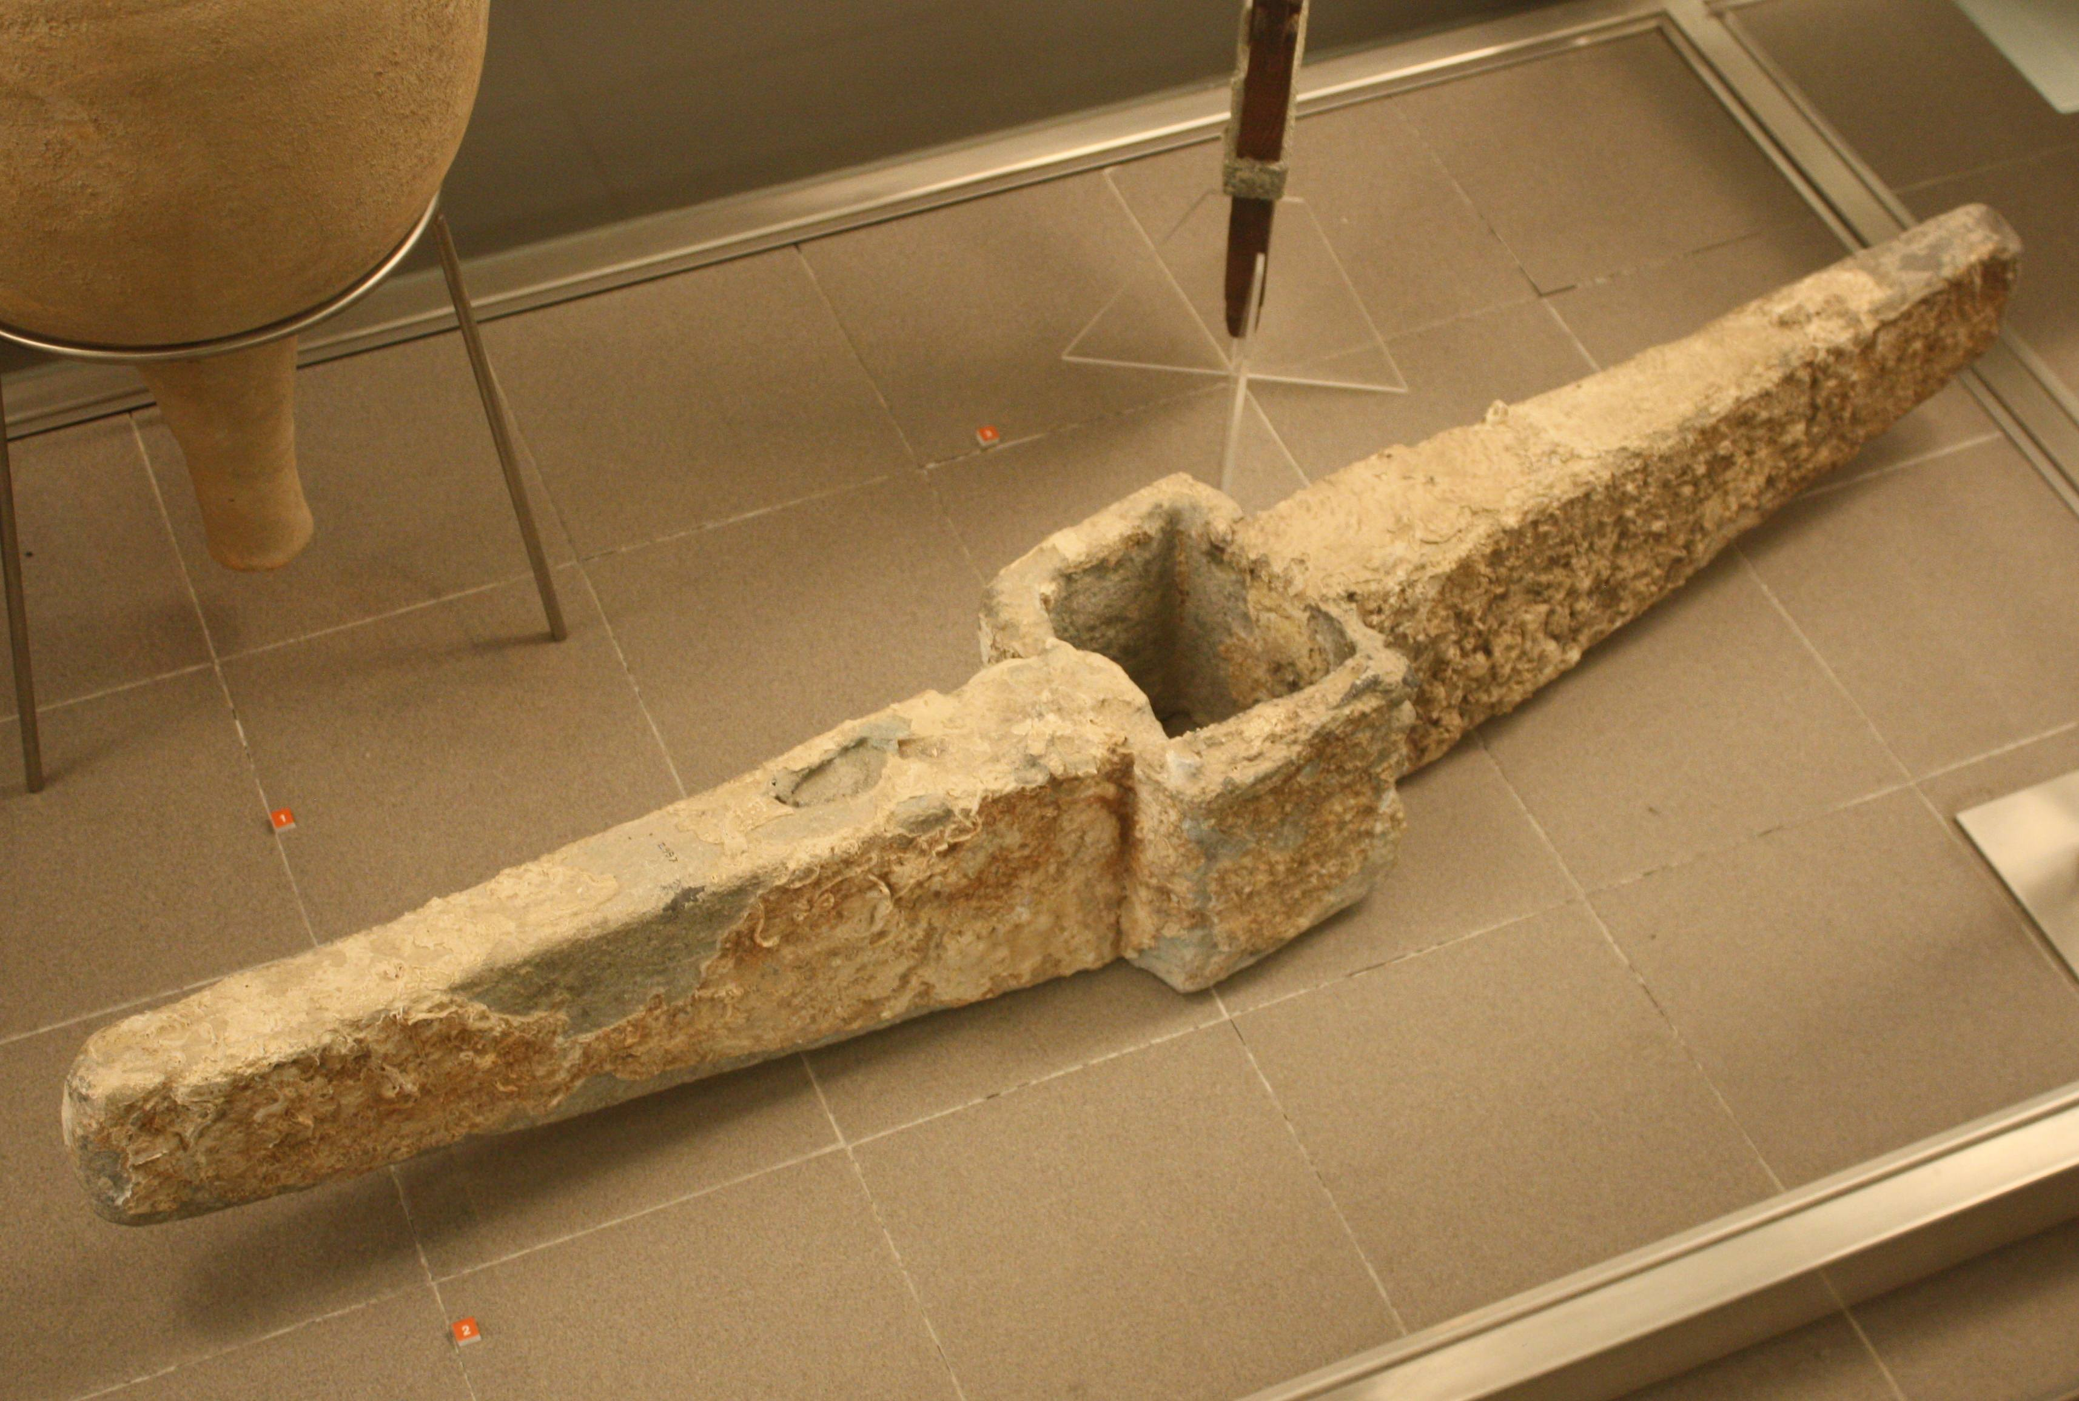
.
Adramyttiu
Pamphylia
?
Cnidus
Myra
Cilicia
.
Lasaos Fair Harbor
.
Phoenix
Shipwreck
Salmona
Sidon
Cauda
Caesarea
Which Way Did He Go?

Slide 11
Mysterious Island?

Slide 12
The Set-Up
Crude, raw, (“barbaric”)
Generous, liberal (“philanthropic”)
Fastens onto, clamps itself onto
βάρβαροι
Φιλανθρωπίαν
καθῆψεν

Slide 13
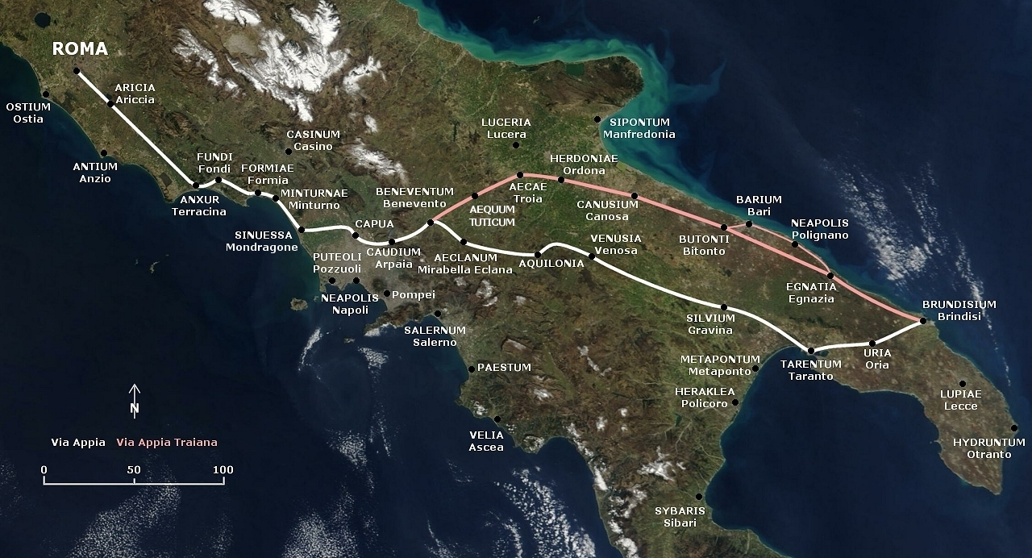
Are We There, Yet?
Puteoli
Syracuse

Slide 14
Inconvenient Status
Three days of solitary confinement (v. 16)
Assemblage of Jewish leaders (v. 17)
Sticking to the HOPE of Israel (v. 20)
Many came to his lodging (v. 23)
Some believed (v. 24)
He rented a house for two years (v. 30)
And preached “UNHINDERED” (v. 31)

Slide 15
.
Adramyttiu
Pamphylia
?
Cnidus
Myra
Cilicia
.
Lasaos Fair Harbor
.
Phoenix
Shipwreck
Salmona
Sidon
Cauda
Caesarea
Which Way Did He Go?

