Slide 1
Preparing to Teach Acts 2-3
Pentecost and Holy Spirit Power

Slide 2
The Power of Pentecost
συμπληρο͡υσθαι = idea of fullness suggests perfect timing
Pentecost (all males supposed to attend)
ˀομο͡υ = same, as in homogenous, homogenized, etc.
In the same location = available

Slide 3
Old Testament Symbols of God’s Presence
Exodus 3:2 cloud earthquake fire lightning sound thunder wind
Exodus 13:21-22 cloud earthquake fire lightning sound thunder wind
Exodus 19:16-19 cloud earthquake fire lightning sound thunder wind
1 Kings 19:11-12 cloud earthquake fire lightning sound thunder wind
Psalm 104:4 cloud earthquake fire lightning sound thunder wind
Isaiah 66:15 cloud earthquake fire lightning sound thunder wind
Ezekiel 1:4 cloud earthquake fire lightning sound thunder wind

Slide 4
Looking at the Phenomena
Suddenly (unexpected)
ἦχος = “EH-kohs”
διαμεριζόμεναι = divided or distributed
πυρός = fire, as in pyromania, pyrotechnics, or funeral pyre

Slide 5
Fire As a Metaphor
Destroys impurities
Cauterizes bleeding
Transforms
Strengthens
Sterilizes
Warms
Enlightens
Protects
Destroys

Slide 6
Fire As Healing
“Those diseases that medicines do not cure are cured by the knife. Those that the knife does not cure are cured by fire. Those that the fire does not cure must be considered incurable.” [quoted in Henning, Meghan R., “Holy Impairment: The Body as the Nexus of Apocalyptic Ekphrasis in Acts 2:1-13” in Journal of Biblical Literature 141:3 (July, 2022) (Atlanta, GA: Society of Biblical Literature, 2022), p. 546.]

Slide 7
Ancient Idea of Healing?

Slide 8
Authority and Overcoming “Division”

Slide 9
Populations Present From Persia (v. 9a)
Parthians
Medes
Elamites

Slide 10
Populations Present From Persia (v. 9a)
Cappadocia
Pontus
Asia
Phrygia
Pamphylia
Cretans

Slide 11
Ridicule
They must be Galileans (“troublemakers”) (v. 7)
Humans always look for a natural cause
They must be drunk (v. 13)
Peter didn’t deny that the apostles COULD have been drunk, …
Peter emphasized that it was too early (so unlikely) they would be drunk (v. 15)

Slide 12
Did Peter Misuse Joel 2:28-29?

Slide 13
Why Did Peter Quote “Davidic” Psalms
Verses 25-28 quotes Psalm 16:8-11
David is important because of the promise that his throne would last
By New Testament times, this was a Messianic expectation
Verse 34 cites Psalm 110 with a Messianic claim because it seems clear David is deferring to another
Peter wanted them to believe that Jesus is Messiah

Slide 14
Continuity in God’s Plan
תמיד
The morning and evening sacrifices named after the “eternal light” and the flames on the altar that would never go out.

Slide 15
Recreation of Shushan Gate
“…its height was fifty cubits [75’ high]; and its doors were forty cubits [60’ high]; and it was adorned after a most costly manner, as having much richer and thicker plates of silver and gold upon them than the other.” --Josephus Wars of the Jews, V, 5, 3.

Slide 16
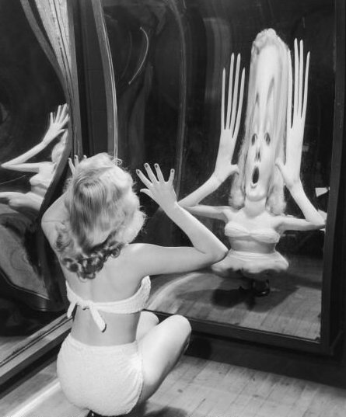
Accurate Reflections or…

Slide 17
Where Is The Focus?
Peter clearly says it is NOT based on his own financial resources
Peter says he will give what he has, BUT it isn’t what the man is expecting
By means of the NAME of Jesus Christ {Not merely reputation, but the totality of the Person of Christ}
Grace requires some reciprocal action on the part of the believer

Slide 18
Response of Action and Gratitude

Slide 19
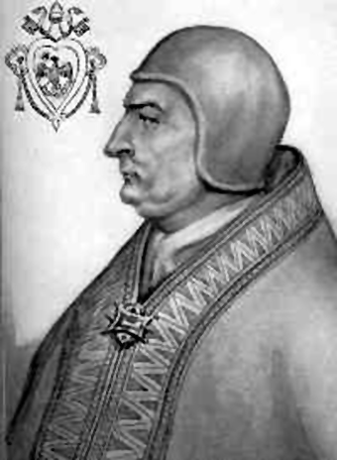
Aquinas and Pope Clement IV

