Slide 1
Preparing to Teach Acts 4-5
Grace Chinese Christian Church Workshop for 11/1/2023

Slide 2
Remember the Acts 1:8 Structure
Witnesses in Jerusalem (Acts 1-7)
Witnesses in Judea and Samaria (Acts 8-12)
Witnesses to Uttermost Parts (Acts 13-28) (Asia Minor and Europe, ending in Rome, capitol of the world)

Slide 3
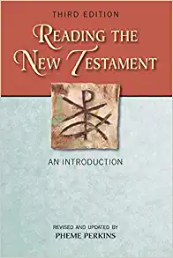
Perkins, Pheme, Reading the New Testament: An Introduction: Third Edition (Mahwah, NJ: Paulist Press, 2012), p. 238.
e. Witnesses before the council (Acts 4:1-22)
f. Prayer and life in fellowship (Acts 4:23-5:16)
g. Miraculous escape and witness before the council (Acts 5:17-42)

Slide 4
Arrington, French L., The Acts of the Apostles: Introduction, Translation, and Commentary (Peabody, MA: Hendrickson Publishers, 1988), p. v.
3.3 Peter and John’s Arrest and Trial (Acts 4:1-22)
3.4 The Prayer of the Church (Acts 4:23-31)
4.1 The Fellowship / Generosity of the Church (Acts 4:32-37)
4.2 False Generosity of Ananias and Sapphira (Acts 5:1-11)
5.1 Opposition (Acts 5:12-42)

Slide 5
1) And as they were speaking to the people, the priests and the commander [root idea is strategist] of the temple [guard], and the Sadducees stood against them. [PJT]

Slide 6
The Name of Jesus Brings Opposition
͗εφίστημι
Eh-FIH-stay-mih or eh-FEE-stee-mee
Literally means to “stand nearby” but…
Used in classical Greek for “standing close to spy” …
Or standing against someone

Slide 7
2) being worked up because they [Peter and John] were teaching the people and publicly declaring resurrection of the dead by means of Jesus. [PJT]
διαπονούμενοι
“dih-ah-poh-NOO-mehn-oy” or “thee-ah-poh-NOO-mehn-EE”
Root idea is to work hard or exercise
Often used for being disturbed (“worked up”) about something

Slide 8
3) And they seized them with their hands and placed them in custody till the next day for it was already evening. [PJT]
Assume “custody” means “protective custody”
Who was protecting whom from what?
Disciples from a mob that seemed more curious than hostile?
The people from the truth?
Is healing one man worth it?

Slide 9
4) But many of those who heard the word believed, and the number of men came to be about 5,000. [PJT]
5,000 saved
5,000 additional responding in the temple?
5,000 men, so 2-3x?
5 symbolic of human sufficiency times divine plenty (10³)?
5,000 cumulative since Pentecost?

Slide 10
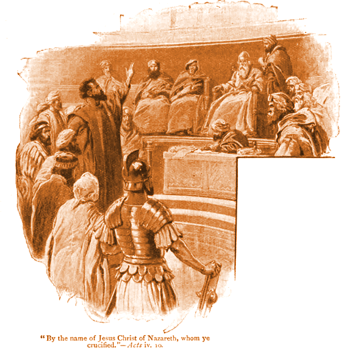
5) So, it happened the next day that the rulers, elders, and scribes were gathered together in Jerusalem, 6) with Annas, the high priest, Caiaphas, John, Alexander and those who were of the high priestly family. 7) So, they stood them in the middle and asked, “By means of
what power or authority [lit. by means of what name] have YOU accomplished this [thing]?” 8) Then, Peter filled to the brim with the Holy Spirit said to them, “Rulers of the people and elders, 9) if you are examining this wonder concerning a good deed for an infirm man by means of which he was made whole [“saved”], 10) know all of you, even all the people of Israel that by means of the name of Jesus Christ of Nazareth, the One whom you crucified, the One God raised from dead, by means of Him this one stands before you well and strong, … [PJT]

Slide 11
Chronology of High Priests Per Flavius Josephus
Year | High Priests | Emperors | Governors | Key Relationship?
6 | Annas (Ananias) | Tiberias | Quirinius
15 | Ismael |  | Valorius Gratus
16 | Eleazar |  |  | son of Annas
17 | Simon |  |  | son of Annas
26 | Joseph (Caiaphas) |  | Pontius Pilate | Annas’ son-in-law
35 | Jonathan |  | Vitellius | son of Annas
37 | Theophilus | Caligula |  | son of Annas

Slide 12
By Means of the Name of Jesus
Baptized in the name of Jesus (Acts 2:38)
Healed in the name of Jesus (Acts 3:6, 16; 4:10)
Spoke in the name of Jesus (Acts 4:17-18)
Taught in the name of Jesus (Acts 4:30)

Slide 13
11) This One is “the stone of which” YOU “the builders rejected, the One who became the head of the cornerstone.” [PJT]
There is no you in Psalm 118:22
Peter inserts the pronoun for emphasis (accusation)
Messianic prophecy
Jesus Himself used it to describe the significance of the tenants killing the landlord’s son in Mark 12:10

Slide 14
12) And there is no other salvation because neither is there another name under the heavens given to humankind by means of which one must be saved.” [PJT]
Note that sincerity is not a good test of truth. People can be sincerely wrong about plenty, even dead wrong (See Pr. 14:12)
Truth claims are exclusive. For example, if “All truth is relative,” even that statement is relative. “Every truth claim excludes its opposite. Hence if Jesus is the only way to God, then there are no other ways.” [Giesler, Norman L., A Popular Survey of the New Testament (Grand Rapids, MI: Baker Books, 2007), p. 133.]
Jesus and the NT repeatedly state: John 14:6; 10:9; 1 Timothy 2:5

Slide 15
13) Then, seeing the boldness of Peter and John, along with perceiving that they were illiterate and untrained [the Greek sounds like “idiotic”], they were amazed and they recognized that they had been with Jesus. [PJT]
Παρρησίας = “pahr-ray-SIH-ahs” / “pah-ree-SEE-ahs”
To have “standing” in a court of law
Perhaps, to have “standing” in the presence of a potentate
They have been backed into a corner by two uneducated men.
They have incontrovertible physical evidence in the appearance of the lame man now walking (Acts 4:14, 16) in their midst
If they attack Peter and John directly, the crowd may revolt in sympathy with those who just did a good deed
“So, the authorities take what is always the first step by authoritarian leadership, they suppress information

Slide 16
After “Testifying” (v. 23) They Prayed! (v. 24)
Δέσποτα = “DEHS-poh-tah”
From which English, DESPOT
Equivalent to Latin, TYRANT
It means the ruler who is in absolute authority
Affirming God’s sovereignty
Luke 2:29, 2 Peter 2:1, Jude 4, Revelation 6:10
Emperor Domitian Tyrannical Caesar of Revelation

Slide 17
Reapplication for the Present
Past
Present
Heathen kings and nations against Israelite kings (Ps. 2:1-2)
God ridiculed their plot and worked against it with derision (Ps. 2:4-5)
God gave all nations as an inheritance for the Messiah (Ps. 2: 7-8)
Perishing or being blessed depends on relation to Him (Ps 2:12)
Herod, Pilate, Gentiles, and Israelites versus Jesus (see vv. 27-28)
May God work so that the church can have boldness (v. 29)
Reveal power of the Messiah in Jesus’ name (v. 30)
Left prayer meeting ready to act (v. 31)

Slide 18
32) But the vast amount [plenitude / multitude] of believers were of a singular determination (heart) and a singular mind (soul) and none of them said that anything they owned was theirs, BUT they had everything common. [PJT]
“Pooling goods involved selling lands and properties, and liquidating capital assets followed (4:34, 37). Early commentators saw here a cause for the later poverty of the Jerusalem church (Acts 11:29; 2 Corinthians 8, 9). Luke makes no such value judgment but simply reports the facts as a proof of Christian concern for all.” [Martin, Ralph P., New Testament Foundations: A Guide for Christian Students: Volume 2: The Acts, The Letters, The Apocalypse (Grand Rapids, MI: William B. Eerdmans, 1994), p. 81.]
“What is often called the community of property in the earliest church on the basis of Acts 2:45; 4:34ff, is in reality a practical sharing of property on the basis of love. To call this actual communism is out of the question, for it lacks both a social program and organized production.” [Bultmann, Rudolf, Theology of the New Testament: Complete in One Volume (New York: Charles Scribner’s Sons, 1951), p. 62.]

Slide 19
Barnabas (Acts 4:36-37)
“Son of Assistance”
“Son of Consolation”
“Son of Encouragement”
“Son of Patronage”

Slide 20
The Story is Familiar

Slide 21
Ananias and Sapphira
Ananias = “favored of God”
Sapphira = “beautiful”
“possession” signifies something smaller than a field
“set apart from” means “holding out”

Slide 22
Misleading Picture?
There is no evidence that Peter cursed him
This wasn’t voodoo
Rather, it seems to be an expression of helplessness in the face of being found out in his sin

Slide 23
Reasons for a Quick Burial

Slide 24
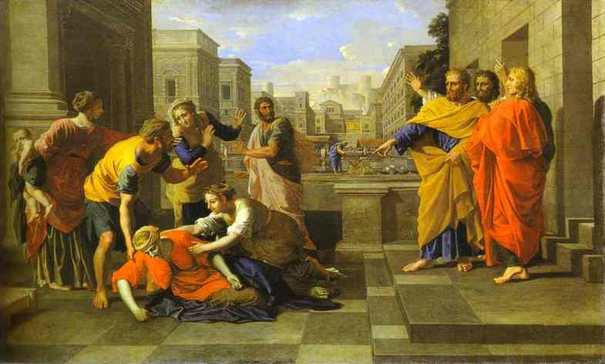
Sin is Rarely in a Vacuum

Slide 25
Activities of the Early Church
σημε͡iα
I pronounce it “see-MEE-ah”
Word from which we get “semiotics”
The study of meaning
Τέρατα
I pronounce it “THE-rah-tah”
Means wonders in the sense of amazing tricks

Slide 26
Cars in the Bible?
“…and they were all with one accord…” (KJV)
̔ομοθυμαδὸν
I pronounce it as “oh-moh-thee-mah-thohn”
“homo” = the same
Do you hear “theme?”
Used 10x in Acts

Slide 28
Expect Opposition!

Slide 29
On Obeying God, NOT Humans

