Slide 1
Preparing to Teach Acts 6-7
Grace Chinese Christian Church Sunday School Teacher Training

Slide 2
Cause and Tendency? (6:1)
Acts 5:42: EVERY day in temple and houses, they kept preaching Christ
Acts 6:1a: In THOSE days, disciples were multiplying
Acts 6:1b: Greek-speaking Jews complained Hebrew-speaking widows having the advantage in the daily social ministry
Problems
# Growth

Slide 3
What Are You Going to Do About It?
ἀρεστόν = “ah-rehs-TOHN”
Old adjective for “pleasing”
Rare in the New Testament
“right” (KJV, ESV, J. B. Phillips, and CEB)
“fit” (ASV)
“appropriate” (PJT)

Slide 4
Seven Who Are Full of the Spirit
7 is an established number in Judaism
Symbolically a divine 3 + created order 4 = God and creation in right relation
Local officials of the Jewish community = 7
Members of a Jewish council = 7
μαρτυρουμένους
μαρτυρουμένους
Solid references
Filled with Holy Spirit
Inspired and spiritual
Filled with wisdom
Practical in conjunction with spirituality

Slide 5
Three Lessons from Acts 6:1-4 Willimon, William H., Interpretation: A Bible Commentary for Teaching and Preaching: Acts (Atlanta, GA: John Knox Press, 1988), p. 59].
Leadership in the church grows out of necessity
Leadership is authorized by the congregation (the multitude) rather than the hierarchy (professionals)
As the apostles adapted their ministry to reflect the changing need, so is adapting ministry styles to changing needs the test of your leadership [Notice the seven’s job description changes slightly, too.]

Slide 6
Deacons or “Servants?” (Acts 6:5-6)
Stephen = first martyr
Philip = evangelist who baptizes eunuch
Nicolas = a proselyte from Antioch (traditionally, not definitely founder of the Nicolaitans in Revelation)

Slide 7
Acts 6:7 Depicts a Process
The word of God increased [see also 12:24 and 19:20]
The number of believers multiplied
Great many of the priests became obedient to the faith

Slide 8
Stephen’s Words and Wonders Ignites Opposition
Had apostles focused on temple rather than synagogues to this point?
1-5 synagogues out of an estimated 480 synagogues (from Talmud) at the time
Ever known a holy person to be opposed like this before?

Slide 9
Stephen’s Response
Quiet and confident in God
Angelic face is Jewish tradition, remember that angels are messengers
It may be that the look on his face is exactly what caused the high priest to interrupt and question

Slide 10
Where Is The Light and Shadow?

Slide 11
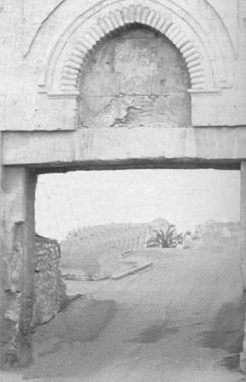
Pay Attention (Ps. 24:7, 9)
“Lift up your heads” to the gates means, “You’re not ready.”
A pagan hymn read, “Lift up your heads, O ye gods” when Baal was coming
Indicates God is more powerful than false belief and physical limitations

Slide 12
New Awareness of God (Ps. 24:8, 10)
Who IS this King of Glory?
Yahweh who is strong enough and mighty enough to protect us
Yahweh who wins our battles for us
Yahweh, the God of Armies (the God of ALL resources!)
Yahweh is THE King of Glory

Slide 13
Stephen’s Speech (Acts 7)
2-8 -- Abraham called far away
-- Abraham no inheritance before covenant
-- Abraham = “stranger in strange land”
-- We are all children of Abraham

Slide 14
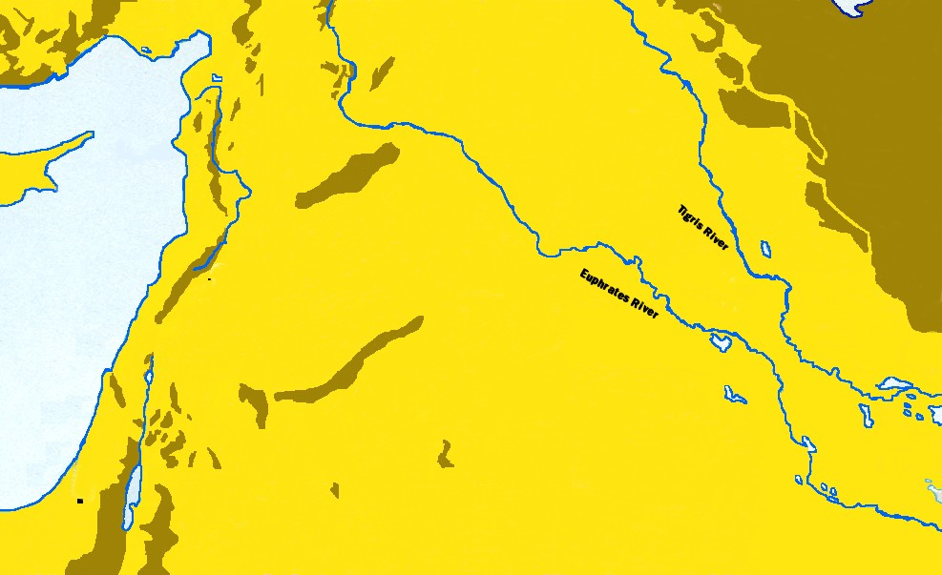
HARAN
DAMASCUS
UR
Leaving the FAMILIAR, the COMFORTABLE

Slide 15
Stephen’s Speech (Acts 7)
2-8 -- All children of Abraham
9-16 – God chose a younger son, Joseph, to rescue Israel
-- Taken as child to Egypt (parallel to Jesus)
-- Fulfilled his purpose in Egypt, not Land of Promise

Slide 16
The symbol of Joseph’s privilege became the “evidence” against him
“And they proceeded to take Joseph’s coat and they proceeded to kill a kid from the goats and they dipped the coat in the blood. And they proceeded to send the coat with sleeves and bring it to their father and to say: ‘We found this. Do you know if it is your son’s?’” (Genesis 37:31-32 jlw)

Slide 17
And What Happened with His Brothers? (Genesis 50:20)
He tested them, but confessed the purpose of God!

Slide 18
Stephen’s Speech (Acts 7)
2-8 -- All children of Abraham
9-16 – God chose a younger son, Joseph, to rescue Israel
17-44 – God’s way is better than the traditional culture via Moses

Slide 19
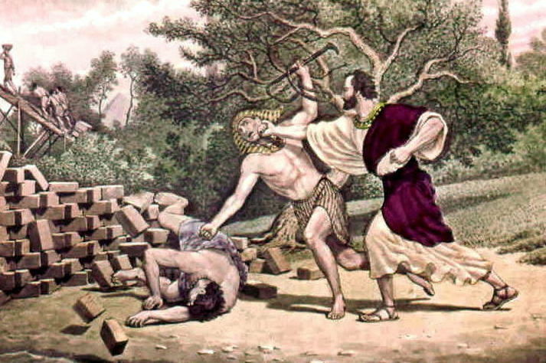
Stephen’s Speech (Acts 7)
-- “Who made YOU king?”
-- God appeared to Moses at Sinai not in Jerusalem
-- Reminder of Aaron (first priest) creating the calf

Slide 20
Stephen’s Speech (Acts 7)
2-8 -- All children of Abraham
9-16 – God chose a younger son, Joseph, to rescue Israel
17-44 – God’s way is better than the traditional culture
45-50 – Temple built AFTER tabernacle
-- Tabernacle used till David defeated Philistines
-- Even after David gathered and Solomon built this House, God doesn’t dwell in houses made by human hands.

Slide 21
Stephen’s Speech (Acts 7)
2-8 -- All children of Abraham
9-16 – God chose a younger son, Joseph, to rescue Israel
17-44 – God’s way is better than the traditional culture
45-50 – Temple built AFTER tabernacle
51-53 – Israel persecutes prophets

Slide 22
Stephen’s Speech (Acts 7)
2-8 -- All children of Abraham
9-16 – God chose a younger son, Joseph, to rescue Israel
17-44 – God’s way is better than the traditional culture
45-50 – Temple built AFTER tabernacle
51-53 – Israel persecutes prophets

Slide 23
Why Stoning?
Stones were plentiful in Ancient Israel
Method requires participation by the crowd rather than one executioner
Stones also associated with memorializing and creating boundaries in the ancient world
Mishnah is deliberate:
victim stripped, thrown off
scaffold by one witness,
and first stone by the other
witness—then, everyone (M. Sanh. 6:1-4)

Slide 24
The Rejection (Acts 7:54-60)
As if PROVING exactly what Stephen had just said…
Why outside the gates?
Leviticus 24:14
Why Stephen?
Blasphemy (Leviticus 24:16)

Slide 25
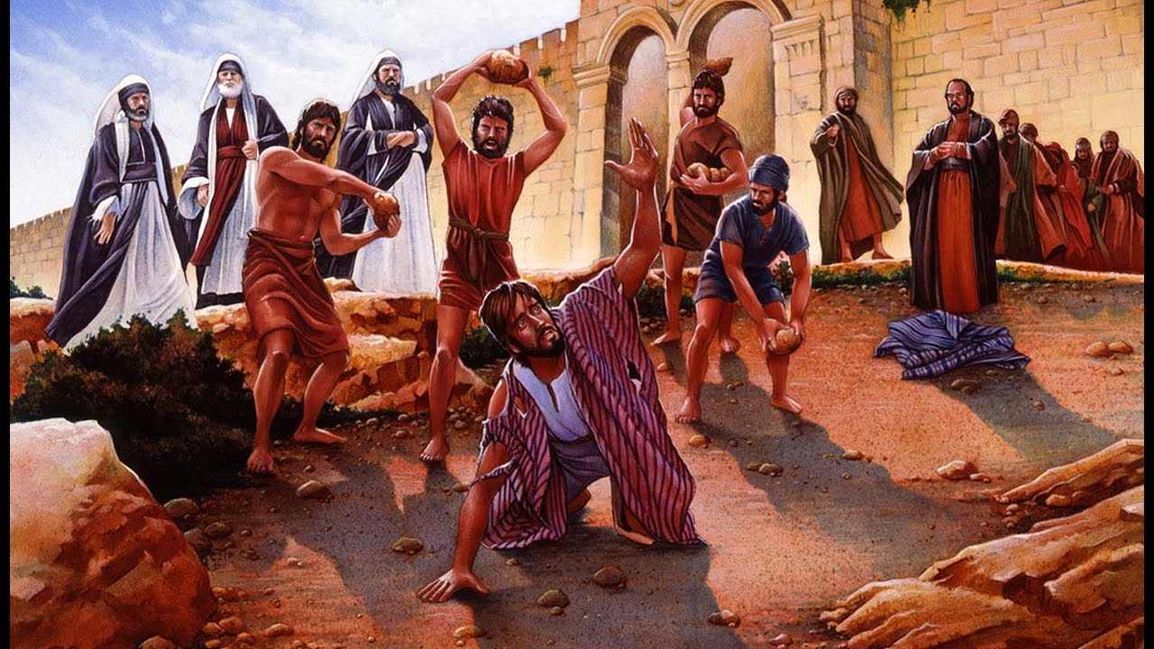
Forgiveness Emulates Christ

