Slide 1
Preparing to Teach Acts 8
Grace Chinese Christian Church of Skokie, IL Dr. Johnny L. Wilson

Slide 2
Outline of Acts Using Acts 1:8
Structural Section | Scripture | Primary Theme
Opening and Ascension | 1:1-11 | Jerusalem, Judea, Samaria and furthest parts of the earth
Witnesses in Jerusalem | 1:12-8:1 | Holy Spirit followed by the Jerusalem ministry of Peter and John
Witnesses in Judea & Samaria | 8:2-12:23 | Scattering leads to further ministry and first gentile converts
Witnesses to the ends of the earth | 13:1-28:31 | The gentile mission leads to Paul's missionary journeys

Slide 3
The Task Before Them (1:8)

Slide 4
Six Waves of Evangelism
Acts 19:10 -28:31
Acts 16:6- 19:9
Acts 9:32 -12:23
Acts 13:1- 16:5
Acts 6:8-9:31
Rome & Beyond
Acts 1:1-6:7
Europe
Jerusalem
Israel
Syria
Asia Minor

Slide 5
1a) So Saul was in total agreement concerning condemning him [Stephen] to death. [PJT]

Slide 6
1b) Then, it happened on that same day, a great persecution upon the church in Jerusalem, so all were scattered, except the apostles, into the regions of Judea and Samaria. [PJT]
2) So, reverent men buried [arranged the funeral for] Stephen and beat their breasts [aka “lamented”] greatly concerning him. [PJT]

Slide 7
3) So, Saul was committing atrocities against the church by means of entering the houses, netting men and women, handing them over into prison. [PJT]
Galatians 1:13: ¹³ You have heard, no doubt, of my earlier life in Judaism. I was violently persecuting the church of God and was trying to destroy it. [NRSV]
1 Corinthians 15:9: ⁹ For I am the least of the apostles, unfit to be called an apostle, because I persecuted the church of God. [NRSV]
Philippians 3:6: ⁶ as to zeal, a persecutor of the church; as to righteousness under the law, blameless. [NRSV]

Slide 8
3) So, Saul was committing atrocities against the church by means of entering the houses, netting men and women, handing them over into prison. [PJT]

Slide 9
4) Therefore, the ones who had been scattered migrated, evangelizing the Word.” [PJT]
“The enemies of Christ sought to destroy the church but the persecution only led to a wider and fuller proclamation of the gospel. The believers could have been satisfied to settle down in Jerusalem, but God forced the church’s hand and used persecution to fulfill Acts 1:8.” [Arrington, French L., The Acts of the Apostles: Introduction, Translation, and Commentary (Peabody, MA: Hendrickson Publishers, 1988), p. 85.]

Slide 10
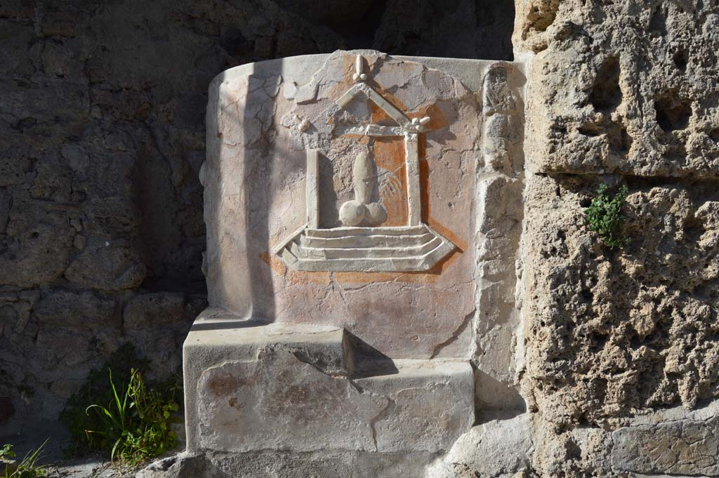
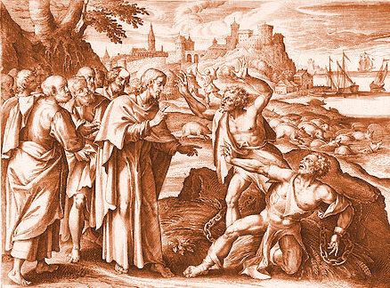
5) Then, Philip went down to the city of Samaria proclaiming to them concerning Christ. 6) So, the crowds, all as one, paid close attention to what was said by Philip by means of hearing him and seeing the signs he accomplished, 7) For many of the ones having unclean spirits, those same came out crying with a loud voice, for many, paralyzed and lame were healed. 8) So, it happened there was much joy in the city. [PJT]

Slide 11
“Samaritan Mission” [Oscar Cullmann and R. P. Martin]
Jesus met woman (John 4)
Woman leaves jars in urgency (John 4:28)
Woman testifies (v. 29)
Fields are ripe (v. 35)
Jesus establishes the mission objective (v. 38)

Slide 12
There are always frauds!
9) But there was a man whose name was Simon who had practiced magic in the city and kept the nation of Samaria off-guard [“amazed”], saying he himself was great. [PJT]
Associated with Hercules?

Slide 13
God Works Differently
In Samaria (Acts 8:12-17), the sequence was preaching, faith, baptism, laying on hands, gift of Spirit
With eunuch (8:26-39), the sequence was the reading of scriptures, preaching, and baptism, preceded by confession of faith in some texts.
With Paul’s conversion accounts, it is conviction, trust, laying on of hands, gift of Spirit and sight, and baptism.
Never settle for formulae.

Slide 14
Curse or Call to Repentance?

Slide 15
The Angel of the Lord
Wings are figurative
Usually identified with God’s Own Being
God is God’s Own Messenger
God Cares Enough To Be Involved In Our Ordinary Lives

Slide 16
Disappointment = His Appointment
God’s Timetable—Not Ours

Slide 17
Strange Encounter
“an Ethiopian eunuch” (v. 27)
“The eunuch asked…” (v. 34)
“…the eunuch said…” (v. 36)
“Philip and the eunuch” (v. 38)
“…the eunuch saw…” (v. 39)
“No one whose testicles are crushed or whose penis is cut off shall be admitted to the assembly of the LORD.”
--Deuteronomy 23:1 NRSV

Slide 18
Isaiah 56:3-5
Neither let the son of the stranger, that hath joined himself to the LORD, speak, saying, The LORD hath utterly separated me from his people, neither let the eunuch say, Behold I am a dry tree. For thus saith the LORD unto the eunuchs that keep my Sabbaths, and choose the things that please me, and take hold of my covenant, Even unto them will I give in mine house and within my walls a place and a name better than of sons and daughters…

Slide 19
“Do you understand what you’re reading?

Slide 20
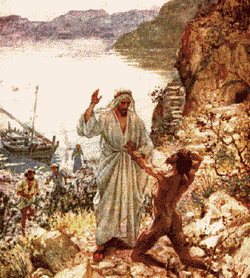
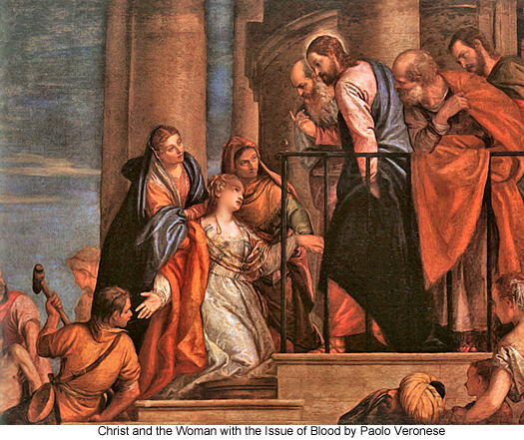
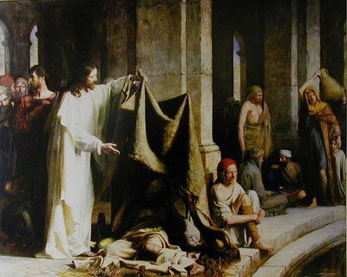
Starting with a Question
What is your name?
Do you want to be healed?
Who touched my cloak?

Slide 21
Isaiah 53:8
The Greek translation would read:
In humiliation, his crisis was removed; Who can recount his lineage? Because his life has been taken from the earth.
κρίσις

Slide 22
Believer’s Baptism

