Slide 1
Preparing to Teach Acts
Part I -- Introduction

Slide 2
Α͗κωλύτως = “ah-koh-LOO-tohs”
“no hindrance”
“no prevention”
“no limitations”
“no reservations”
Luke intentionally leaves the conclusion of Acts open-ended, so that readers themselves can and must continue to develop the story of Paul and the relation between church and synagogue in their own times. --Daniel Marguerat

Slide 3
Unto the Uttermost…

Slide 4
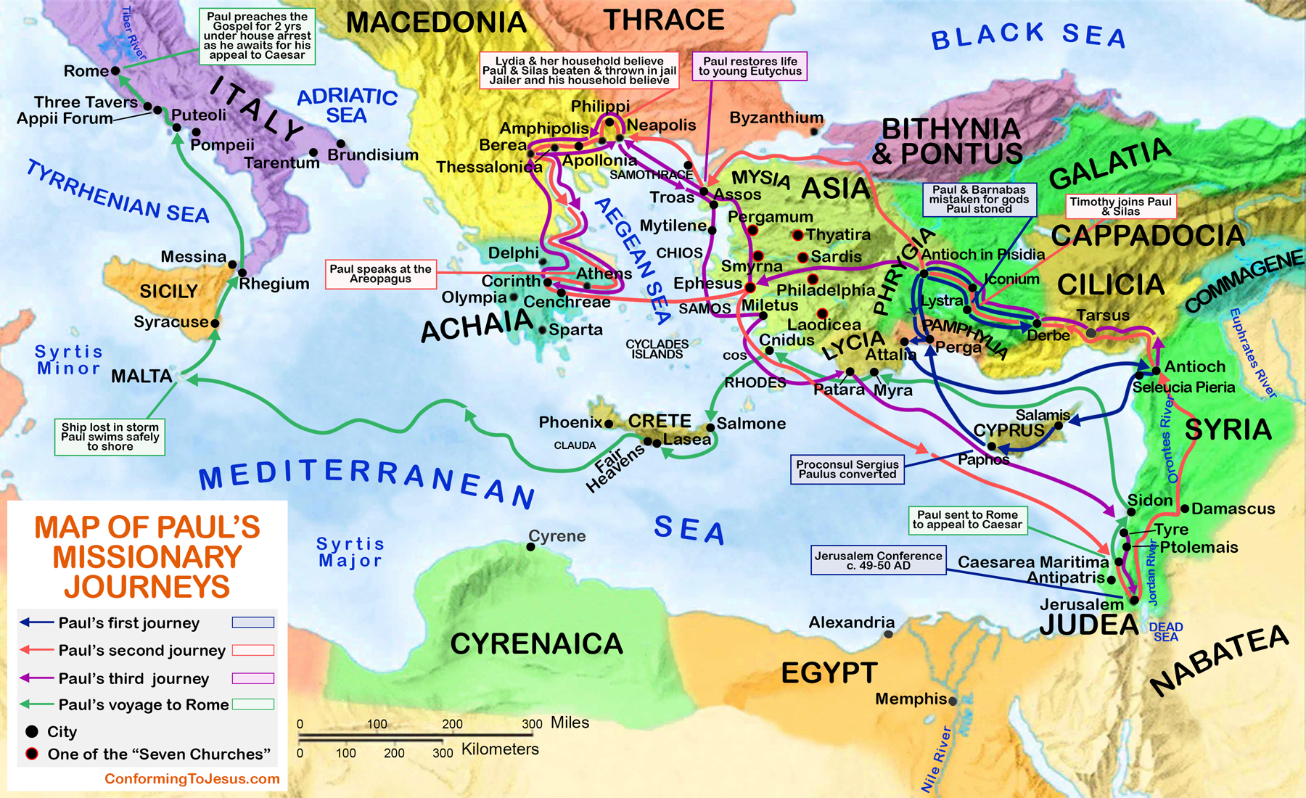
AFTER PAUL
BEFORE PAUL

Slide 5
The “TITLE” of the Book of Acts
Originally, as with the Gospel of Luke, the manuscripts had NO title
Later “Acts of the Apostles” by early church
But apostles (other than Peter in 9 chapters & Paul in 17) are rarely mentioned
So some scholars call it “The Acts of Peter and Paul”

Slide 6
Comparison of Holy Spirit References
52 references in 28 chapters of Acts
34 references in 68 combined chapters of Matthew, Mark and Luke
45 references in 32 combined chapters of Romans and I Corinthians
21 references in 28 combined chapters of John, I John, II John, and III John

Slide 7
No Longer “FOLLOWERS” But “Sent Ones”

Slide 8
Evidence of Authorship of Luke-Acts
Source | Date (AD) | Evidence
Partial manuscript of Luke's gospel | ca. 120 | Phrase "But I, Luke…" inserted
Anti-Marcionite Prologue | ca. 175 | Cites Luke as a Syrian doctor living to 84, associated with Paul
Papyrus 75 | ca. 200 | Manuscript has "According to Luke" added to the end
Tertullian | ca. 220 | Refers to Acts as "the gospel of Paul"

Slide 9
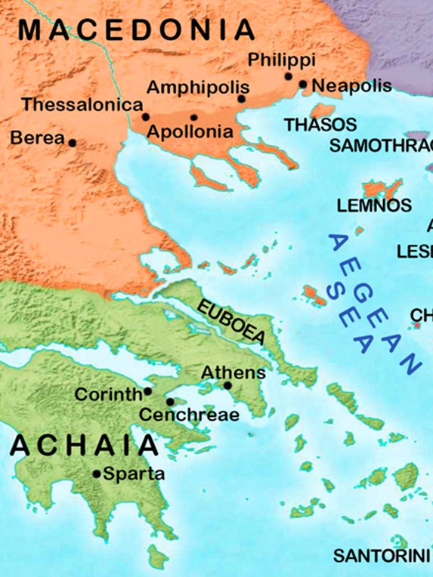
1st “WE” Passage:
Acts 16:10
After Macedonian Call of 16:9
Philippi
360BC -1400AD
Roman after 42 BC
Goes through meeting Lydia until arrest
Stops after in 16:18

Slide 10
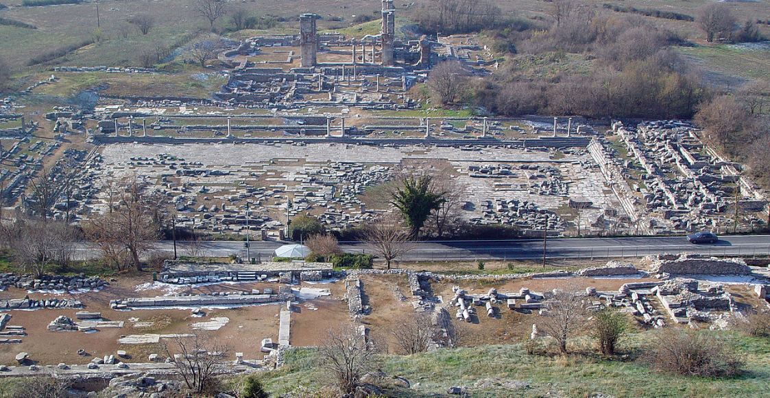
PHILIPPI:
GRACE CHINESE CHRISTIAN CHURCH

Slide 11
Acts 20:5 Picks Up “We” Narrative Again And Continues Through Eutychus Story

Slide 12
Last “We” Reference in Acts 20 is v. 15 When Paul Meets at Miletus Harbor

Slide 13
In Acts 21:1-18, “we” and “us” continues through the Agabus account and stops after Paul goes in to see James in verse 19

Slide 14
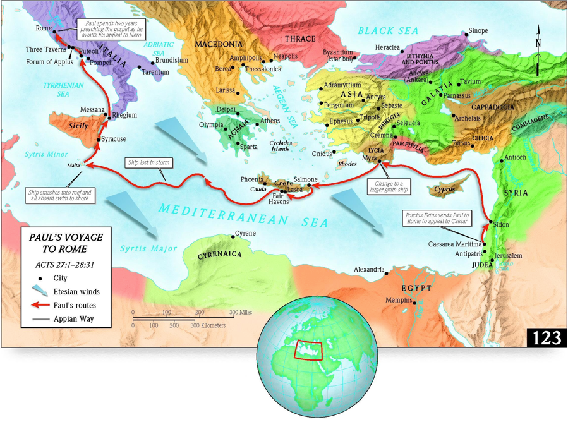
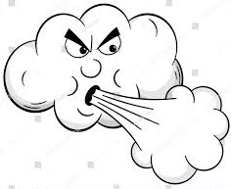

Slide 15
Outline of Acts Using Acts 1:8
Structural Section | Scripture | Primary Theme
Opening and Ascension | 1:1-11 | Jerusalem, Judea, Samaria and furthest parts of the earth
Witnesses in Jerusalem | 1:12-8:1 | Holy Spirit followed by the Jerusalem ministry of Peter and John
Witnesses in Judea & Samaria | 8:2-12:23 | Scattering leads to further ministry and first gentile converts
Witnesses to the ends of the earth | 13:1-28:31 | The gentile mission leads to Paul's missionary journeys

Slide 16
WAIT
In JERUSALEM
BUT, most were from GALILEE
Their businesses in GALILEE

Slide 17
ISSUES
The times and seasons and dependence upon God (1:7)
Notice the use of Old Testament backgrounds before telling the story of Jesus in most of the sermons in Acts
Notice the emphasis on baptism and its relationship to church involvement (Acts 2:38-41)
Notice the emphasis on fellowship, community, partnership, and commitment (Greek word is κοινονία = “koi-noh-NEE-ah”)

