Slide 1
Love/Hate/Life/Death
Preparing to Teach Ecclesiastes 9-10

Slide 2
A Schematic for Chapters 9-10
9:1-10 Carpe Diem [Why we need to seize the day!]
9:11-10:15 The World is Full of Risks
10:16-11:16 On Living with Risks
9:1-10 The Shadow of Death
9:11-12 Time and Chance
9:13-18 Wasted Wisdom
10:1-20 Proverbs on Wisdom and Folly
Seow, Choon-Leong, The Anchor Bible: Ecclesiastes: A New Translation with Introduction and Commentary (New York: Doubleday & Company, 1997), p. 47.
Crenshaw, James L., The Old Testament Library: Ecclesiastes (Philadelphia, PA: Westminster Press, 1987), p. 48.

Slide 3
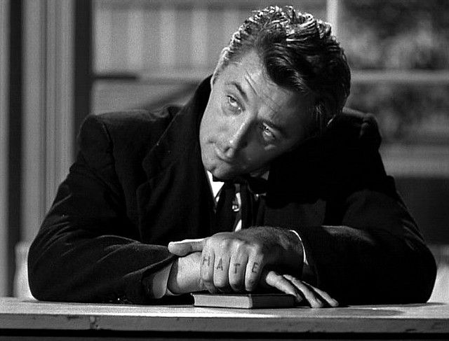
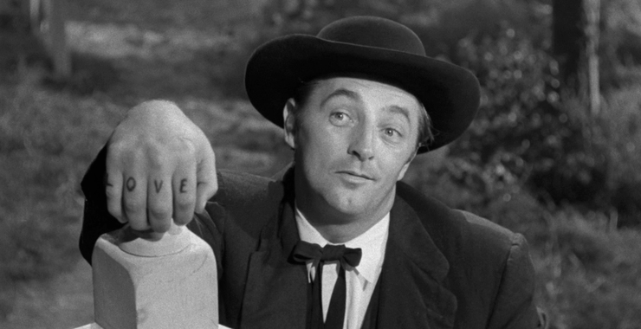
1) Because all of this I gave to my heart, so to make it clear that the righteous and the wise, and their accomplishments are in God’s hand, even love, even hate, humanity cannot know; it is before them. [PJT]

Slide 4
The Great Equalizer (vv. 2-3)
2) Everyone is just as everyone else, one [common] fate: for the righteous and for the wicked, for the good [and for the bad], for the pure and for the impure, for the ones sacrificing and for those not sacrificing, as the good so the sinner, the ones giving [positive] oaths just as those fearing giving oaths. 3) This is evil among all which is done under the sun because there is one [common] fate for everyone [lit. “all”], so even heart(s) [or “wills”] of the children of humanity are full of evil and madness is in their hearts during [lit. “in”] their lives and afterward, to their deaths. [PJT]

Slide 5
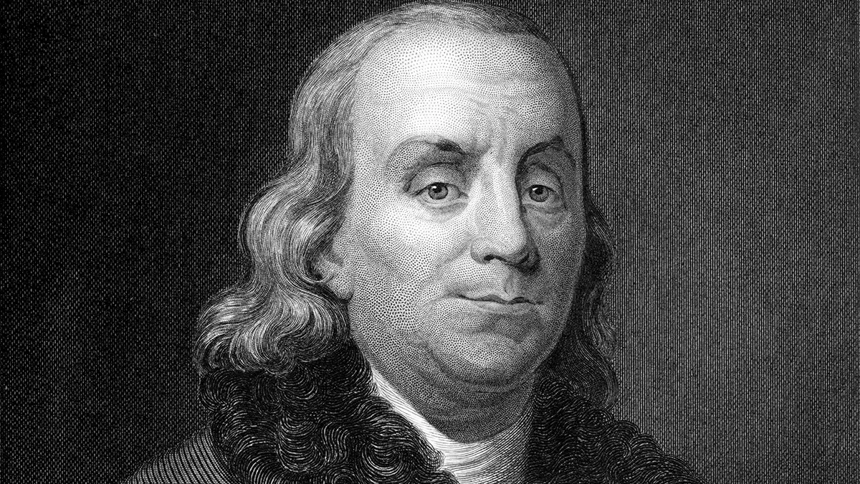
That Which Is Certain!
"Our new Constitution is now established, everything seems to promise it will be durable; but, in this world, nothing is certain except death and taxes." –Benjamin Franklin

Slide 6
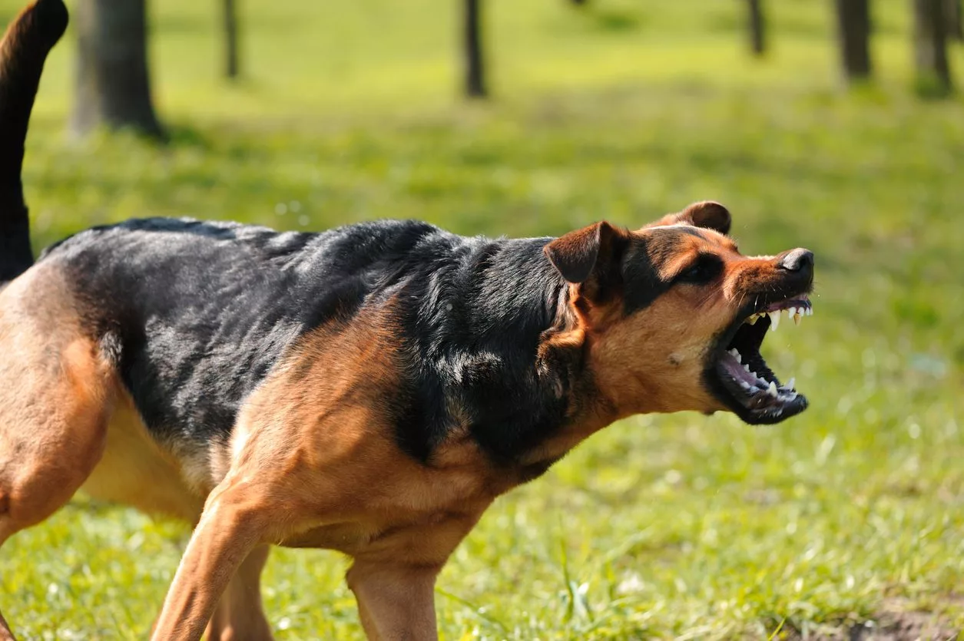
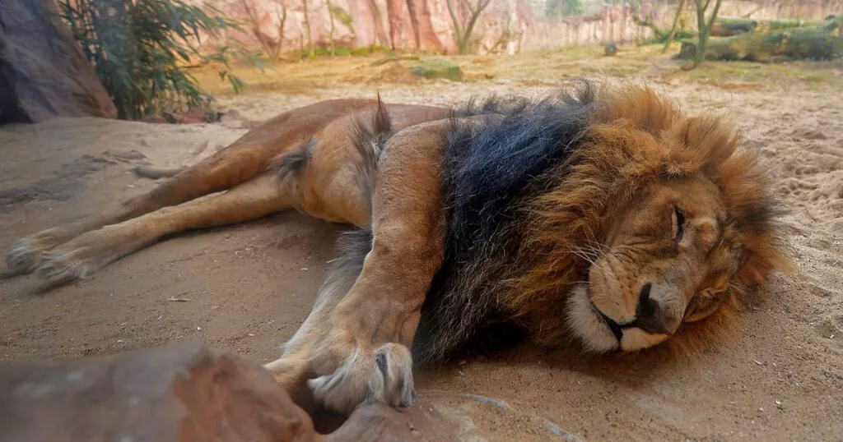
4) Because, who is the one who chooses? To all the living there is certitude because for the living dog it is better than [for] the dead lion. [PJT]

Slide 7
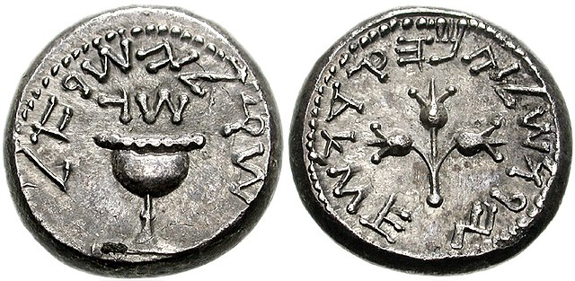
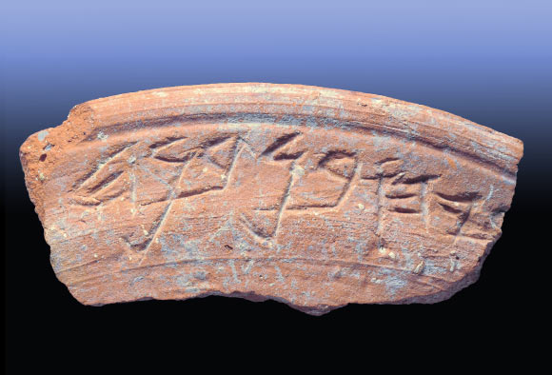
5) Because the living know that they will die and the dead don’t know anything, they don’t even have any reward belonging to them because their legacy [lit. “memorial” is not remembered. [PJT]
שכר = “sah-KAHR”
זכר = “zah-KAHR”
6) Even their love, even their hatred, even their enthusiasm [lit. “zeal”]
is already destroyed, and their portion [legacy, purpose] shall not belong to
them again for ever, in everything accomplished under the sun. [PJT]

Slide 8
7) Go, eat your food in pleasure, and drink your wine with a good heart [“Enjoy, but don’t overdo it!”] because God is already pleased with your accomplishments. [PJT]
This is the FIFTH “Carpe diem” [“Seize the Day!”] passage. Previously:
2:24-26 (eat, drink, gain satisfaction from work, and please God),
3:13-14 (eat, drink, gain satisfaction from work, prioritize what God wants to last, and reverence [“fear”] God),
5:18-20 (eat, drink, gain satisfaction from work, treat blessings as a gift, allow God to provide joy),
8:15 (enjoy with eat, drink, pleasure to balance toil, and savor God’s gift of life).

Slide 9
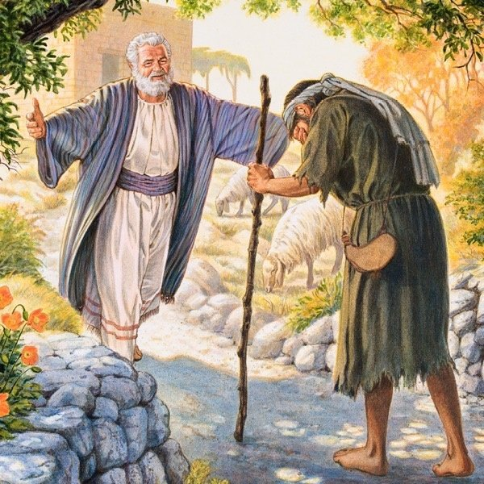
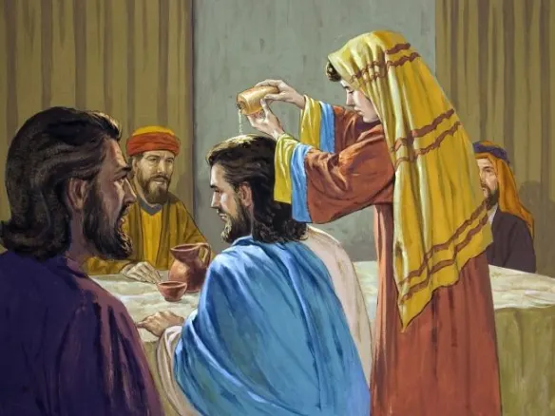
8) In every circumstance [lit. “in all times”], let your garments be white and don’t ration [lit. “diminish”] the oil upon your head. [PJT]

Slide 10
Awareness of Life’s Priorities (vv. 9-10)
9) Enjoy life with the wife whom you love, all the days living in your wisp [of life] of life which were given to you under the sun, all the days of your wisp [of life], BECAUSE it is your legacy [portion, purpose] in life and in your unsatisfying work with which you toil under the sun. [PJT]
10) Everything you hand discovers to do, accomplish it with all your might BECAUSE there aren’t accomplishments, reasoning [lit. “accounting”], knowledge, and wisdom in Sheol [place of the dead] or the grave where you are going. [PJT]

Slide 11
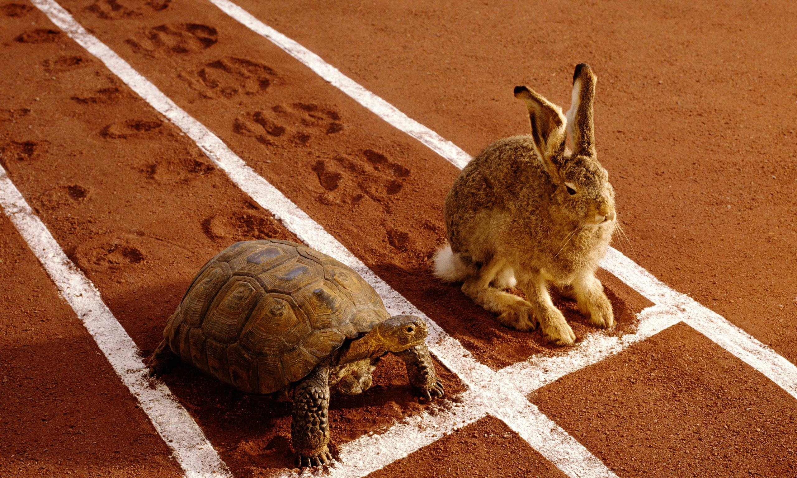
When Potential Fails
Speed doesn’t always win
Might doesn’t always win
Sages not always paid well
Pundits don’t always profit
Being “in the know” doesn’t
always lead to favor
[Crenshaw, Ecclesiastes, p. 164.]

Slide 12
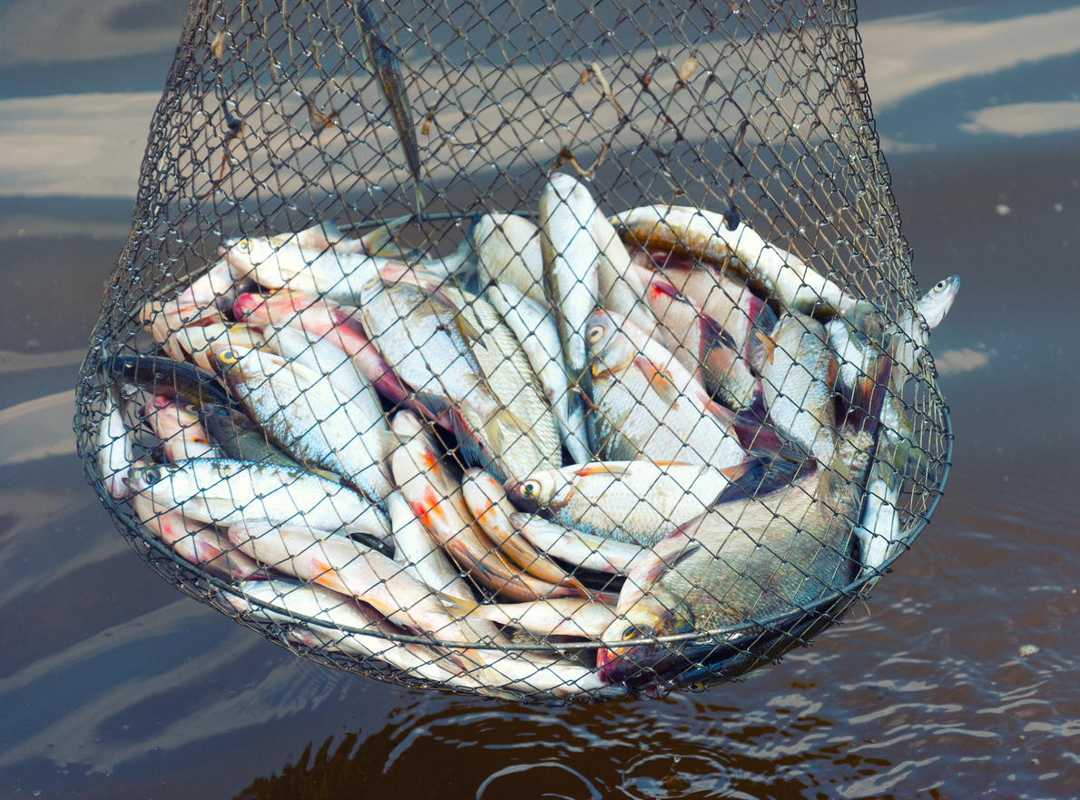
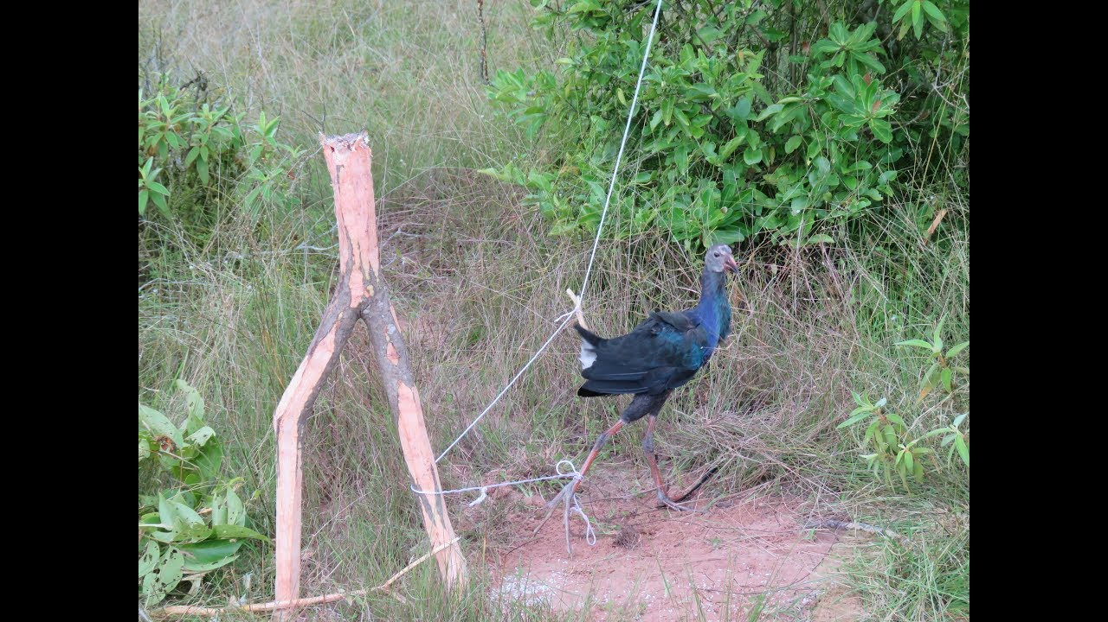
No One Knows “Their Time” (v. 12)

Slide 13
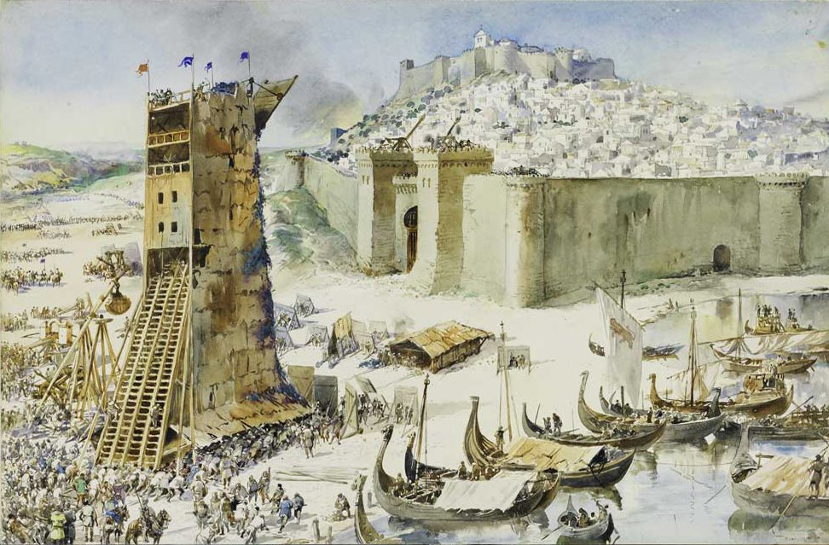
The Waste of Wisdom (vv. 13-18)

Slide 14
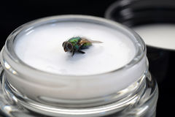
Chapter 10 as Compendium of Proverbs
Flies in ointment make the perfume stink (v. 1)
Right = moral, honorable
Left = awkward in Greek, sinister in Latin, awkward in French (v. 2)
Lacking an inner compass, fools reveal themselves just by walking (or
by their actions) (v. 3)
Don’t escalate conflict (v. 4)

Slide 15

Another Parable of Absurd, Topsy-Turvey Life
Evil caused by ERROR [v. 5] (negligence, forgetfulness,
accident, irresponsibility)
Fool appointed where he didn’t belong [v. 6] (in the place of the wise)
Society is upside-down where the slaves have horses and nobles walk [v. 7] (opposite of what should be—caused by 5]

Slide 16
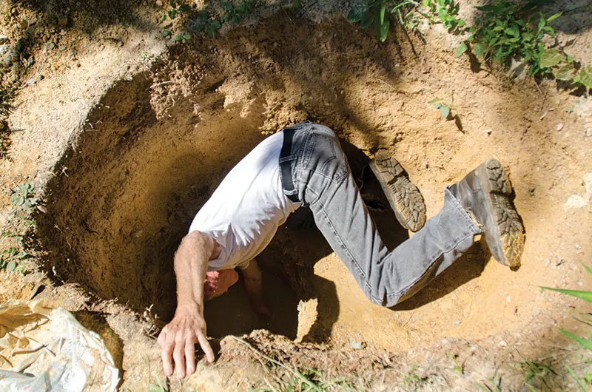
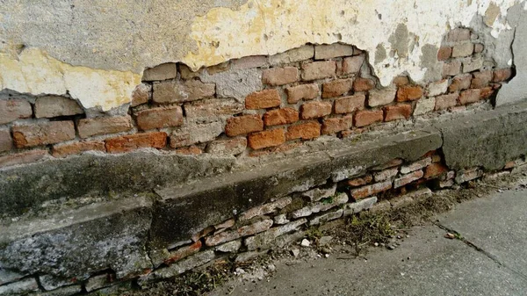
Risks of Life (vv. 8-11)
8) The one digging a pit may fall in it;
the one breaching a wall may be
bitten by a snake. [PJT]

Slide 17
Risks of Life (continued)
Quarrying stones may lead to injury from them (v. 9a)
Cutting down trees may be dangerous (v. 9b)
A dull axe requires more effort (v. 10a)
Lesson: wisdom sharpens axe of life (v. 10b)
Snake charmer doesn’t get paid when snake bites before
it is charmed (v. 11)

Slide 18
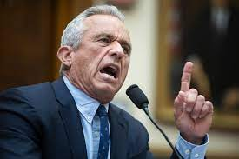

Back to Fools with Authority? (vv. 12-17)

Slide 19
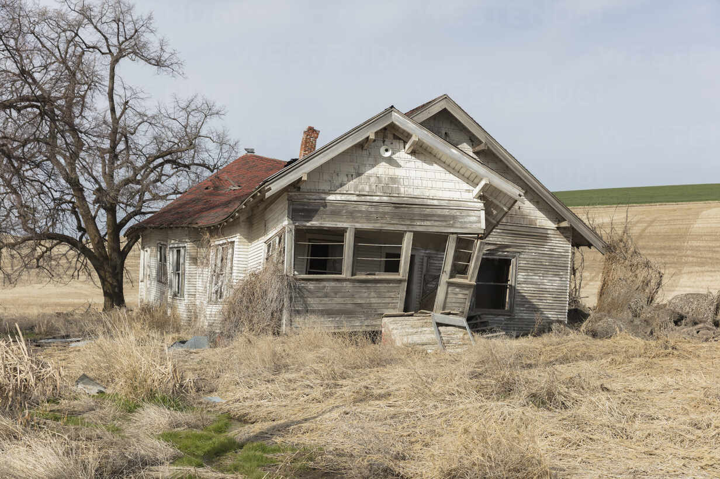
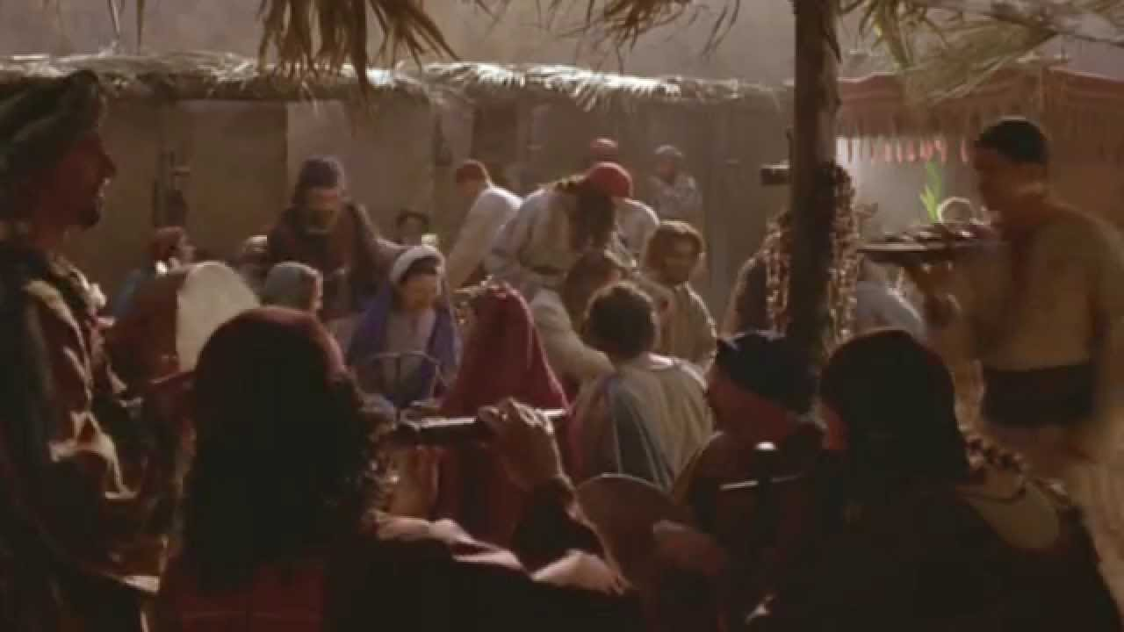
Beams and Leakage (v. 18)
Feast and Wine (v. 19)

Slide 20
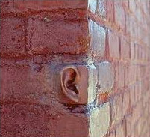
Don’t even think negatively about authority,
Don’t even whisper in your bedroom (v. 20)

