Slide 1
Preparing to Teach Hebrews Part III
Chapter 4 Perfect Rest and Perfect Priest

Slide 2
30% of Exhortations in Hebrews in Chapter 4
Let us fear lest any fail to reach God’s rest (4:1)
Let us strive to enter that rest (4:11)
Let us hang onto our confession (4:14)
Let us approach the throne of grace with confidence (4:16)

Slide 3
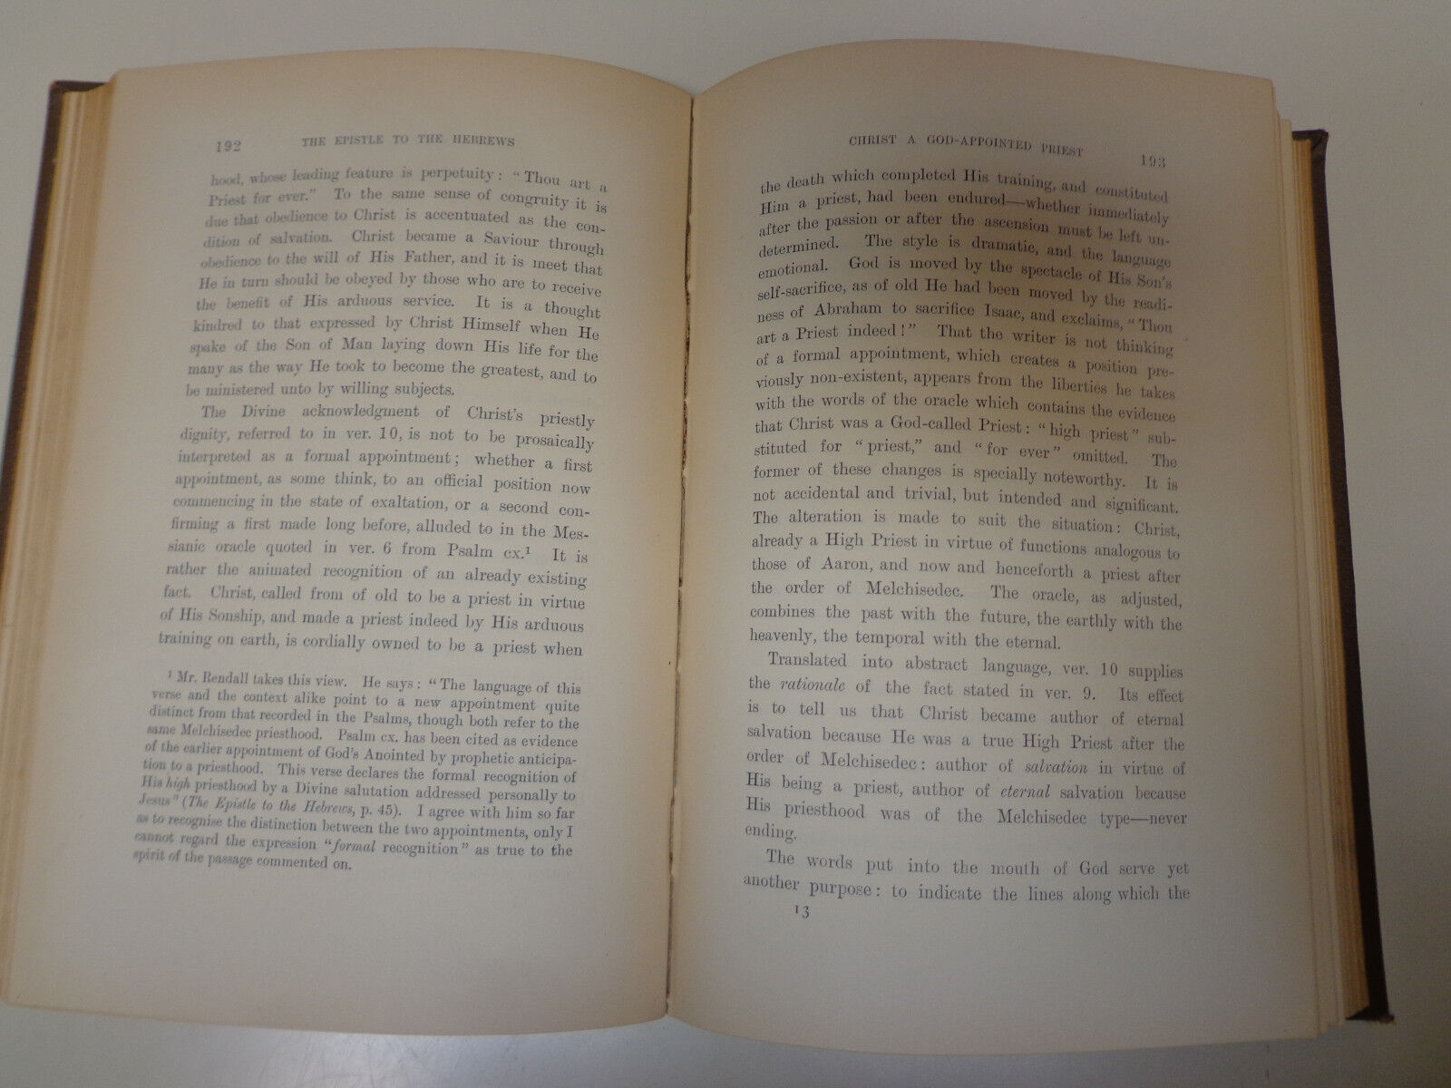
Absalom B. Bruce – 1899 [Bruce, A. B. The Epistle to the Hebrews: The First Apology for Christianity: An Exegetical Study (New York: Charles Scribner’s Sons, 1899), p. xi.]
Christ and the Prophets (1:1-4)
Christ and the Angels (1:5-14, 2:1-4)
The Humiliation of Christ and Its Rationale (2:5-18)
Christ and Moses (3:1-19)
God’s Rest (4:1-16)

Slide 4
[Bruce, F. F. The New International Commentary on the New Testament: The Epistle to the Hebrews (Grand Rapids, MI: William B. Eerdmans, 1964), p. lxiii.]
I. The Reality of Christianity (1:1-2:18) (See last week’s slides)
II. The True Home of the People of God (3:1-4:13) 1. Jesus Greater Than Moses (3:1-6) 2. Second Admonition: The Rejection of Jesus More Serious Than the Rejection of Moses (3:7-19) 3. The True Rest of God May be Forfeited (4:1-10) 4. Exhortation to Attain God’s Rest (4:11-13)
III. The High Priesthood of Jesus (4:14-6:20) 1. Christ’s High Priesthood, Encouragement (4:14-16)

Slide 5
[DeSilva, David A. Perseverance in Gratitude: A Socio-Rhetorical Commentary on the Epistle “to the Hebrews” (Grand Rapids, MI: William B. Eerdmans, 2000), p. 71.]
3:1-4:13 Second Appeal to Honor God’s Word Through Trust and Perseverance 3:1-6 Jesus as Son over God’s House, has greater honor than Moses, the servant in God’s House. 3:7-4:13 Do not imitate those who rejected God’s patronage under the servant Moses, for we would find ourselves similarly under God’s judgment; rather, let us strive to enter the rest that remains open to us.
4:14-10:18 Central Exposition: Long, Difficult Word 4:14-16 Exhortation: We have a high priest who has secured and will maintain God’s favor toward us, so let us draw near to God for sustaining help

Slide 6
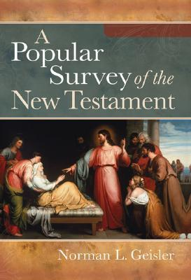
[Geisler, Norman L. A Popular Survey of the New Testament (Grand Rapids, MI: Baker Books, 2007), p. 256.]
I. Doctrinal—Christ is Better than Anything Else (Chapters 1-10) A. Prophets (1:1-3) B. Angels (1:4-2:18) with peril of drifting (2:1-4) C. Moses (3:1-19) with peril of doubting (3:7-19) D. Joshua (4:1-13) E. Levitical Priests (4:14-7:28)

Slide 7
Jobes, Karen H. Letters to the Church: A Survey of Hebrews and the General Epistles (Grand Rapids, MI: Zondervan Academic Publishing, 2011), pp. 51-53.
F. Warning Against Refusing the Ultimate Sabbath Rest (3:7-4:13) 1. The Failure of Moses’ generation (3:7-11) 2. Another Warning (3:12-15) 3. God Did Not Spare Moses’ generation (3:16-19) 4. The Sabbath of the New Covenant (4:1-11) 5. Warning That Nothing is Hidden from God (4:12-13) II. Jesus as High Priest (4:14-10:18) A. Christological Claim: The Son is Our Great High Priest (4:14-5:10) 1. Exhortation to Approach God’s Throne with Confidence (4:14-16)

Slide 8
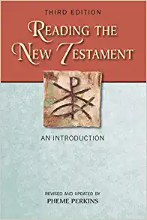
Perkins, Pheme. Reading the New Testament: An Introduction: Third Edition (Mahwah, NJ: Paulist Press, 2012), p. 250.]
Prologue: God has spoken through His Son (1:1-4) The Son’s superiority to the angels (1:5-14) Exhortation: Do not drift away from such a salvation (2:1-4) By suffering, the Son brings many to salvation (2:5-18) Jesus is greater than Moses (3:1-6) Exhortation: Do not fall away like Israel in the wilderness (3:7-4:13) Jesus is the sympathetic high priest (4:14-5:10)

Slide 9
“Therefore, while the promise remains of entering into His rest, let us fear so that none of you should miss it.” Hebrews 4:1 HCSB
“Let us fear, therefore, lest haply, a promise being left open of entering into his rest, any one of you should seem to have come short of it.” F. F. Bruce’s translation, p. 70.
“the Christian salvation is here presented under a third aspect as a rest, a sabbatism, a participation in the rest of God ; the new view, like the two preceding, in which the great salvation was identified with lordship in the world to come and with deliverance from the power of the devil and the fear of death, …” A. B. Bruce, p. 151

Slide 10
Some Interpretations of “Rest”

Slide 11
Rest Tied to Promise and Presence
Then He replied, “My presence will go with you and I will give you rest.” (Exodus 33:14 HCSB)
When the LORD your God gives you rest from all the enemies around you in the land the LORD your God is giving you to possess as an inheritance, blot out the memory of Amalek from under heaven. Do not forget. (Deuteronomy 25:19 HCSB)

Slide 12
Numbers 13 and 14

Slide 13
Relationships from Numbers 14 to Hebrews
Disobedience
“disobedience” (Heb. 4:6, 11)
“from Him” (Num. 14:43)
Not Enter
“His rest” (Heb. 3:18; 4:1)
“My rest” (Heb. 3:11; 4:3,5)
Distrust
“distrust” (Heb. 3:19)
“distrust” (Num. 14:11)

Slide 14
“For we also have received the good news just as they did; but the message they heard did not benefit them, since they were not united with those who heard it in faith…” Hebrews 4:2 HCSB

Slide 15
“For somewhere He has spoken about the seventh day in this way: And on the seventh day God rested from all His works.” Hebrews 4:4 HCSB
“But if God’s rest on the seventh day is a reference to the rule of what he has created, his people obviously cannot imitate that. Instead, the cessation of work on the seventh day of each week is an acknowledgment of the basic principle of Theology 101—that the Creator God is in control and we are not; that it is he who brings stability and order to our lives. ‘Sabbath is for recognizing that it is God who provides for us and who is the master of our lives and our world.’” Jobes, Karen H. Letters to the Church: A Survey of Hebrews and the General Epistles (Grand Rapids, MI: Zondervan Academic Publishing, 2011), p. 130 [quoting Walton, John H. The Lost World of Genesis One: Ancient Cosmology and the Origins Debate (Downer’s Grove, IL: IVP Academic, 2009), p. 147.]

Slide 16
“pattern” Hebrews 8:5 “imitation and representation of the universe” Josephus, F. Antiquities of the Jews 3.7.7.180
Application Question: Why might the temple have been so important to early Christians addressed in Hebrews?

Slide 17
Hebrews 4:8 = Joshua Imperfect
“A true fulfilment of the task of Joshua, as Ps. 95:5-7 ff. also demonstrates, v. 8, will take a different form from the historical. Since it is from God, it will and must bring a [rest] which corresponds to that of God Himself.” (Bauerfeind, Otto, Theological Dictionary of the New Testament: Volume III, p. 637)

Slide 18
How Then Do We Succeed?
“What it ultimately divides is the world of life from the world of death, and this can be accomplished only by a language that escapes from argument and refutation. The language used in the Bible is the language of love, …” Frye, Northrup. The Great Code: The Bible and Literature (New York: Harcourt & Brace, 1982), p. 231
“…essential for cutting through all the confusions of experience and reshaping the structure of vision in the mind.” (Frye, p. 225)

Slide 19
The High Priest as Mediator

