Slide 1
Preparing to Teach Hebrews Part IV
Hebrews 5:1-6:20

Slide 2
[Bruce, F. F. The New International Commentary on the New Testament: The Epistle to the Hebrews (Grand Rapids, MI: William B. Eerdmans, 1964), p. lxiii.]
III. The High Priesthood of Jesus (4:14-6:20) 1. Christ’s High Priesthood, Encouragement (4:14-16) 2. Qualifications for High Priesthood (5:1-4) 3. Christ’s qualifications (5:5-10) 4. 3rd Admonition: Spiritual Immaturity (5:11-14) 5. No Second Beginning Possible (6:1-8) 6. Encouragement to Persevere (6:9-12) 7. The Steadfastness of God’s Promise (6:13-20)

Slide 3
[DeSilva, David A. Perseverance in Gratitude: A Socio-Rhetorical Commentary on the Epistle “to the Hebrews” (Grand Rapids, MI: William B. Eerdmans, 2000), p. 71.]
4:14-10:18 Central Exposition: Long, Difficult Word 4:14-16 Exhortation: We have a high priest who has secured and will maintain God’s favor toward us, so let us draw near to God for sustaining help 5:1-10 Argument: Jesus’ appointment as High Priest
5:11-6:20 Digression (Guide to Gaining God’s Pleasure) 5:11-14 Interruption and appeal for attentive hearing 6:1-3 Exhortation to move forward, not fall away 6:4-8 Those who fall away resent God and God’s gifts 6:9-12 Palliation: We expect YOU to continue your efforts and are confident of the outcome 6:13-20 WHY we are confident of the outcome: perseverance

Slide 4
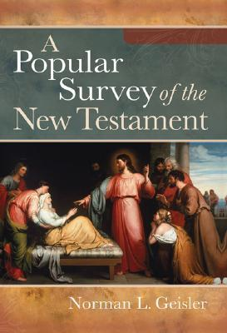
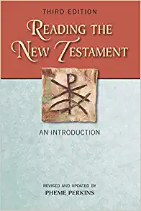
I. Doctrinal—Christ is Better than Anything Else (Chapters 1-10) E. Levitical Priests (4:14-7:28)
[Geisler, Norman L. A Popular Survey of the New Testament (Grand Rapids, MI: Baker Books, 2007), p. 256.]
Perkins, Pheme. Reading the New Testament: An Introduction: Third Edition (Mahwah, NJ: Paulist Press, 2012), p. 250.]
Jesus is the sympathetic high priest (4:14-5:10)
Exhortation: Don’t be Immature in Faith (5:11-6:12)
God’s Promises Confirmed by an Oath (6:13-20)

Slide 5
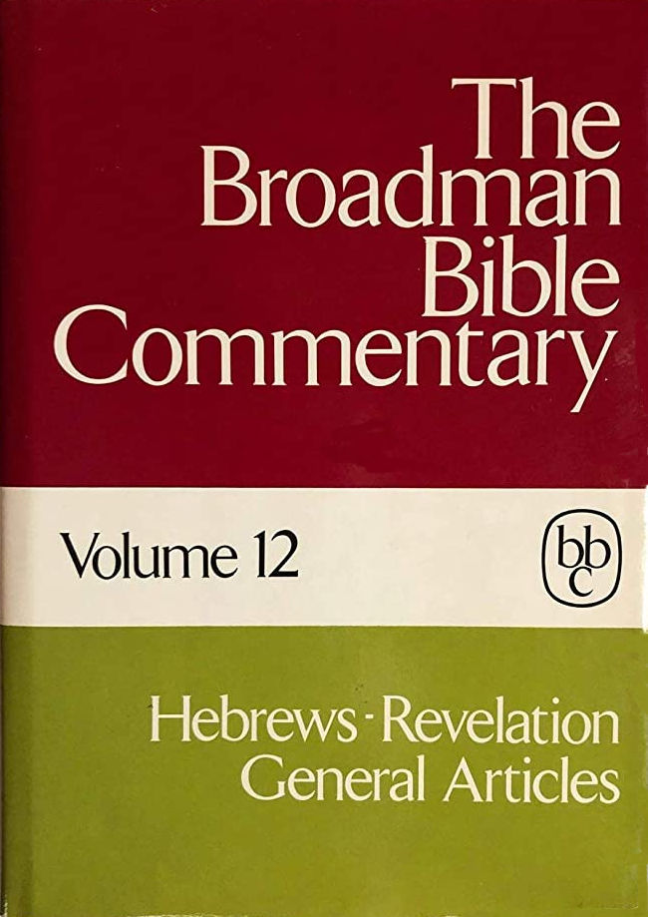
III. Our Great High Priest (4:14-5:10) 1. Nature of the High Priest (4:14-16) 2. Qualifications of the High Priest (5:1-10) a. Human Qualifications (5:1-6) b. Moral Qualifications (5:7-10)
IV. Application (5:11-6:20) 1. Against sluggishness (5:11-14) 2. Crucifying Christ Again (6:1-12) 3. Reassurance (6:13-20) a. The Promise (6:13-17) b. Anchor of Hope (6:18-19) c. Forerunner and High Priest (6:20)
Trantham, Charles A., “Hebrews” in Clifton J. Allen (ed.), The Broadman Bible Commentary: Volume 12: Hebrews-Revelation, General Articles (Nashville: Broadman Press, 1972), p. 13.

Slide 6
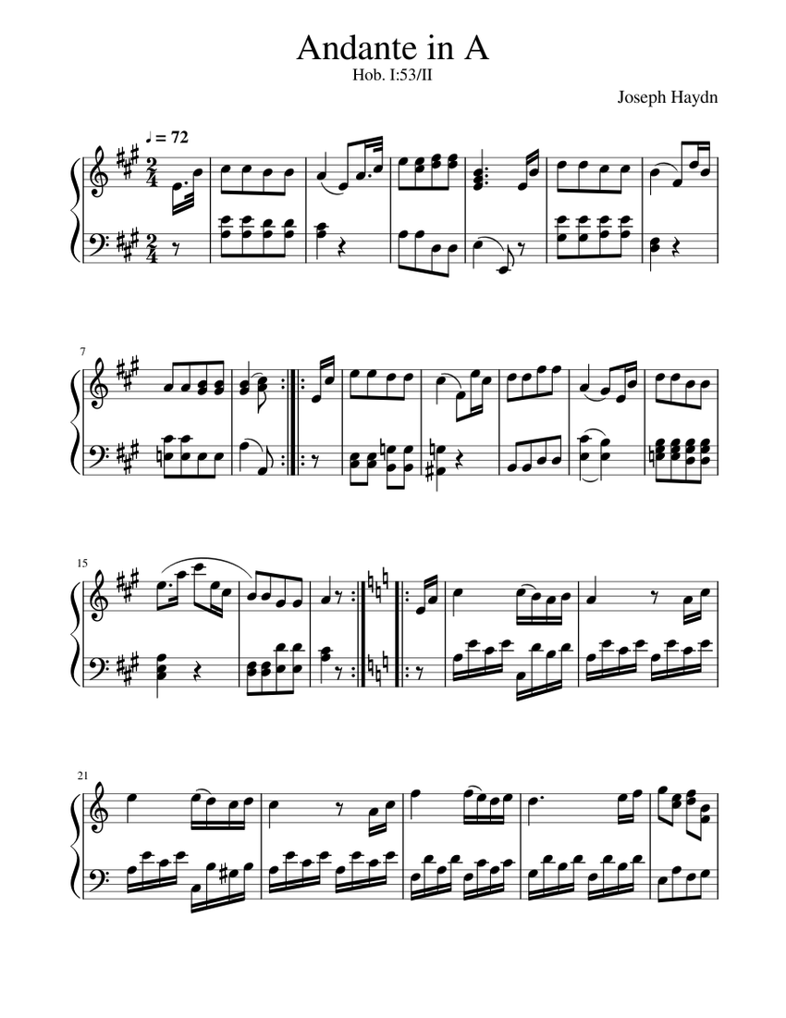
Pastor Johnny’s Symphonic View and Guthrie, George, The Structure of Hebrews: A Text-Linguistic Analysis (Grand Rapids, MI: Baker Book House, 1994), p. 94.
Andante – (4:14-6:12) slower pace with emotion / Jesus as great high priest, warning against immaturity and apostasy

Slide 7
1) For every high priest is collected out of humankind, appointed on behalf of humankind pertaining to things of God in order to continue offering gifts and sacrifices regarding sins. [PJT]

Slide 8
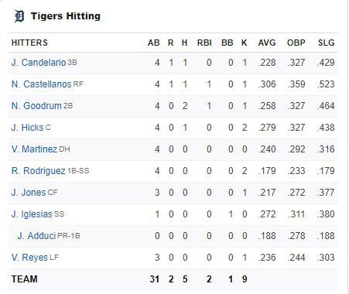
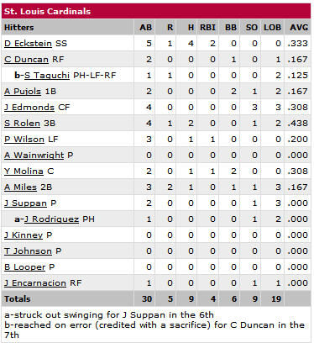
Appointed versus Designated
5:1 “appointed on behalf of humankind pertaining to things of God” v.2
5:10 “10) He was designated high priest by God, according to the order of Melchizedek. [PJT]

Slide 9
Jesus As Superior to the Levitical Priesthood
Levitical High Priests
Jesus as High Priest
“able to measure out compassion in weakness” (5:2)
“obligated to offer sacrifices” for people, himself, sins (5:3)
“called by God just as Aaron was” (5:4) (but hereditary)
“has sympathy with weakness, but without weakness (4:15)
“source of eternal salvation” (5:9)
“approved by God to become high priest” (5:5) (not hereditary)

Slide 10
Is Melchizedek Identical to Jesus?
מלכי־צדך = “King of Righteousness”
שלם מלך = “King of Peace”
“priest of Highest God”
“bread and wine”
“received tithe”
gave blessing
But Jesus is King, Priest, AND Son of God (Hebrews 5:5-6) quoting Psalm 2:7, 110:4

Slide 11
7) Who, in the days of His physical body offered prayers and pleas with loud cries and tears to the One able to rescue Him from death, and He was heard from His authentic fear.
8) Even though He was a Son, He learned obedience from what He suffered
9) And became complete, becoming the source of eternal salvation to all who obey Him. (Hebrews 5:7-9 PJT)

Slide 12
Observations on Hebrews 5:8-9
“At any rate, the status of sonship and obedience to the Father go together. Obedient subordination to the Father characterizes Jesus as the Son. As Paul puts it, he lets himself be guided by the Spirit of God (Romans 8:14). His obedience, then, is not the alien obedience of the slave. It is an expression of his free agreement with the Father. By this Spirit, he has in himself the eternal life that shows him to be the living and incorruptible Christ in his resurrection from the dead.” [Pannenberg, Wolfhart. Systematic Theology: Volume 2 (Grand Rapids, MI: William B. Eerdmans, 1994), p. 316.]

Slide 13
Warning Against Complacency (vv. 11-14)
Difficult interpretation (v. 11) (usually used by philosophers)
Complacency (v. 11)
Obligated to be teaching (v. 12)
Settling for easy lessons (milk) makes one less qualified to act as God wants (v. 13)
Solid food is for the mature (complete – v. 14)

Slide 14
Hebrews 6:1-3 / “driven like the wind”
1) Therefore, let us leave behind the initial teaching [lit. “word”] concerning Christ, being driven like the wind toward the goal line, not laying again the foundation of repentance from dead works and so, faith in God, 2) of baptismal catechism, of laying on of hands, of resurrection of the dead, and eternal punishment, 3) but these things we will do only if God permits, [PJT]

Slide 15
Hebrews 6:4-6 [PJT] / Inoculation?
4) Since, it cannot be done that those who were once enlightened, those tasting of the heavenly gift, becoming partners with the Holy Spirit, 5) even tasting of the good word of God and the power of the coming age, 6) and then, fall away, to be restored again for the purpose of repentance, since [so doing] they re-crucify the Son of God for themselves [on their own account], exposing Him to public ridicule.
“This may be perhaps because they have believed just enough, just long enough to be inoculated, so to speak, against the gospel, and tragically will never again desire to be reconciled to God in Christ.” [Jobes, Karen H., Letters to the Church: A Survey of Hebrews and the General Epistles (Grand Rapids, MI: Zondervan Academic, 2011), p. 140.]

Slide 16
8) But the one bearing thorns and thistles is of no value and near to being cursed; its end is burning. [PJT]

Slide 17
Reviews and Previews μακρθυμήσας
“The author’s purpose is in the first place to show, by Abraham’s example, how surely faith and patience will find their reward—how certain they are to obtain the promises; and in the next place to remind his readers on what a strong foundation their Christian hope, as formerly that of Abraham, is now established.” [Delitzsch, Franz, Delitzsch’s Commentary on the Hebrews: Volume 1 (Edinburgh: T & T Clark, 1868), p. 305.]

