Slide 1
Preparing to Teach Hebrews IX
Hebrews 11:23-12:29

Slide 2
Adapted in Jobes, Karen H., Letters to the Church: A Survey of Hebrews and the General Epistles (Grand Rapids, MI: Zondervan Academic Publishing, 2011), p. 127, from Westfall, Cynthia Long, A Discourse Analysis of the Letter to the Hebrews: The Relationship between Form and Meaning, Library of New Testament Studies 297, Studies in New Testament Greek (London: T&T Clark, 2005), p. 298.
Let's Hold On | Let's Draw Near | Let's Go Forward
Pay closer attention to what we've heard (2:1) | Approach the throne of grace for mercy and help (4:16) | Be anxious so no one fails to reach the Sabbath rest (4:1)
Hold tight to our confession [of Jesus as Lord] (4:14) | Approach "Holy of Holies" cleansed and ready (10:22) | Be active toward reaching that rest and don't disobey (4:11)
Hold tight to our faith because of His reliability (10:23) | Worship/serve God with awe and gratitude (12:28) | Move from rudimentary doctrines to maturity (6:1)
 | Be willing to suffer [outside the camp] with Jesus (13:12) | Consider how to stimulate each other's good works (10:24)
 | Constantly praise, do good, and share (13:15-16) | Finish the race we started (12:1)

Slide 3
Bruce, F. F. The New International Commentary on the New Testament: The Epistle to the Hebrews (Grand Rapids, MI: William B. Eerdmans, 1964), p. lxiv.
f. The faith of Moses (11:23-28) g. Faith at the Exodus and Settlement (11:29-31) h. Further examples of faith (11:32-38) i. Epilogue: Faith’s vindication comes with Christ (11:39-40) 5. Jesus, the Pioneer and Perfector of Faith (12:1-3) 6. Discipline is for Sons (12:4-11) 7. Let us then be up and doing (12:12-17) 8. The Earthly Sinai and the Heavenly Zion (12:18-24) 9. Pay Heed to the Voice of God (12:25-29)

Slide 4
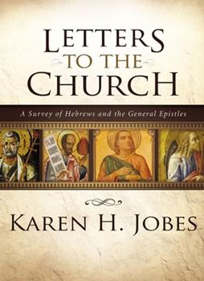
Jobes, Karen H. Letters to the Church: A Survey of Hebrews and the General Epistles (Grand Rapids, MI: Zondervan Academic Publishing, 2011), p. 53.
B. The Examples of Those Who Persevered Before Us (11:1-40) 1. A Definition of Faith (11:1) 2. The Examples of Old Testament Believers (11:2-38) 3. Their faith commended, but promise deferred (11:39-40) C. Another Exhortation to Persevere (12:1-28) 1. The Example of Jesus (12:1-3) 2. The Discipline of the Father (12:4-13) 3. Warning not to refuse the Father’s discipline (12:14-17) 4. Warning not to refuse the new covenant (12:18-28)

Slide 5
Trentham, Charles A., “Hebrews” in Clifton J. Allen (ed.), The Broadman Bible Commentary: Volume 12: Hebrews-Revelation, General Articles (Nashville: Broadman Press, 1972), p. 13.
IX. Meaning of Faith (11:1-40) 1. Substance and Evidence (11:1-2) 2. Belief in the Creator (11:3) 3. The Faithful of the OT (11:4-34) 4. Summary of Horrors (11:35-38) 5. Delay of the Promise (11:39-40)
X. Words of Encouragement and Discipline (12:1-24) 1. Call to complete the course (12:1-2) 2. Need for discipline (12:3-17) 3. The final arrival (12:18-24) 4. The final warning (12:25-27) 5. Call to gratitude and worship (12:28-29)

Slide 6
The Example of Moses (11:23) Godly Parents – Family Important to Faith
Hidden by parents for three (3) months in defiance of Pharaoh
Placed in an “ark” [same word as in Genesis 6]
Firstborn son, but … Exodus 2:1, 4?
Emphasis on legitimacy
Compared to the origin tale of Sargon I (illegitimate son of princess)

Slide 7
Moses Rejects Egyptian Identity (24-26)
Moses is the Egyptian word for “son” as in Thutmoses
Exodus uses a sound-alike, “to be drawn out”
Notice the “by means of faith” in verse 24
Notice the refusal to live in the comfort of sin in verses 25-26
Contrast “people of God” with “temporary” enjoyment
“He estimated loss and gain not by outward and transient appearances, but according to inward truth and reality, which though for the present hidden, would one day be manifested.” [Delitzsch, Franz, Delitzsch’s Commentary on the Hebrews: Volume II (Edinburgh: T&T Clark, 1870), p. 261.]

Slide 8
Comparison of Acts 7 and Hebrews 11
Acts | Stephen's Sermon | Hebrews | Hebrews Emphasis
7:20 | "Exceptional" child nurtured 3 months | 11:23 | Parents hid "exceptional child" 3 months
7:21-23 | Raised Egyptian till 40 years old | 11:24-26 | Refused privilege of Egypt
7:24-25 | Assumed he could be deliverer | 11:27 | Fled Egypt, but still trusted "invisible“ (Exodus 2:14?)
7:29 | Fled Egypt in (Exodus 2:14?) Fear | 11:28 | By means of faith, kept the Passover
7:30 | After 40 years, saw burning bush | 11:29 | By means of faith, crossed the Reed Sea
7:36 | Led them out with wonders for 40 years

Slide 9
By Faith, Leaving Egypt (11:27)
Operative phrase “By faith:
NOT afraid of king?
Compare with Exodus 2:14-15
Some try to make it a reference to the Exodus to harmonize
NOT a plural reference or in sequence with other points
LESSON: Sometimes, in faith, we must retreat, then advance!

Slide 10
Faith in God’s Action (11:28-29)

Slide 11
Faith in Conquest/Settlement (11:30-31)

Slide 12
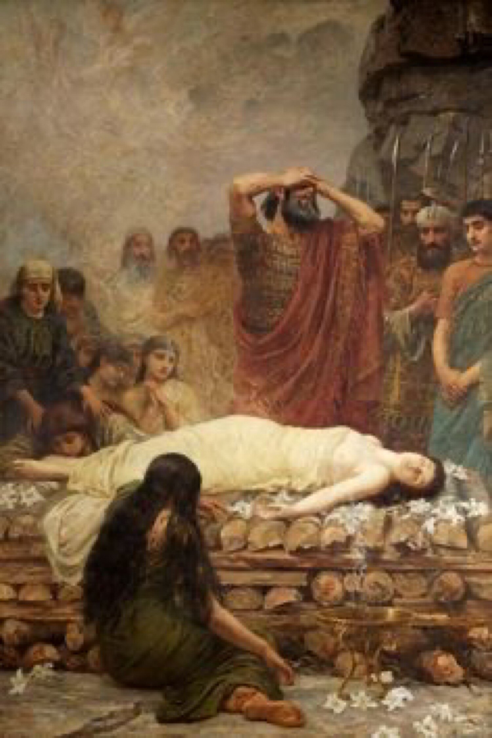
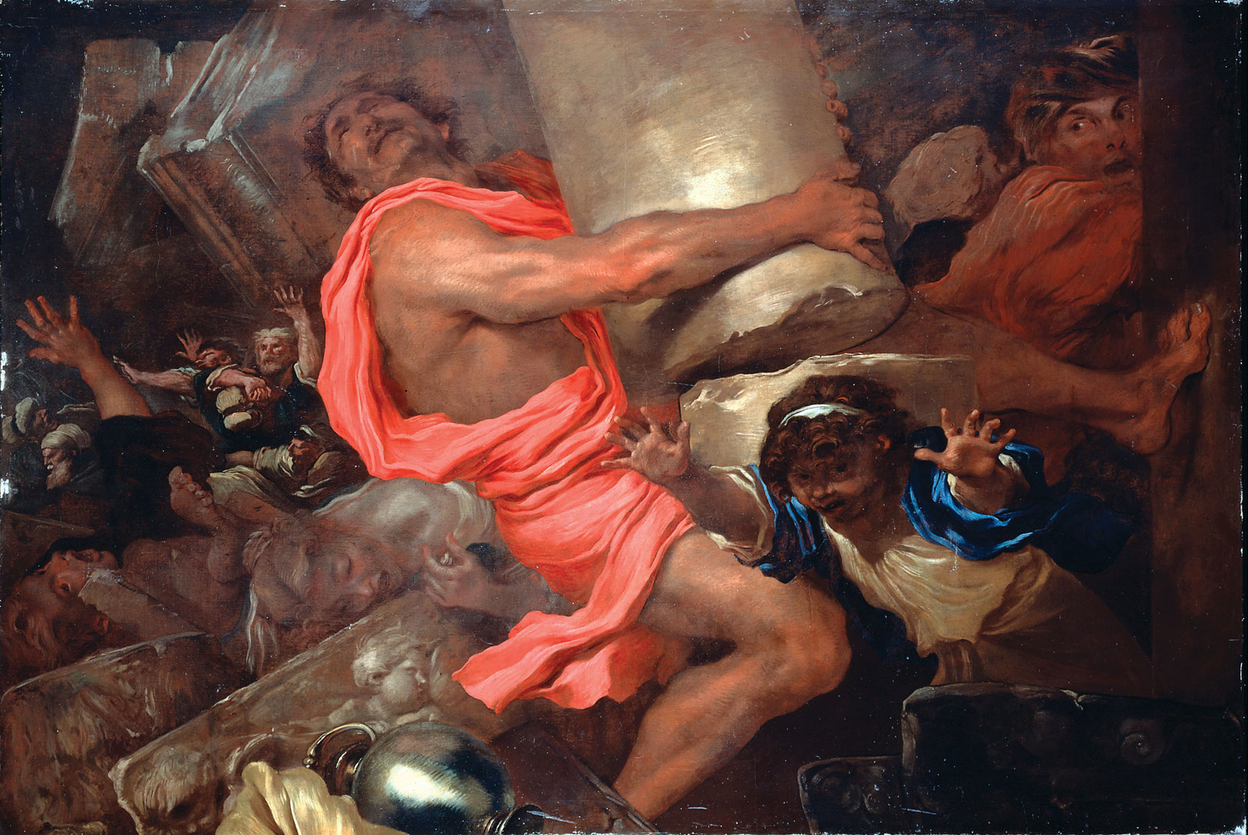
Time is Too Short (11:32)

Slide 13
List of Horrors (vv 35-38)
Receiving sons via resurrection (1 Kings 17, 2 Kings 4)
Tortured, refusing to accept relief
Mocking, scourging, chains, imprisonment
Stoned, sawn in two
Forced to wander in destitution

Slide 14
Martyrdom of Eleazar (2 Maccabees 6:18-31) Rabbinical Sawing of Isaiah

Slide 15
Delayed Fulfillment (vv. 39-40)
“Some of them, as we were told in v. 33, ‘obtained promises,’ but none of them received the promise in the sense of witnessing its fulfillment.” F. F. Bruce, p. 343
“For them final salvation was simply a future good; for us it is at once present and future: present, in that the whole blessing has been procured for us by the self-sacrifice of Christ once for all; future, in that the full development and apprehension of this blessing is not yet realized…” Franz Delitzsch, p. 291.

