Slide 1
Preparing to Teach Hebrews
Part V Hebrews 7 and 8

Slide 2
The HEART of the Matter!
“Chapter 7 not only reveals ‘the core of Hebrews, but also the unveiling of secrets,’ as the Melchizedek speculation most clearly indicates.” Käsemann, Ernst. The Wandering People of God: An Investigation of the Letter to the Hebrews (Minneapolis: Augsburg Publishing, Inc., 1984—original 1957), p. 187. He goes on to say that not only is Chapter 7 the heart of the teaching in Hebrews, but is a demonstration of the “meat” the author was urging the Hebrews to get prepared for (p. 191).

Slide 3
Hebrews: Finding the Center
Christian Living Hebrews 13
Application Hebrews 6
Superior and Eternal High Priest Hebrews 7
Call to Action Hebrews 12
High Priest Hebrews 5
Faith Displayed Hebrews 11
Above “Rest” Hebrews 4
Best Forgiveness Hebrews 10
Above Moses Hebrews 3
Best Tabernacle Hebrews 9
Above Ritual Hebrews 2
Best Covenant Hebrews 8
Above Angels Hebrews 1

Slide 4
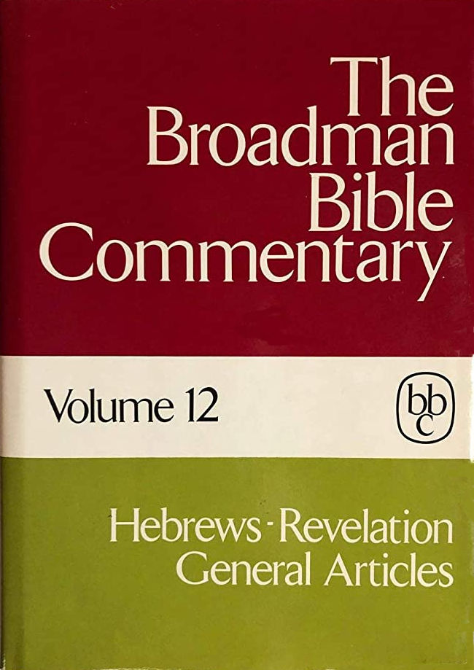
Trantham, Charles A., “Hebrews” in Clifton J. Allen (ed.), The Broadman Bible Commentary: Volume 12: Hebrews-Revelation, General Articles (Nashville: Broadman Press, 1972), p. 13.
V. Heart of the argument (7:1-28) 1. Melchizedek (7:1-3) 2. Superiority of Melchizedek (7:4-10) 3. A divine priesthood (7:11-14) 4. An effectual priesthood (7:15-19) 5. An eternal priesthood (7:20-22) 6. A perpetual priesthood (7:23-25) 7. The perfect priesthood (7:26-28)
VI. The new tabernacle (8:1-6)
VII. The new covenant (8:7-9:28) 1. Inward and effective (8:7-13) 2. Place of the old covenant (9:1-28) (1) Ark of the covenant (9:1-5) (2) System of exclusion (9:6-10) (3) A superior tabernacle (9:11) (4) A superior sacrifice (9:12-23) (5) The superior hope (9:25-28)

Slide 5
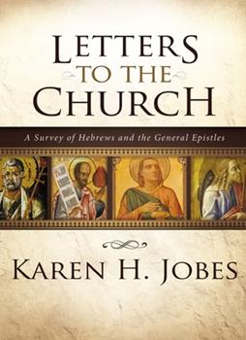
Jobes, Karen H. Letters to the Church: A Survey of Hebrews and the General Epistles (Grand Rapids, MI: Zondervan Academic Publishing, 2011), p. 52.
C. Melchizedek and Jesus (6:20-7:28) 1. Jesus’ priesthood in the order of Melchizedek (6:20) 2. About Melchizedek (7:1-10) 3. The new priesthood (7:11-22) 4. The Son is the final, perfect Priest (7:23-28)
D. A New Priesthood Means a New Covenant (8:1-13) 1. Our High Priest ministers in heaven itself (8:1-2) 2. The ministry of Jesus is superior to the priesthood of the old covenant (8:3-13) a. The new covenant is based on better promises (8:3-6) b. The new covenant is written on hearts (8:7-12) c. The old covenant is obsolete and will disappear (8:13)

Slide 6
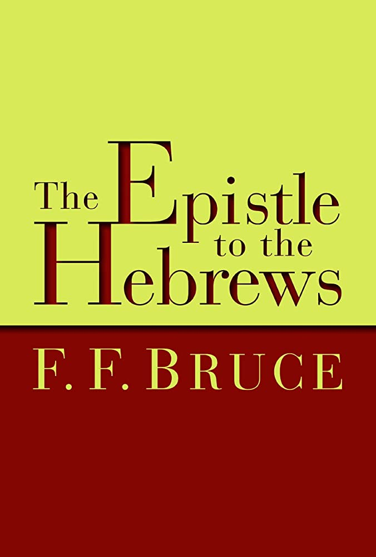
[Bruce, F. F. The New International Commentary on the New Testament: The Epistle to the Hebrews (Grand Rapids, MI: William B. Eerdmans, 1964), p. lxiii-lxiv.
IV. The Order of Melchizedek (7:1-28) 1. Melchizedek the priest king (7:1-3) 2. The Greatness of Melchizedek (7:4-10) 3. The imperfections of the Aaronic priesthood (7:11-14) 4. Superiority of the new priesthood (7:15-19) 5. Superior because of the divine oath (7:20-22) 6. Superior because of its permanence (7:23-25) 7. Superior because of the character of Jesus (7:26-28)

Slide 7
[Bruce, F. F. The New International Commentary on the New Testament: The Epistle to the Hebrews (Grand Rapids, MI: William B. Eerdmans, 1964), p. lxiii-lxiv.
V. Covenant, Sanctuary, and Sacrifice (8:1-10:18) 1. Priesthood and promise (8:1-7) 2. The old covenant superseded (8:8-13) 3. The sanctuary under the old covenant (9:1-5) 4. A temporary ritual (9:6-10) 5. Christ’s Eternal Redemption (9:11-14) 6. Mediator of the new covenant (9:15-22) 7. The perfect sacrifice (9:23-28) 8. The old order a shadow of reality (10:1-4) 9. The new order the reality (10:5-10) 10. The Enthroned High Priest (10:11-18)

Slide 8
“For THIS, …” Hebrews 7:1
Did you know that verses 1-3 are ONE long sentence?
Main thought: “For THIS [purpose], Melchizedek …remains a priest for perpetuity” (or “continually”)
Has two purposes: a) apologetic: to convince why Christ can be a “priest” despite not being a Levite, as well as superior because the order is older than the Levites and the “oath” was given before the Law was given b) doctrinal: to use Melchizedek’s priesthood as a symbol of the eternal validity of Christ’s priestly functions [Bruce, A. B. The Epistle to the Hebrews: The First Apology for Christianity: An Exegetical Study (New York: Charles Scribner’s Sons, 1899), pp. 240-243.]

Slide 9
Genesis 14
Tidal “Goyim”
Amraphel Shinar
Abram’s Pursuit
Chedorlaomer Elam
Arioch Ellasar
Admah, Bera, Gomorrah, Sodom, Zeboiim

Slide 10
Often-Missed Detail

Slide 11
King of Peace (Shalom/Salem) and Righteousness

Slide 12
Melchizedek as “Crypto-Key”
Psalm 110
Qumran Cave 11, Scroll 13
Sits @ right hand of God (v. 1)
Rules (scepter) from Zion (v. 2)
Battle to come (v. 3)
Oath of priest forever (v. 4)
Lord @ right hand (v. 5)
Will judge/crush enemies/nations (v. 6)
Lifts up head after drinking from a brook (v. 7)
“And the Day of Atonement is the end of the tenth Jubilee, when all the Sons of Light and the men of the lot of Melchizedek will be atoned for…For this is the moment of the Year of Grace for Melchizedek…And Melchizedek will avenge the vengeance of the judgments of God….And your elohim is Melchizedek, who will save them from the hand of Belial.”

Slide 13
“All before [“first then”] is simple repetition of what is recorded in the history (Gen. xiv). All that follows is Christological interpretation and application of the historical record.” [Delitzsch, Franz. (Edinburgh: T & T Clark, 1868Delitzsch’s Commentary on the Hebrews: Volume I), pp. 327-328.]
Repetition
Christological
“The meaning is: though the historical Melchizedek doubtless died, the Melchizedek of the sacred narrative does nothing but live.” [A. B. Bruce, The Epistle to the Hebrews: The First Apology for Christianity: An Exegetical Study (New York: Charles Scribner’s Sons, 1899), p. 261.]
King of Salem
Priest of God Most High
Met Abram
Blessed Abram
Given tithe by Abram
Peace (& Righteousness)
ἀπάτωρ, ἀμήτωρ, ἀγενεαλόγιτος
No father, No mother, No genealogy
Resembling the Son of God ἀφωμοιωμένος

Slide 14
Why Christ is Greater than His Ancestor
Melchizedek must have been greater to receive tithes (v. 4)
Unlike Levites, it was pre-Law (v. 5)
Blesser > Blessee (vv. 6-7)
No record of death (v. 8) argument from silence
Levites “tithe” through Abram (v. 9)

Slide 15
Better Than κρεῖσσον 20x in New Testament 13x Here!
1:4 = Jesus better than the angels
6:9 = Faithful better than the apostate
7:7 = One blessing better than the one being blessed
7:19 = God has offered a better hope than the Law
7:22 = Jesus’ covenant better than the old
8:6 = Jesus’ ministry better than Levitical priests
8:6 = Jesus’ covenant better than theirs
9:23 = Heavenly matters require sacrifices better than the old

Slide 16
Chronological Argument
“Perfection” in verse 11 is “completion” of “cleansing” to allow access to God
Levitical law didn’t allow the people full access – even high priest limited to one day
Generally, latter supersedes the former
So, why David, long after Exodus/Leviticus declare an order of Melchizedek?

Slide 17
Activity: Ask the class to list ways Jesus fits the idea of Melchizedek better than Melchizedek
Melchizedek
Jesus (see especially 7:24-28)
King of Peace
King of righteousness
Mysterious origin
Serving as “eternal” priest
Worthy of Abraham’s devotion
Lord of authentic peace
The only truly sinless one
Virgin birth
Seated at right hand of God
Has a greater Father than Abraham

Slide 18
Learning from the Tabernacle (Hebrews 8)
“These serve as a copy and shadow of the heavenly things, as Moses was warned when he was about to complete the tabernacle...” [Hebrews 8:5a Holman Christian Standard Bible]

Slide 19
Medieval Interpretation of Stephen Langton
Tabernacle = Church
5 of 10 curtains = Books of Moses as history
4 colors of curtains represent four (4) ways of reading Scripture (historically, allegorically, figuratively, practically)
Other 5 curtains = Books of Moses as spiritual types
Table = Scripture, Loaves = word of salvation
Altar = atonement

Slide 20
Context of Jeremiah 31/ Book of Consolation
31:1-6 God tells of His love for His people, faithfulness to them, and His plan to restore and build His people.
31:7-14 God tells of the praises from His people after restoration.
31:15-22 God responds to the oppression of His people by telling them to be strong and not worry for there is still hope for their future.
31:23-34 God tells of the praise He will receive after restoration and of the new covenant (which seems to describe the NT church.
31:35-37 God foretells the permanence of Israel as God’s nation. God uses His control over nature to assure this.
31:38-40 God describes the rebuilding of Jerusalem and its sacredness and permanence.

Slide 21
Four (4) Aspects of Covenant
Treaty – a matter of peace and cooperation
Contract – an agreement on what will be done
Confession – an affirmation of values to build on
Constitution – a plan for securing and remember the values to be built on

