Slide 1
Preparing to Teach Hebrews VI
Holy Places/Holy Deeds
Preparing to Teach Hebrews 9:1-10:25
Grace Chinese Christian Church of Skokie, IL
May 3, 2023

Slide 2
Hebrews: Finding the Center
Christian Living
Hebrews 13
Application
Hebrews 6
Superior and Eternal High Priest
Hebrews 7
Call to Action
Hebrews 12
High Priest
Hebrews 5
Faith Displayed
Hebrews 11
Above “Rest”
Hebrews 4
Best Forgiveness
Hebrews 10
Above Moses
Hebrews 3
Best Tabernacle
Hebrews 9
Above Ritual
Hebrews 2
Best Covenant
Hebrews 8
Above Angels
Hebrews 1

Slide 3
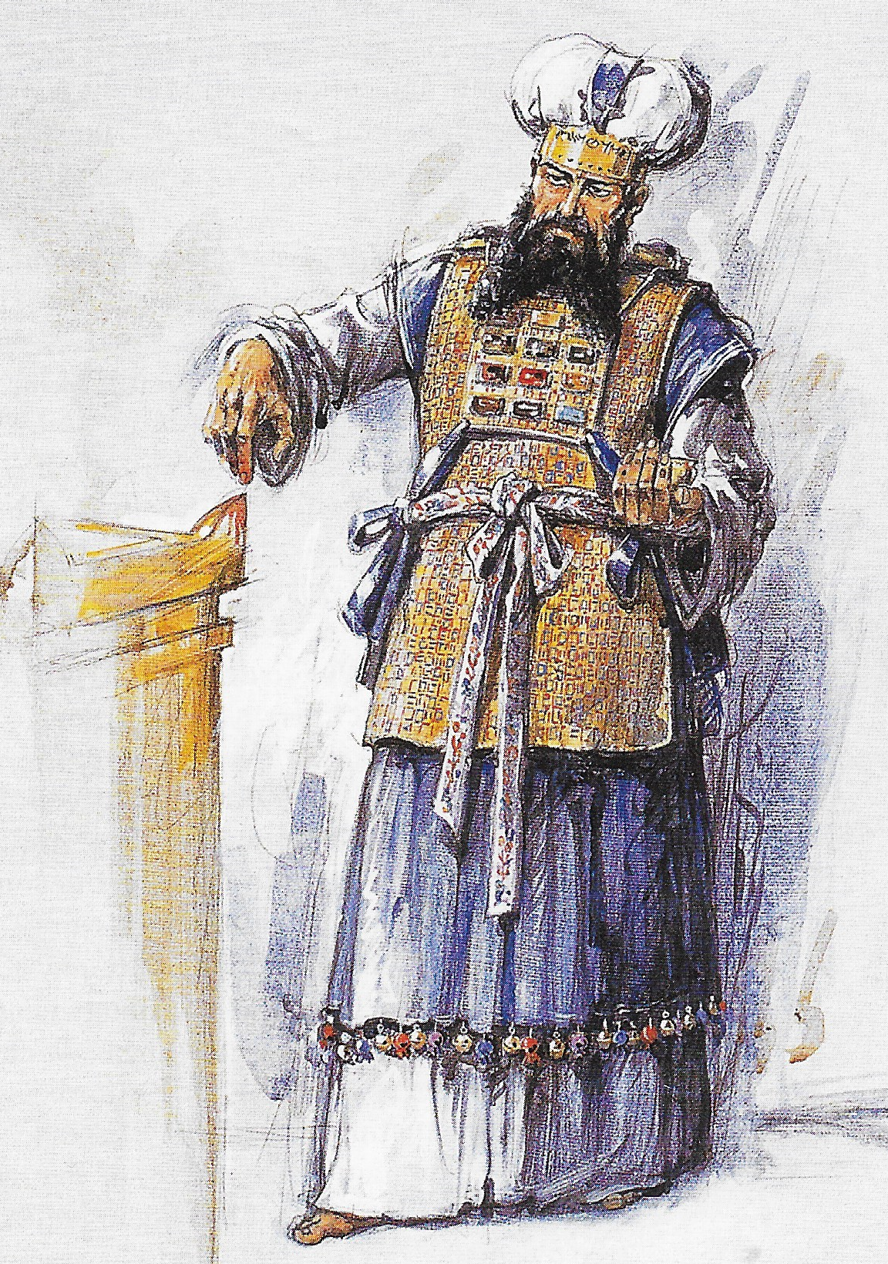
Where We Left Off (Hebrews 8:13)
“By means of saying, ‘NEW,” [covenant], the first was declared obsolete, and the aged will soon disappear [lit. not be seen].” [PJT]
What?
The old priesthood
The old sanctuary
The old covenant relationship

Slide 4
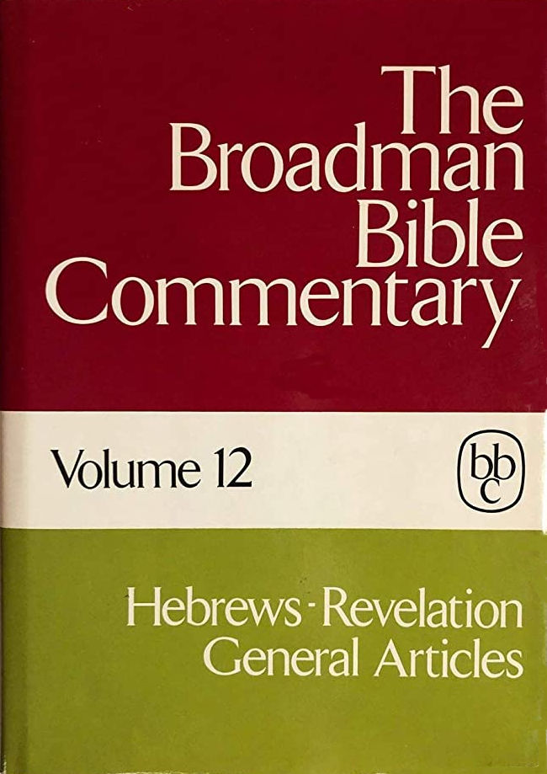
Trantham, Charles A., “Hebrews” in Clifton J. Allen (ed.), The Broadman Bible Commentary: Volume 12: Hebrews-Revelation, General Articles (Nashville: Broadman Press, 1972), p. 13.
VII. The new covenant (8:7-9:28)
1. Inward and effective (8:7-13)
2. Place of the old covenant
(9:1-28)
(1) Ark of the covenant (9:1-5)
(2) System of exclusion (9:6-10)
(3) A superior tabernacle (9:11)
(4) A superior sacrifice (9:12-23)
(5) The superior hope (9:25-28)
VIII. The Ultimate Will of God (10:1-39)
1. Failure of the Law (10:1-4)
2. Final Sacrifice (10:5-10)
3. Final Forgiveness (10:11-18)
4. The Invitation (10:19-25)
5. The Warning (10:26-31)
6. The Encouragement (10:32-39)

Slide 5
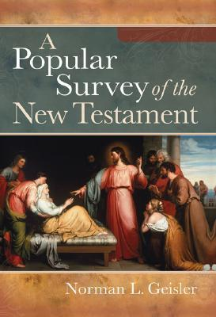
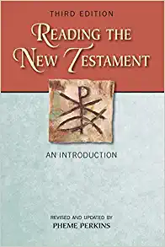
I. Doctrinal—Christ is Better than Anything Else (Chapters 1-10)
G. Old Covenant (8:6-9:22)
H. Sacrifices (9:23-10:39)
[Geisler, Norman L. A Popular Survey of the New Testament
(Grand Rapids, MI: Baker Books, 2007), p. 256.]
[Perkins, Pheme. Reading the New Testament: An Introduction:
Third Edition (Mahwah, NJ: Paulist Press, 2012), p. 250.]
Christ as mediator of the new covenant makes the
sacrifices of the old covenant unnecessary (9:1-22)
Christ’s sacrifice for sin takes place once-for-all in
the heavenly sanctuary (9:23-10:18)

Slide 6

[DeSilva, David A. Perseverance in Gratitude: A Socio-Rhetorical Commentary on the Epistle “to the Hebrews” (Grand Rapids, MI: William B. Eerdmans, 2000), p. 74.]
9:1-28 Admission to God’s Presence
The Levitical priests could not prepare the worshipers
to enter into God’s presence (symbolized by the earthly
holy places), but Christ’s single sacrifice has cleansed the
conscience of the worshiper for direct access to God’s favor;
Christ’s ascension into the heavenly sanctuary allows him
also to cleanse the true tabernacle of the defilement of human
sins, erasing their negative testimony from God’s memory.
10:1-18 Proof from Scripture (Psalm 40:6-8)
God has set aside the repetitious, ineffective animal sacrifices
in favor of Jesus’ single sacrifice of himself, which cleanses
the worshiper’s conscience once and for all.

Slide 7

[Bruce, F. F. The New International Commentary on the New Testament:
The Epistle to the Hebrews (Grand Rapids, MI: William B. Eerdmans, 1964), p. lxiii-lxiv.]
V. Covenant, Sanctuary, and Sacrifice (8:1-10:18)
1. Priesthood and Promise (8:1-7)
2. The Old Covenant Superseded (8:8-13)
3. The Sanctuary under the Old Covenant (9:1-5)
4. A Temporary Ritual (9:6-10)
5. Christ’s Eternal Redemption (9:11-14)
6. The Mediator of the New Covenant (9:15-22)
7. The Perfect Sacrifice (9:23-28)
8. The Old Order a Shadow of the Reality (10:1-4)
9. The New Order the Reality (10:5-10)
10. The Enthroned High Priest (10:11-18)

Slide 8
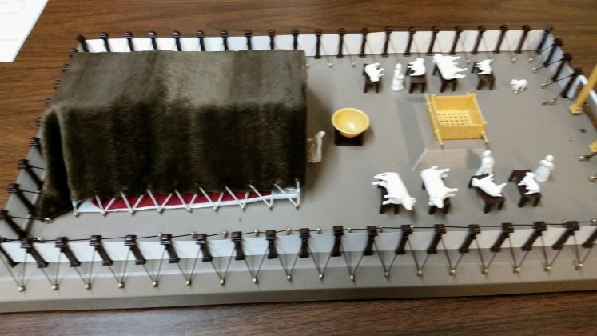
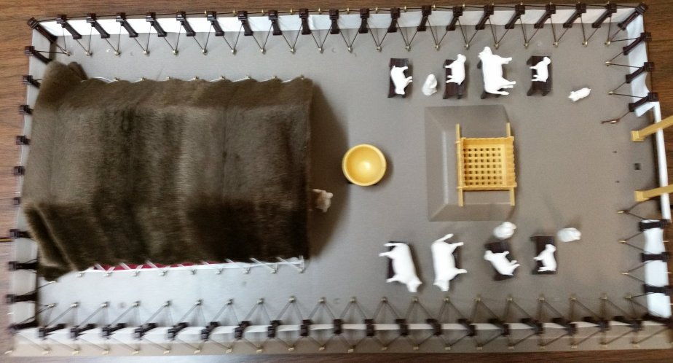
Tabernacle Model Exterior

Slide 9
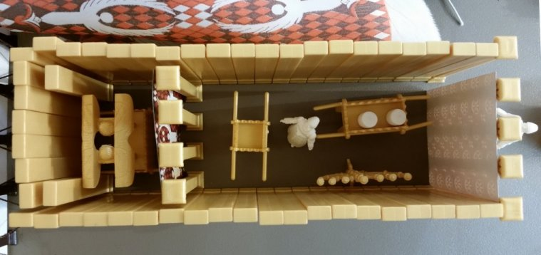
Tabernacle Model Interior

Slide 10
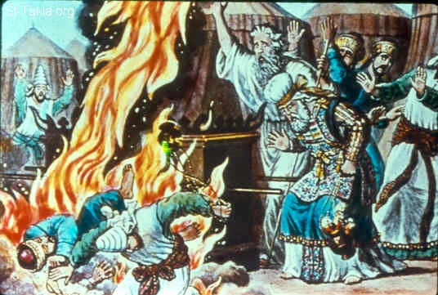
Who Were Nadab and Abihu?
Sons of Aaron
Priests in their own right
Offered “strange fire”
Leviticus 10:1
Burned to death (v. 2)
Demonstration of God’s holiness (v. 3)

Slide 11
Tabernacle Model Interior

Slide 12
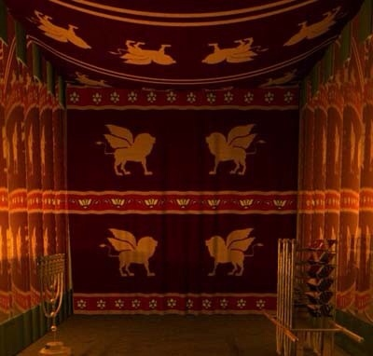
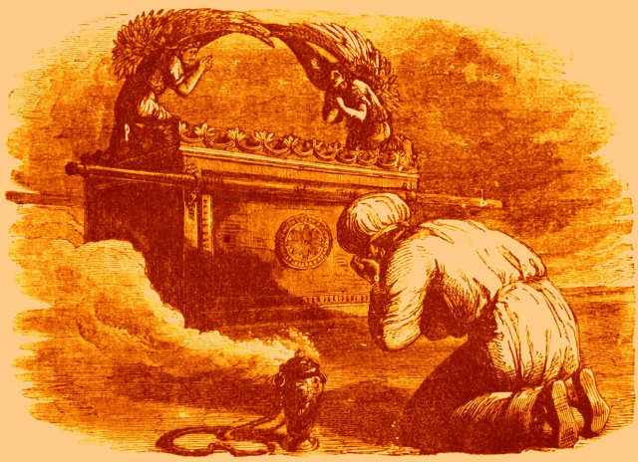
Limitations (Hebrews 9:6-10)
Symbol of the “Present Age”
Not for ordinary people
Only consecrated (cleansed by blood sacrifices) priests could enter the holy place to perform their functions
Only the high priest (cleansed by a blood sacrifice and offering one for himself and people) could enter 1x per year
Jesus destroyed the barrier

Slide 13
Perkins, Pheme. Reading the New Testament: An Introduction:
Third Edition (Mahwah, NJ: Paulist Press, 2012), p. 254.]
“The Levitical cult established rules for worship in an earthly sanctuary. But such rules could only affect the body. They did not affect the conscience. The earthly tent symbolizes the present age. Christ’s sacrifice does not take place in the earthly tent. It implies entry into the heavenly world.”
What does this mean for our access to God?
If the heavenly world is superior, why do so many believers still
allow earthly concerns to be their priorities?

Slide 14
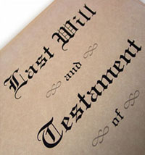
The Necessity of Death
Much more of Christ’s blood (v. 14)
Mediator of new covenant (v. 15)
Death activates a will (vv. 16-17)
Pay close attention to v. 22

Slide 15
Do You Agree?
The following is from a famous Bible expositor:
“There was no sacrifice under the Old Testament that could really deal with sin.”
Now, hear from another scholar:
“The blood of slaughtered animals under the old order did have some efficacy, but it was an outward efficacy for the removal of ceremonial pollution.”
But they all pointed to the sacrifice which was to come. (9:14)
1) D. Martyn Lloyd-Jones / 2) F. F. Bruce

Slide 16
Of Sanctuaries Made with Human Hands
Mark 14:58 – Pharisees accuse Jesus
John 2:19-22 – Jesus’ claim (see above)
Acts 7:48, Isaiah 66:1-2 – Stephen quotes Isaiah
Acts 17:24 – Paul says God cannot be contained
Ephesians 2:6 – In Christ, we are seated in heaven with Him

Slide 17
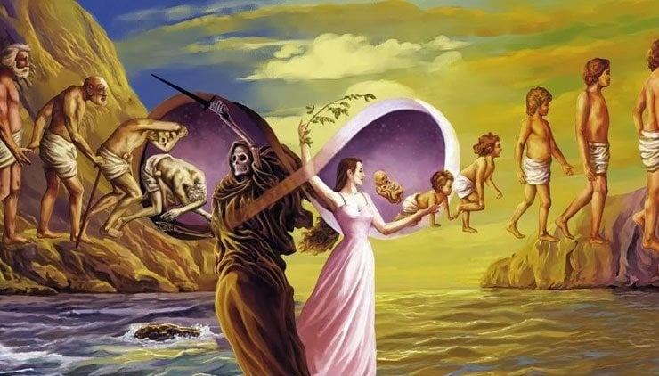
The Reincarnation Issue (Hebrews 9:27-28)

Slide 18

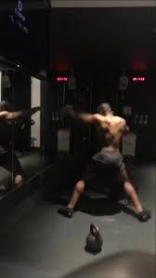
Shadow-boxing with the Law (10:1-10)

Slide 19
The Old Testament Quotation
Psalm 40:6-8 [NASB]
⁶ You have not desired sacrifice and meal offering;
You have opened my ears;
You have not required burnt offering and sin offering.
⁷ Then I said, “Behold, I have come;
It is written of me in the scroll of the book.
⁸ I delight to do Your will, my God;
Your Law is within my heart.”

Slide 20
Agreement from the Old Testament
Micah 6:6-8 [NASB]
⁶ With what shall I come to the Lord
And bow myself before the God on high?
Shall I come to Him with burnt offerings,
With yearling calves?
⁷ Does the Lord take pleasure in thousands of rams,
In ten thousand rivers of oil?
Shall I give Him my firstborn for my wrongdoings,
The fruit of my body for the sin of my soul?
⁸ He has told you, mortal one, what is good;
And what does the Lord require of you
But to do justice, to love kindness,
And to walk humbly with your God?

Slide 21
Other OT Concurring Verses [NASB]
⁶ For I desire loyalty rather than sacrifice,
And the knowledge of God rather than burnt offerings. (Hosea 6:6)
²² Even though you offer up to Me burnt offerings and your grain
offerings,
I will not accept them;
And I will not even look at the peace offerings of your fattened oxen.
²³ Take away from Me the noise of your songs;
I will not even listen to the sound of your harps.
²⁴ But let justice roll out like waters,
And righteousness like an ever-flowing stream. (Amos 5:22-24)

Slide 22
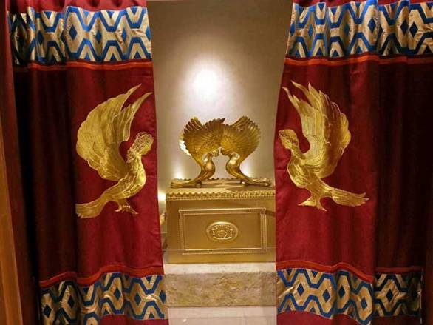
Getting Ready to Enter God’s Presence
(vv. 19-25)

Slide 23
Recapitulation
4:14-16
10:19-23
Having a great high priest (v. 14)
Jesus (v. 14)
Hold fast this confession (v. 14)
Boldness (v. 16)
Draw near then with … (v. 16)
Having a great priest (v. 19)
Jesus (v. 19)
Hold fast the confession (v. 23)
Boldness (v. 19)
Draw near then with (v. 22)

