Slide 1
The Most Appropriate Time
Preparing to Teach Ecclesiastes 3-4

Slide 2
“Turn, Turn, Turn” (Popular Song from 1960s)

Slide 3
“Green Leaves of Summer” [Reminded of this Song by Kong Zane]
At the moment of birth, woo A time to be reaping A time to be sowing A time just for living
A place for to die " Twas so good to be young then To be close to the earth Now the green leaves of summer Are calling me home "

Slide 4
Paul Simon and Ecclesiastes 3
“God only knows And God has His plan; The information’s unavailable to the mortal man. We work our jobs; collect our pay; Believe we’re driving down life’s highway when, in fact, we’re slip, sliding away!”

Slide 5
The Concern for Timing
²³ A man takes joy in giving an answer; and a timely word—how good that is! --Proverbs 15:23 [HCSB]
⁶ Jesus told them, “My time has not yet arrived, but your time is always at hand.” --John 7:6 [HCSB]

Slide 6
[Adapted from LaSor, William S. (et. al.), Old Testament Survey: The Message, Form, and Background of the Old Testament: Second Edition (Grand Rapids, MI: William B. Eerdmans, 1996), p. 502.]
Theme: God is in control of all events (3:1-11) Conclusion: Enjoy life now as God gives it (3:12-15)
Theme: Humans have a limited lifespan (3:16-21) Conclusion: Enjoy life now as God gives it (3:22)

Slide 7
“For everything, there is a window of opportunity [lit. “season”] and an appropriate time for every consideration [business, pleasure, activity] under heaven [lit. “heavens”].” [PJT]
“Season” is an Aramaic word that is not used until during and after the Exile and “…is always used of a predetermined or appointed time.” [Seow, Choon-Leong, The Anchor Bible: Ecclesiastes: A New Translation with Introduction and Commentary (New York: Doubleday and Company, 1997), p. 159.]
“time” is parallel to “season” so it also means a specific time, a best time, an appropriate time rather than the flow of time [Crenshaw, James, The Old Testament Library: Ecclesiastes (Philadelphia, PA: The Westminster Press, 1987), p. 92.]
עת is used 40x in Ecclesiastes and 28x in 3:2-8

Slide 8
2a) A time for birthing and a time for dying [PJT]

Slide 9
2b) A time for planting and a time for uprooting planting [PJT]

Slide 10
3a) A time for killing and a time for healing. [PJT]

Slide 11
3b) A time for breaking down and a time for constructing [PJT]

Slide 12
Is There a Relationship Between Verses?
2a birthing and dying
2b planting and uprooting 8a love and hate 8b war and peace

Slide 13
Is There a Relationship Between Verses?
2) A time for birthing and a time for dying A time for planting and a time for uprooting planting
4) A time to cry and a time to laugh A time for lamenting and a time for skipping [joyfully]
3) A time for killing and a time for healing A time for breaking down and a time for constructing

Slide 14
Is There a Relationship Between Verses?
5) A time to throw out stones and a time to gather stones A time to embrace and a time to hold back embracing
6) A time to search out and a time to lose A time to keep and a time to throw out
8) A time for loving and a time for hating A time for warfare and a time for peace
7) A time to rip apart and a time to sew together A time for silence and a time to speak [out]
Relationships cited in Ceresko, Anthony, Introduction to Old Testament Wisdom: A Spirituality for Liberation (Maryknoll, NY: Orbis Books, 1999), p. 107.

Slide 15
Positive Lessons from 3:1-8
Things are constantly changing so we shouldn’t get bored or stuck in our ways
Time is always FOR something; it is never neutral. [Wright, Christopher J. H., Hearing the Message of Ecclesiastes: Questioning Faith in a Baffling World (Grand Rapids, MI: Zondervan, 2023), p. 31.]
“The various actions named are carried out apparently at man’s volition—all but the first. The times of his birth and death are not his to decide, and this gives the clue to Qoheleth’s meaning. Just as surely as birth and death, so all other events and human actions take place when and as God deems them fitting.” [Scott, R. B. Y., The Way of Wisdom in the Old Testament (New York: Macmillan and Company, 1971), p. 180.]

Slide 16
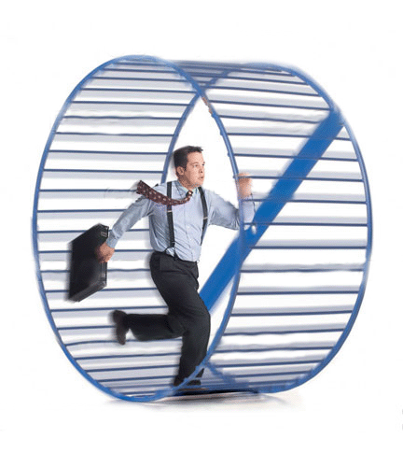
9) What profit [edge, advantage] does one doing the work get from his unsatisfying labor? [PJT]
We expect a negative answer here.
There is no advantage just doing what we are constrained to do!
10) I see the burdensome task which God has give to the children [lit. “sons”] of humankind [lit. “Adam”] with which to afflict themselves. [PJT]

Slide 17
11) He has made everything beautiful in its time, even eternity He has given into their hearts so that humanity will not discover the accomplishments which God has accomplished from first to the end. [PJT]
“Everything is timed by an eternal law which is above time. We are not able to penetrate into the meaning of this timing. For us, it is mystery and what we see is vanity and frustration. …[Yet] God’s timing breaks into our human timing. Something new appears…” [Tillich, Paul, “The Right Time” in The New Being (New York: Charles Scribner’s Sons, 1955), pp. 163, 165.]
“Out of these two facts—says our text—man’s where and man’s what, his nature and his position, there rises a mist of perplexity and darkness that wraps the whole course of the divine actions —unless, indeed, we have reached that central height of vision which this Book of Ecclesiastes puts forth as the conclusion… ‘Fear God, and keep His commandments.’” [Maclaren, Alexander, Expositions of Holy Scripture Volume III (Grand Rapids, MI: William B. Eerdmans, 1942), p. 336.]

Slide 18
Verse 11 as Tapestry
We observe the wonder and beauty of God’s accomplishment from within time [“tapestry”]
We sense, with human intuition, the transcendent reality God has placed in our mental/spiritual DNA.
Our knowledge is finite and bounded. We see the pattern, but we can’t see beyond our scene. [adapted from Wright, Christopher J. H. Hearing the Message of Ecclesiastes: Questioning Faith in a Baffling World, p. 34.]

Slide 19
12) I know that there is nothing better for them [humankind] than if being happy and accomplishing good in their lives. [PJT]
0 > being happy and finding “success”/ “meaning”
Each time “nothing better” is used in Ecclesiastes, it “…is followed by a clause which makes specific reference to the God-givenness of the human situation.” [Ogden, Graham S. “Qoheleth’s Use of the ‘Nothing is Better’ Form” in Journal of Biblical Literature 98/3 (September, 1979), p. 341.]

Slide 20
14b) And God has accomplished such that they fear His presence. [PJT]
Proverbs 1:7, 2:5, 3:7, 8:13, 9:10, 14:26, 15:16, 19:23, 23:17, 31:30
Job 1:1, 8; 2:3; 28:28
Deuteronomy 5:29, 6:2, 10:12, 13:4, 14:23; 17:18-19

Slide 21
“Only God successfully seeks out and apprehends whatever is sought (by God or human being).” [Brown, William P. Ecclesiastes: Interpretation: A Bible Commentary for Teaching and Preaching (Louisville, KY: Westminster John Knox Press, 2011), , p. 46.]
15b) “And God diligently seeks what has been pursued.” [PJT]
Nothing is swept under the carpet of existence/history!
“…the last line injects a fundamental element of biblical faith. The God of biblical faith is the judge of all the earth who will do what is right. …The past lies open before God, and there will be a ‘putting right.’” [Wright, Christopher J. H., Hearing, p. 37.]

Slide 22
What Shouldn’t Be Where? (v. 16) [The Images Are Anachronisms]
Place of Judgment
Place of Righteousness

Slide 23
18) I reasoned about humankind that God is testing them and showing them that they are really beasts. [Crenshaw, Ecclesiastes, p. 101.]

Slide 24
Humanity Like the Animals
We share the same fate—death (v. 19a)
We share the same breath— רוח (wind, spirit) (v. 19b)
We both decompose (v. 20)
Do either have a spirit (רוח) that goes on? (v. 21) [Negative answer expected here in that we can’t PROVE, but Positive answer given in Ecclesiastes 12:7] [Peterson, Wayne H. “Ecclesiastes” in Allen, Clifton J. (ed.), The Broadman Bible Commentary: Volume 5: Ecclesiastes - Isaiah (Nashville: Broadman Press, 1971), p. 114.]

Slide 25
No Sense Being Dissatisfied!
22) And I have seen that there is nothing better than humankind [lit. “the Adam”] being happy in his accomplishments BECAUSE this is his portion. Who can bring them to see how it will be after them? [PJT]
What we get to accomplish is our God-given gift (portion)
It is “our duty, our allotted function in life.” (Wright, Hearing, p. 49)
“The portion conveys both the sense of the limitations and the possibilities of life.” [Seow, Ecclesiastes, p. 176.]
Who can bring them? We know it is only God.

Slide 26
Oppression and Tears (4:1-3)
First use of oppression is that human evil is reality
Second use emphasizes the plight of the victims
Third use points the fingers at the oppressors
Wording indicates that these happen over and over
Tears and lack of comfort (2x) leads to Job-like expression (v. 2)
Social polarity defined by possession of power
Adapted from Crenshaw, James, Ecclesiastes, p. 105.

Slide 27
Why Work?
“Those who might help the ones ‘with no one to comfort them’ (4:1) are busy toiling in competition with others. They do not help those in need, and in regard to their own benefit, accomplish nothing either.” [Miller, Douglas B. Symbol and Rhetoric in Ecclesiastes: The Place of Hebel in Qohelet’s Work (Atlanta, Society of Biblical Literature, 2002), p. 116].

Slide 28
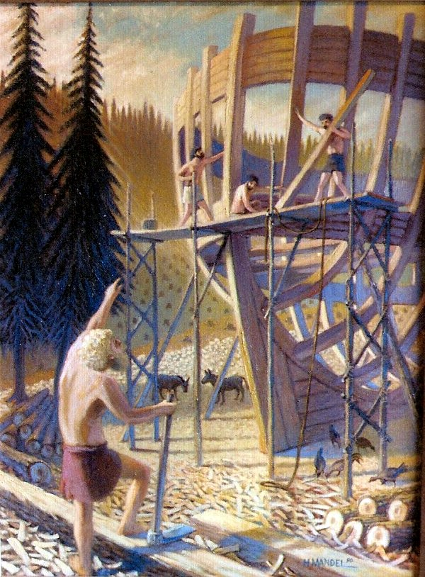
Work Can Be Soul-Destroying (4:4-6)
Envy motivates into empty-striving (v. 4): “In this company, you’re either on your way up or on your way out!”
Laziness leads to ruin (v. 5)
“Rest” = contentment, tranquility, equilibrium (v. 6) [“Noah” wasn’t merely inactive]

Slide 29
The Miser/Workaholic (4:7-8)
In isolation, he had no one
No son or brother meant no relation close enough to inherit
Rhetorical Question: Who am I toiling (engaging in drudgery) for? [Expected answer is NO ONE!]
This too is a wisp, a gust of air, an absurdity, topsy-turvy

Slide 30
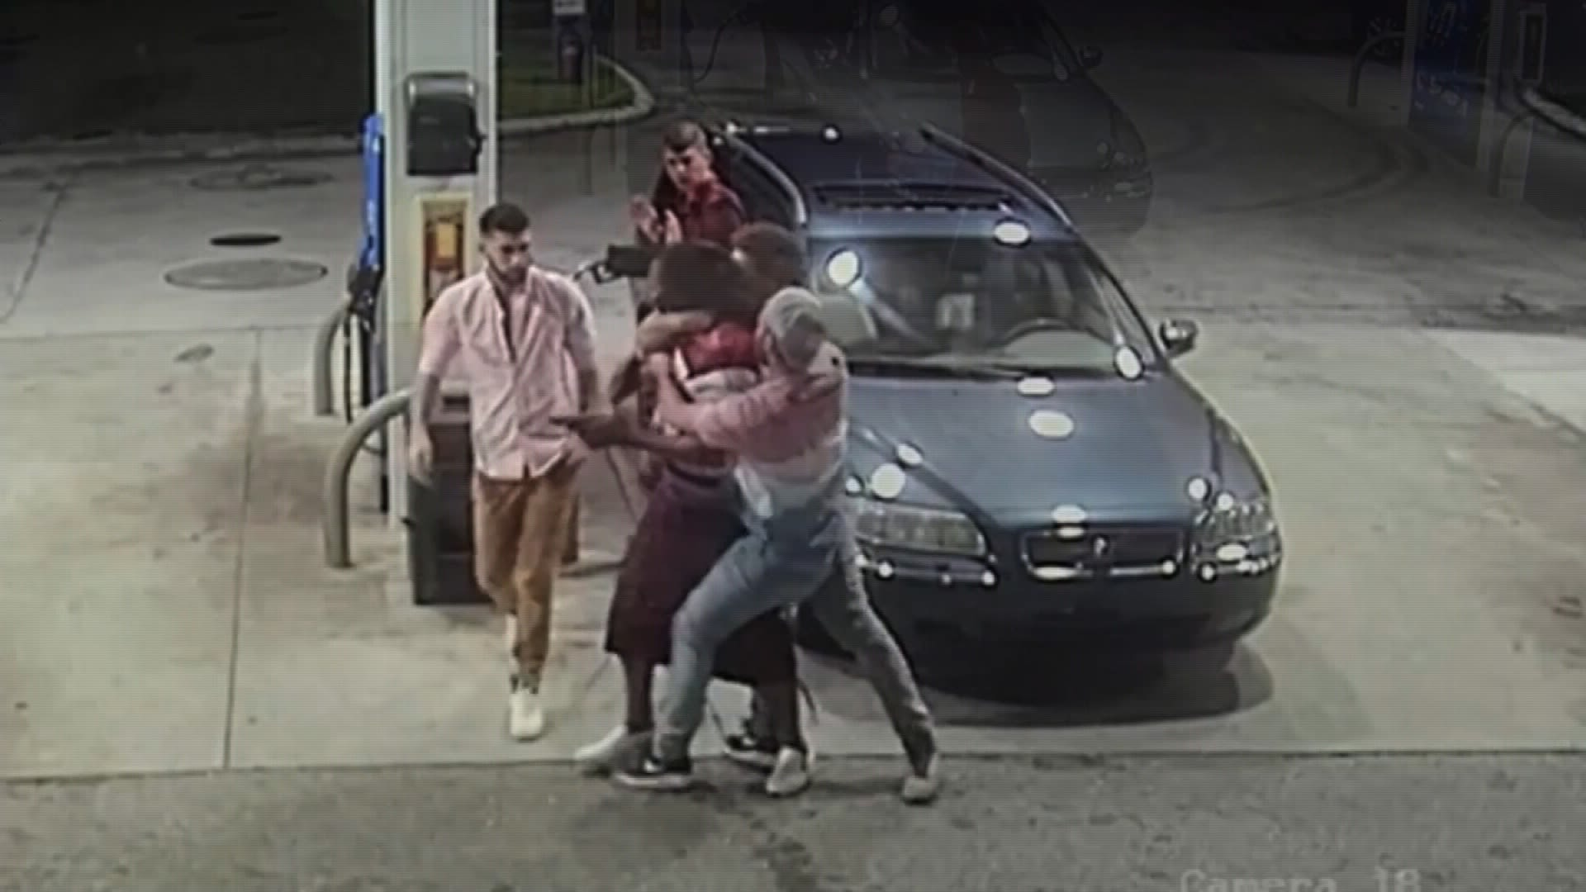
Three Lessons from “Desert” Life (4:9-12)

Slide 31
A Political Parable (4:13-16)

