Slide 1
Rivers to the Sea
Ancient Wisdom and the Inspiration of Ecclesiastes

Slide 2
“The fear of the LORD is the beginning of knowledge; fools despise wisdom and instruction.” Proverbs 1:7 [Revised Standard Version]
“Go with the stream as God has ordered it and you will be successful and happy. Go against it and you will only destroy yourself.” [Johnson, L. D., Israel’s Wisdom: Learn and Live: Introducing the Wisdom Books: Proverbs, Ecclesiastes, Job (Nashville, TN: Broadman Press, 1975), p. 10.]

Slide 3
Some Biblical References to Wise = Skillful
Reference | Meaning of Wisdom
1 Kings 5:6 | Sidonians wise in timber cutting
Exodus 35:30-33 | Bezalel's metallurgical craftsmanship
Exodus 35:34-35 | Oholiab's craftsmanship with cloth
Ezekiel 28:4-5 | [Secular] wisdom increased wealth
Isaiah 28:24-29 | God gives farmer practical sense
Jeremiah 9:17 | Female "embalmers" for funerals

Slide 4
Cunning is the Underside of Wisdom

Slide 5
More Undercurrents of Wisdom

Slide 6
Solomon’s 3,000 Proverbs / 1,005 Songs?
Tested Solomon with Riddles (1 Kings 10:1)

Slide 7
Origin in Folk Wisdom? Found in “All” Cultures
“The earth is a beehive, we all enter by the same door but live in different cells.” [Bantu proverb]
“If the people must be ever fearful of death, then there will always be an executioner.” [Lao Tzu]
“For two feasts Baal hates, / three the Rider of the Clouds: A feast of shame and a feast of contention, And a feast of the lewdness of maids.” [Ugaritic]
“Dripping water hollows out stone, not through force but through persistence.” [Ovid]
Wisdom tends to be observational, experience-based!

Slide 8
Bible or Not?
“As for mankind, numbered are their days; Whatever they achieve is but the wind.”
Epic of Gilgamesh, Tablet III, Lines 8-9
“’Vanity of vanities,’ says the Preacher, ‘Vanity of vanities! All is vanity! What advantage does man have in all his work Which he does under the sun?’”
Ecclesiastes 1:1-2

Slide 9
Gilgamesh flood tablet

Slide 10
Bible or Not?
“For the living know they will die; But the dead do not know anything; Nor have they any longer a reward, For their memory is forgotten.”
Ecclesiastes 9:5
“Since the days of yore, there has been no permanence, The resting and the dead, how alike they are!”
Epic of Gilgamesh, Tablet X, Lines 32-33

Slide 11
Epic of Gilgamesh tablet x

Slide 12
Bible or Not?
“The wrath of a king, if it be commanded, Obey it at once. Do not let it be kindled against thee And burn your hands.”
Words of Ahiqar, Fragment vii
“The life of the day before yesterday is that of any day.”
Akkadian Proverb, ANET, 425, Line 50

Slide 13
Words of Ahiqar

Slide 14
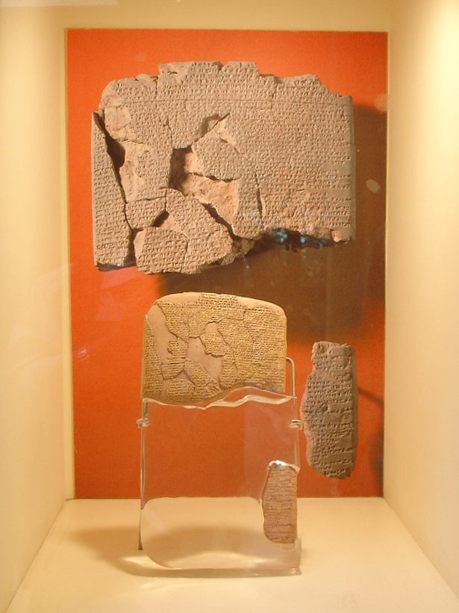
Israel in the Middle

Slide 15
Training for Annals, Inventories, Taxes
Egyptian Scribes
Mesopotamian Scribes

Slide 16
Biblical Evidence for Official Scribes
2 Samuel 20:23-25 Offices of Recorder, Secretary
Proverbs 25:1 Scribes of Hezekiah copied sayings
2 Samuel 16 Hushai is an advisor and “spy” used metaphors like: “a bear robbed of her cubs” “like the heart of a lion” “like the sand of the sea”
Jeremiah 18:18 Offices of Priest, Wise Counselor, Prophet

Slide 17
Forms of Wisdom Literature: Riddles
“Out of the Eater Came something to eat. Out of the Strong Came something sweet.”

Slide 18
Other Forms of Wisdom: Fables and Lists
“The leech has two daughters; ‘Give, give,’ they cry. Three things are never satisfied; four never say, ‘Enough’: Sheol, the barren womb, the earth ever thirsty for water, and the fire which never says, ‘Enough.’” Proverbs 30:15-16 [RSV]

Slide 19
Sayings and Admonitions
משל
Perhaps, origin in a riddle “What is like…”
Perhaps, related to verb “to rule” since wisdom most available to the ruling/upper class
Could show identity or equivalence: “This is really like…”
Could show non-identity/paradox: “This is not really like…”
Could show analogy: “This acts like…”
Could express futility: “What’s the use of…?”
Could personify action or character: “He who…will…”

Slide 20
Rhetorical Questions
2:2 What good is pleasure?
2:15 Why have I been so wise?
2:19 Who knows whether he is wise or a fool?
2:25 Who can eat or enjoy apart from God?

Slide 21
Qoheleth or Ecclesiastes?
Qoheleth is Hebrew for “calling out” or “calling together”
Could mean “Preacher, Teacher, Counselor, Curator, etc.”
Ecclesiastes comes from the Latin translation
Means “Assemblyman or Preacher”
So, Qoheleth is the original
Nickname for Solomon?

Slide 22
Dating of Qoheleth/Ecclesiastes
If one assumes Solomon is author of it all, 970-931 BC(E)
Earliest fragment is from Qumran (Dead Sea Scroll) circa 200 BC(E)
There are so many Aramaisms that some thought it was written in Aramaic first
Many Persian words and customs appear

Slide 23
Taking Chapter 12 as a Later Addition
Qoheleth’s confession (1:12-2:26)
Sage doesn’t know God’s general design (3:1-13) Sage doesn’t know what follows death (3:14-22)
Deceptions and Exhortations (4:1-8:15)
B’ Wisdom’s ineffectiveness (8:16-9:10)
A’ Deceptions and Exhortations (9:11-11:10)

Slide 24
Structure of Ecclesiastes [Norbert Lohfink, Kohelet: Die Neue Echter Bibel (Würzburg: Echter, 1980), p. 10.]
Frame – Breath, Wisp, Nothing (1:1-2)
Macrocosm—Nature Outlasts Humanity (1:3-11)
Anthropology—Observations about Human Life (1:12-3:15)
Social Critique I—Lack of Social Justice (3:16-4:17)
Critique of Religion—Don’t Expect to Understand God’s Purpose (5:1-7)
Social Critique II—Lack of Economic Fairness (5:8-6:9)
Human Belief Systems—Observations about Human Understanding (6:10-9:6)
Microcosm—Human Ethics Considered (9:7-12:7)
Frame—Wisp of Wisps, Nothing of Nothing (12:8)
(Epilogue—Fear and Obey God, Regardless (12:9-13))

Slide 25
Choon-Leong Seow Notes Symmetry
הבל
37x in the book
Gematria [numerical value of letters] is 37
Key word in book = breath, wisp, emptiness, worthlessness
Begins with “words of...”
Gematria [numerical value] is 216
Without epilogue (12:9-13), the book has 216 verses

Slide 26
What is wind symbolic of?
Ecclesiastes 1:6
Ecclesiastes 1:14, 17
Ecclesiastes 2:11, 17, 26
Ecclesiastes 4:4, 16
Ecclesiastes 5:16
Ecclesiastes 6:9
Ecclesiastes 11:4, 5

