Slide 1
The Purpose of the Book
Acts 1:1-26

Slide 2
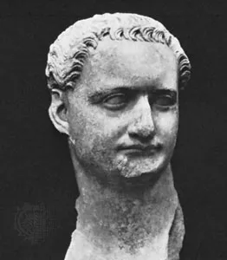
Dates for the Composition of Acts
AD 62-63 Events Concluding Book of Acts
AD 70 Destruction of Jerusalem
AD 85 Early Reign of Terror Under Domitian (81-96)
AD 150 Written Prior to Being Quoted

Slide 3
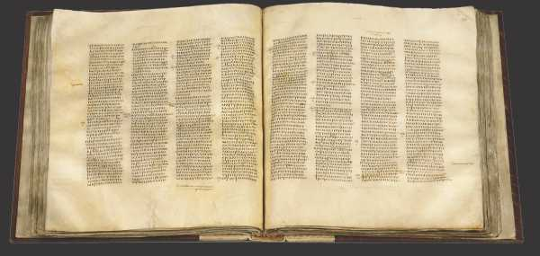
Texts I May Cite During Our Study
א Codex Sinaiticus: Most likely dates to the 4th century and contains the entire book.

Slide 4
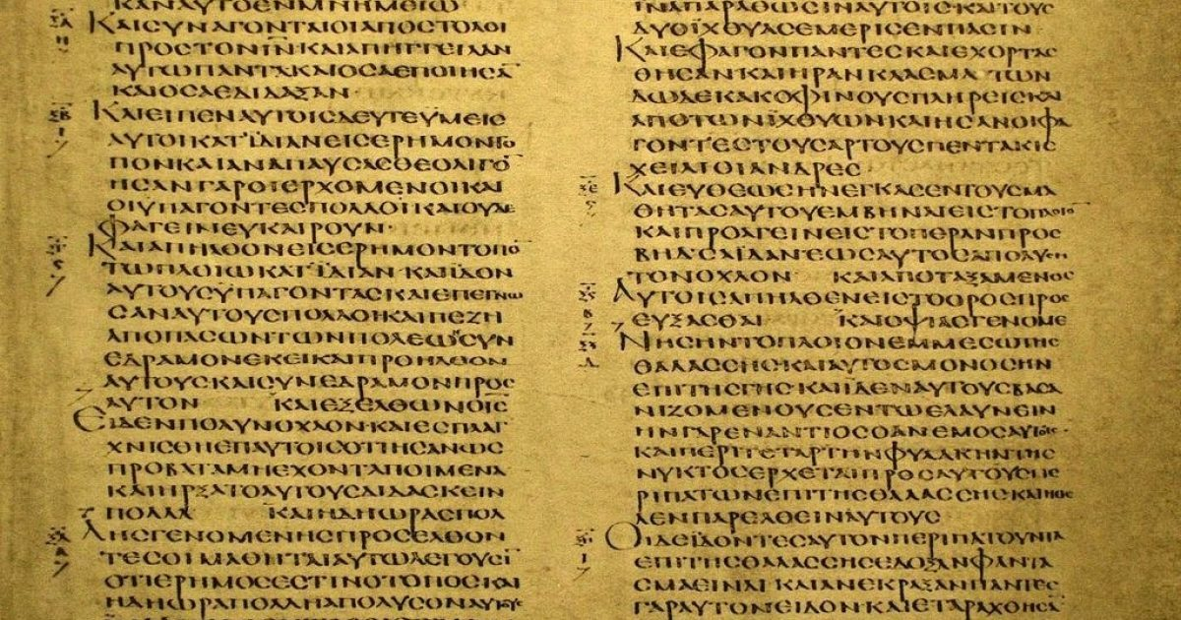
Texts I May Cite During Our Study
A Codex Alexandrinis: Most likely dated to the 5th century and contains the full book.

Slide 5
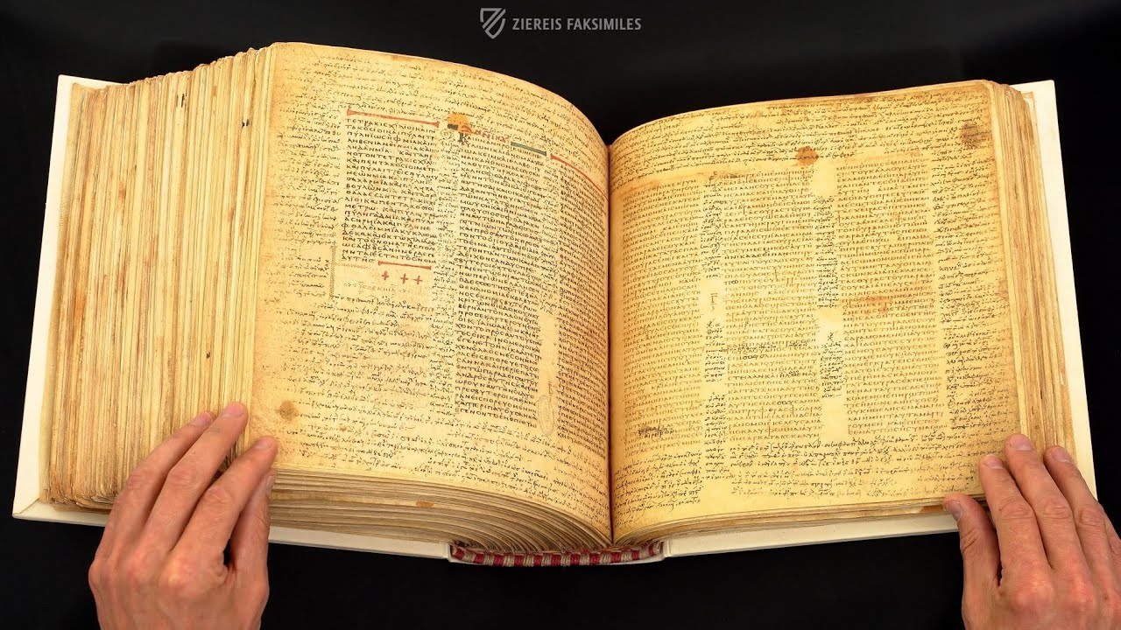
Texts I May Cite During Our Study
B Codex Vaticanus: Most likely dates to the 4th century and includes the full book.

Slide 6
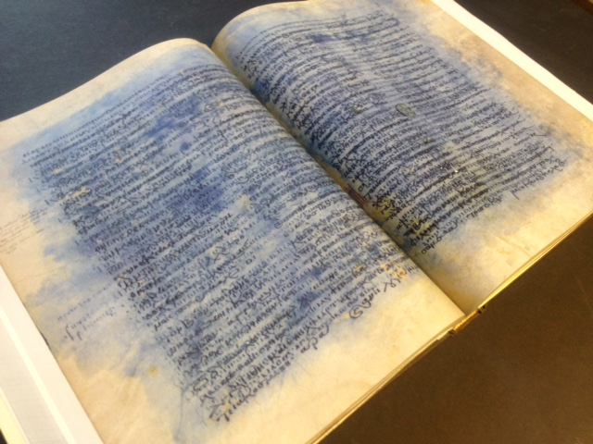
Texts I May Cite During Our Study
C Codex Ephraemi: Written over the course of the 5th century and contains fragments which include: 1:2-4:3; 5:35-10:42; 22:21-23:18; 24:15-25:19; 27:6-28:4.

Slide 7
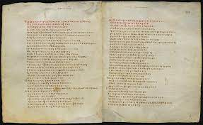
Texts I May Cite During Our Study
D Codex Bezae: Likely a 6th century manuscript and is missing many sections.

Slide 8
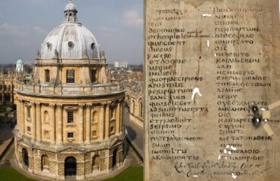
Texts I May Cite During Our Study
E Codex Laudianus: This manuscript is somewhat defective from 26:29-28:26 (due to damage).

Slide 9
Texts I May Cite During Our Study
א Codex Sinaiticus: Most likely dates to the 4th century and contains the entire book.
A Codex Alexandrinis: Most likely dated to the 5th century and contains the full book.
B Codex Vaticanus: Most likely dates to the 4th century and includes the full book.
C Codex Ephraemi: Written over the course of the 5th century and contains fragments which include: 1:2-4:3; 5:35-10:42; 22:21-23:18; 24:15-25:19; 27:6-28:4.
D Codex Bezae: Likely a 6th century manuscript and is missing many sections.
E Codex Laudianus: This manuscript is somewhat defective from 26:29-28:26 (due to damage).
G Codex Bibliothecae Anglicae: Probably 9th century and missing 1:1-5:9.
H Codex Mutinensis: Another 9th century manuscript and missing 1:1-5:27.

Slide 10
Acts 1:1
τὸν μὲν πρῶτον λόγον ἐποιησάμην περὶ πάντων ὦ Θεόφιλε ὧν ἤρξατο ὁ Ἰησοῦς ποιεῖν τε καὶ διδάσκειν
“I” accomplished
“first treatise”
“concerning ALL”
“Jesus began to accomplish and to teach”
“O, Theophilus”

Slide 11
Acts 1:2
ἄχρι ἧς ἡμέρας ἐντειλάμενος τοῖς ἀποστόλοις διὰ πνεύματος ἁγίου οὓς ἐξελέξατο ἀνελήμφθη
Does the Holy Spirit participate in the teaching of the apostles?
Or the choosing of the apostles?

Slide 12
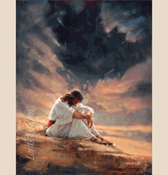
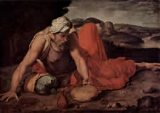
FORTY (40=4*10)

Slide 13
Hints in Acts 1:4
Συναλιζόμενος
Lit. “gathering together”
Fig. “common meal”
Cultural “rallying soldiers”

Slide 14
WAIT
In JERUSALEM
BUT, most were from GALILEE
Their businesses in GALILEE
Jerusalem was dangerous!

Slide 15
Water Versus HOLY SPIRIT

Slide 16
εἶπεν δὲ πρὸς αὐτούς οὐχ ὑμῶν ἐστιν γνῶναι χρόνους ἢ καιροὺς οὓς ὁ πατὴρ ἔθετο ἐν τῇ ἰδίᾳ ἐξουσίᾳ
Don’t get distracted by our own speculation about God’s work (v. 7)
Don’t get bogged down by our lack of resources since, as verse 8 will reveal, it is God’s power that counts
Don’t be so heavenly-minded you are no earthly good (vv. 9-12)
Don’t focus on the past so that you can’t participate in the future

Slide 17
Δυναμις (Acts 1:8)
power to change
power to explode
power to illuminate,
power to build
and power to grow

Slide 18
The Task Before Them (1:8)

Slide 19
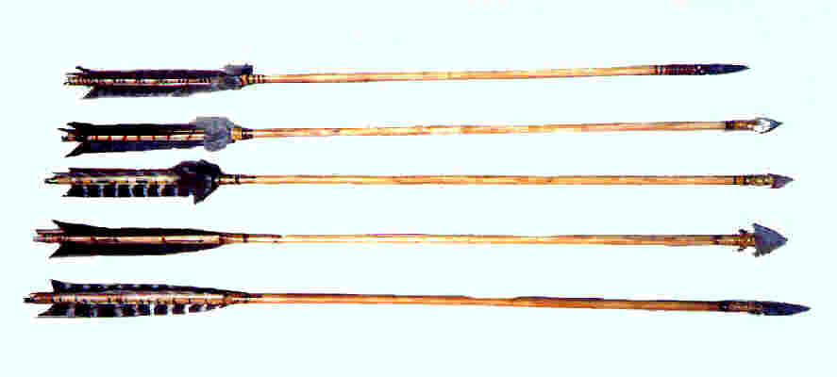
Casting Lots (see Proverbs 16:33)
One theory of “drawing” or “casting” lots was that colored stones were placed within a bag. The colors symbolized something or one color represented the “black ball” that pinpointed the guilty one.
Another theory is that the “lots” were like dice with light and dark sides. Getting a roll matching light sides = “Yes” and a roll matching dark sides = “No,” while one of each meant no definite answer.
Another idea would be that arrows of different sizes were drawn or dumped from a quiver to form a “pattern” or have the “short” arrow lose like a short straw.

Slide 20
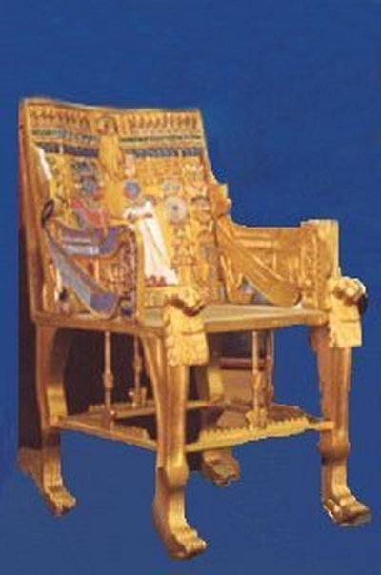
God’s Consistent Plan
24 Thrones
12 Thrones?
12 Thrones?
12 heads of tribes?
12 apostles?
24 thrones MAY refer to 24 priests as found in I Chronicles 24:4 or to Old + New Covenants!

