Slide 1
Two witnesses
Revelation 11
Notes:
NOTE:
To change the image on this slide, select the picture and delete it. Then click the Pictures icon in the placeholder to insert your own image.

Slide 2
Measure the Temple!
Reminder of the sacrificial nature of Christian service/liturgy
/ Morris
God’s people at worship
/ Morris

Slide 3
Let’s Review Ezekiel 40
Ezekiel measures outer court in v. 17 John told NOT to measure it in Rev. 11:2
vv. 1-2 – Hand of the Lord brings to mountain as visions
v. 3 -- Man like bronze w/ reed
v. 4 -- Purpose to show Israel
v. 5 -- Six royal cubits (1+hand)
H = 1 reed W = 1 reed
v. 6-- Gate threshold = 1 reed
v. 7 -- Recesses = 1 x 1 reed
v. 8 -- Gate 25 cubits deep
H = 1 reed W = 1 reed

Slide 4
Purpose of Ezekiel’s Vision?
Measuring usually done before restoration or additions
Measuring might be part of preparation for an important arrival
At the end of the measuring, the Lord tells Ezekiel the purpose of the measuring in Ezekiel 44:5-8
John’s vision must be similar, but different
Ezekiel’s measurement makes exclusive sanctuary
John’s measurement is to realize what will be trampled

Slide 5
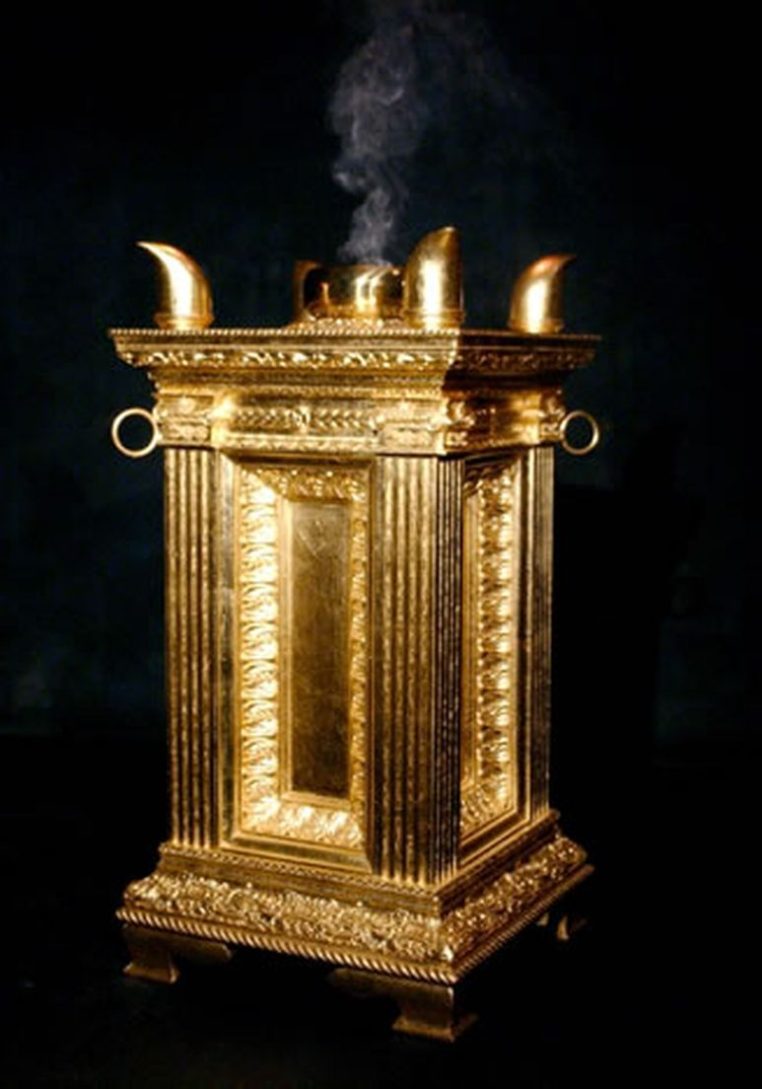
What About That Altar?
Similar to the temple?
Golden?
Rings?
Horns?
Incense?
Prayers?
Sanctification?
Mystery?

Slide 6
Two Witnesses Ascending
Who are these guys?
Literal olive trees?
Literal lamps?
Verification of John’s Vision?
Elijah and Enoch?
Elijah and Moses?

Slide 7
Two Witnesses

Slide 8
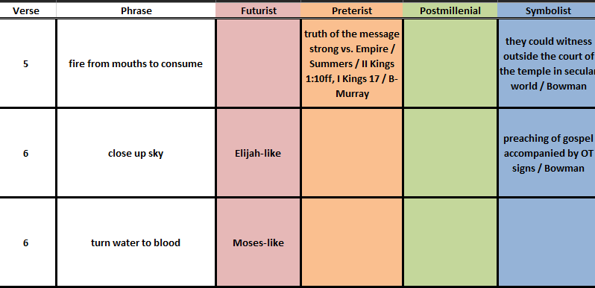
Two Witnesses Imagined

Slide 9
Martyrdom

Slide 10
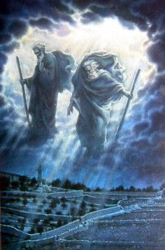
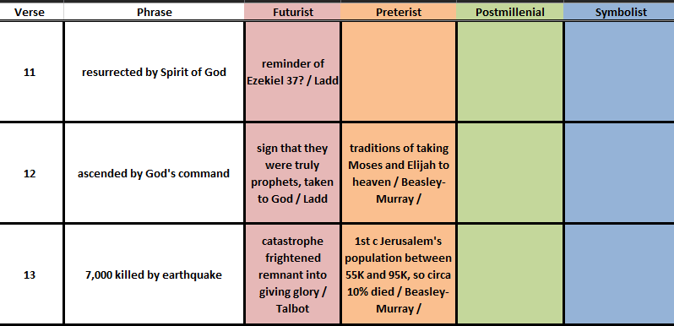
God Offers Hope & Judgment

Slide 11
Just Know Who Is In Charge

Slide 12
Title and Content Layout with Chart

Slide 13
Two Content Layout with Table
First bullet point here
Second bullet point here
Third bullet point here
Class | Group 1 | Group 2
Class 1 | 82 | 95
Class 2 | 76 | 88
Class 3 | 84 | 90

Slide 14
Title and Content Layout with SmartArt
Step 1 Title
Task description
Task description
Task description
Task description
Step 2 Title
Task description
Task description
Task description
Step 3 Title
Task description
Task description
Step 4 Title
Task description
Task description

Slide 15
Add a Slide Title - 1

Slide 16
Add a Slide Title - 2

Slide 17
Add a Slide Title - 3

Slide 18
Add a Slide Title - 4

Slide 20
Add a Slide Title - 5

